Slide 1
CSCE 510 - Systems Programming
Lecture 01 - Template

Slide 2
Overview
Last Time
Outback
Readings for today
Text Chapter 1 and 2
Prologue
A Brief History - Systems programming and Unix (Chap 1)
Interlude - Course Pragmatics, CS man of the day, Quiz
Epilogue
fundamental Unix/systems programming (Chap 2)
Kernel, Shell, Users/groups, Directory Hierarchy
File I/O model
processes

Slide 3
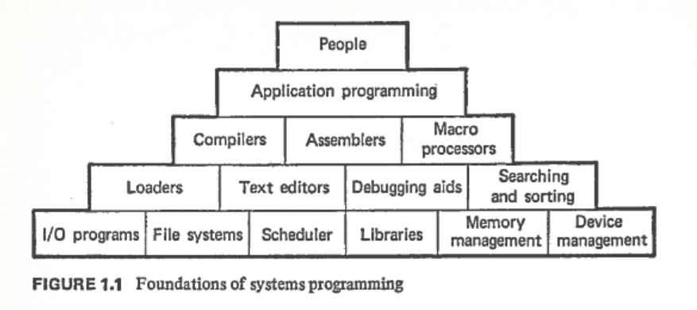
What is Systems Programming?
Systems Software
Donavon Diagram
Systems Programming by John Donovan, 1972

Slide 4
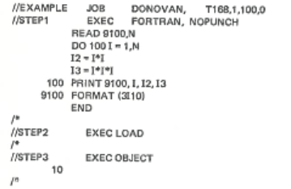
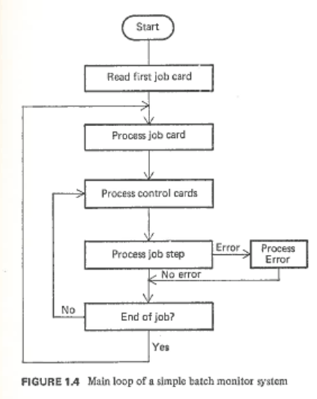
The Dark Ages - JCL
Darkages ~ 1972
JCL?
Batch Processing
Job card?
Systems Programming by John Donovan, 1972

Slide 5
What is CSCE 510?
First version – assembly language,
macro processors,
linkers …
Unix/C version circa 1987 ➔ 2002 version
Make
M4/cpp macro processors
Shell1: variables, regexps, filename completion, history
Shell2: I/O redirection, signals, …
webserver
2008 Summer version – done in ruby

Slide 6
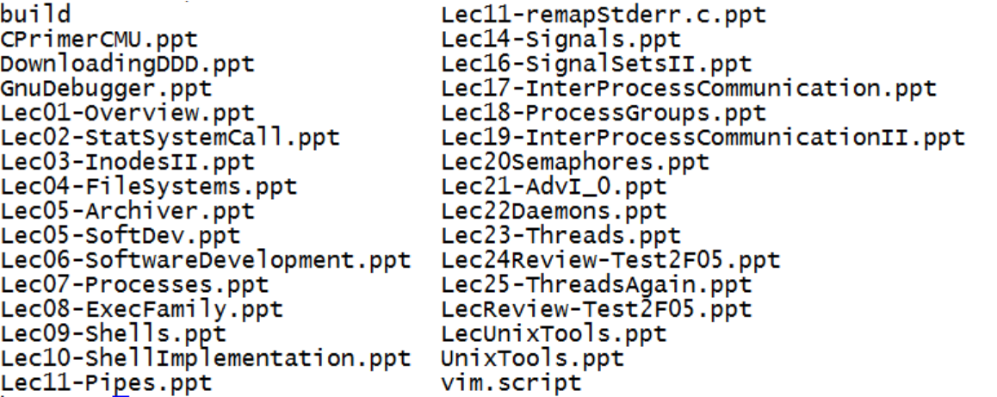
CSCE 510 - 2005

Slide 7
CSCE 510 the 2013 version
The Usual Suspects: programming assignments
ls, ar, cpp/m4, shell1, shell2, webserver0, SSH
New possibilities
Windows – don’t get me started
Environments: Rails, Posix Threads, Iphone/Android Apps, Vmware, Cloud Computing, SourceForge, GitHub
Unix Software: Shells. Gcc/g++, make, script/pseudo-terminals
Tools: Valgrind, Cucumber/capybara, Rspec, gdb,
Database: Mysql; postgress
Languages: …
Editors/IDEs: Nano/pico, Vi/Vim, Emacs, OS X Textmate
IDE: Eclipse Netbeans
Software Engineering: Agile, Git, Junit, Bugzilla,

Slide 8
Which Language?
Linux Journal Best of 2012
Best Programming Language
Python 28%
C++ 19%
C 18.9%
Java 8.2% Perl 6.1% Other 4% Ruby 3.1% JavaScript 2.4% C# .7% Erlang .7% Haskell
(2012-12-02). Linux Journal December 2012 (Kindle Locations 1628-1633). BELLTOWN MEDIA INC. Kindle Edition.
Linux Journal December 2012

Slide 9
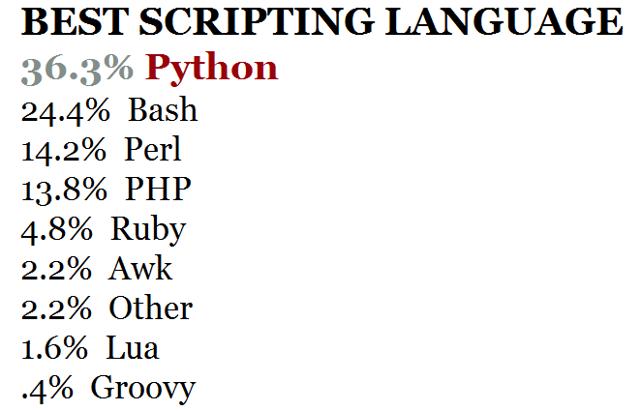
Linux Journal December 2012

Slide 10
More Linux Journal Best of 2012
Best IDE –Eclipse 27%, vim 26%, Netbeans 5% …
BEST REVISION CONTROL SYSTEM Git 63%, Subversion 18.6%, …
BEST OPEN-SOURCE CONFIGURATION MANAGEMENT TOOL – Puppet 42% …
BEST PLATFORM FOR DEVELOPING RICH INTERNET APPS - HTML5 87%
BEST PACKAGE MANAGEMENT APPLICATION – apt 34%
BEST CONTENT MANAGEMENT SYSTEM
WordPress 35%, Drupal 28%, Joomla 15%
BEST LINUX-FRIENDLY WEB HOSTING COMPANY–other 19%
BEST LINUX BOOK
Tie between Linux in a Nutshell and Debian Administrator’s Handbook
Second place goes to The Linux Programming Interface: A Linux and UNIX System Programming Handbook, by Michael Kerrisk.
BEST OTHER LINUX-BASED GADGET – Raspberry Pi
Linux Journal December 2012

Slide 11
A Brief History of Time (UNIX and C)
1969 – First Unix Ken Thompson at AT&T Bell Labs
Unix pun on MULTICS
Ideas from Multics:
Tree structured file system
Program for interpreting commands (shell)
Files – unstructured streams of bytes
1970 Unix rewritten in assembly for DEC PDP-11
C – Dennis Ritchie – a systems programming language
BCPL ➔ B (Thompson) ➔ C
1970 Kernel rewritten in C – eases porting to other machines
1984 Turing Award Lecture – C compiler learned backdoor
Chapter 1 and …

Slide 12
Berkeley Software Division (BSD)
(1975) Thompson visiting Prof. at UC-Berkeley
A student Bill Joy added new features
Vi editor
C shell
First paging virtual memory management (Unix) BSD 4.2
Sendmail, Pascal compiler
Later co-founded Sun Microsystems
BSD 4.2 (1983) – full TCP/IP & sockets API

Slide 13
Unix after Unix 7th Edition (1979)
BSD continued at UC-Berkeley
Bell Labs System III ➔ Systems V
POSIX standard (1988)
Other Software
X windows
Free Software Foundation
GNU Public License
Minix – (1988)Unix like; MINI-uniX; for education; A. Tannenbaum

Slide 14
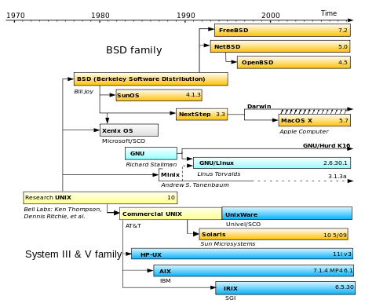
.
http://en.wikipedia.org/wiki/Linux

Slide 15
GNU
Recursive acronym “GNU’s not UNIX”
http://www.gnu.org/ not http://www.gnu.com/
Richard Stallman (1983) Goal a free Unix
Known for Free Software movement, GNU, Emacs, gcc
Never really released GNU operating system
Free Software Foundation
http://www.fsf.org/
http://en.wikipedia.org/wiki/GNU

Slide 16
Linux -
(1991) Linus Torvalds
For Intel x86 systems
Moved to big Iron
more than 90% of today's 500 fastest supercomputers run some variant of Linux
Network routers
Embedded systems
Android
http://en.wikipedia.org/wiki/Linux

Slide 17
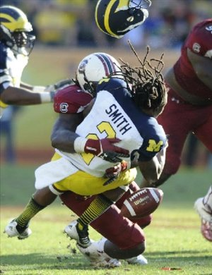
Computer Science Concepts- Interrupt
Mr. Smith has a plan that he is executing
“run for touchdown”
Suddenly an interrupt arrives
Clowney
Now he is executing another plan
Find helmet, walk to sideline

Slide 18
Course Pragmatics
Text: The Linux Programming Interface by M. Kerrisk
Website:
http://www.cse.sc.edu/~matthews/Courses/510/index.html
Code Examples
CSE linux server /class/csce510-001
Assignments –
Dropbox - https://dropbox.cse.sc.edu/
Late HW – not accepted

Slide 19
Provost’s Retreat
Best and Worst Classes
Dr. Buell’s note

Slide 20
Homework Assignment
Write a C/C++ program to read command line arguments and just print them.
Read “man getopt” (all sections).
What sections of the manual has a getopt section?
What types of strings does getopt usually process?

Slide 21
References
Text: The Linux Programming Interface by M. Kerrisk
http://man7.org/tlpi/
Other Books
Adv Prog in Unix Environment (APUE) by Richard Stevens (Rago 2nd ed)
http://www.kohala.com/start/apue.html
http://www.apuebook.com/ 2nd edition site – code etc
C by Kernighan and Ritchie (K&R) 2nd edition
http://en.wikipedia.org/wiki/The_C_Programming_Language
http://clc-wiki.net/wiki/K%26R2_solutions
http://cm.bell-labs.com/who/dmr/

Slide 22
Linux in general
http://www.linux.org/
Man Pages
http://man7.org/linux/man-pages/index.html
Slashdot
StackOverflow
Python
http://www.python.org/
http://docs.python.org/2/tutorial/

Slide 23
The kernel
What is the kernel?
What distinguishes it from the Operating System?

Slide 24
Kernel Tasks
Process scheduling
Memory management
File System
Access to devices
/dev – device drivers
Networking
System call API

Slide 25
Kernel Mode and user mode
When an application makes a system call
Time command
hermes> time make
… 10 pages of compiles .. uses cc
real 0m33.067s
user 0m13.545s
sys 0m5.596s
hermes>

Slide 26
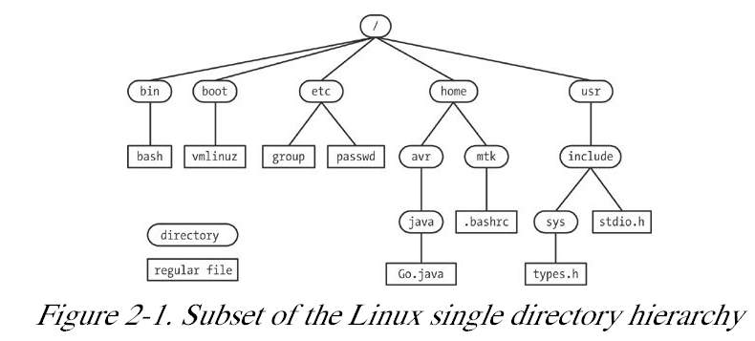
Directory Hierarchy – fig 2.1

Slide 27
File Types
Filenames
Regular files
Special Files
Directory
. (this directory),
..(my parent),
list of files contained (filename and inode number)
od –c . “used to work” but alas no longer
Symbolic link
hermes> ln –s README link
hermes> ls -l link
lrwxrwxrwx 1 matthews faculty 6 2013-01-13 17:51 link -> README

Slide 28
Pathnames
Unix basic commands with hierarchy
Current working directory – each running process has a “current working directory” assigned to it
cd dir - (change directory to dir)
pwd
Relative paths
Absolute Paths – start with /
/ = root of the directory hierarchy

Slide 29
The /class subtree
Examples
?
Code
TLPI
APUE

Slide 30
The Shell
Command interpreter in original Unix
Read command
Perhaps pre-process command
Fork/execute
Return exit status of command
A little history revisited
Bourne Shell (sh)
C chell
Korn shell
Bourne Again shell (bash)

Slide 31
Users, Groups and Permissions
User ID (UID)
Setuid
Group (GID)
Permissions
hermes> ls -l
…
drwxr-xr-x 2 matthews faculty 57 2012-10-15 09:54 acl
Super user = root; sudo

Slide 32
Man – the Online Manual
The sections of the manual
Commands
System Calls
Library functions
Special files (usually found in /dev)
File formats and conventions eg /etc/passwd
Games
Miscellaneous (including macro packages and conventions), e.g. man(7), groff(7)
System administration commands (usually only for root)
Kernel routines [Non standard]
Man command

Slide 33
Man – the command
hermes> man chmod
CHMOD(1) User Commands CHMOD(1)
NAME
chmod - change file mode bits
SYNOPSIS …
man –k chmod
man –s 2 chmod
Online
http://man.he.net/
http://www.tldp.org/guides.html
http://man7.org/linux/man-pages/index.html

