Slide 1
Lecture 14
Y86-64: PIPE – pipelined implementation
CSCE 212 Computer Architecture
Topics
  Pipelining operations in general
  Data dependencies
  Seq+
  Y86-64 PIPE implementation
  Handling data dependencies = stalls
March 22, 2018

Slide 2
Y86-64 Instruction Set #4 (To be given as handout with Test 2)
6
7
8
jmp
9
Byte
0
1
2
3
4
5
7
0
halt
0
0
jle
7
1
nop
1
0
jl
7
2
cmovXX rA, rB
2
fn
rA
rB
je
7
3
irmovq V, rB
3
0
F
rB
V
jne
7
4
rmmovq rA, D(rB)
4
0
rA
rB
D
jge
7
5
mrmovq D(rB), rA
5
0
rA
rB
D
jg
7
6
OPq rA, rB
6
fn
rA
rB
jXX Dest
7
fn
Dest
call Dest
8
0
Dest
ret
9
0
pushq rA
A
0
rA
F
popq rA
B
0
rA
F

Slide 3
Speeding things up
Latency – the amount of time it takes to do one operation from start to completion
Throughput - the number of operations per unit time
Is Amazon more concerned about latency or throughput for their website?

Slide 4
Pipelining
Consider “doing the laundry”
  Wash – machine cycle 30 minutes
  Dry – machine cycle 40 minutes
  Fold - on average 20 minutes (no machine yet)
So how long does it take to do 6 loads?
6*(30+40+20) = 9 hours?
What is the latency of doing a load of clothes?
http://homepage.cs.uiowa.edu/~ghosh/4-20-10.pdf

Slide 5
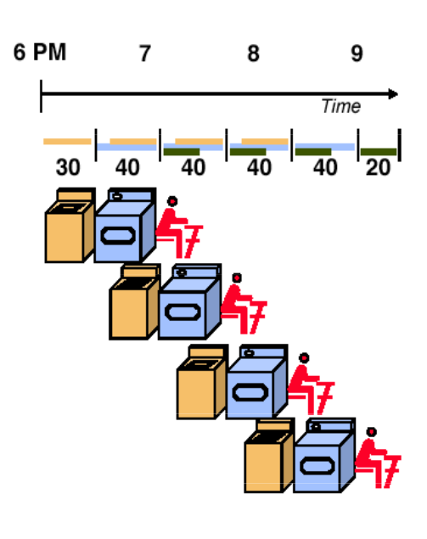
Do some parallel processing!
Of course this is not what you do! while the 1st load is drying, you start washing the 2nd
And while you are folding the 1st load then you are:
  Drying the 2nd load, and
  Washing the 3rd load
So how long does it take?
http://homepage.cs.uiowa.edu/~ghosh/4-20-10.pdf

Slide 6
Pipelining
Notes on the pipelined approach
You can’t go any faster than the dryer!
Except when the dryer is not involved! 1st and last
Cycle time = time for the slowest segment?
Time <= Cycle-time * Number-of-cycles
Total time = 30+4*40+20

Slide 7


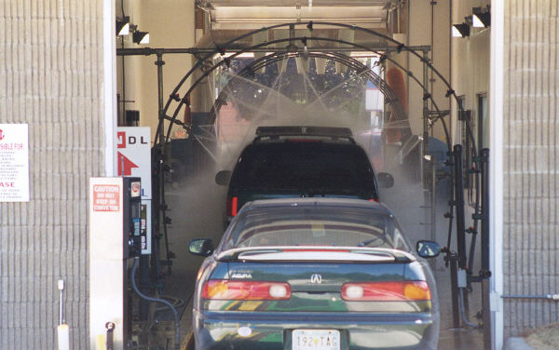
Real-World Pipelines: Car Washes
Sequential
Parallel
Pipelined
Idea
  Divide process into independent stages
  Move objects through stages in sequence
  At any given times, multiple objects being processed

Slide 8
Computational Example
300 ps
20 ps
Combinational
logic
R
e
g
Delay = 320 ps
Throughput = 3.12 GIPS
Clock
System
  Computation requires total of 300 picoseconds
  Additional 20 picoseconds to save result in register
  Must have clock cycle of at least 320 ps

Slide 9
3-Way Pipelined Version
100 ps
20 ps
100 ps
20 ps
100 ps
20 ps
Comb.
logic
A
R
e
g
Comb.
logic
B
R
e
g
Comb.
logic
C
R
e
g
Delay = 360 ps
Throughput = 8.33 GIPS
Clock
System
  Divide combinational logic into 3 blocks of 100 ps each
  Can begin new operation as soon as previous one passes through stage A.
    Begin new operation every 120 ps
  Overall latency increases
    360 ps from start to finish

Slide 10
Pipeline Diagrams
Unpipelined
  Cannot start new operation until previous one completes
3-Way Pipelined
  Up to 3 operations in process simultaneously
OP1
OP2
OP3
Time
OP1
A
B
C
OP2
A
B
C
OP3
A
B
C
Time

Slide 11
Operating a Pipeline
239
241
300
359
Clock
OP1
A
B
C
OP2
A
B
C
OP3
A
B
C
0
120
240
360
480
640
Time
100 ps
20 ps
100 ps
20 ps
100 ps
20 ps
100 ps
100 ps
100 ps
20 ps
20 ps
20 ps
100 ps
100 ps
100 ps
20 ps
20 ps
20 ps
100 ps
100 ps
100 ps
20 ps
20 ps
20 ps
Comb.
logic
A
R
e
g
Comb.
logic
B
R
e
g
Comb.
logic
C
Comb.
logic
A
R
e
g
Comb.
logic
B
R
e
g
Comb.
logic
C
R
e
g
Comb.
logic
A
Comb.
logic
A
R
e
g
R
e
g
Comb.
logic
B
Comb.
logic
B
R
e
g
R
e
g
Comb.
logic
C
Comb.
logic
C
R
e
g
R
e
g
R
e
g
Clock
Clock
Clock
Clock

Slide 12
Limitations: Nonuniform Delays
50 ps
20 ps
150 ps
20 ps
100 ps
20 ps
Comb.
logic
A
R
e
g
Comb.
logic
B
R
e
g
Comb.
logic
C
R
e
g
Delay = 510 ps
Throughput = 5.88 GIPS
Clock
OP1
A
B
C
OP2
A
B
C
OP3
A
B
C
Time
  Throughput limited by slowest stage
  Other stages sit idle for much of the time
  Challenging to partition system into balanced stages

Slide 13
Limitations: Register Overhead
50 ps
20 ps
50 ps
20 ps
50 ps
20 ps
50 ps
20 ps
50 ps
20 ps
50 ps
20 ps
Comb.
logic
R
e
g
Comb.
logic
R
e
g
Comb.
logic
R
e
g
Comb.
logic
R
e
g
Comb.
logic
R
e
g
Comb.
logic
R
e
g
Clock
Delay = 420 ps, Throughput = 14.29 GIPS
  As try to deepen pipeline, overhead of loading registers becomes more significant
  Percentage of clock cycle spent loading register:
    1-stage pipeline: 6.25%
    3-stage pipeline: 16.67%
    6-stage pipeline: 28.57%
  High speeds of modern processor designs obtained through very deep pipelining

Slide 14
Data Dependencies
Combinational
logic
R
e
g
Clock
OP1
OP2
OP3
Time
System
  Each operation depends on result from preceding one

Slide 15
Data Hazards
Comb.
logic
A
R
e
g
Comb.
logic
B
R
e
g
Comb.
logic
C
R
e
g
Clock
OP1
A
B
C
OP2
A
B
C
OP3
A
B
C
OP4
A
B
C
Time
  Result does not feed back around in time for next operation
  Pipelining has changed behavior of system

Slide 16
Data Dependencies in Processors
1 irmovq $50, %rax
2 addq %rax , %rbx
3 mrmovq 100( %rbx ), %rdx
  Result from one instruction used as operand for another
    Read-after-write (RAW) dependency
  Very common in actual programs
  Must make sure our pipeline handles these properly
    Get correct results
    Minimize performance impact

Slide 17
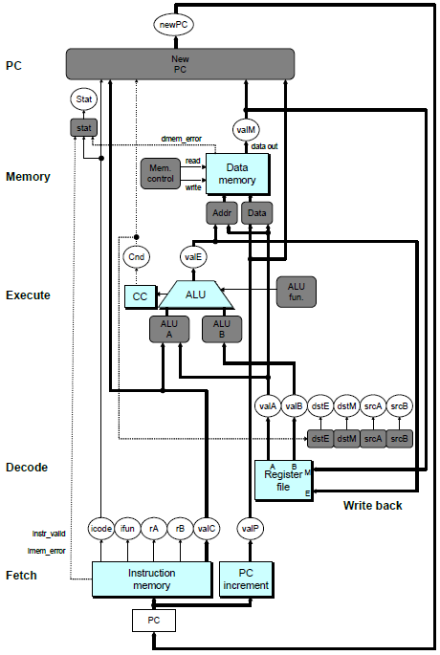
SEQ Hardware
  Stages occur in sequence
  One operation in process at a time

Slide 18
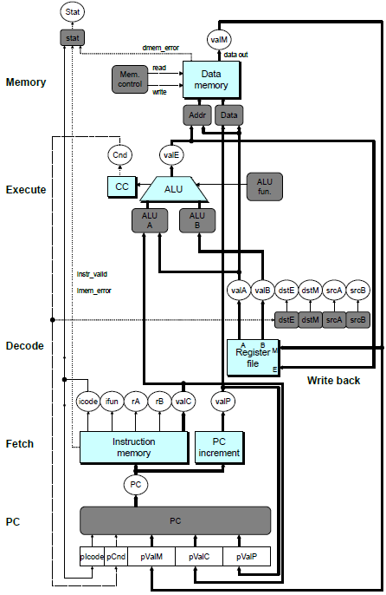
SEQ+ Hardware
  Still sequential implementation
  Reorder PC stage to put at beginning
PC Stage
  Task is to select PC for current instruction
  Based on results computed by previous instruction
Processor State
  PC is no longer stored in register
  But, can determine PC based on other stored information

Slide 19
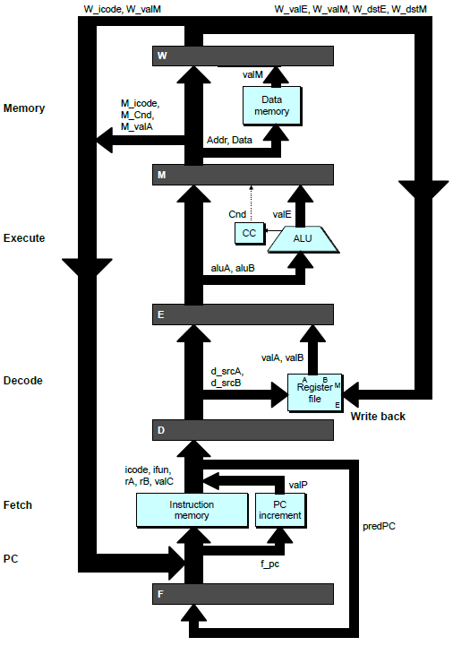
Adding Pipeline Registers
PC
newPC
valE
,
valM
Write back
valM
Data
Memory
Data
memory
memory
Addr
, Data
valE
CC
CC
ALU
Execute
Cnd
ALU
aluA
,
aluB
valA
,
valB
Decode
srcA
,
srcB
A
A
B
dstA
,
dstB
B
M
Register
M
Register
Register
Register
file
file
file
file
E
E
icode
,
ifun
valP
rA
,
rB
valC
Instruction
PC
Instruction
PC
Fetch
memory
increment
memory
increment
PC

Slide 20
Pipeline Stages
Fetch
  Select current PC
  Read instruction
  Compute incremented PC
Decode
  Read program registers
Execute
  Operate ALU
Memory
  Read or write data memory
Write Back
  Update register file

Slide 21
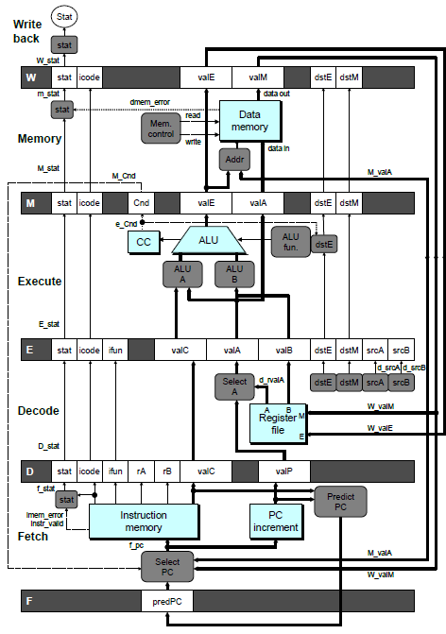
PIPE- Hardware
  Pipeline registers hold intermediate values from instruction execution
Forward (Upward) Paths
  Values passed from one stage to next
  Cannot jump past stages
    e.g., valC passes through decode

Slide 22
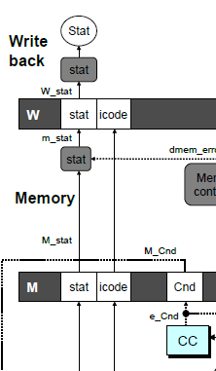
Signal Naming Conventions
S_Field
  Value of Field held in stage S pipeline register
s_Field
  Value of Field computed in stage S

Slide 23
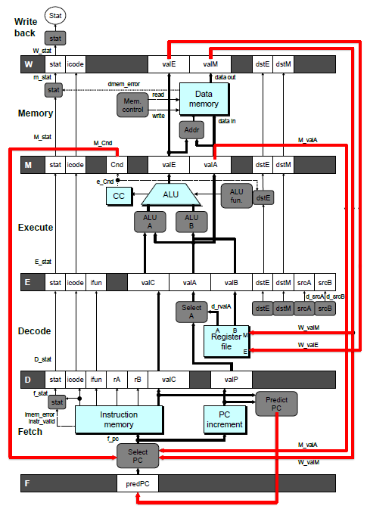
Feedback Paths
Predicted PC
  Guess value of next PC
Branch information
  Jump taken/not-taken
  Fall-through or target address
Return point
  Read from memory
Register updates
  To register file write ports

Slide 24
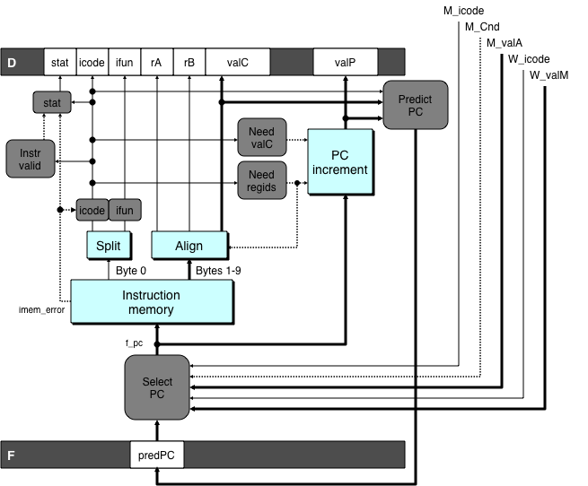
Predicting the PC
  Start fetch of new instruction after current one has completed fetch stage
    Not enough time to reliably determine next instruction
  Guess which instruction will follow
    Recover if prediction was incorrect

Slide 25
Our Prediction Strategy
Instructions that Don’t Transfer Control
  Predict next PC to be valP
  Always reliable
Call and Unconditional Jumps
  Predict next PC to be valC (destination)
  Always reliable
Conditional Jumps
  Predict next PC to be valC (destination)
  Only correct if branch is taken
    Typically right 60% of time
Return Instruction
  Don’t try to predict

Slide 26
Recovering from PC Misprediction
  Mispredicted Jump
    Will see branch condition flag once instruction reaches memory stage
    Can get fall-through PC from valA (value M_valA)
  Return Instruction
    Will get return PC when ret reaches write-back stage (W_valM)

Slide 27
Pipeline Demonstration
1
2
3
4
5
6
7
8
9
irmovq $1,%rax #I1
F
D
E
M
W
irmovq $2,%rcx #I2
F
D
E
M
W
irmovq $3,%rdx #I3
F
D
E
M
W
irmovq $4,%rbx #I4
F
D
E
M
W
halt #I5
F
D
E
M
W
Cycle 5
File: demo-basic.ys
W
I1
M
I2
E
I3
D
I4
F
I5

Slide 28
Data Dependencies: 3 Nop’s
# demo-h3.ys
1
2
3
4
5
6
7
8
9
10
11
F
F
D
D
E
E
M
M
W
0x000:
irmovq
$10,%
rdx
W
F
F
D
D
E
E
M
M
W
0x00a:
irmovq
$3,%
rax
W
F
F
D
D
E
E
M
M
W
0x014:
nop
W
F
F
D
D
E
E
M
M
W
0x015:
nop
W
F
F
D
D
E
E
M
M
W
0x016:
nop
W
F
F
D
D
E
E
M
M
W
0x017:
addq
%
rdx
,%
rax
W
F
F
D
D
E
E
M
M
W
0x019: halt
W
Cycle 6
W
W
f
R[
f
R[
]
]
3
%
3
%
rax
rax
Cycle 7
D
D
f
valA
f
valA
R[
R[
]
]
=
=
10
%
10
%
rdx
rdx
f
valB
f
valB
R[
R[
]
]
=
=
3
%
3
%
rax
rax

Slide 29
Data Dependencies: 2 Nop’s
# demo-h2.ys
1
2
3
4
5
6
7
8
9
10
F
F
D
D
E
E
M
M
W
0x000:
irmovq
$10,%
rdx
W
F
F
D
D
E
E
M
M
W
0x00a:
irmovq
$3,%
rax
W
F
F
D
D
E
E
M
M
W
0x014:
nop
W
F
F
D
D
E
E
M
M
W
0x015:
nop
W
F
F
D
D
E
E
M
M
W
0x016:
addq
%
rdx
,%
rax
W
F
F
D
D
E
E
M
M
W
0x018: halt
W
Cycle 6
W
W
W
f
f
R[
f
R[
R[
]
]
]
3
3
%
3
%
%
rax
rax
rax
•
•
•
•
•
•
D
D
D
f
f
valA
f
valA
valA
R[
R[
R[
]
]
]
=
=
=
10
10
%
10
Error
%
%
rdx
rdx
rdx
f
f
valB
f
valB
valB
R[
R[
R[
]
]
]
=
=
=
0
0
%
0
%
%
rax
rax
rax

Slide 30
Data Dependencies: 1 Nop
# demo-h1.ys
1
2
3
4
5
6
7
8
9
0x000:
irmovq
$10,%
rdx
F
D
E
M
W
0x00a:
irmovq
$3,%
rax
F
D
E
M
W
F
F
D
D
E
E
M
M
W
0x014:
nop
W
F
F
D
D
E
E
M
M
W
0x015:
addq
%
rdx
,%
rax
W
F
F
D
D
E
E
M
M
W
0x017: halt
W
Cycle 5
W
W
f
R[
f
R[
]
]
10
%
10
%
rdx
rdx
M
M_
valE
= 3
M_
dstE
=
%
rax
•
•
•
D
D
Error
f
valA
f
valA
R[
R[
]
]
=
=
0
%
0
%
rdx
rdx
f
valB
f
valB
R[
R[
]
]
=
=
0
%
0
%
rax
rax

Slide 31
Data Dependencies: No Nop
# demo-h0.ys
1
2
3
4
5
6
7
8
0x000:
irmovq
$10,%
rdx
F
D
E
M
W
0x00a:
irmovq
$3,%
rax
F
D
E
M
W
0x014:
addq
%
rdx
,%
rax
F
D
E
M
W
0x016: halt
F
D
E
M
W
Cycle 4
M
M_
valE
= 10
M_
dstE
=
%
rdx
E
e_
valE
f
0 + 3 = 3
E_
dstE
=
%
rax
D
D
Error
f
valA
f
valA
R[
R[
]
]
=
=
0
%
0
%
rdx
rdx
f
valB
f
valB
R[
R[
]
]
=
=
0
%
0
%
rax
rax

Slide 32
Branch Misprediction Example
demo-j.ys
0x000: xorq %rax,%rax
0x002: jne t # Not taken
0x00b: irmovq $1, %rax # Fall through
0x015: nop
0x016: nop
0x017: nop
0x018: halt
0x019: t: irmovq $3, %rdx # Target (Should not execute)
0x023: irmovq $4, %rcx # Should not execute
0x02d: irmovq $5, %rdx # Should not execute
  Should only execute first 8 instructions

Slide 33
Branch Misprediction Trace
# demo
-
j
1
2
3
4
5
6
7
8
9
0x000:
xorq
%
F
D
E
M
W
rax
,%
rax
0x002:
jne
t # Not taken
F
D
E
M
W
0x019: t:
irmovq
$3, %
rdx
# Target
F
D
E
M
W
0x023:
irmovq
$4, %
rcx
# Target+1
F
D
E
M
W
F
F
D
D
E
E
M
M
W
0x00b:
irmovq
$1, %
rax
# Fall Through
W
Cycle 5
  Incorrectly execute two instructions at branch target
M
M_Cnd =
0
M_
valA
= 0x007
E
E
f
valE
f
valE
3
3
dstE
dstE
=
=
%
%
rdx
rdx
D
D
valC
valC
=
=
4
4
dstE
dstE
=
=
%
%
ecx
rcx
F
F
f
valC
f
valC
1
1
f
rB
f
rB
%
%
rax
rax

Slide 34
Return Example
demo-ret.ys
0x000: irmovq Stack,%rsp # Intialize stack pointer
0x00a: nop # Avoid hazard on %rsp
0x00b: nop
0x00c: nop
0x00d: call p # Procedure call
0x016: irmovq $5,%rsi # Return point
0x020: halt
0x020: .pos 0x20
0x020: p: nop # procedure
0x021: nop
0x022: nop
0x023: ret
0x024: irmovq $1,%rax # Should not be executed
0x02e: irmovq $2,%rcx # Should not be executed
0x038: irmovq $3,%rdx # Should not be executed
0x042: irmovq $4,%rbx # Should not be executed
0x100: .pos 0x100
0x100: Stack: # Initial stack pointer
  Require lots of nops to avoid data hazards

Slide 35
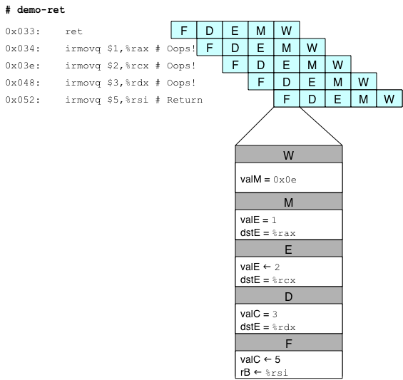
Incorrect Return Example
  Incorrectly execute 3 instructions following ret

Slide 36
Pipeline Summary
Concept
  Break instruction execution into 5 stages
  Run instructions through in pipelined mode
Limitations
  Can’t handle dependencies between instructions when instructions follow too closely
  Data dependencies
    One instruction writes register, later one reads it
  Control dependency
    Instruction sets PC in way that pipeline did not predict correctly
    Mispredicted branch and return
Fixing the Pipeline
  We’ll do that next time

