Slide 1
Specialization and Heterogeneity:
The Last Ride on Moore’s Law?
Jason D. Bakos
Grad assistants: Rasha Karakchi and Madushan Abeysinghe

Slide 2

Heterogeneous and Reconfigurable Computing Group
Heterogeneous Computing:
CPUs + domain-specific processors
Applying
Field Programmable Gate Arrays
  and
  Digital Signal Processors
  to:
  Distributed control of power electronics,
  Machine learning,
  Sparse linear algebra / graphs,
  Data analytics,
  Computer vision,
  Genomic analysis
Heterogeneous Computing:
CPUs + domain-specific processors
Applying
Field Programmable Gate Arrays
  and
  Digital Signal Processors
  to:
  Distributed control of power electronics,
  Machine learning,
  Sparse linear algebra / graphs,
  Data analytics (RA: Madushan Abeysinghe),
  Computer vision (RA: Rasha Karakchi),
  Genomic analysis

Slide 3
Heterogeneous Computing
“What’s the problem with general-purpose CPUs?”

Slide 4
Performance: Intel Desktop Peak Performance
Desktop Processor | Year | Tech | Max. Clock Speed (GHz) | Integer IPC/core | Cores | Max. DRAM Bandwidth (GB/s) | SP Floating Point (Gflop/s) | L3 cache (MiB)
Westmere i7-620 | 2010 | 32 | 3.33 | 4 | 2 | 17.1 | 107 | 4
Ivy Bridge i7-3770K | 2013 | 22 | 3.90 | 6 | 4 | 25.6 | 250 | 8
Broadwell i7-6700K | 2015 | 14 | 4.20 | 8 | 4 | 34.1 | 269 | 8
Kaby Lake i7-7700K | 2017 | 14 | 4.50 | 8 | 4 | 38.4 | 288 | 8
Ice Lake i7-9700K | 2019 | 10 | 4.90 | 8 | 8 | 42.7 | 627 | 12
Imp./year |  | 26% | 4% | 7% | 15% | 10% | 19% | 12%
Doubles every |  | 3 years | 18 years | 10 years | 5 years | 7 years | 4 years | 6 years
*
* 1/nm²

Slide 5
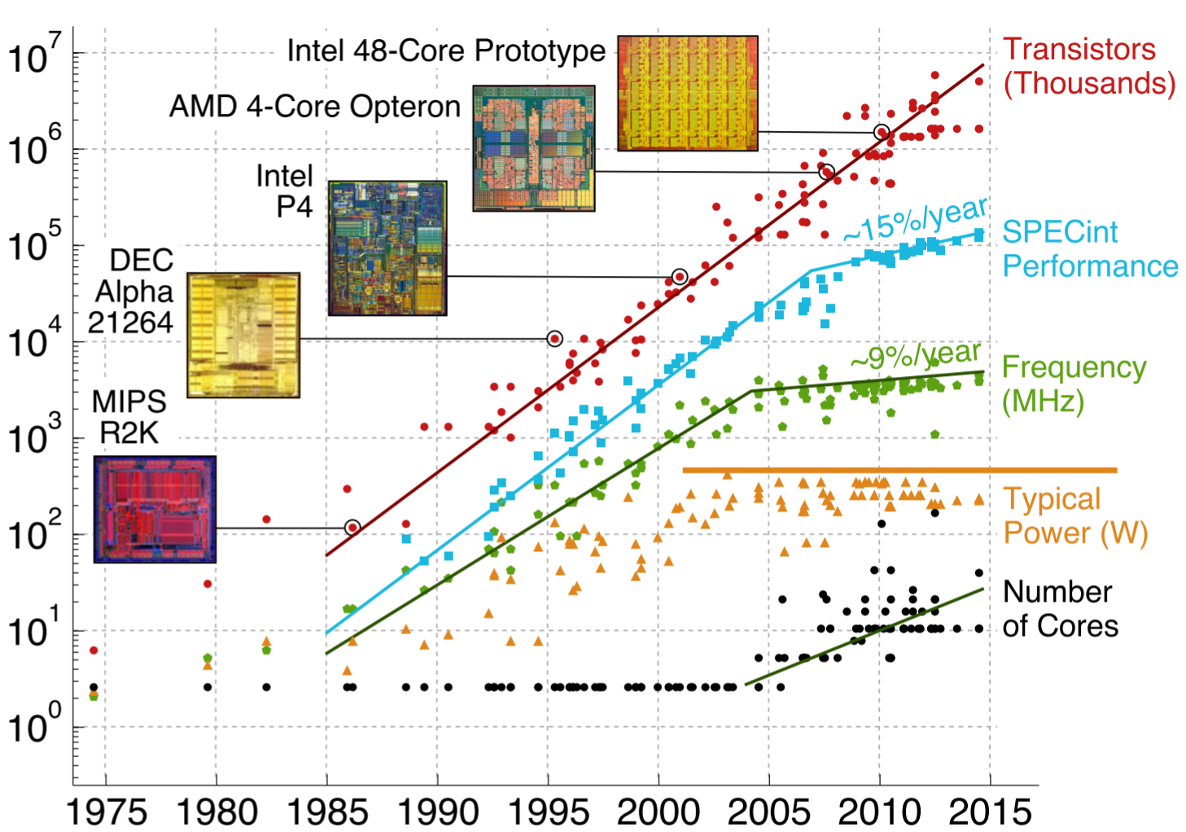
CPU Performance
source: Christopher Batten, Cornell

Slide 6
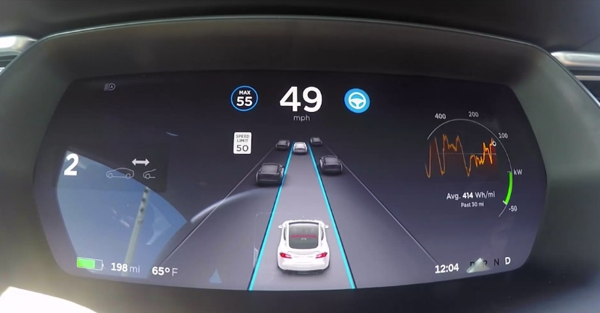




New Capabilities
Tesla Autopilot (2014)
4K video on a phone (2015)
FaceID (2017)
Animojis (2017)
Computational photography (2018)

Slide 7
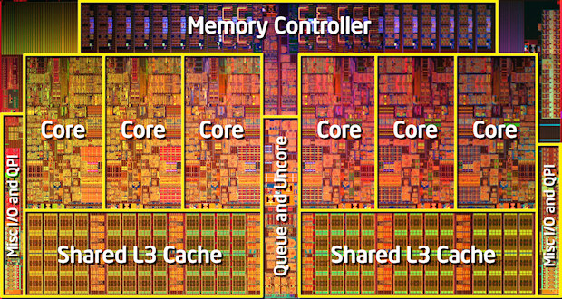
Performance: Intel Desktop Peak Performance
Desktop Processor | Tech | Year | Max. Clock Speed (GHz) | Integer IPC/core | Cores | Max. DRAM Bandwidth (GB/s) | SP Floating Point (Gflop/s) | L3 cache (MiB)
Westmere i7-620 | 32 | 2010 | 3.33 | 4 | 2 | 17.1 | 107 | 4
114 mm² die
CPU/cache
= 72%
(82 mm²)

Slide 8
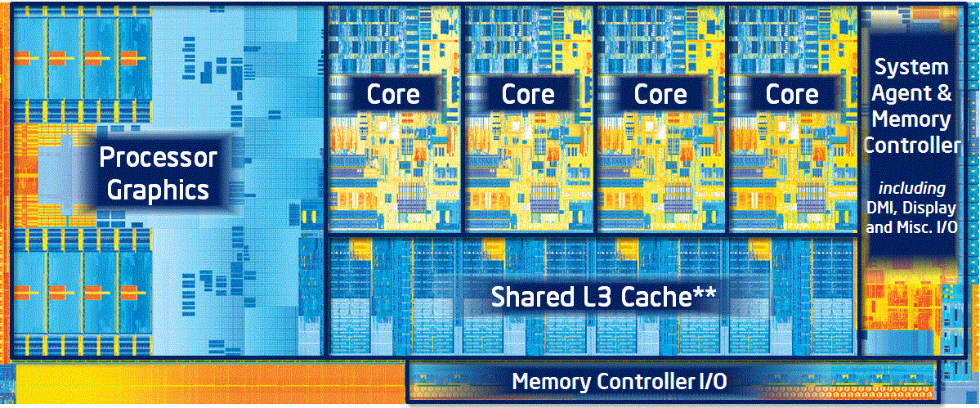
Performance: Intel Desktop Peak Performance
Desktop Processor | Tech | Year | Max. Clock Speed (GHz) | Integer IPC/core | Cores | Max. DRAM Bandwidth (GB/s) | SP Floating Point (Gflop/s) | L3 cache (MiB)
Ivy Bridge i7-3770K | 22 | 2013 | 3.90 | 6 | 4 | 25.6 | 250 | 8
160 mm² die
CPU/
cache = 47%
(75 mm²)

Slide 9
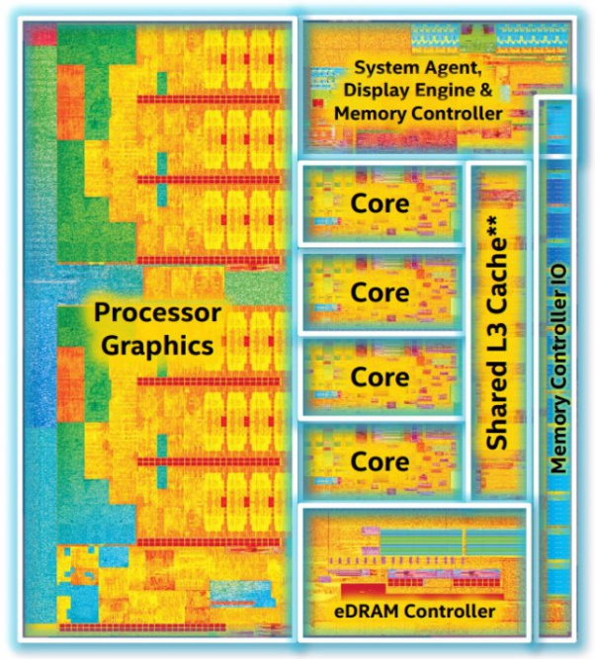
Performance: Intel Desktop Peak Performance
Desktop Processor | Tech | Year | Max. Clock Speed (GHz) | Integer IPC/core | Cores | Max. DRAM Bandwidth (GB/s) | SP Floating Point (Gflop/s) | L3 cache (MiB)
Broadwell i7-6700K | 14 | 2015 | 4.20 | 8 | 4 | 34.1 | 269 | 8
133 mm² die
CPU/
cache
= 20%
(27 mm²)

Slide 10
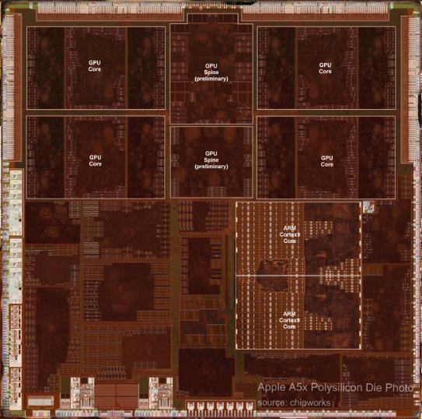
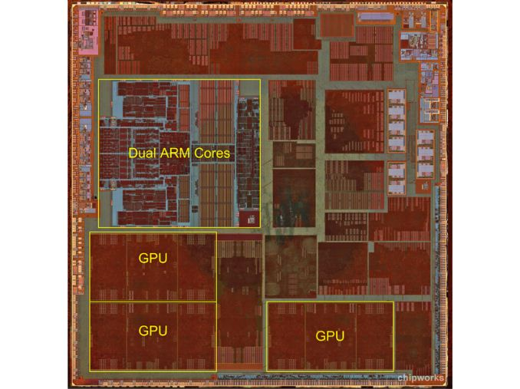
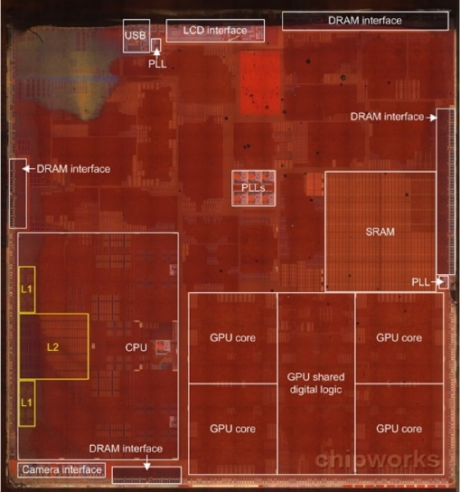
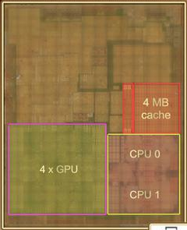
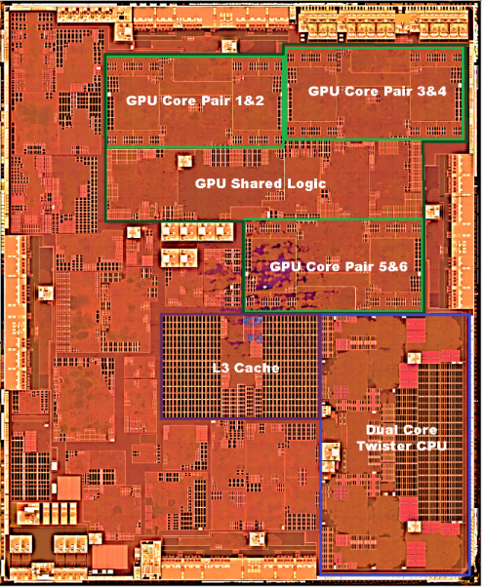
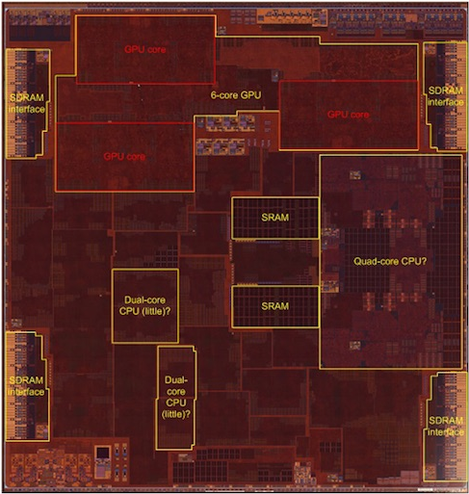
Apple
Apple A5x (2012)
Apple A6 (2012)
Apple A7 (2013)
Apple A8 (2014)
CPU: ~12%
Apple A9 (2015)
Apple A10 (2016)

Slide 11
Embedded SoC: Specialized Processors
Qualcomm Snapdragon 835 [phone]
  CPU + 6:
  DSP, audio, location services, display and video, camera, and security
Apple A11 Bionic [phone/tablet]
  CPU + 3:
  Neural engine: 600 teraops/sec (face ID, animoji, other)
  Apple GPU
  Motion coprocessor: 12 million pixels per second for computational photography, 2 million image tiles per second for video analysis, 500 million pixels/second for H265 encoding
Nvidia Xavier [advanced driver assistance systems]
  CPU + 3:
  8 Volta GPU cores with support for fp16, int8
  Deep Learning Accelerator (DLA)
  Programmable Vision Accelerator (PVA): 7-way VLIW processor

Slide 12
HPC/Data Center
GPU, Xeon Phi, etc.
Machine Learning:
  Google Tensor Processor Unit
    DNN inferrence
    Specialized scratchpad
    256x256x8b MAC unit
  Intel Crest
    DNN training
    32x32x16b MAC
    SRAM + HBM2

Slide 13
Domain-Specific Architectures
Memory wall: RAM performance limits CPU utilization
Power wall: Power envelope (1-2 W per mm²) limits CPU utilization
  DSAs “skirt” using customized on-chip memory structures
  DSAs “skirt” by eliminating overheads needed for dynamic ILP and deep memory hierarchy
DSAs in reconfigurable logic => allows niche domains
  Challenges:
    10X penalty on clock/density
    Engineering effort

Slide 14
Engineering Effort
gates and wires
Application
LUT
LUT
LUT
LUT
SW
SW
SW
LUT
LUT
LUT
LUT
SW
SW
SW
LUT
LUT
LUT
LUT
SW
SW
SW
LUT
LUT
LUT
LUT

Slide 15
FPGA Overlays
program code for PEs
gates and wires
LUT
LUT
LUT
LUT
PE
PE
PE
SW
SW
SW
Application
LUT
LUT
LUT
LUT
PE
PE
PE
SW
SW
SW
LUT
LUT
LUT
LUT
PE
PE
PE
SW
SW
SW
LUT
LUT
LUT
LUT

Slide 16
NAPOLY: Pattern Matching Overlay
Patterns: ex. threat signatures,
network addresses,
genomic seq.
preprocess
(slow)
TCAM
Bloom filter
Automata
input sequence
pattern matches
(fast)

Slide 17
Nondeterministic Finite Automata (NFA)
Recognize pattern: “ababc”
Input | Active States
 | 0
a
b
a
b
c
0
1
2
3
4
5

Slide 18
Nondeterministic Finite Automata (NFA)
Recognize pattern: “ababc”
Input: “a”
Input | Active States
 | 0
a | 0,1
a
b
a
b
c
0
1
2
3
4
5
tracking pattern “a”

Slide 19
Nondeterministic Finite Automata (NFA)
Recognize pattern: “ababc”
Input: “ab”
Input | Active States
 | 0
a | 0,1
b | 0,2
a
b
a
b
c
0
1
2
3
4
5
tracking pattern “ab”

Slide 20
Nondeterministic Finite Automata (NFA)
Recognize pattern: “ababc”
Input: “aba”
Input | Active States
 | 0
a | 0,1
b | 0,2
a | 0,1,3
a
b
a
b
c
0
1
2
3
4
5
tracking pattern “a”
tracking pattern “aba”

Slide 21
Nondeterministic Finite Automata (NFA)
Recognize pattern: “ababc”
Input: “abab”
Input | Active States
 | 0
a | 0,1
b | 0,2
a | 0,1,3
b | 0,2,4
a
b
a
b
c
0
1
2
3
4
5
tracking pattern “ab”
tracking pattern “abab”

Slide 22
Nondeterministic Finite Automata (NFA)
Recognize pattern: “ababc”
Input: “ababa”
Input | Active States
 | 0
a | 0,1
b | 0,2
a | 0,1,3
b | 0,2,4
a | 0,3
a
b
a
b
c
0
1
2
3
4
5
tracking pattern “aba”
lost track

Slide 23
Nondeterministic Finite Automata (NFA)
Recognize pattern: “ababc”
Input: “ababab”
Input | Active States
 | 0
a | 0,1
b | 0,2
a | 0,1,3
b | 0,2,4
a | 0,3
b | 0,4
a
b
a
b
c
0
1
2
3
4
5
tracking pattern “abab”

Slide 24
Nondeterministic Finite Automata (NFA)
Recognize pattern: “ababc”
Input: “abababc”
Input | Active States
 | 0
a | 0,1
b | 0,2
a | 0,1,3
b | 0,2,4
a | 0,3
b | 0,4
c | 0,5 (accept)
a
b
a
b
c
0
1
2
3
4
5
accept

Slide 25
Hamming Distance
Reference seq. “abab”
Input seq. 1 “”
4
match
b
mis-match
3
a
b
2
b
a
b
1
a
b
a
b
0

Slide 26
Hamming Distance
Reference seq. “abab”
Input seq. 1 “a”
4
b
3
a
b
2
b
a
b
1
a
b
a
b
0
a

Slide 27
Hamming Distance
Reference seq. “abab”
Input seq. 1 “ab”
Input seq. 2 “b”
4
b
3
a
b
2
b
b
a
b
1
a
b
a
b
0
ab

Slide 28
Hamming Distance
Reference seq. “abab”
Input seq. 1 “abb”
Input seq. 2 “bb”
Input seq. 3 “b”
4
b
3
a
b
2
b
bb
abb
b
a
b
1
a
b
a
b
0

Slide 29
Hamming Distance
Reference seq. “abab”
Input seq. 1 “abbb”
Input seq. 2 “bbb”
Input seq. 3 “bb”
Input seq. 4 “b”
4
b
3
bbb
a
b
2
b
bb
abbb
b
a
b
1
a
b
a
b
0

Slide 30
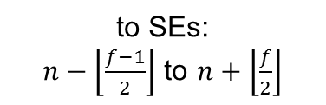
State Element (SE)
a
b
a
b
c
a
b
a
b
c
To output priority encoders
Other SEs
Shift in
256x1 RAM
counter
Input buffer
64Kx8
start
report
to SEs:
$n−\left\lfloor \frac{f−1}{2}\right\rfloor$ to $n+\left\lfloor \frac{f}{2}\right\rfloor$
…
Active
(f = 6 here)
Activation from predecessors
n
To successors
Shift out
$$bw={freq}_{clock}∙{SEs}_{num}∙{SEs}_{\%active}∙f∙\%succ$$

Slide 31
Runtime Behavior
FIB = fill input buf.
R = reconfigure
IBF = input buf. flush
OBF = output buf. flush
Encoders
256x1 RAM
Input buffer
64Kx8
Input buffer
64Kx8
Output buffer
start
Output buffer
start
report
counter
report
Active
…
Active
…
Activation from predecessors
n
To successors
time
x (#states/#SEs)
FIB
R
IBF
OBF
…
R
IBF
OBF
FIB
R
IBF
…
x input_size/64K

Slide 32
Overlay Configurations
SEs (K) | f
4 | 103
8 | 44
12 | 25
16 | 12
20 | 6
24 | 3
Fmax (MHz) | Max. B/W* for 25% a.s. (GB/s)
152 | 1866
136 | 1427
122 | 1091
121 | 692
119 | 426
112 | 240
Encoders | Max. Report cycles | Max. report rate (GHz)
16 | 100% | 2.4
32 | 50% | 2.2
48 | 33% | 2.0
64 | 25% | 1.9
80 | 20% | 1.9
96 | 17% | 1.8
R (μs)
21
31
43
53
67
74
Through- Put 24K states (MB/s) | Through- Put 128K states (MB/s)
14 | 3
27 | 5
32 | 6
36 | 9
31 | 9
67 | 11

Slide 33
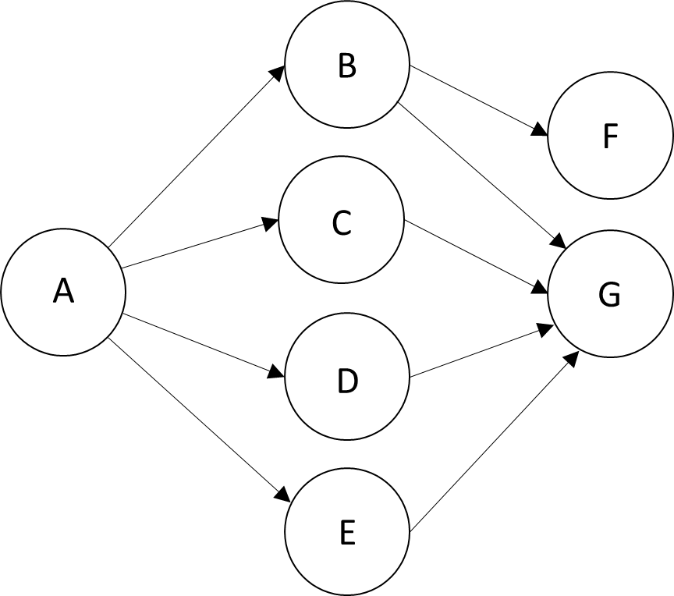
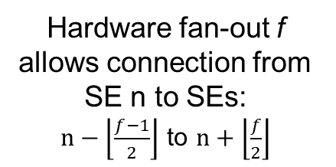
Physical Mapping
Hardware fan-out f allows connection from SE n to SEs:
$n−\left\lfloor \frac{f−1}{2}\right\rfloor$ to $n+\left\lfloor \frac{f}{2}\right\rfloor$
Assume f = 9
  [n-4 to n+4]
SE Mapping:
7! = 5040 possible mappings
f | valid mappings
5 | 0
6 | 24 (0.5%)
7 | 48 (1%)
8 | 372 (7%)
State | SE
A | 0
B | 1
C | 2
D | 3
E | 4
F | 5
G | 6

Slide 34
Performance Results
Benchmark | # states | Minimum Hardware Fan-out Achieved | Overlay | #R/ buffer | Through put (MB/s)
Brill | 26668 | 40 | 8K | 4 | 20
ClamAV | 49538 | 18 | 12K | 5 | 13
Levenshtein | 2784 | 17 | 12K | 1 | 63
Hamming | 11346 | 21 | 12K | 1 | 63
SPM | 100500 | 8 | 16K | 5 | 10
EntityResolution | 95136 | 62 | 4K | 19 | 3
RandomForest | 75340 | 12 | 16K | 5 | 15
PowerEN | 40513 | 29 | 8K | 5 | 16
Snort | 69029 | 60 | 4K | 17 | 5
Fermi | 40783 | 8 | 16K | 2 | 24
Protomata | 42061 | 42 | 8K | 6 | 13
DotStar | 96438 | 4 | 20K | 5 | 12
* iNFAnt on Nvidia Titan Xp ** Nmcart, 4 threads on i5-4440@3.1 GHz

Slide 35
Performance Results
Benchmark | # states | Minimum Hardware Fan-out Achieved | Overlay | #R/ buffer | Through put (MB/s)
Brill | 26668 | 40 | 8K | 4 | 20
ClamAV | 49538 | 18 | 12K | 5 | 13
Levenshtein | 2784 | 17 | 12K | 1 | 63
Hamming | 11346 | 21 | 12K | 1 | 63
SPM | 100500 | 8 | 20K | 5 | 11
EntityResolution | 95136 | 62 | 4K | 19 | 3
RandomForest | 75340 | 12 | 16K | 5 | 15
PowerEN | 40513 | 29 | 8K | 5 | 16
Snort | 69029 | 60 | 4K | 17 | 5
Fermi | 40783 | 8 | 20K | 2 | 21
Protomata | 42061 | 42 | 8K | 6 | 13
DotStar | 96438 | 4 | 20K | 5 | 12
Through put (MB/s) | Ave. act. states | iNFAnt (GPU) * | Hyperscan (CPU) ** | Speedup
20 | 14 | 7 | 1 | 3
13 | 4 | 4 | 14 | 0.9
63 | 88 | 38 | 1 | 1.7
63 | 240 | 18 | 10 | 3.5
10 | 6331 | 0.5 | 0.1 | 20
3 | 10 | 4 | 1 | 0.8
15 | 968 | 2 | 0.5 | 7.5
16 | 31 | 53 | 10 | 0.3
5 | 98 | 14 | 0.4 | 0.4
24 | 3854 | 2 | 1 | 12
13 | 19 | 5 | 1 | 2.6
12 | 3 | 40 | 10 | 0.3
* iNFAnt on Nvidia Titan Xp ** Nmcart, 4 threads on i5-4440@3.1 GHz

Slide 36
Current/Future Work
Hide input buffer flush latency with output buffer flush
SAT-solver based mapping algorithm
Scale up to larger FPGAs and faster memory (DDR4/HBM2)

Slide 37
Digital Signal Processors (DSPs)
Statically scheduled VLIW
  High IPC for innermost loop if body is a single basic block
Scratchpad+DMA
  Instead of last-level cache
Examples:
  Qualcomm Hexagon
  Nvidia Programmable Vision Accelerator (PVA)
  Google Pixel Visual Core
  Texas Instruments C66x

Slide 38

DMA and Scratchpad

Slide 39


DMA and Scratchpad
(process)
(read)

Slide 40
DMA and Scratchpad
time
input ping buffer
tile n+1
tile n+1
tile n+1
input pong buffer
tile n
tile n
tile n
tile n+2
tile n+2
tile n
tile n
output ping buffer
tile n-1
tile n+1
tile n+1
tile n-1
tile n-1
output pong buffer
tile n
tile n
tile n+2
tile n
processor
trigger
process tile n
idle
trigger
process tile n+1
idle
trigger
process tile n+2
DMA controller
idle
write tile n-1 to DRAM
read tile n+1 from DRAM
idle
write tile n to DRAM
read tile n+2 from DRAM
idle
write tile n+1 to DRAM

Slide 41
Performance
1.92X
1.58X

Slide 42
OpenVX
“Front-end” vision routines for pixel-by-pixel ops, such as:
  Statistical
  Filtering
  Colorspace conversion
  Partial derivative, corner score, optical flow
vxColorConvertNode
vxGaussian3x3Node
vxChannelExtractNode

Slide 43
OpenVX
DRAM -> scratchpad (A)
DRAM -> scatchpad (E)
scatchpad -> DRAM (F)
scratchpad -> DRAM (B)
vxColorConvertNode
ex. time = X
vxGaussian3x3Node
ex. time = Z
DRAM -> scratchpad (C)
vxChannelExtractNode
ex. time = Y
scratchpad -> DRAM (D)
time = max(C+D,X)
scratchpad buffers: 2, size = scratchpad/4

Slide 44
OpenVX
DRAM -> scratchpad (A)
DRAM -> scatchpad (E)
scatchpad -> DRAM (F)
scratchpad
vxColorConvertNode
ex. time = X
vxGaussian3x3Node
ex. time = Z
scratchpad
vxChannelExtractNode
ex. time = Y
time = max(A+D,X+Y+λ)
scratchpad -> DRAM (D)
scratchpad buffers: 3, size = scratchpad/6

Slide 45
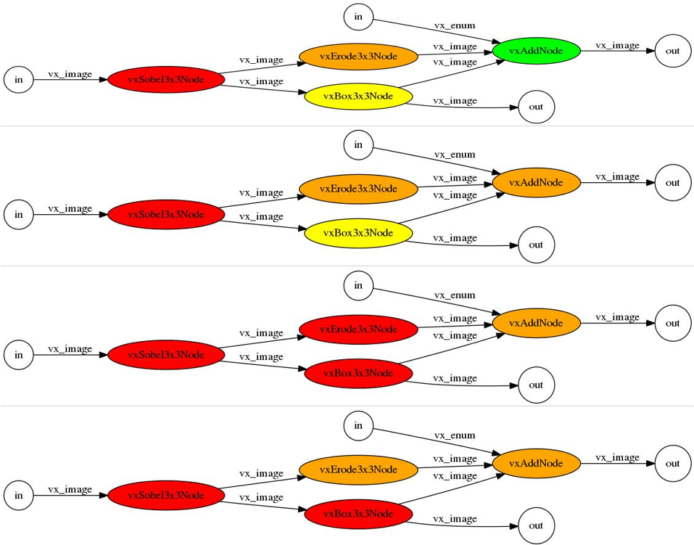
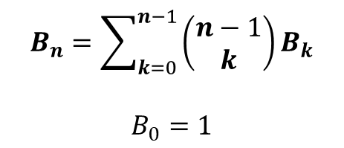
Graph Partitioning
$$B_{n}=\sum_{k=0}^{n−1}{\left(\begin{matrix}n−1 \\ k\end{matrix}\right)}B_{k}$$
$$B_{0}=1$$
B₆ = 203,
B₇ = 877,
B₈ = 4140,
B₉ = 21147
B₁₀ = 115975
B₁₁ = 678570
B₁₂ = 4213597

Slide 46
Performance Considerations
Problem:
  Group size determines:
    Number of DMA transactions
    Tile size
  Tile size determines:
    DMA bandwidth
    Compute throughput
Approach:
  Train memory performance model and compute model to optimize grouping and tile size together

Slide 47
DMA Memory Performance Model
Characterize:
  43 kernels, 25 tile sizes, all possible pixel depths (per kernel)
  2819 total tests
Features:
  input tile width, height in pixels (TIW, TIH)
  output tile width, height in pixels (TOW, TOH)
  total input, output width (tile width x pixel size x number of inputs) (TTIW, TTOW)
  total input, output size, TTIW*TIH (TIS, TOS)
  number of inputs, outputs (NI, NO)
  pixel depth (PD)
  stencil neighborhood width, height (SNW, SNH)
Best accuracy: TTIW, TIH, TTOW, TOH

Slide 48
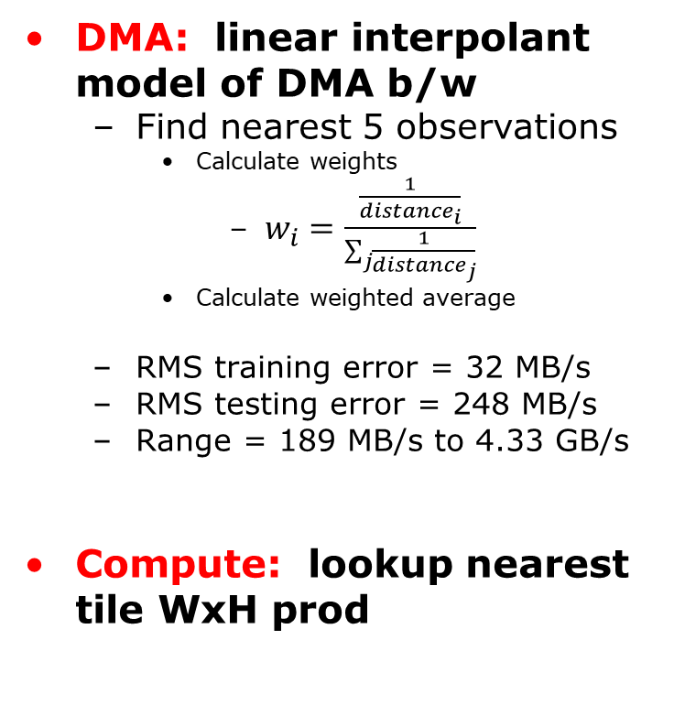
Performance Models
DMA: linear interpolant model of DMA b/w
  Find nearest 5 observations
    Calculate weights
      $w_{i}=\frac{\frac{1}{{distance}_{i}}}{\sum_{j}{\frac{1}{distance_{j}}}}$
    Calculate weighted average
  RMS training error = 32 MB/s
  RMS testing error = 248 MB/s
  Range = 189 MB/s to 4.33 GB/s
Compute: lookup nearest tile WxH prod
in_width=8,
out_width=6,
in_height=48,
out_height=46
356 MB/s
in_width=16,
out_width=14,
in_height=48,
out_height=46
8.5
723 MB/s
w=.17
6.3
w=.23
in_width=16,
out_width=8,
in_height=48,
out_height=48
6.3
in_width=16,
out_width=10,
in_height=48,
out_height=42
w=.23
616 MB/s
8.0
w=.18
8.0
w=.18
in_width=16,
out_width=16,
in_height=48,
out_height=48
in_width=8,
out_width=8,
in_height=48,
out_height=48
742 MB/s
423 MB/s

Slide 49
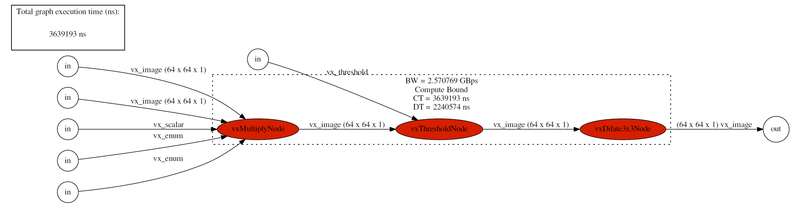
Model Accuracy and Performance
0.13 cycles/pixel
(compute)
0.44 cycles/pixel
(compute)
0.25 cycles/pixel (compute)
Compute bound:
0.81 cycles/pixel
DMA bound:
3 x 1600x1200x1 DMA @ 4.33 GB/s @ 750 MHz
0.48 cycles/pixel

Slide 50
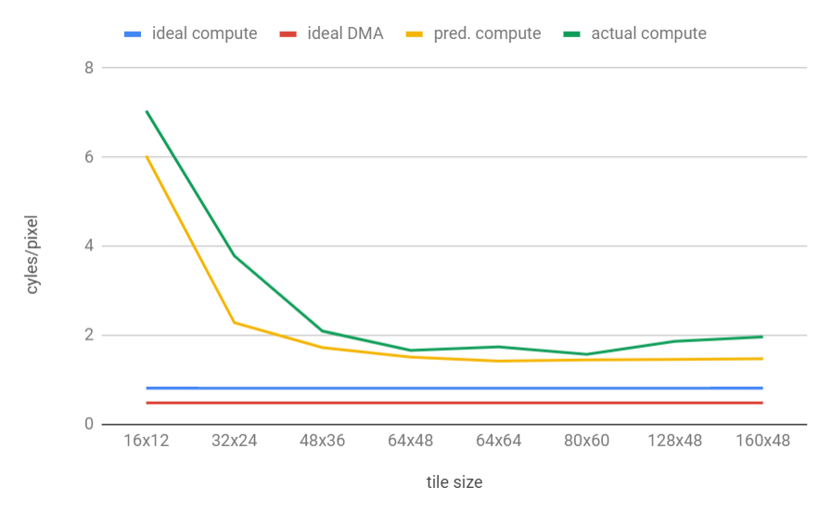
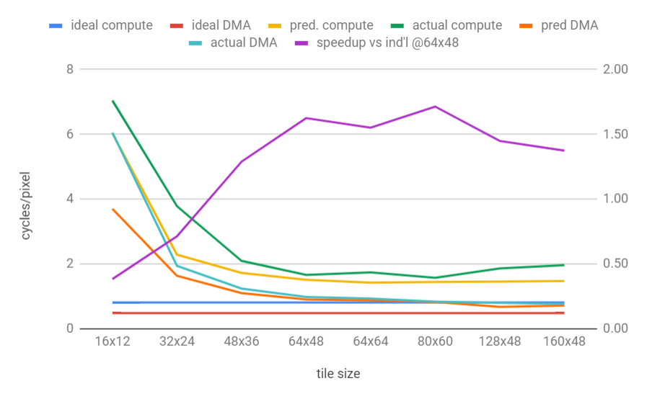
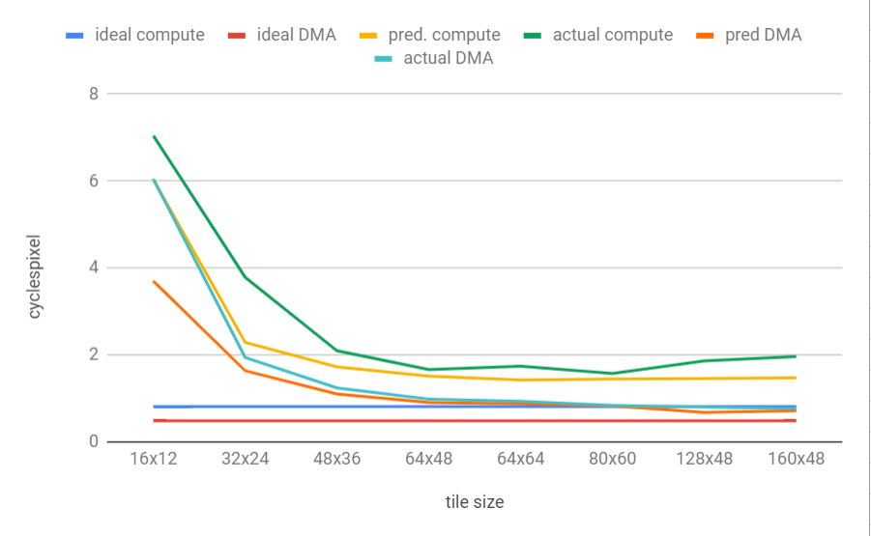
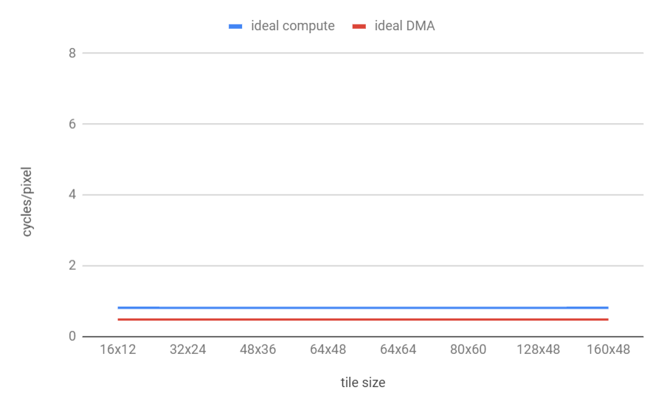
Impact of Tile Size on Merged Kernels
1.71

Slide 51
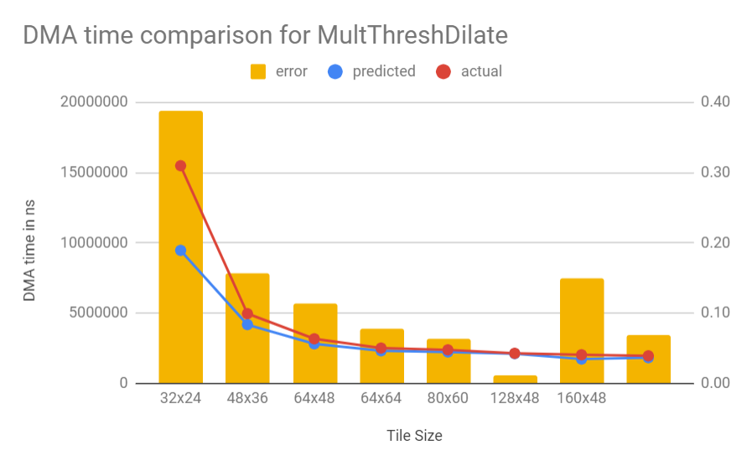
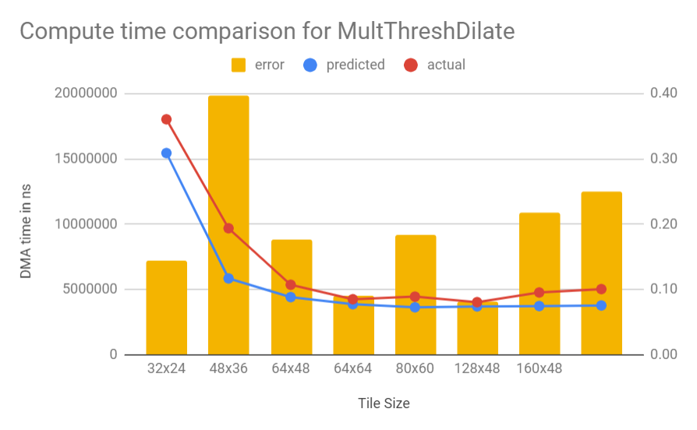
Model Accuracy

Slide 52
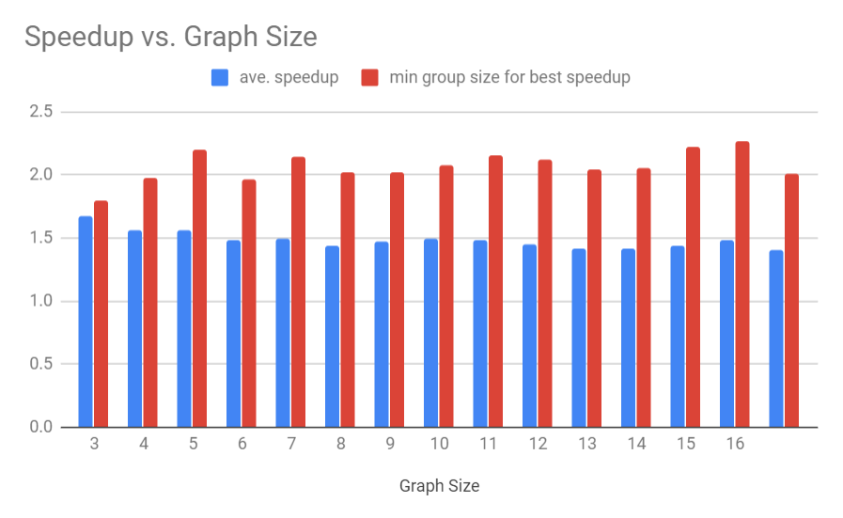
Randomly Generated Graphs
For each graph
  For each grouping
    For each allocable tile size (constrained by scratchpad capacity)…
      Find predicted speedup (vs individual nodes with 64x48 tiles)

Slide 53
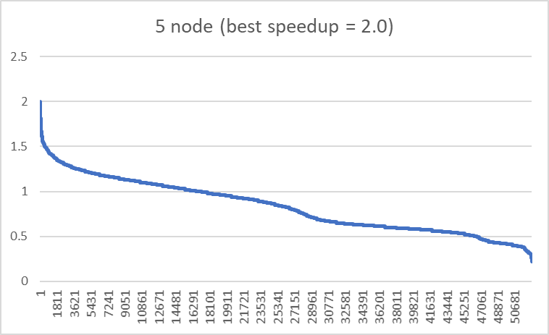
Speedup Distribution
grouping+tile size enumerations for example 5-node graph

Slide 54
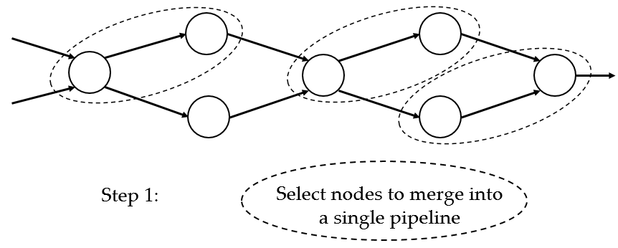
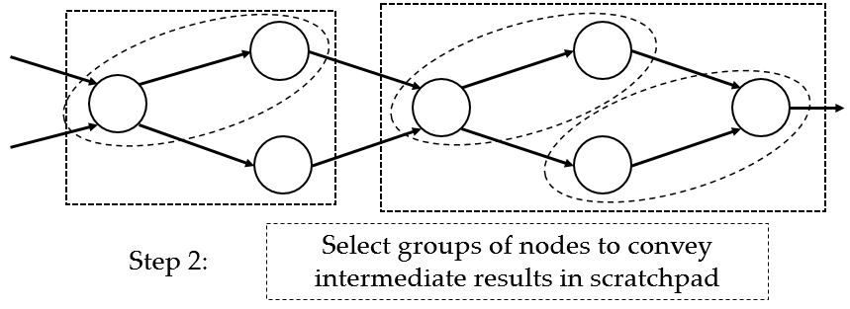
Current Work
Develop better models for compute + DMA
Develop compiler support for loop merging
  Intermediate results via register instead of stratchpad

Slide 55
General Conclusions
DSAs drive new computational capabilities
Post-Moore’s Law, DSAs will be the only source of new performance capability
New design and programming paradigms are needed

Slide 56
Thank you!

Slide 57
Physical Mapping
Logical fan-in = 4
Logical fan-out = 4
Hardware fan-out = 9
range = [-4,4]
SE Mapping:
SE | State
0 | A
1 | B
2 | C
3 | D
4 | E
5 | F
6 | G

Slide 58
Physical Mapping
Logical fan-in = 4
Logical fan-out = 4
Hardware fan-out = 9
range = [-4,4]
SE Mapping:
SE | State
0 | A
1 | B
2 | C
3 | D
4 | E
5 | F
6 | G

Slide 59
Mapping Algorithm
Initially map states to SEs in order listed in input file
For each edge S -> D , if there is a mapping violation, move either S or D in a way that minimizes the resulting score
SE | State
0 | A
1 | B
2 | C
3 | D
4 | E
5 | F
6 | G
Edge | Distance | Edge | Distance
A->B | 1 | B->G | 5
A->C | 2 | C->G | 4
A->D | 3 | D->G | 3
A->E | 4 | E->G | 2
B->F | 4
SE | State
0 | A
1 | C
2 | B
3 | D
4 | E
5 | F
6 | G
Edge | Distance | Edge | Distance
A->B | +1 | B->G | -1
A->C | -1 | C->G | +1 (5)
A->D | 0 | D->G | 0
A->E | 0 | E->G | 0
B->F | -1
Option 1:
Move B to SE 2
Relative score = -1
(but one new violation)

Slide 60
Mapping Algorithm
Initially map states to SEs in order listed in input file
For each edge S -> D , if there is a mapping violation, move either S or D in a way that minimizes the resulting score
SE | State
0 | A
1 | B
2 | C
3 | D
4 | E
5 | F
6 | G
Edge | Distance | Edge | Distance
A->B | 1 | B->G | 5
A->C | 2 | C->G | 4
A->D | 3 | D->G | 3
A->E | 4 | E->G | 2
B->F | 4
SE | State
0 | A
1 | C
2 | D
3 | B
4 | E
5 | F
6 | G
Edge | Distance | Edge | Distance
A->B | +2 | B->G | -2
A->C | -1 | C->G | +1 (5)
A->D | -1 | D->G | +1
A->E | 0 | E->G | 0
B->F | -2
Option 2:
Move B to SE 3
Relative score = -2
(but one new violation)

Slide 61
Mapping Algorithm
Initially map states to SEs in order listed in input file
For each edge S -> D , if there is a mapping violation, move either S or D in a way that minimizes the resulting score
SE | State
0 | A
1 | B
2 | C
3 | D
4 | E
5 | F
6 | G
Edge | Distance | Edge | Distance
A->B | 1 | B->G | 5
A->C | 2 | C->G | 4
A->D | 3 | D->G | 3
A->E | 4 | E->G | 2
B->F | 4
SE | State
0 | A
1 | B
2 | C
3 | D
4 | E
5 | G
6 | F
Edge | Distance | Edge | Distance
A->B | 0 | B->G | -1
A->C | 0 | C->G | -1
A->D | 0 | D->G | -1
A->E | 0 | E->G | -1
B->F | +1 (5)
Option 6:
Move G to SE 5
Relative score = -3
(but one new violation)

Slide 62
Mapping Algorithm
Initially map states to SEs in order listed in input file
For each edge S -> D , if there is a mapping violation, move either S or D in a way that minimizes the resulting score
SE | State
0 | A
1 | B
2 | C
3 | D
4 | E
5 | F
6 | G
Edge | Distance | Edge | Distance
A->B | 1 | B->G | 5
A->C | 2 | C->G | 4
A->D | 3 | D->G | 3
A->E | 4 | E->G | 2
B->F | 4
SE | State
0 | G
1 | A
2 | B
3 | C
4 | D
5 | E
6 | F
Edge | Distance | Edge | Distance
A->B | 0 | B->G | -3
A->C | 0 | C->G | -1
A->D | 0 | D->G | +1
A->E | 0 | E->G | +3 (5)
B->F | 0
Option 11:
Move G to SE 0
Relative score = 0
(but one new violation)

Slide 63
Mapping Algorithm
Movement | Relative Score | # violations | Movement | Relative Score | # violations
State B from SE 1 to SE 2 | -1 | 1 | State G from SE 6 to SE 5 | -3 | 1
State B from SE 1 to SE 3 | -2 | 1 | State G from SE 6 to SE 4 | -5 | 2
State B from SE 1 to SE 4 | -3 | 1 | State G from SE 6 to SE 3 | -5 | 2
State B from SE 1 to SE 5 | -3 | 2 | State G from SE 6 to SE 2 | -3 | 2
State B from SE 1 to SE 6 | -4 | 1 | State G from SE 6 to SE 1 | 0 | 1
 |  |  | State G from SE 6 to SE 0 | 0 | 1

Slide 64
Runtime Behavior

Slide 65
VLIW and Software Pipelining
for i = 0 to n
$1 = load A[i]
add $2,$2,$1
A[i] = store $2
endfor
Loop
Schedule
L
L
7 cycles
A
L
A
Load 3 cycles
Add 3 cycles
S
S
A
L
3
cycles
Store 1 cycles
S
A
S
Notes:
Practical limitation, branches, register, assembly(parallel not happen obviously, lower level than C), 3 cycles add

Slide 66
OpenVX
DRAM -> scratchpad (A)
scatchpad -> DRAM (F)
scratchpad -> DRAM (B)
scatchpad (E)
vxColorConvertNode
ex. time = X
vxGaussian3x3Node
ex. time = Z
DRAM -> scratchpad (C)
vxChannelExtractNode
ex. time = Y
scratchpad
time = max(C+F,Y+Z+λ)
scratchpad buffers: 3, size = scratchpad/6

Slide 67
Equivalence Classes
Features | #Classes/ Ave. Size | Ave. /max. stddev of class b/w | Mean error of classes
TTIW, TTOW, TIH, TOW, NI, NO, TIS, TOS | 500 2.9 | 6.7 MB/s 100 MB/s | 114 MB/s
TIW, TIH, NI, NO, TIS, TOS, SNW, SNH | 500 2.9 | 6.7 MB/s 100 MB/s | 219 MB/s
TTIW, TIH, TTOW, TO | 448 3.3 | 17 MB/s 340 MB/s | 100 MB/s

Slide 68
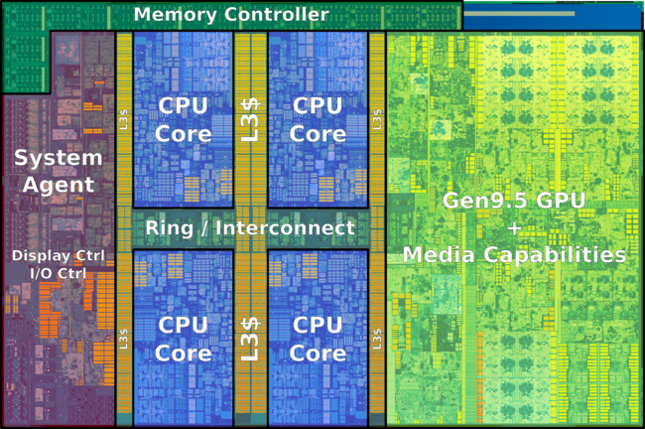
Performance: Intel Desktop Peak Performance
Desktop Processor | Year | Max. Clock Speed (GHz) | Integer IPC/core | Cores | Max. DRAM Bandwidth (GB/s) | SP Floating Point (Gflop/s) | L3 cache (MiB) | Tech
Kaby Lake i7-7700K | 2017 | 4.50 | 8 | 4 | 38.4 | 288 | 8 | 14
123 mm² die
CPU/
cache = 38%
(47 mm²)

