Slide 1




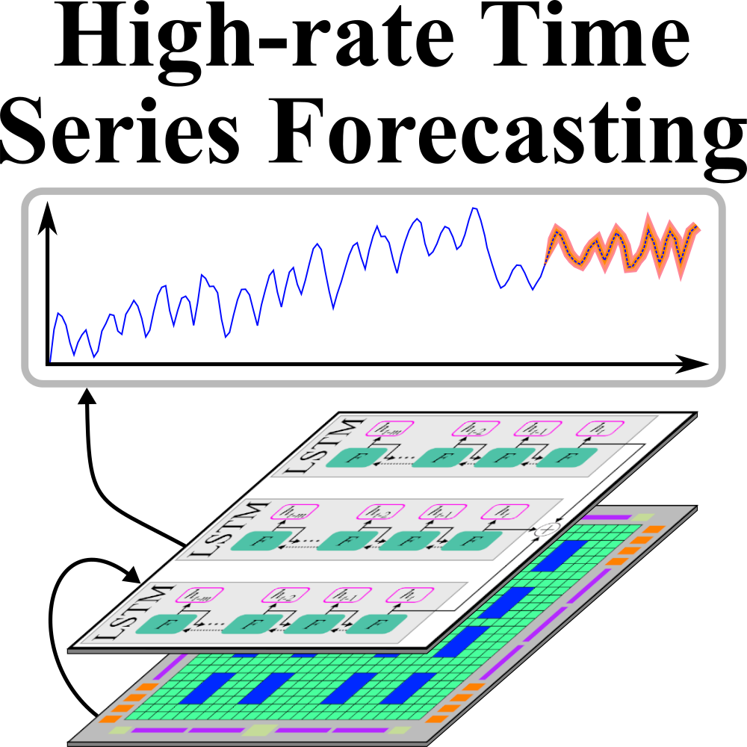
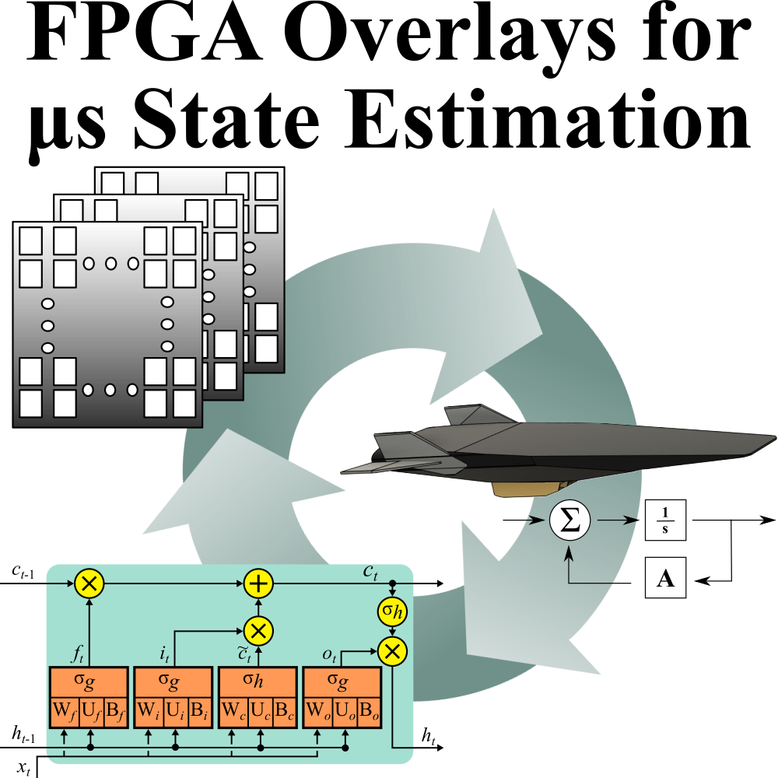

High Rate Machine Learning for Forecasting Time-Series Signals
Austin Downey
Atiyehsadat Panahi
Ehsan Kabir
David Andrews
Miaoqing Huang
Heterogeneous and Reconfigurable Computing Group
Jason D. Bakos
This material is based upon work supported by the National Science Foundation under Grant No. 1956071.

Slide 2
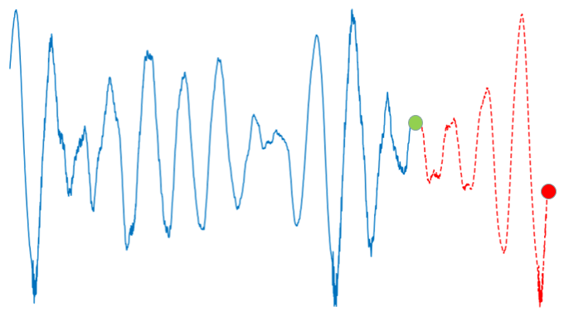
Objectives
future time
(predict this)
Objective:
Simultaneous forecast +
learn for time series
Performance metrics:
Forecast accuracy
Re-training time
Latency
Contributions:
Algorithms
HLS-based implementation
Overlay-based implementation
current time

Slide 3
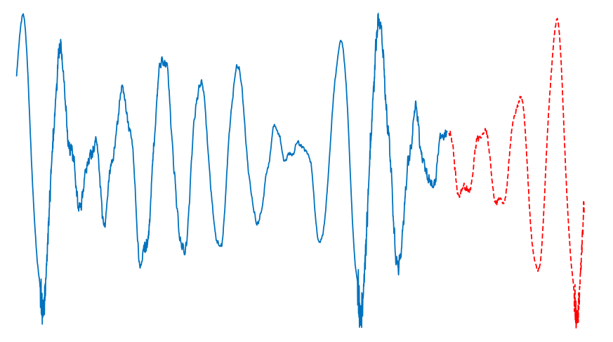
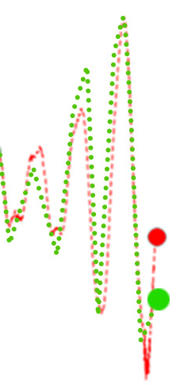
Time Series Forecasting
current time
Most recent sample
forecast time (f)
forecast
error
time

Slide 4
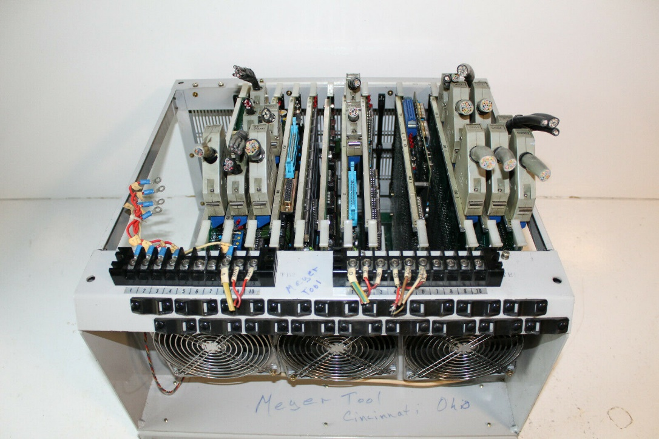
Applications: Control of Active Structures
Active Vibration Control
Deformable Mirrors
Sensors
Structure
Actuator
* ALPAO Corp.
Control System

Slide 5
Approach
Signal must be periodic
Period unknown and may be too long for timely relearn
Nonstationarity

Slide 6
Approach: MLP-Based Model
current time
forward pass
history length (h)
forecast time (f)
MLP2
MLP1
backward pass
history length (h)
forecast time (f)
time

Slide 7
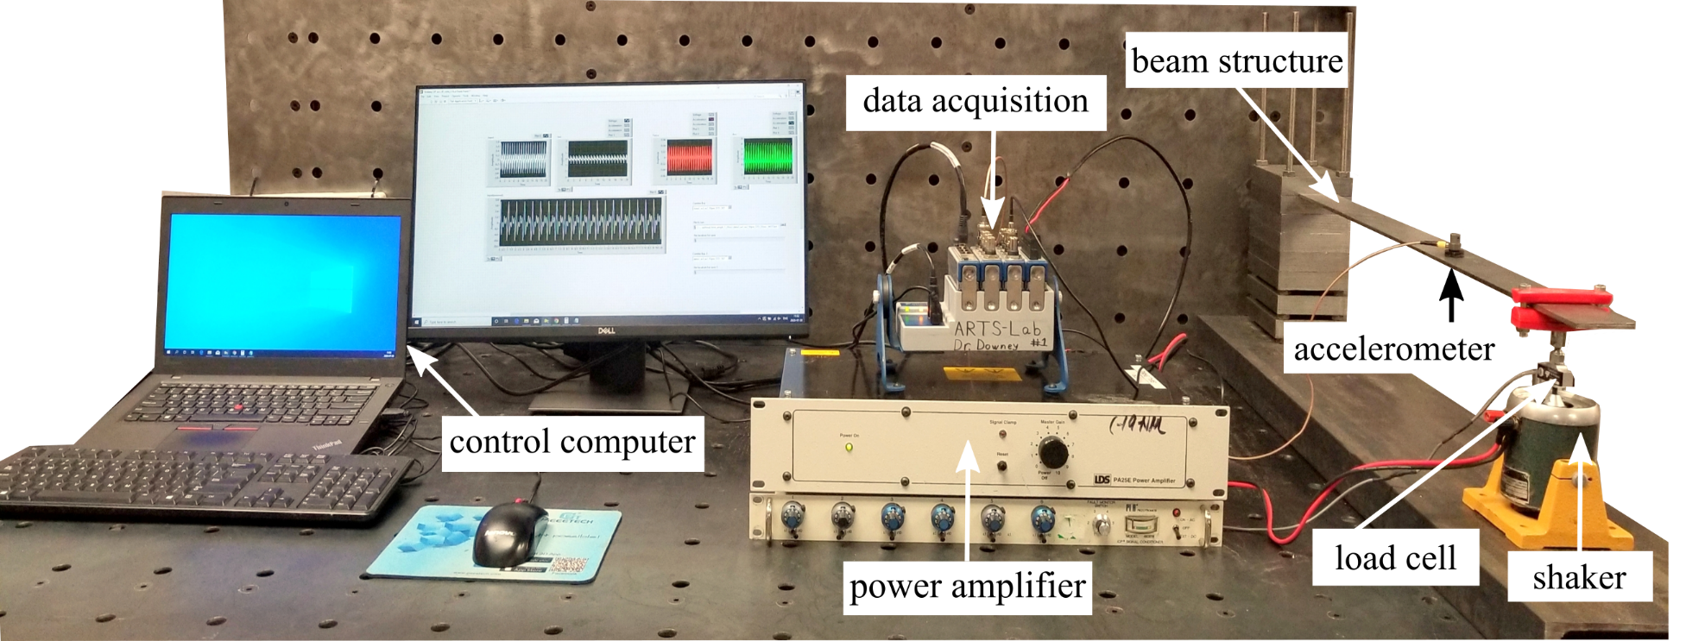
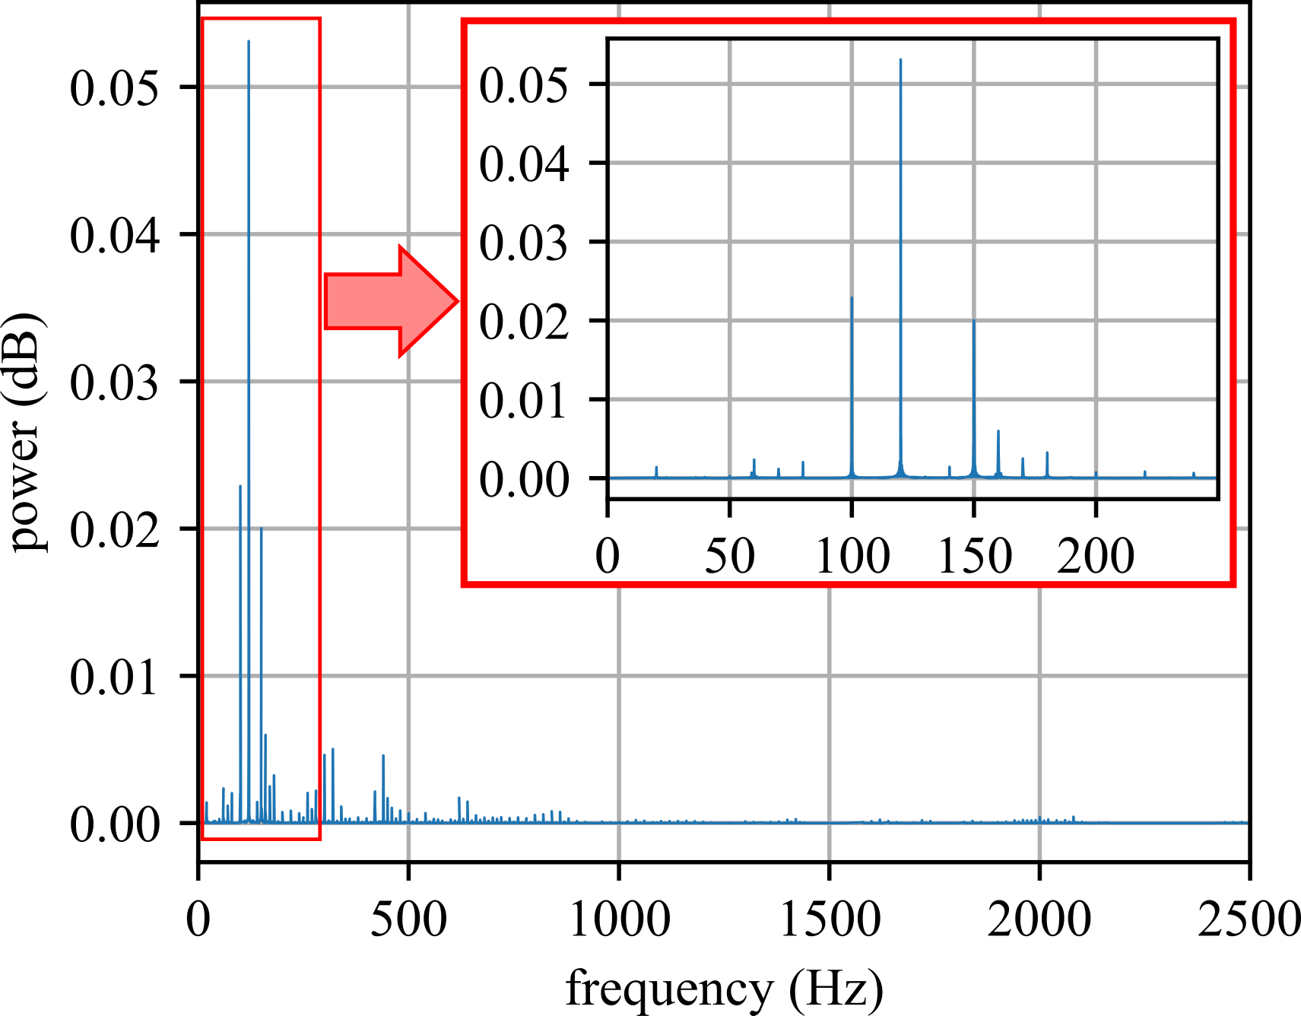
Test Data
stimulus:
100 Hz+120 Hz+150 Hz
stimulus:
100 Hz+120 Hz
nonstationarity
???

Slide 8
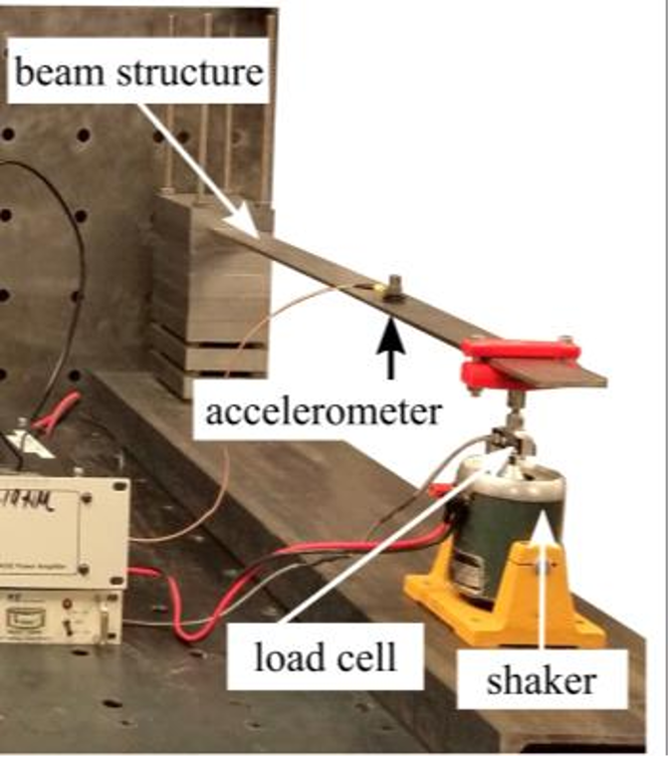
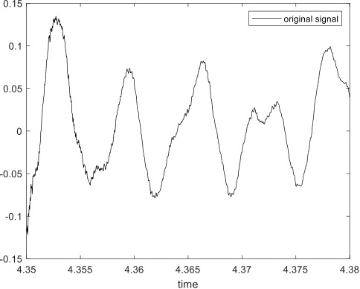
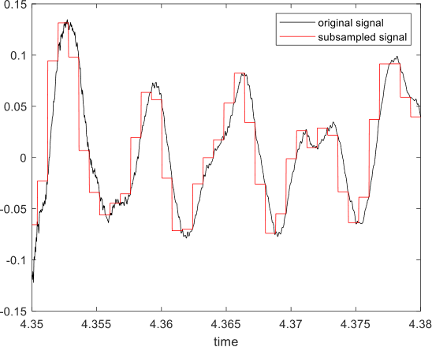

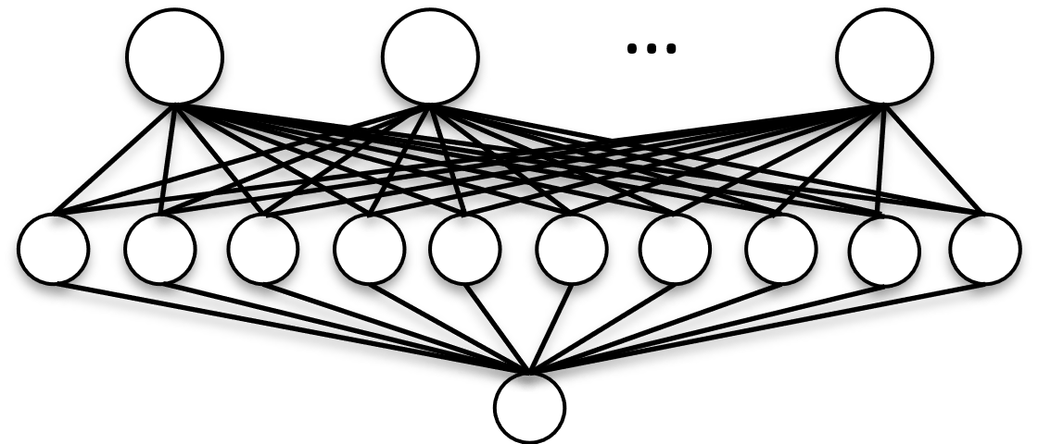
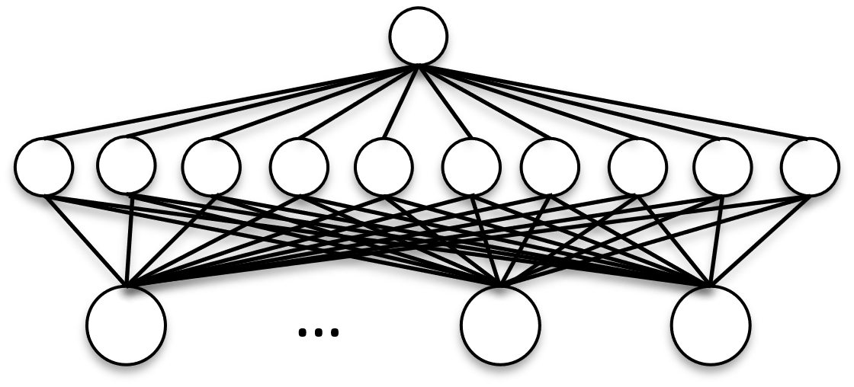
System Design
51.2 KHz
r_{s} Hz
rate r to rate r_{s}
word size n
t : t-h-1
t-f : t-f-h-1
z⁻¹
z⁻¹
…
z⁻¹
…
z⁻¹
z⁻¹
…
z⁻¹
forecast
learn
execution time < 1/r_{s}

Slide 9
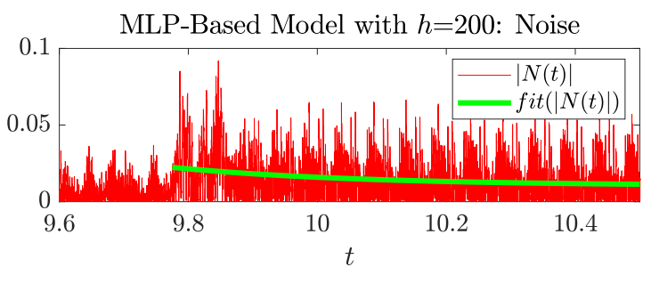
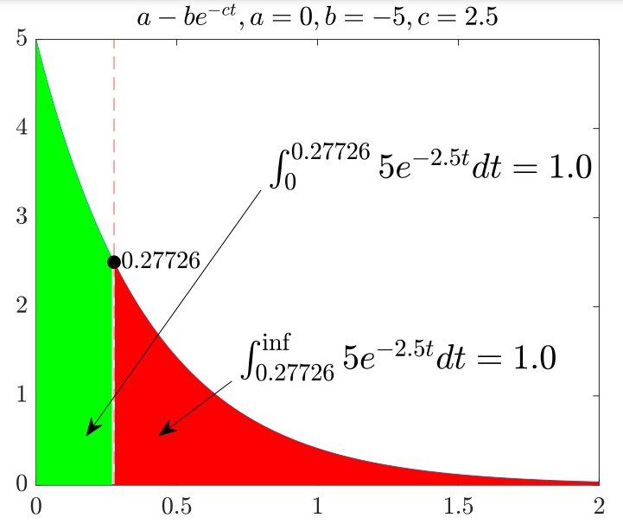
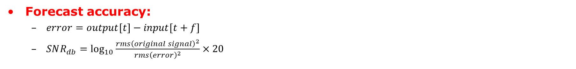

Performance Metrics
Forecast accuracy:
  $error=output[t]−input[t+f]$
  $SNR_{db}=\log_{10}{\frac{rms{\left(original signal\right)}^{2}}{rms{\left(error\right)}^{2}}}×20$
Re-training time:
  Fit absolute error to $a−be^{−ct}$
  Find "center of gravity" of curve: $\frac{\ln{\frac{1}{2}}}{c}$
Parameters:
  History length (h)
  Hidden layer size (s)
  Subsample rate (r_{s})
  Data width (n)

Slide 10
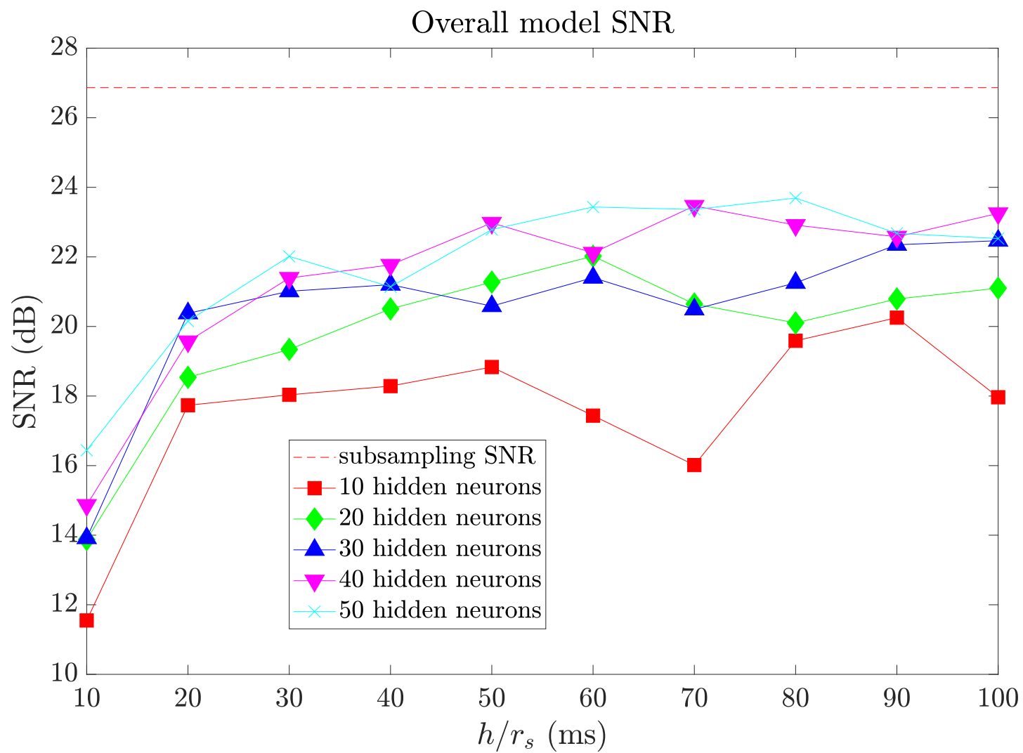
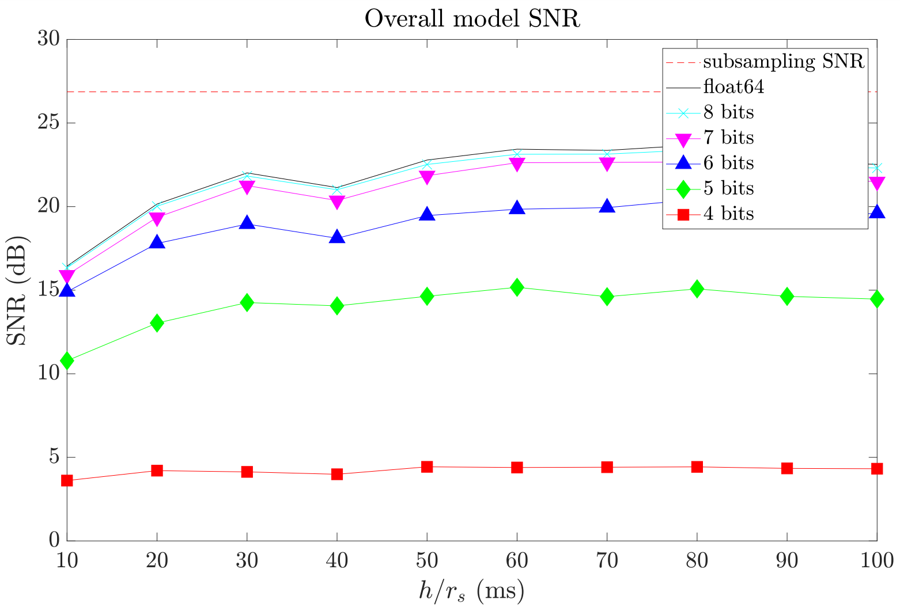
Impact of h, s, r_{s}, and n on Accuracy
Subsampled @ 2500 Hz
Subsampled @ 2500 Hz
50 hidden neurons

Slide 11
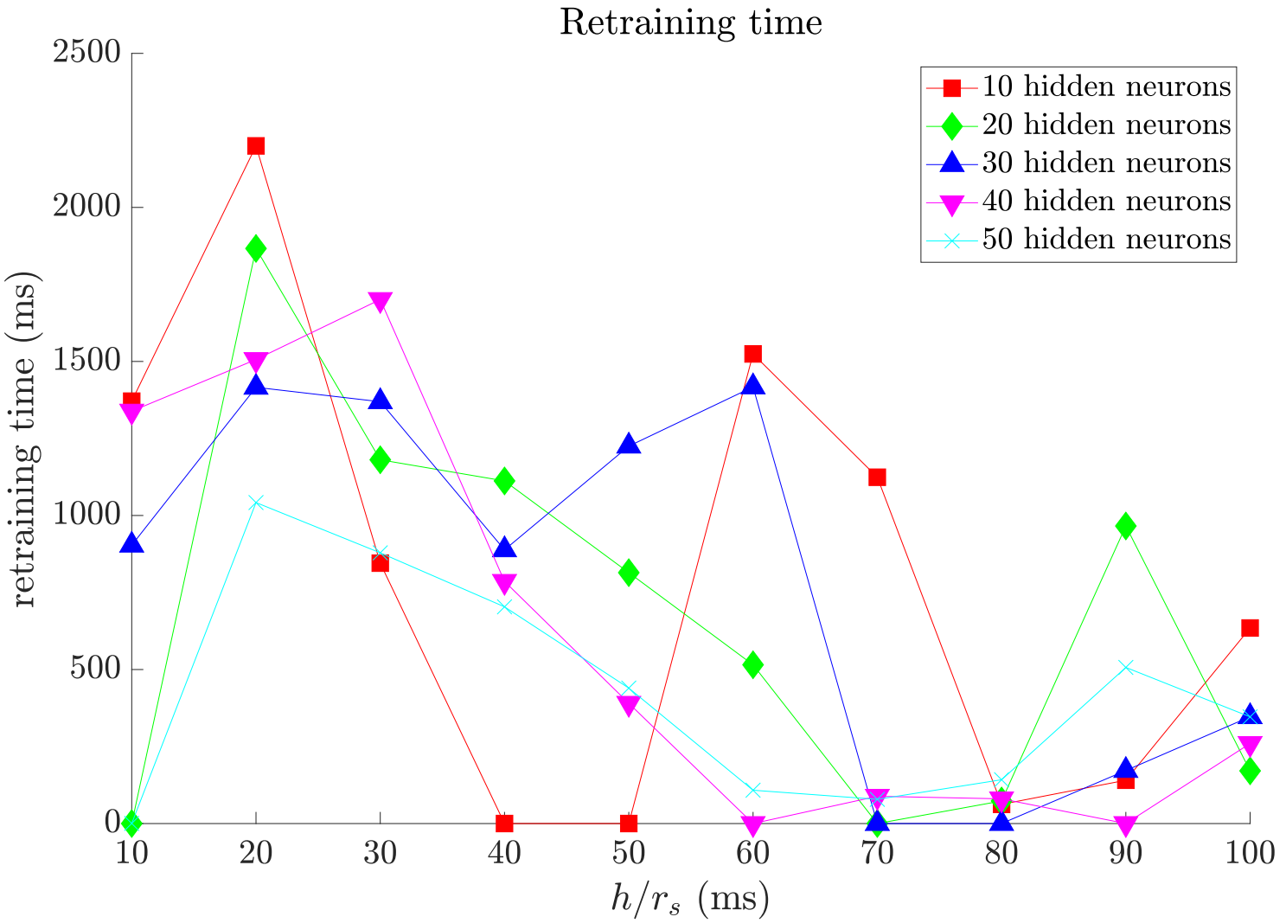
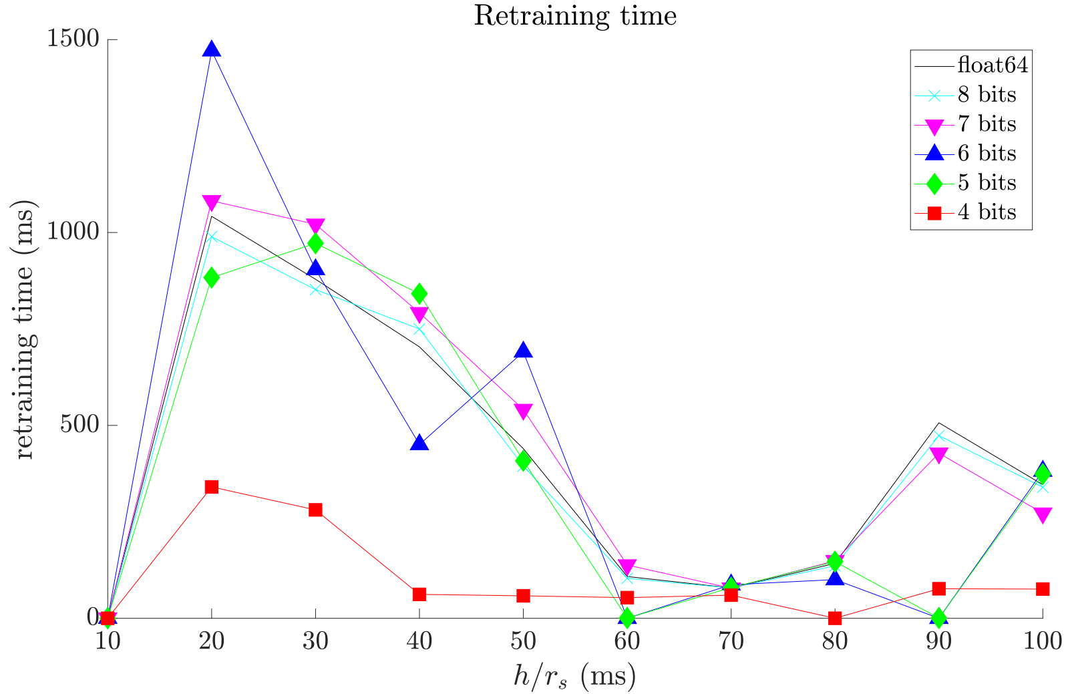
Impact of h, s, r_{s}, and n on Retraining Time
Subsampled @ 2500 Hz
Subsampled @ 2500 Hz
50 hidden neurons

Slide 12
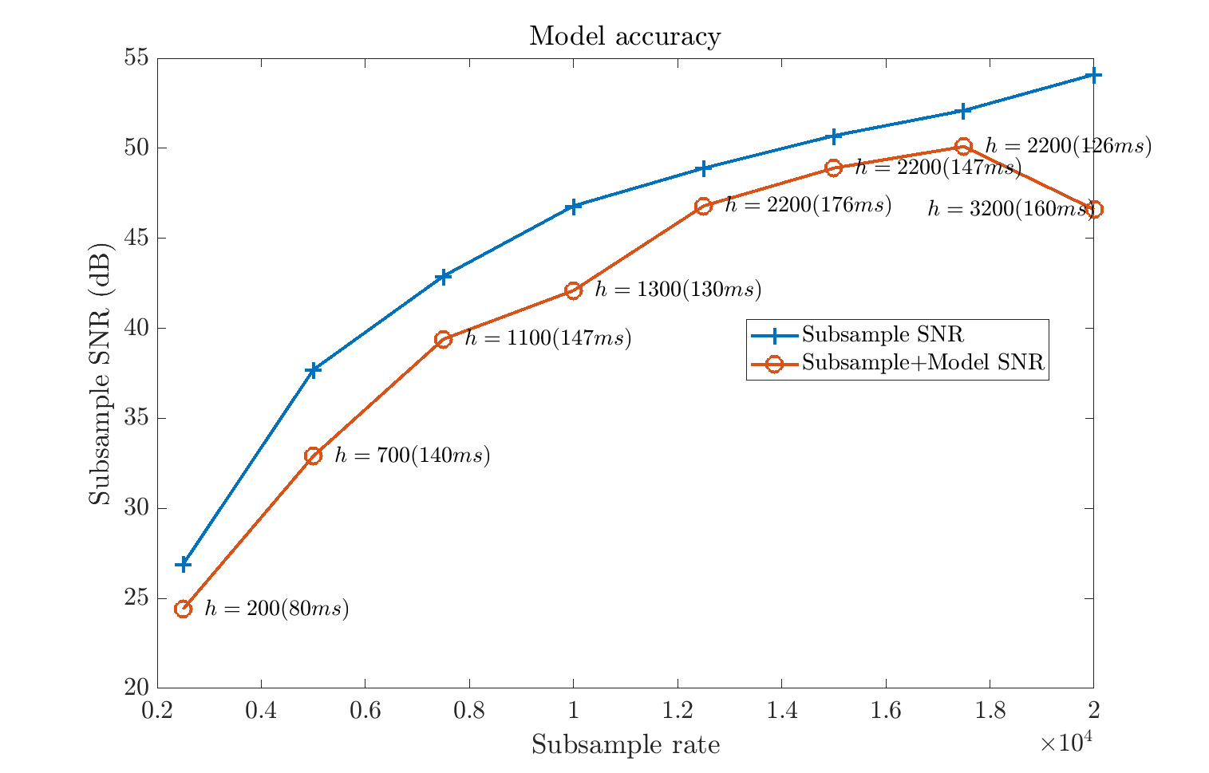
Deployment Results

Slide 13

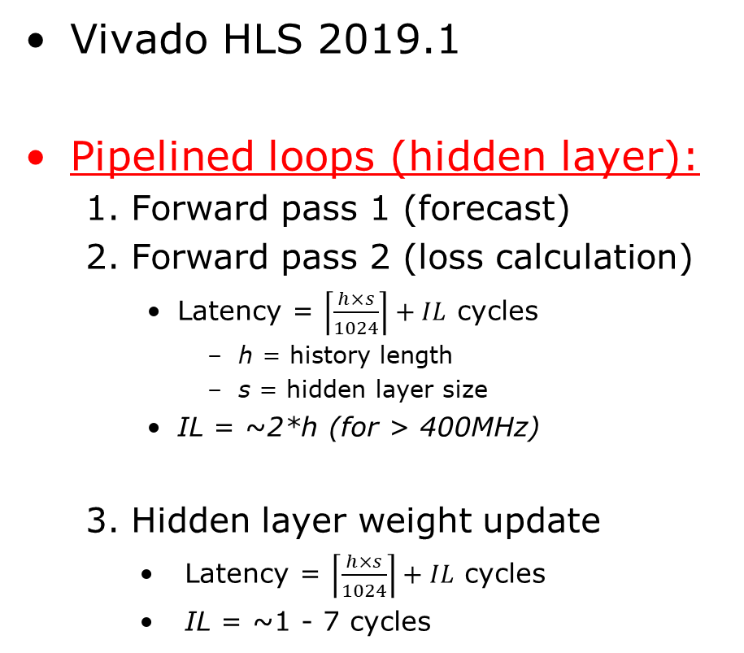


HLS Architecture
Steps:
Vivado HLS 2019.1
Pipelined loops (hidden layer):
  Forward pass 1 (forecast)
  Forward pass 2 (loss calculation)
    Latency = $\left\lceil \frac{h×s}{1024}\right\rceil +IL$ cycles
      h = history length
      s = hidden layer size
    IL = ~2*h (for > 400MHz)
  Hidden layer weight update
    Latency = $\left\lceil \frac{h×s}{1024}\right\rceil +IL$ cycles
    IL = ~1 - 7 cycles
serial/parallel converter
complete unroll
forward pass 1
$\left\lceil \frac{h×s}{1024}\right\rceil +IL$ cycles
forward pass 2
$\left\lceil \frac{h×s}{1024}\right\rceil +IL$ cycles
hidden layer gradient calculation
complete unroll
output neuron weight update
complete unroll
hidden layer weight update
$\left\lceil \frac{h×s}{1024}\right\rceil +IL$ cycles

Slide 14
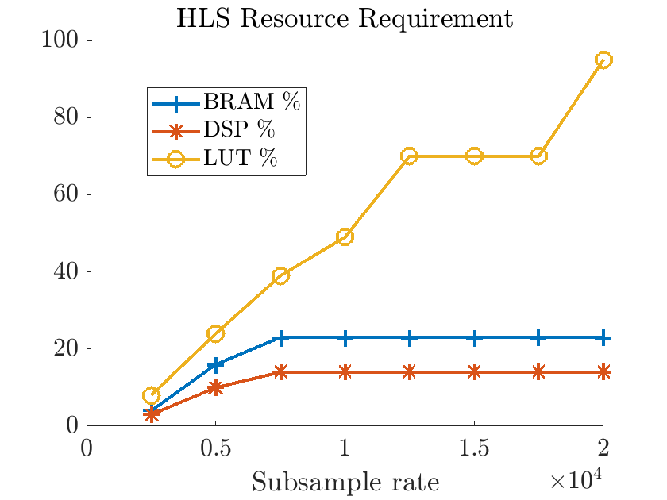
HLS Implementation
Targeted Virtex Ultrascale+ VU9P
  484 MHz
Has fixed BRAM/DSP usage for 1024-banks
  1 MB allocated weight capacity
  Largest model uses only 15% of allocated RAM
Current design limited by LUT usage
uses 15% of allocated BRAM
20K parameters
320K parameters

Slide 15
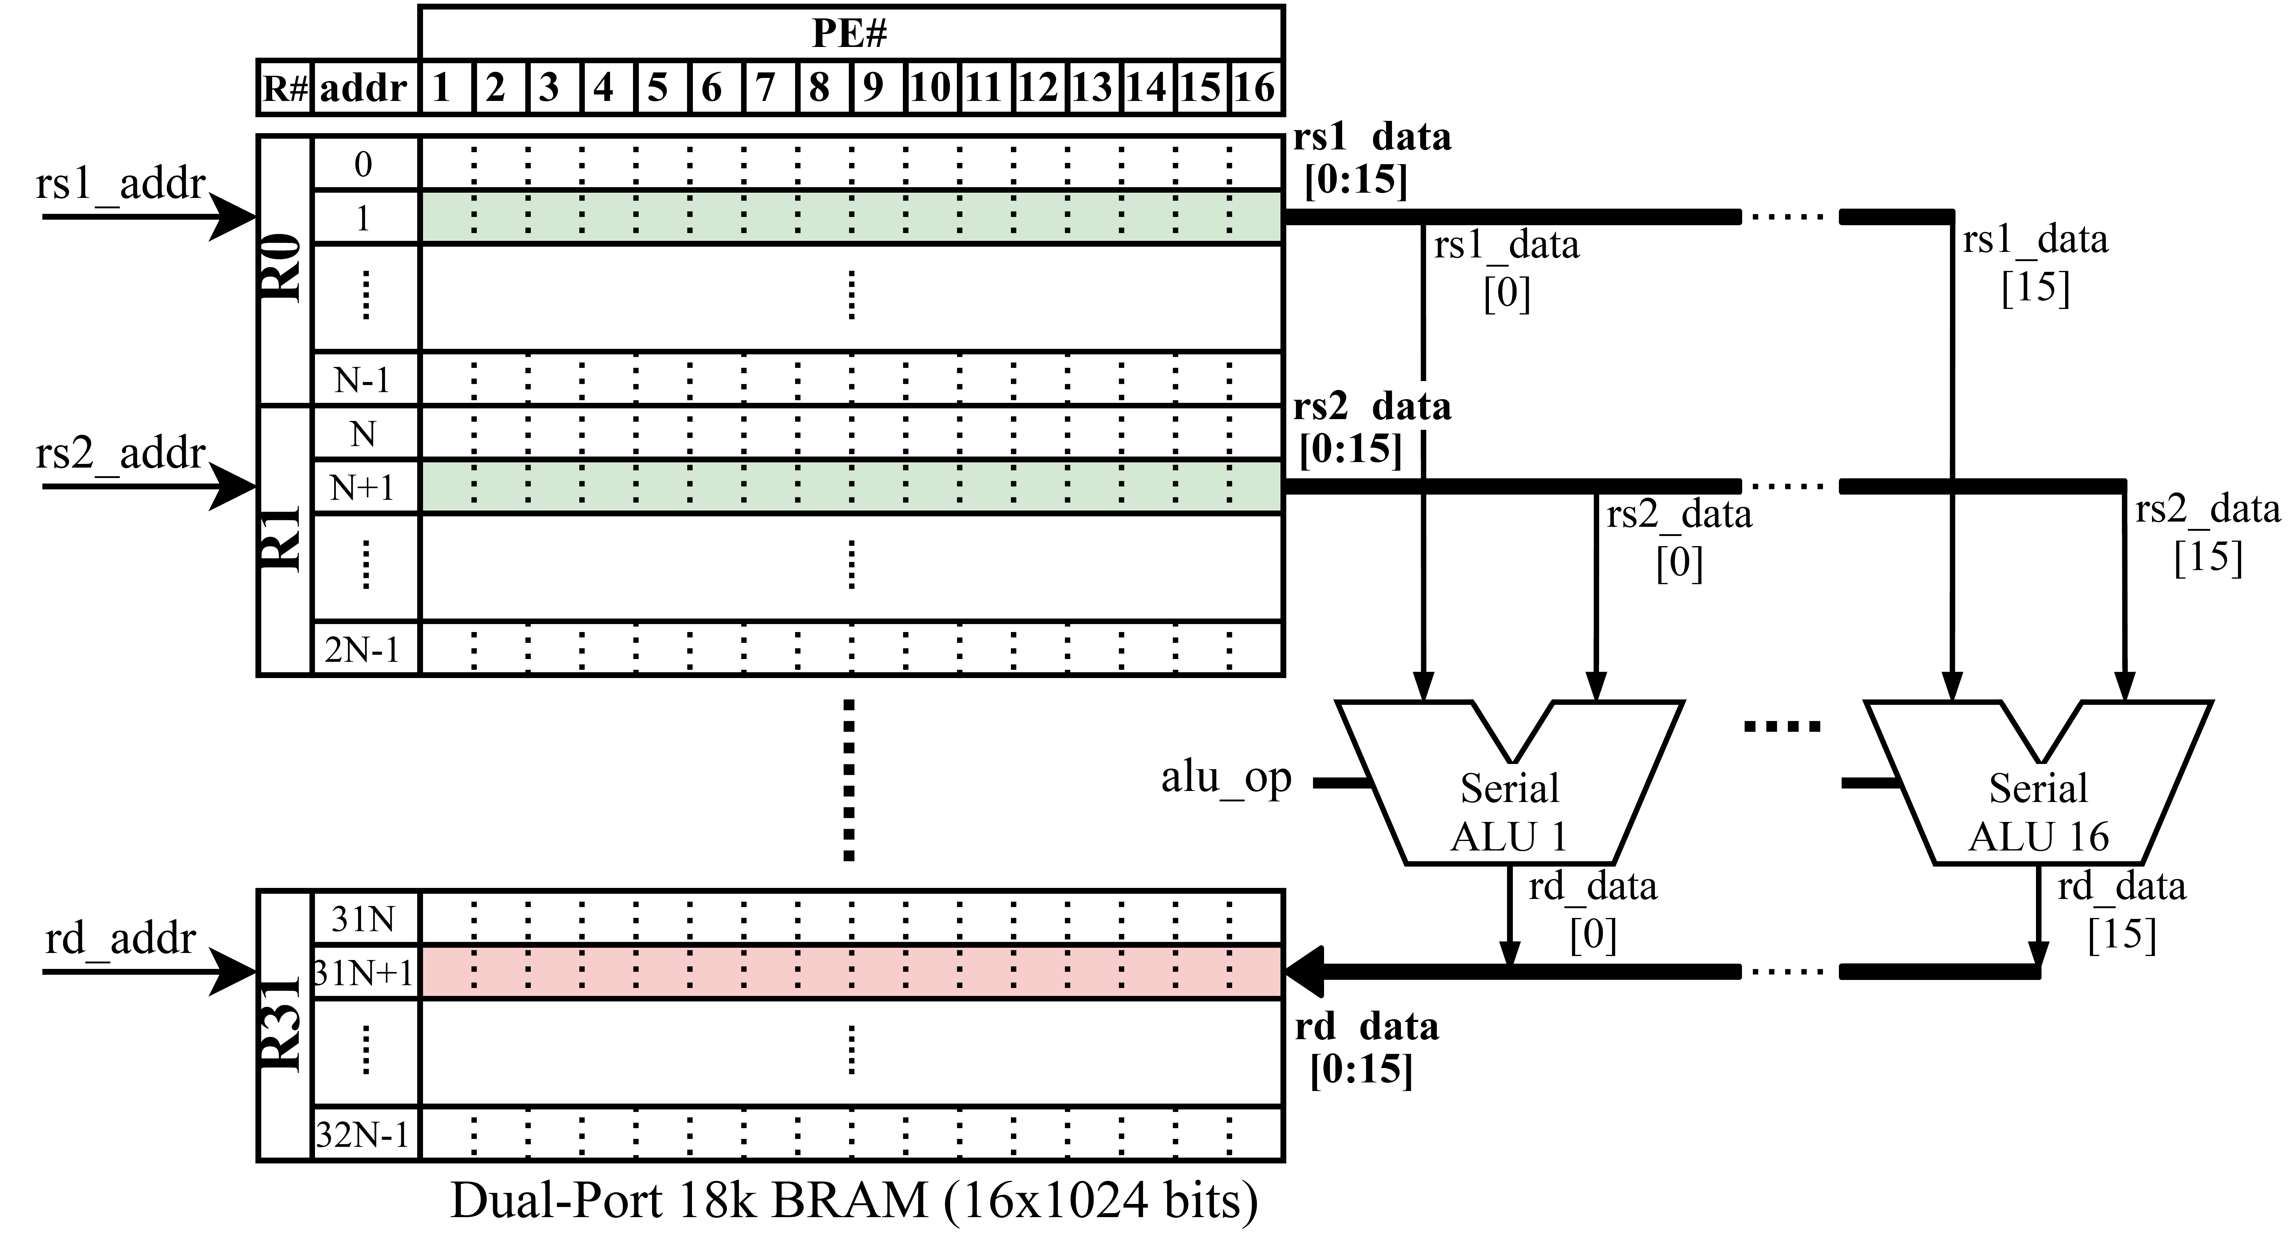
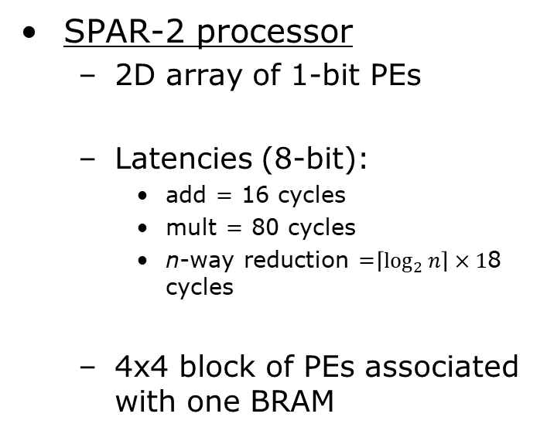
Array Processor Memory
SPAR-2 processor
  2D array of 1-bit PEs
  Latencies (8-bit):
    add = 16 cycles
    mult = 80 cycles
    n-way reduction =$\left\lceil \log_{2}{n}\right\rceil ×1$8 cycles
  4x4 block of PEs associated with one BRAM
A. Panahi, S. Balsalama, A. T. Ishimwe, J.M. Mbongue, D. Andrews,
"A Customizable Domain-Specific Memory-Centric FPGA Overlay for Machine Learning Applications," FPL 2021.

Slide 16
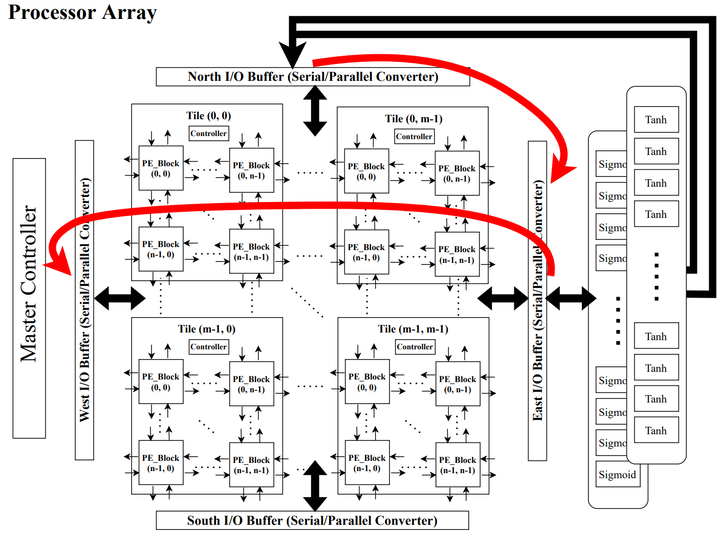
Array Processor Architecture
Structure:
  5x5 blocks/tile
  5x5 tiles/grid
  10K PEs
PEs can exchange with neighbors
10 MB capacity, best performance when weights < 160 KB
Custom instructions added for backpropagatation
vs HLS:
  Overcomes HLS's 1024-bank limit
  Limited by multi-cycle adds and lower Fmax of 330 MHz

Slide 17
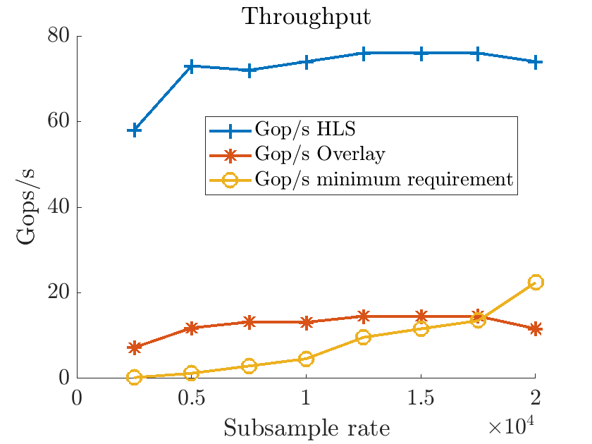
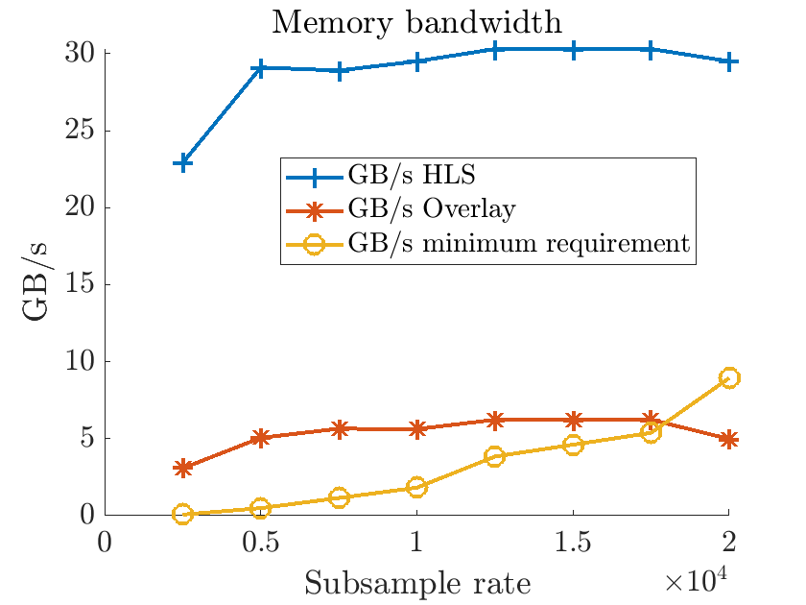
Performance Results

Slide 18
Conclusions
Real-time, data driven simultaneous forecasting and learning of time series signals
Developed two implementations of the system
Current work:
  Dynamically adjust learning rate to improve re-training time
  Add support for LSTM forecasters

Slide 19

Thank you!

