Slide 1
CSCE 313: Embedded Systems
Scaling Multiprocessors
Instructor: Jason D. Bakos

Slide 2
Design Space Exploration
In Lab 3 we explored the performance impact of cache size
In Lab 4 we explored the performance impact of data-level parallelism for two processors
In Lab 5 we will explore the performance impact of scaling up the number of processors beyond two
  We’ll also implement a new application

Slide 3
Processor Scaling
In Lab 4 some groups encountered resource limits on the FPGA, maxing out the number of M4K RAMS
  This was due to instancing two processors with large caches
The Cyclone 4 E 115 FPGA has 432 M9K RAMs (each holds 1.125 KB)
Each processor requires 2 M4Ks for the register file, 1 for the debugger, and 8 for 1KB/1KB I/D caches
My SOPC System, without character buffer, requires ~16 M4Ks without processors
  Overhead required for Avalon bus, mailbox memory, video FIFO, etc.
I was able to build a four processor system (with 1 KB cache) with only 67 M4Ks

Slide 4
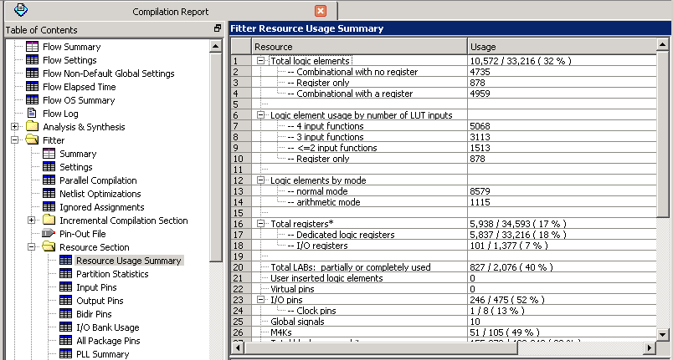
Resource Usage

Slide 5
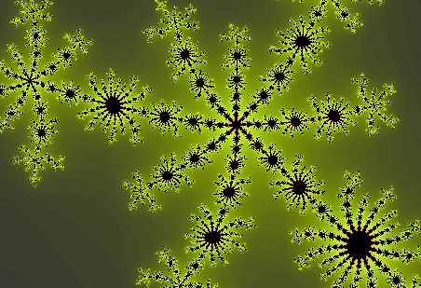
Fractals

Slide 6

Fractals

Slide 7
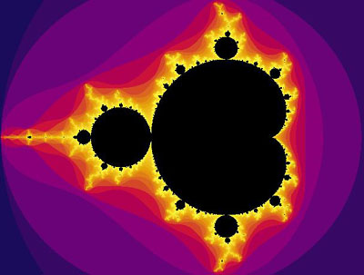
Mandelbrot Set

Slide 8
Mandelbrot Set
Basic idea:
  Any arbitrary complex number c is either in the set or not
    Recall complex numbers have a real and imaginary part
    e.g. 3 + 2i
    i = sqrt(-1)
  Plot all c’s in the set, set x=Real(c), y=Imag(c)
    Black represents points in the set
    Colored points according to how “close” that point was to being in set

Slide 9
Mandelbrot Set
Definition:
  Consider complex polynomial P_{c}(z) = z² + c
  c is in the set if the sequence:
    P_{c}(0), P_{c}(P_{c}(0)), P_{c}(P_{c}(P_{c}(0))), P_{c}(P_{c}(P_{c}(P_{c}(0)))), …
  …does NOT diverge to infinity
  All points in the set are contained radius = 2 around (0,0)

Slide 10
Mandelbrot Set
How do you square a complex number?
  Answer: treat it as polynomial, but keep in mind that i² = -1
  Example:
    (3 + 2i)²
      = (3 + 2i) (3 + 2i)
      = 9 + 6i + 6i + 4i²
      = 9 + 12i – 4
      = 5 + 12i
    (x + yi)²
      = (x + yi) (x + yi)
      = x² + 2xyi – y²
      = (x² - y²) + 2xyi

Slide 11
Example 1
Is (.5 + .75i) in the Mandelbrot set?
  P_{(.5 + .75i)}(0) = 0²+(.5 + .75i) = .5 + .75i
  P_{(.5 + .75i)}(P_{(.5 + .75i)}(0)) = (.5 + .75i)² + (.5 + .75i) = 0.1875 + 1.5i
  P_{(.5 + .75i)}(P_{(.5 + .75i)}(P_{(.5 + .75i)}(0))) = (0.1875 + 1.5i)² + (.5 + .75i)
  = -1.7148 + 1.3125i (outside)
  … = 1.7179 - 3.7514i (outside)
  … = -10.6218 -12.1391i (outside)
  Color should reflect 4 iterations

Slide 12
Example 2
Is (.25 + .5i) in the Mandelbrot set?
  Iteration 1 => 0.2500 + 0.5000i
  Iteration 2 => 0.0625 + 0.7500i
  Iteration 3 => -0.3086 + 0.5938i
  Iteration 4 => -0.0073 + 0.1335i
  Iteration 5 => 0.2322 + 0.4980i
  Iteration 6 => 0.0559 + 0.7313i
  Iteration 7 => -0.2817 + 0.5817i
  Iteration 8 => -0.0090 + 0.1723i
  …
  Iteration 1000 => -0.0095 + 0.3988
  (Looks like it is)

Slide 13
Mandelbrot Set
Goal of next lab:
  Use the DE2 board to plot a Mandelbrot fractal over VGA and zoom in as far as possible to “reveal” infinitely repeating structures
  Problems to solve:
    How to discretize a complex space onto a 320x240 discrete pixel display
    How to determine if a discretized point (pixel) is in the set
    How to zoom in
    What happens numerically as we zoom in?
    How to parallelize the algorithm for multiple processors

Slide 14
Plotting the Space
Keep track of a “zoom” window in complex space using the four floating point variables:
  min_x, max_x, min_y, max_y
Keep a flattened 240x320 pixel array, as before
  Each pixel [col,row] can be mapped to a point in complex space [x,y] using:
    x = col / 320 x (max_x – min_x) + min_x
    y = (239-row) / 240 x (max_y – min_y) + min_y
Keep track of your zoom origin in complex space, or target point:
  target_x, target_y

Slide 15
Algorithm
For each pixel (row,col):
  Check to see if the corresponding point in complex space is in Modelbrot set:
    Transform (row,col) into c = (x0,y0)
    initialize z = 0 => x=0, y=0 // recall that series begins with P_{c}(0)
    set iteration = 0
    while ((x*x + y*y) <= 4) and (iteration < 500)
    // while (x,y) is inside radius=2 (otherwise we know the series has diverged)
      xtemp = x*x – y*y + x0
      y = 2*x*y + y0
      x = xtemp
      iteration++
    if iteration == 500 then
    color=black,
    else
    color=(some function of iteration)

Slide 16
Zooming
Goal:
  We want to zoom in to show the details on the fractal
  Problem: on which point to we zoom?
  Set the initial frame to encompass:
    -2.5 <= x <= 1
    -1 <= y <= 1
    (This is the typical window from which the Mandelbrot fractal is shown)
  During the first frame rendering, find the first pixel that has greater than 450 iterations
    Set this only once!
    How to set when theres >1 processors?
  This will identify a colorful and featureful area
  Set this point (in complex space) as your target_x and target_y

Slide 17
Zooming
To zoom in:
  min_x=target_x – 1/(1.5^zoom)
  max_x=target_x + 1/(1.5^zoom)
  min_y=target_y - .75/(1.5^zoom)
  max_y=target_y + .75/(1.5^zoom)
In the outer loop, increment zoom from 1 to 100 (or more)
Fractals are deliberately made colorful, but the way you set the colors is arbitrary
  Here’s one sample technique:
  color [R,G,B] =
    [iteration*8/zoom, iteration*4/zoom, iteration*2/zoom]
  This creates a yellowish brown hue that dampens as you zoom in
  Make sure you saturate the colors

Slide 18
Numerical Precision
You’ll notice as you zoom in that picture definition quickly degrades
This is because double precision values have a precision of 2⁻⁵² and zooming in at a quadratic rate reaches this quickly
  In other words, the difference in the complex space between pixels approaches this value
  Note: 2⁻⁵² = 2.2 x 10⁻¹⁶
Inter-pixel distance from 0 to 200 iterations using specified zoom

Slide 19
Precision
Interesting note:
  Size of observable universe
    93 billion light years
    = 8.8 x 10²⁶ meters
  Smallest constant in physics, Plank’s constant:
    6.0 x 10⁻³⁴ m²kg/s
  Ratio is 6.8 x 10⁻⁶¹
  At the rate we’re zooming, we achieve that ratio in ~341 iterations

Slide 20
Parallelizing
The frame rate will depend on how many of the pixels in the frame are in the Mandelbrot set, since these pixels are expensive (requires 1000 loop iterations each)
  Lighter-colored pixels are also expensive, though less so
To speed things up, use multiple processors
Use the data parallel approach and write to the frame buffer in line

Slide 21
Notes
Make sure you enable hardware floating point and hardware multiply on each processor
Use at least 1KB instruction and data cache per processor
Implement on one processor first
You don’t need the key inputs, LCD, LEDs, or Flash memory, so feel free to delete their interfaces
For recording performance, measure the average time for rendering each frame (including sending the pixels to the pixel buffer)
You’ll need math.h for exponentiation, but only use it for the zooming (actually not…)
You’ll also need four mailboxes to implement your barriers

