Slide 1
CSCE 313: Embedded Systems
Multiprocessor Systems
Instructor: Jason D. Bakos

Slide 2
Performance Considerations
time per frame = (number of pixels) * (time per pixel)
time per pixel = (cycles per pixel) * (clock period)
cycles per pixel = (instructions per pixel) * (cycles per instruction)
(constant)
(variable)
(variable)
(constant)
multiple instruction/multiple data (MIMD)
(variable)
programmer,
compiler
(variable)
data and control hazards

Slide 3
Performance Considerations
CPU 0
pixels
pixels
DRAM
SRAM
pixels
pixels
CPU 1
DRAM:
  Assume inner loop fits in instruction cache
  Peak memory bandwidth = 32 bits / 4 bytes per cycle
  One pixel per cycle per CPU, 4 cycles/pixel/CPU for interpolation

Slide 4
Multiprocessor Systems
SOPC Builder allows you to add multiple CPUs to your design
The CPUs can share memories and other system components
SOPC Builder also offers hardware components to allow multiple CPUs to synchronize and communicate
Having multiple CPUs allows you to speed up the system by taking advantage of parallelism

Slide 5
Multiprocessor Systems
Without an OS, the linker (encoded in the ELF file) determines the memory addresses used for:
  Code
  Global variables
  Stack
  Heap
Must make sure code from different processors don’t “step on” each other
Can still use program controlled memory using constant memory addresses:
  int *shared_memory = 0x <address of memory>

Slide 6
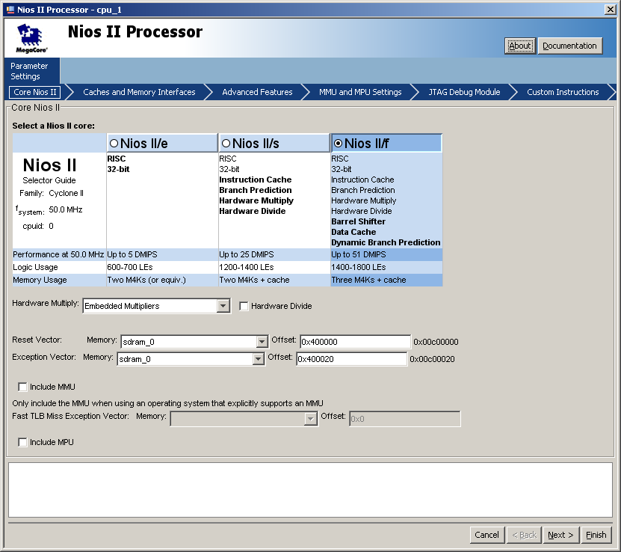
Adding Processors
The reset vector acts as an offset to all the address spans allocated by the linker
Default:
  reset vector: 0x0
  exception vector: 0x20
Add 4 MB separation between processors:
  4 x 1024 x 1024₁₀ = 400000₁₆
for cpu1->
reset vector 0x400000
exception vector 0x400020

Slide 7
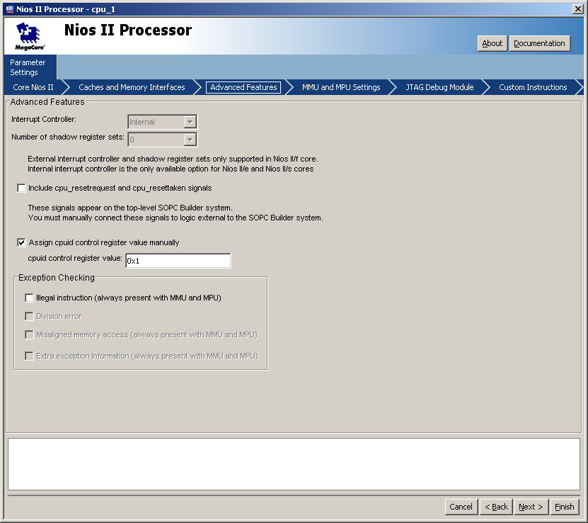
Each processor must be able to self-identify to behave accordingly
CPUID register provides this functionality:
cpuid=__builtin_rdctl(5);
for cpu1, cpuid=1

Slide 8
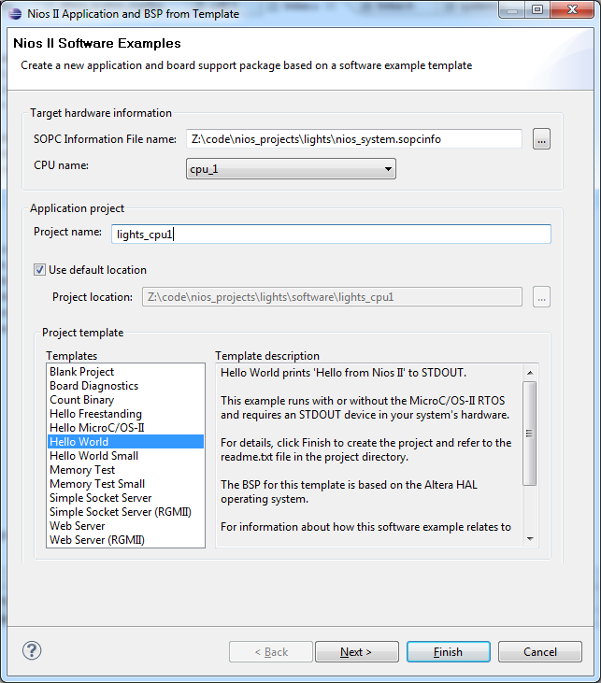
Adding Processors
In Eclipse, you need a project and a BSP for EACH processor
Each processor must be launched separately
Both processors should have the same code
  Use symbolic link to link the hello_world.c file:
  cd lights/software/lab4_cpu1
  rm hello_world.c
  ln –s ../lab4_cpu0/hello_world.c hello_world.c

Slide 9
Processor Synchronization
Make any processor reaching the barrier wait until all processors reach that point
  Useful when parallelized computations occur in “stages”
time
processor 0
processor 1
barrier
(hold)
barrier

Slide 10
Dividing up the Work
How do you divide the work amongst multiple independent CPUs?
In the context of lab 3...
CPU 0
CPU 1
read image from Flash
read image from Flash
Data-level parallelism:
barrier
Apply transformation to even rows and send output pixels to SRAM
for (i=cupid;i<rows;i+=2)
Apply transformation to odd rows and send output pixels to SRAM
for (i=cupid;i<rows;i+=2)
barrier

Slide 11
Implementing Barriers
Use a “mailbox”, a hardware FIFO queue where processors can atomically read and write 32-bit messages
Key concept: reading from an empty mailbox will cause a block until it becomes non-empty
  Create N mailboxes, associate each processor with a mailbox
Algorithm, assuming N processors:
  When processor A reaches a barrier, send one message each into all other mailboxes, except mailbox A
  Try to read N-1 messages from mailbox A

Slide 12
System Design
new components
JTAG UART1
CPU 1
JTAG UART0
CPU 0
Avalon bus
Avalon-MM tristate bridge
Onchip mem 0
mailbox 0
SDRAM interface
SRAM interface
Video DMA
KEYS
Onchip mem 1
mailbox 1
CFI Flash Interface
Remove timer_0
Set the data cache size of both to be no larger than 4KB

Slide 13
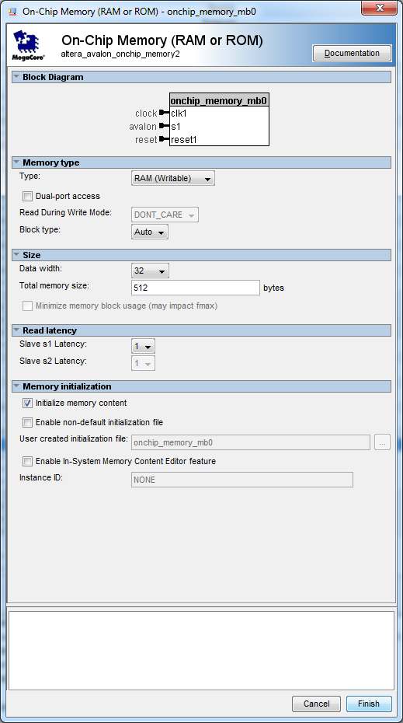
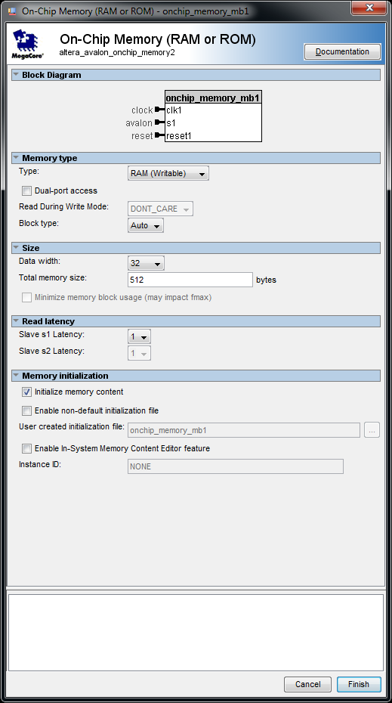
Mailboxes
Mailboxes use small on-chip memory to allow processors to communicate
Add onchip RAM memory, 32 bits wide, 512 entries deep

Slide 14
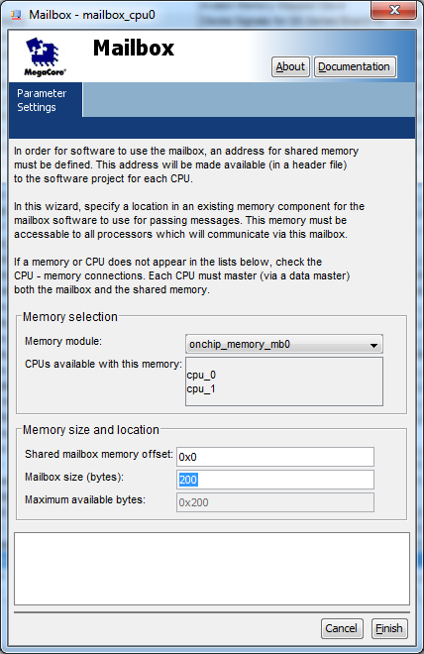
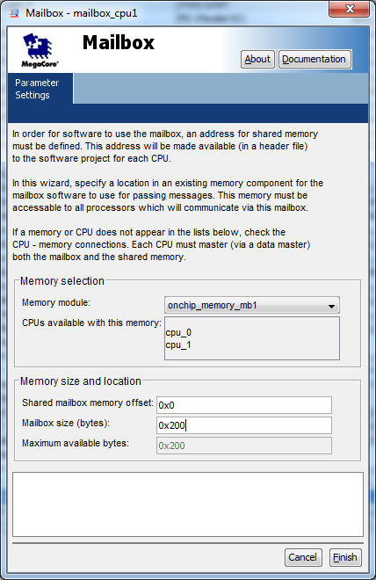
Mailboxes
Add a mailbox for each processor, connected to this on-chip memory

Slide 15
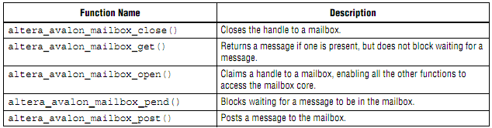
Mailboxes
Software interface:

Slide 16
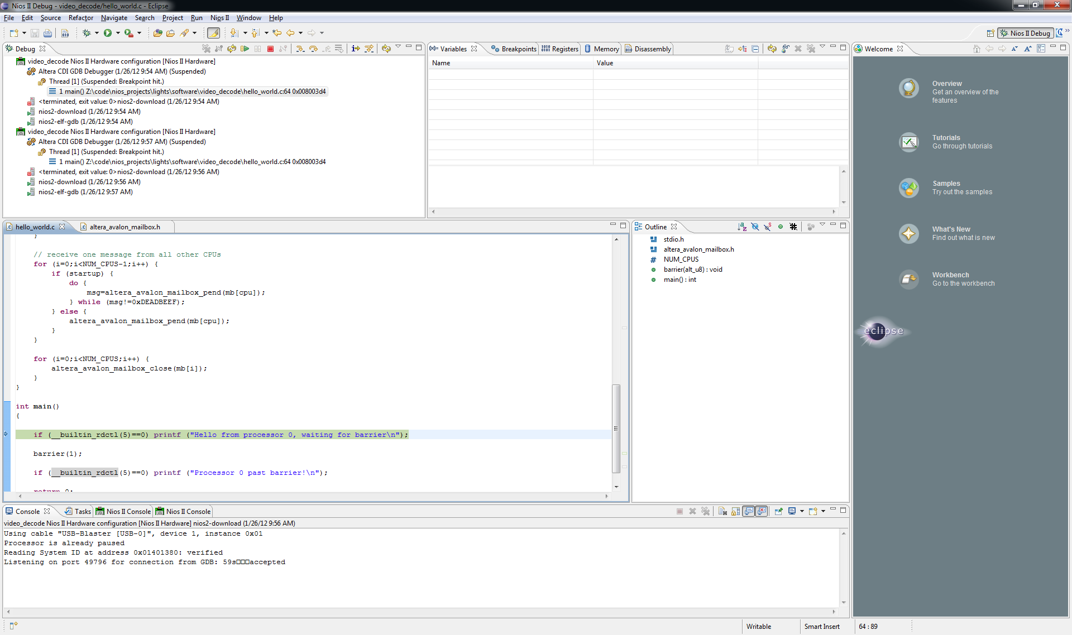
Debugging
Can debug both processors simultaneously
  Change in Run Configurations, then debug

Slide 17
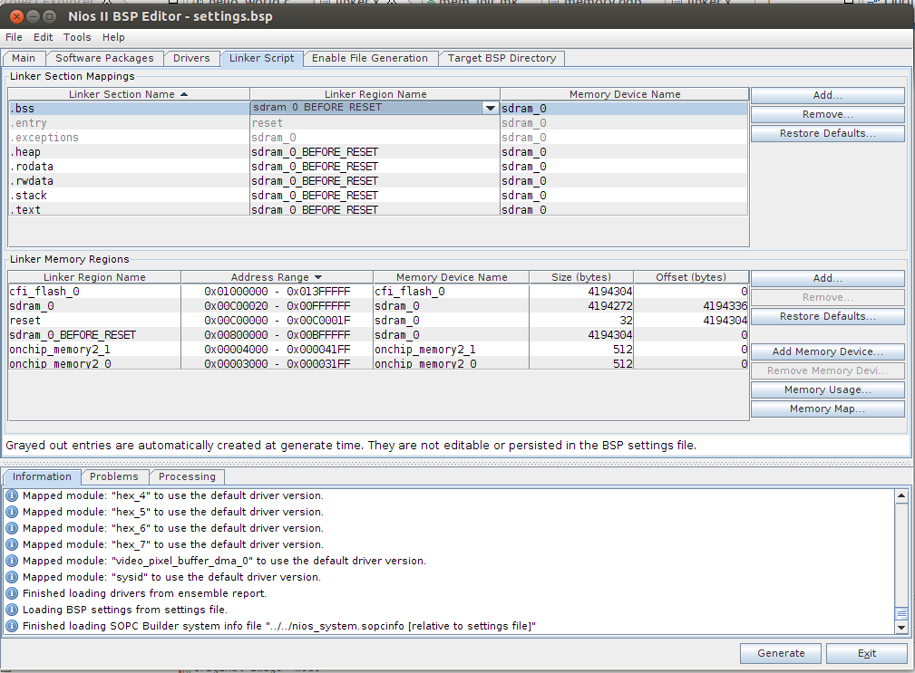
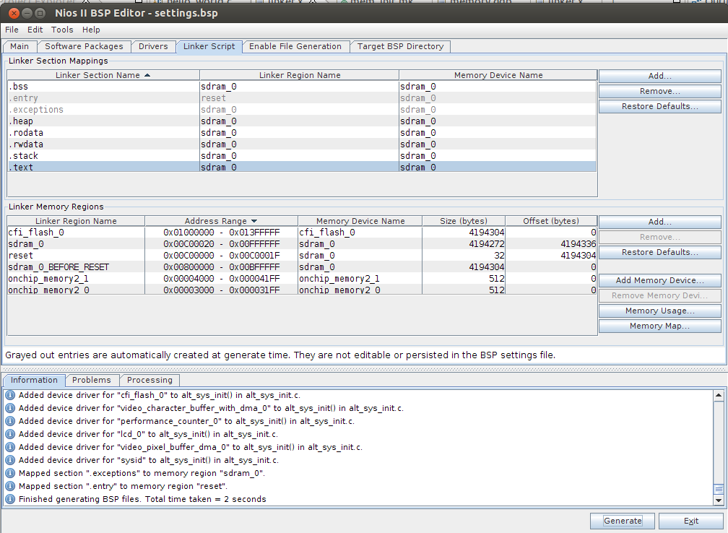
Important Note

