Slide 1
CSCE 313: Embedded Systems
Performance Analysis and Tuning
Instructor: Jason D. Bakos

Slide 2
Performance Considerations
time per frame = (number of pixels) * (time per pixel)
time per pixel = (cycles per pixel) * (clock period)
cycles per pixel = (instructions per pixel) * (cycles per instruction)
instructions per pixel = (ops per pixel) * (instructions per op)
(constant)
(variable)
(variable)
(constant)
(variable)
programmer,
compiler
(variable)
data and control hazards
(constant)
(variable)

Slide 3
Easy Performance Tweaks
Nios2 has no hardware floating point instructions
  Compiler replaces float multiplies with function call to __muldf3
  Compiler replaces int-to-float typecast to __floatsisf
Add floating point “custom instructions”
  Works for float only (not double)
  Floating point instructions will then appear using the “custom” instruction
Make sure you don’t have any doubles
  cos() should be cosf(), floor() should be floorf(), 1.0 should 1.0f

Slide 4
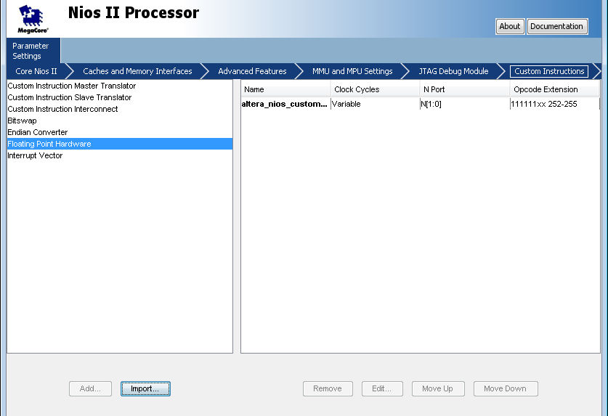

Slide 5
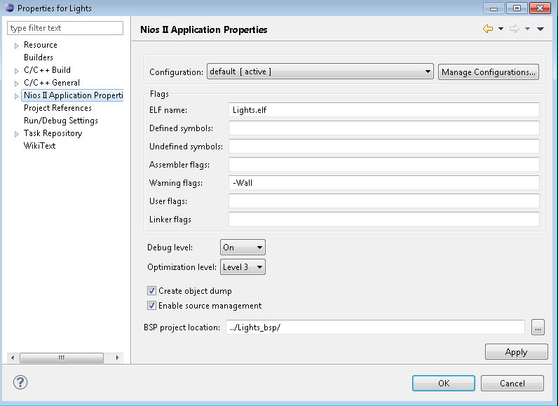
Easy Performance Tweaks
Turn on compiler optimization
  Right-click Eclipse project, Properties, Nios II Application Properties (turn off for debugging)

Slide 6
Counting Cycles
Performance counters: hardware counters that increment under certain conditions
  Allow cycle-level precision
Allows for high resolution hardware instrumentation:
  Events, i.e. cache misses, instruction commits, exceptions
  Timing, use counter to count cycles to execute a segment of code
In Lab 3, we will use them to time sections of code
  counter = <current counter state>
  <code to time>
  cycles elapsed = <current counter state> - counter

Slide 7
Performance Counters in NIOS SOPC
To use, add in SOPC Builder:
  Performance Counter Unit
  Name: “performance_counter_0”
  Number of simultaneous counters = 1
  Make sure you put it on sys_clk and (automatically) assign base addresses

Slide 8
Performance Counters in NIOS SOPC
To use:
  include file:
  #include <altera_avalon_performance_counter.h>
  Reset counters:
  PERF_RESET(PERFORMANCE_COUNTER_0_BASE);
  Start measuring:
  PERF_START_MEASURING(PERFORMANCE_COUNTER_0_BASE);
  Read counter:
  time=perf_get_total_time ((void*)PERFORMANCE_COUNTER_0_BASE);
  PERF_START_MEASURING(PERFORMANCE_COUNTER_0_BASE); // restart counter

Slide 9
Instruction Counting
No way to measure dynamic instruction count
Solution: find static instruction count for innermost loop
  Only the transformation and interpolation code
  No loops
Consider only the most common execution paths
  if-statements for pixel bounds (assume in bounds)
  function calls (include instructions in all function calls, including builtins like __fixsfsi but don’t include alt_up_pixel_buffer_dma_draw())
Open <project>.objdump, search for a unique substring from your code

Slide 10
Object Dump
for(i = 0; i<240; i++) {
for(j = 0; j<320; j++) {
row = (j-120)*cosf(counter) - (i-160)*sinf(counter) + 120;
col = (j-120)*sinf(counter) + (i-160)*cosf(counter) + 160;
alt_up_pixel_buffer_dma_draw(my_pixel_buffer,
(my_image[(row*320)*3+col*3+2]) +
(my_image[(row*320*3+col*3+1)] <<8) +
(my_image[(row*320*3+col*3+0)] <<16),j,i);
}
}
for(i = 0; i<240; i++) {
for(j = 0; j<320; j++) {
row = (j-120)*cosf(counter) - (i-160)*sinf(counter) + 120;
800055c:913fe204 addi r4,r18,-120
8000560:80025880 call 8002588 <__floatsisf>
8000564:1023883a mov r17,r2
col = (j-120)*sinf(counter) + (i-160)*cosf(counter) + 160;
alt_up_pixel_buffer_dma_draw(my_pixel_buffer, (my_image[(row*320)*3+col*3+2]) +
8000568:d8800117 ldw r2,4(sp)
800056c:8889ff32 custom 252,r4,r17,r2
8000570:2589ffb2 custom 254,r4,r4,r22
8000574:0090bc34 movhi r2,17136
8000578:2089ff72 custom 253,r4,r4,r2
800057c:80026200 call 8002620 <__fixsfsi>
8000580:d8c00017 ldw r3,0(sp)

Slide 11

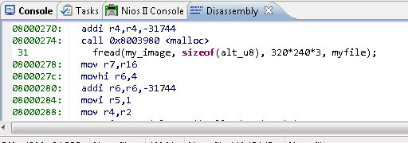
Instruction-Level Debugging
Alternatively you can use instruction stepping in the debugger
  Open your project in the debugger
  Set breakpoint on your pixel code
  Make sure the first iteration doesn’t perform unusual behavior (e.g. transform to an out-of-bounds location)
  Switch to instruction stepping
  Use step into (F6) to walk through your code (until call to alt_up_pixel_buffer_dma_draw(my_pixel_buffer())
  Copy instruction sequence from disassembly view

Slide 12
Data Types
Colors are only 8 bits
Likewise, weights require 8 bits of precision
  Weight value of 2⁻⁸ corresponds to one increment
Row and col require 10-bit range
  +/- 2⁹ = [-512,511] will encompas column value for 320x240
Floating point is overkill for this application
Use 18-bit fixed point

Slide 13
Fixed-Point
Need a way to represent fractional numbers in binary
(N,M) Fixed-point representation
  Assume a decimal point at some location in a value:
  Example (6,4)-fixed format:
    6-bit (unsigned) value
    = 1x2¹ + 0x2⁰ + 1x2⁻¹ + 1x2⁻² + 0x2⁻³ + 1x2⁻⁴
    Range = [0, 2^{N-M} – 2^{-M}] = [0, 4 – 2⁻⁴] = [0,3.9375]
    For signed, use two’s complement
      Range = [-2^{N-M-1}, 2^{N-M-1} – 2-^{M}]
1 | 0. | 1 | 1 | 0 | 1

Slide 14
Range and Accuracy Requirements
For image transformation:
  Need sufficient bits on LHS to accommodate pixel locations
  Need sufficient bits on RHS to accommodate pixel depth

Slide 15
Lab 3 Fixed-Point
C doesn’t offer a dedicated fixed-point type
We don’t have fixed-point sin and cos, so use floating-point for this, but convert to (32,9) fixed point by:
  Multiply result by 512.0
  Typecast to int
Multiply:
  cos/sin, which is (32,9) fixed-point value with
  row/col, which is a (32,0) fixed-point number,
  gives a (32,9) value, so keep this in mind!
Adding two (32,9) values gives a (32,9) value

Slide 16
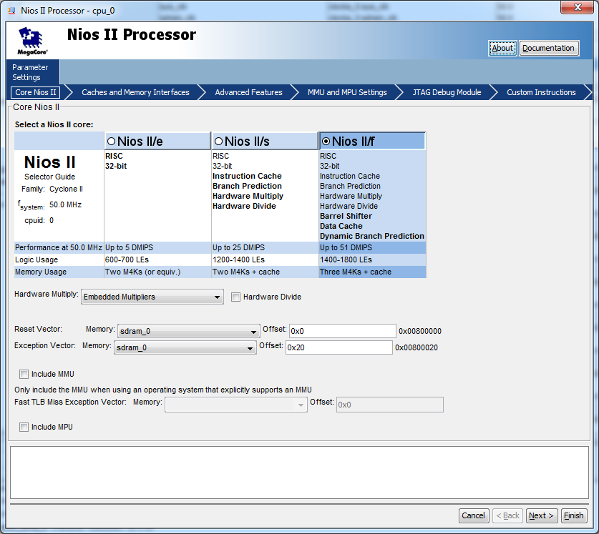
Lab 3
Split into two parts:
  Change CPU to NIOS II/f
  Enable hardware multiply

Slide 17
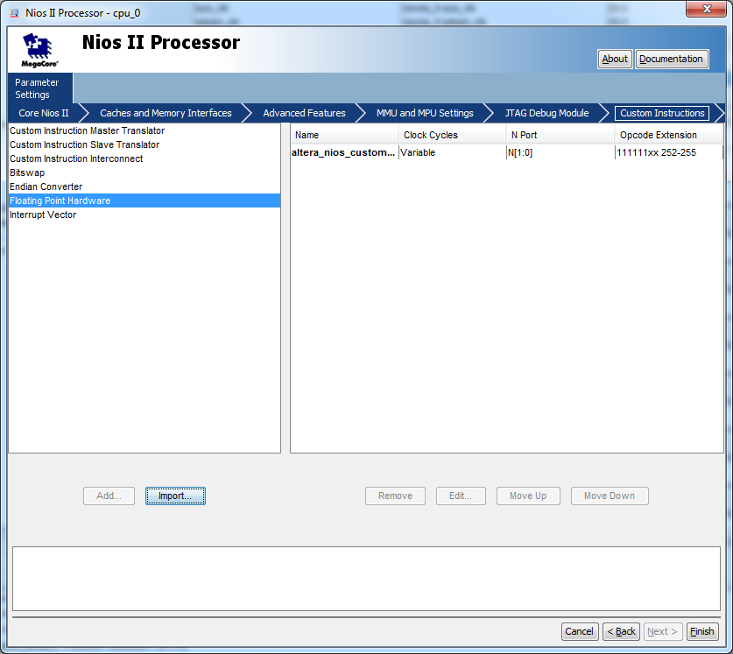
Lab 3
Enable hardware floating point

Slide 18
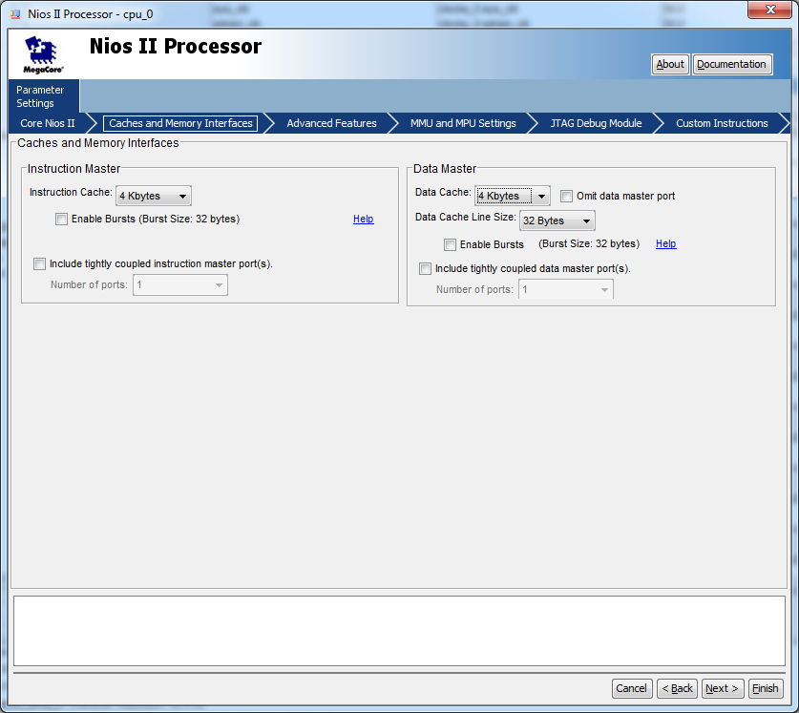
Lab 3
Use performance counters to find average time, in cycles, to transform each individual pixel when using different cache sizes:
  4K instruction cache, 4K data cache
  4K instruction cache, 16K data cache

Slide 19
Lab 3
  For rotation only
  For floating- and fixed-point, calculate:
    Instructions per pixel
  And, for data cache sizes of 4KB and 16KB:
    Cycles per pixel
    Cycles per instruction (CPI)
  Calculate speedup of fixed relative to floating for each cache
  Calculate speedup of 16KB cache over 4KB cache for each datatype

