Slide 1
CSCE 313: Embedded Systems
Video Out and Image Transformation
Instructor: Jason D. Bakos

Slide 2
Annoucements
Demo your Lab 1 to instructor/TA on Monday
Save your Lab 1 in a separate directory
  Ex. cp –a ~/lights ~/lights_lab1
Create new Eclipse project

Slide 3
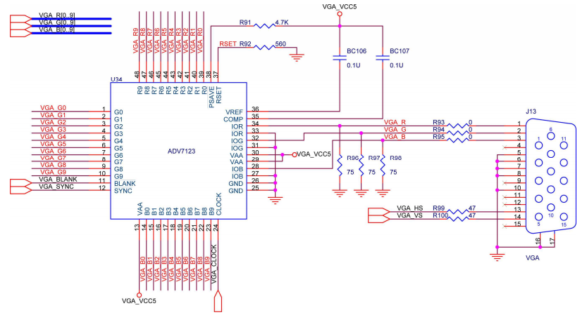
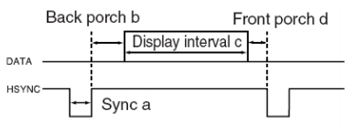

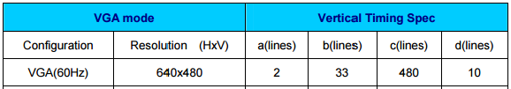
Video on DE2 Board
VGA is a simple video standard from the late 1980’s
  Uses a 15-pin connector, but only 5 pins are needed:
  3 analog pins: red, green, blue using amplitude modulation
  2 digital pins: horizontal sync, vertical sync
DE2-115 has an off-chip video chip
  Mostly just an digital-to-analog converter connected to VGA output
  VGA contains analog reg, green, blue intensity and digital synthronization signals

Slide 4
Video on DE2 Board
VGA controller (in SOPC Builder) sends timed values to the DAC
  Natively set to 640x480 resolution but this can be changed in the Verilog
Images are transmitted to the DAC as “row-major” (line-by-line) array of pixels
  Each pixel has three components: red, green, blue
  All 0’s is black, all 1’s is white
  Each pixel is 10 x 3 bits for DE2, 8 x 3 bits for DE2-115
8 bits
8 bits
8 bits
RED INTENSITY
GREEN INTENSITY
BLUE INTENSITY

Slide 5
Video on DE2 Board
Need to establish a “frame buffer” in memory to hold a picture to display that the CPU can manipulate
  Use the on-board SRAM as our frame buffer (“pixel memory”)
  A 640x480x24 image requires ~1 MB to store
  Initially, scale down the image to 320 x 240 x 24 bits = 225 KB
The Altera University Program contains cores to perform color-space and resolution re-sampling (scaling/conversion) in hardware
SOPC Builder:
  First task: edit your clocks component to add vga_clock to your design

Slide 6
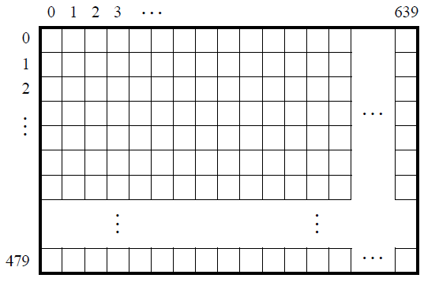
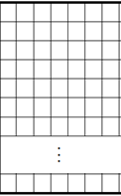

Video on DE2 Board
Frame layout:
  Consecutive addressing, each row stored consecutively
  X-Y addressing, pad each row to make it a power of 2
(not used)
640
1023
pixel x,y has offset (y*row_siz + x) in pixels from base address
pixel x,y has offset (y<<10 | x) in pixels from base address
wastes 184 KB

Slide 7
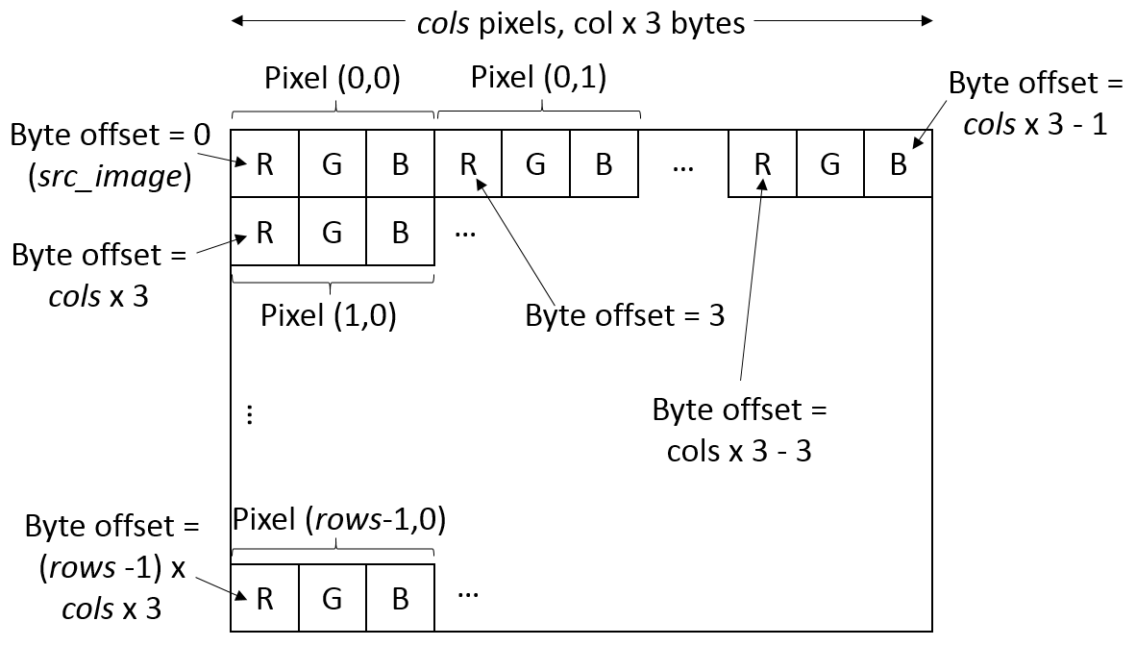
Image Representation

Slide 8
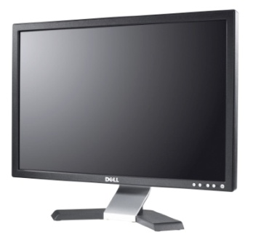
System Design for Video (DE2/DE2-115)
CPU
  Specify the base address of the SRAM as front and back buffer addresses
simple mode
Video alpha blender
sys_clk
dual-clock FIFO
sys->vga
data master
Enable transparency
stream
30 bit
color
640x480
vga_clk
data/control
Video character buffer with DMA
foreground
consecutive mode
background
data
control
SRAM interface
Pixel Buffer for DMA
RGB Resampler
24 -> 30
Video scaler
(x2,x2)
VGA controller
data
stream
24 bit
color
320x240
sys_clk
stream
30 bit
color
320x240
sys_clk
stream
30 bit
color
640x480
sys_clk
  Setting:
  DE2/DE2-115
10 bits/channel
3 channels
on-chip
(From Univ. Program)
on-chip
off-chip
off-chip
SRAM chip
VGA DAC
320x240x24 image
DE-115
D-sub

Slide 9
Verilog Modifications
Add to your top-level module definition:
//////////////////////// SRAM Interface ////////////////////////
inout [15:0] SRAM_DQ, // SRAM Data bus 16 Bits
output [19:0] SRAM_ADDR, // SRAM Address bus 20 Bits
output SRAM_UB_N, // SRAM High-byte Data Mask
output SRAM_LB_N, // SRAM Low-byte Data Mask
output SRAM_WE_N, // SRAM Write Enable
output SRAM_CE_N, // SRAM Chip Enable
output SRAM_OE_N, // SRAM Output Enable
//////////////////////// VGA ////////////////////////////
output VGA_CLK, // VGA Clock
output VGA_HS, // VGA H_SYNC
output VGA_VS, // VGA V_SYNC
output VGA_BLANK_N, // VGA BLANK
output VGA_SYNC_N, // VGA SYNC
output [7:0] VGA_R, // VGA Red
output [7:0] VGA_G, // VGA Green
output [7:0] VGA_B, // VGA Blue

Slide 10
Verilog Modifications
Add to module instantiation for nios_system:
.SRAM_ADDR_from_the_sram_0 (SRAM_ADDR),
.SRAM_CE_N_from_the_sram_0 (SRAM_CE_N),
.SRAM_DQ_to_and_from_the_sram_0 (SRAM_DQ),
.SRAM_LB_N_from_the_sram_0 (SRAM_LB_N),
.SRAM_OE_N_from_the_sram_0 (SRAM_OE_N),
.SRAM_UB_N_from_the_sram_0 (SRAM_UB_N),
.SRAM_WE_N_from_the_sram_0 (SRAM_WE_N),
.VGA_BLANK_from_the_video_vga_controller_0 (VGA_BLANK_N),
.VGA_B_from_the_video_vga_controller_0 (VGA_B),
.VGA_CLK_from_the_video_vga_controller_0 (VGA_CLK),
.VGA_G_from_the_video_vga_controller_0 (VGA_G),
.VGA_HS_from_the_video_vga_controller_0 (VGA_HS),
.VGA_R_from_the_video_vga_controller_0 (VGA_R),
.VGA_SYNC_from_the_video_vga_controller_0 (VGA_SYNC_N),
.VGA_VS_from_the_video_vga_controller_0 (VGA_VS),

Slide 11
Storing and Accessing an Image on the DE2
Altera has designed a read-only flash-based file system that we can use to store data files
Instead of a traditional file system (i.e. NTFS, FAT32, ext3, reiserfs), Altera uses the internal structure of an uncompressed ZIP file to store one or more files
To use it, you need to add an interface for the 8 MB CFI Flash memory to your system design, along with an Avalon tri-state bridge so the flash can be initialized externally
CPU
data master
slave
addr=23 bits
data=8 bits
setup 0 ns,
wait 100 ns,
hold 0 ns
registered
Avalon-MM tristate bridge
master
CFI Flash Interface

Slide 12
Verilog Modifications
Add to your top-level module declaration:
//////////////////////// Flash Interface ////////////////////////
inout [7:0] FL_DQ, // FLASH Data bus 8 Bits
output [22:0] FL_ADDR, // FLASH Address bus 22 Bits
output FL_WE_N, // FLASH Write Enable
output FL_RST_N, // FLASH Reset
output FL_OE_N, // FLASH Output Enable
output FL_CE_N, // FLASH Chip Enable
output FL_WP_N, // for DE2-115 only
Add somewhere in the top-level module:
assign FL_RST_N = 1'b1;
assign FL_WP_N = 1'b1;
Add to module instantiation for nios_system:
.address_to_the_cfi_flash_0 (FL_ADDR),
.data_to_and_from_the_cfi_flash_0 (FL_DQ),
.read_n_to_the_cfi_flash_0 (FL_OE_N),
.select_n_to_the_cfi_flash_0 (FL_CE_N),
.write_n_to_the_cfi_flash_0 (FL_WE_N),

Slide 13
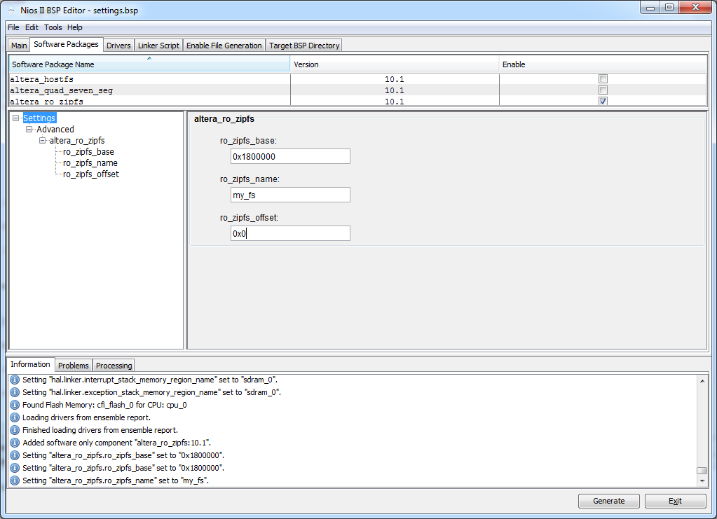
BSP Modifications
In the BSP Editor, make the following changes:
this must match base address in SOPC builder
identifier
make this 0 to use all of Flash memory

Slide 14
Copying Image to RO File System
To load an image into the DE2, I have written a MATLAB script that can:
  read image file with size 320x240 or smaller
  add a black border around the image if smaller than 320x240
  write the image in 24-bit color into a RAW image file
  displays the original and bordered images
To use it:
  download it from the course webpage
  open MATLAB (command: “octave”)
  change current folder to where you downloaded it
  type: convert_image_to_data_file(‘<filename>');
    You may use my image, lumcat.jpg or use your own
  this will generate myfile.dat and myfile.zip

Slide 15
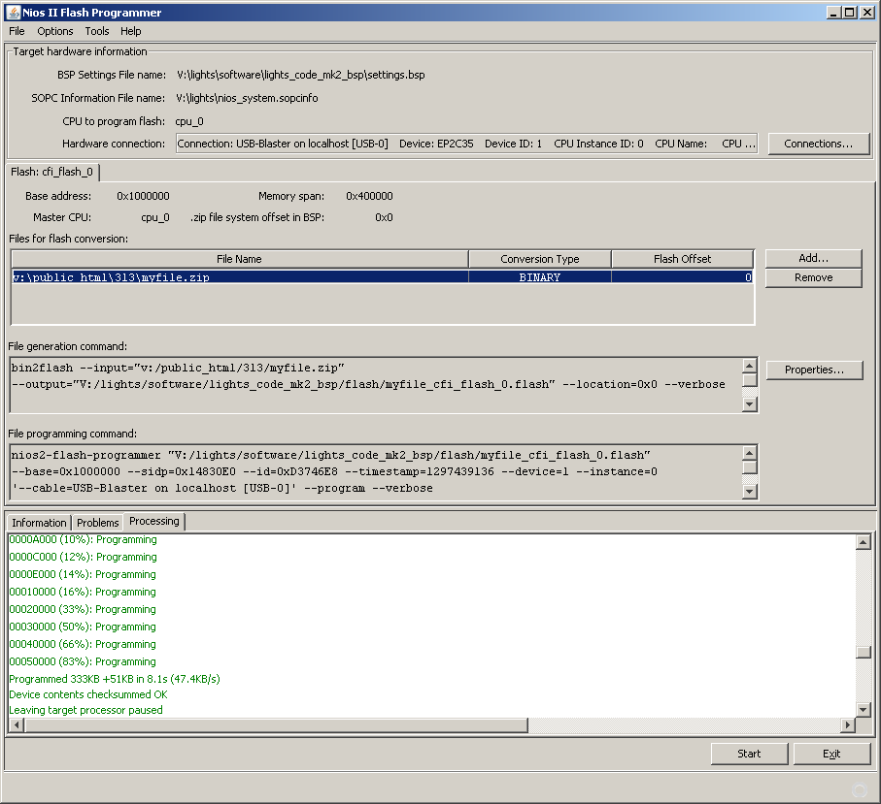
Programming the Flash Memory
To program Flash memory, prior to running your program, in Eclipse, go to Nios II | Flash Programmer
Then, do File | New
  Get settings from BSP settings file
  Browse for your BSP settings file
    Under <project name>/software/<eclipse project>_bsp
  Add myfile.zip and click Start
Make sure this matches BSP

Slide 16
Pointers
In Java, all object “handles” are pointers (references)
In C/C++, object handles can be either actual or pointers:
  int a; (integer)
  int *b; (pointer to an integer)
  b = &a (address of a)
  *b = 2; (assign contents of b)
Arrays are pointers:
  int a[100];
  a[0] = 2; ⬄ *(a) = 2;
  a[5] = 5; ⬄ *(a+5) = 5;
2-dimensional arrays can be “superimposed” over one dimensional:
  a[i * (2nd dimension size) + j]
3-dimensional arrays can be “superimposed” over one dimensional:
  a[i * (2nd dimension size) * (3nd dimension size) + j * (3nd dimension size) + k]

Slide 17
Typecasting
In lab 2, you will need to make use of floats and convert to integers
Examples:
  float a;
  alt_u16 b;
  a = sin(2.5);
  b = (alt_u16)roundf(a);

Slide 18
Allocating Heap (Dynamic) Memory in C
Use the malloc() system call
malloc() returns a void pointer, so you must cast the return value to match the type for which you’re allocating memory
The only parameter is the number of bytes to allocate
For arrays (almost always the case), the number should be a multiple of the size of each element
Example:
  alt_u8 *my_image;
  …
  my_image=(alt_u8 *)malloc(320*240*3);
  …
  free (my_image);

Slide 19
Accessing the RO File System from SW
Declare C-style file pointer:
FILE *myfile;
Open the file:
myfile=fopen(“my_fs/myfile.dat","rb");
if (myfile==NULL) perror ("error opening datafile");
Note: path above must match one in BSP!
Allocate memory and read the image data:
my_image=(alt_u8 *)malloc(320*240*3);
fread(my_image,sizeof(alt_u8),320*240*3,myfile);

Slide 20
Accessing the Source Image
We’re using consecutive mode for the pixel memory, so pixels are stored consecutively
Each pixel is 3-byte value
To access pixel at row=100, col=200:
  my_image[100*320*3+200*3+0] (red)
  my_image[100*320*3+200*3+1] (green)
  my_image[100*320*3+200*3+2] (blue)
row 0, 320 pixels
row 1, 320 pixels
row 2, 320 pixels
…
row 239, 320 pixels
low addresses
high addresses
RED
GREEN
BLUE
23
16
15
8
7
0

Slide 21
New Header Files
Add:
#include <altera_up_avalon_video_character_buffer_with_dma.h> // to write characters to video
#include <altera_up_avalon_video_pixel_buffer_dma.h> // to swap front and back buffer
#include <math.h> // for trigonometry functions
#include <stdlib.h> // for file I/O

Slide 22
The Pixel Buffer
To use:
  Declare global variable:
  alt_up_pixel_buffer_dma_dev *my_pixel_buffer;
  Assign it:
  my_pixel_buffer=
  alt_up_pixel_buffer_dma_open_dev("/dev/video_pixel_buffer_dma_0");
  To clear screen:
    alt_up_pixel_buffer_dma_clear_screen(my_pixel_buffer,0);
  To draw pixel:
  alt_up_pixel_buffer_dma_draw(my_pixel_buffer,
  (my_image[(i*320*3+j*3+2)]) +
  (my_image[(i*320*3+j*3+1)]<<8) +
  (my_image[(i*320*3+j*3+0)]<<16),j,i);

Slide 23
Using the Character Buffer
Use:
  alt_up_char_buffer_dev *my_char_buffer;
  …
  my_char_buffer=alt_up_char_buffer_open_dev("/dev/video_character_buffer_with_dma_0");
  if (!my_char_buffer) printf ("error opening character buffer\n");
  alt_up_char_buffer_clear(my_char_buffer);
  alt_up_char_buffer_string(my_char_buffer,"Video works!",0,59);
Allows you to superimpose text on the screen at (col,row)
  80 cols x 60 rows

Slide 24
Image Transformation Matrices
Simple image transformation matrix can be used to…
  rotate, scale, shear, reflect, and orthogonal projection
For Lab 2, we want to perform rotation and scaling
The matrices we use are 2x2 and used to determine how to move each pixel from the original image to the new image in order to perform the transformation
Consider:
  source pixels (row,col) of original image
  destination pixels (row’,col’) of transformed image

Slide 25
Image Transformation Matrices
Clockwise rotation:
Counterclockwise rotation:
Scaling (factor s):

Slide 26
Issues to Resolve
Using these algorithms directly, the rotation and scaling occur about the origin (0,0)

Slide 27
Issues to Resolve
We want it to occur about the center of the image

Slide 28
Issues to Resolve
To fix this:
  subtract 320/2 from the column
  subtract 240/2 from the row
…before you multiply against the transformation matrix, then add these values back after your multiply

Slide 29
Issues to Resolve
Second problem: pixels aliasing to same location, causing unfilled pixels in destination image

Slide 30
Issues to Resolve
To solve this, iterate over all destination image pixels and calculate reverse transform
  Counterclockwise rotation
  Scale factor 1/s

Slide 31
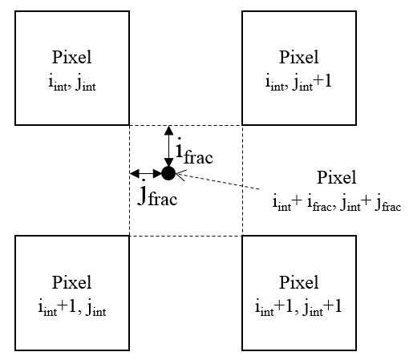

Issues to Resolve
Assume destination pixel (10,20) maps to source pixel (87.4,98.6)
Must interpolate the value of this “virtual” source pixel
$$weight\left(i_{int},j_{int}\right)=(1−i_{frac})∙(1−j_{frac})$$
$$weight\left(i_{int},j_{int}+1\right)=\left(1−i_{frac}\right)∙j_{frac}$$
$$weight\left(i_{int}+1,j_{int}\right)=i_{frac}∙\left(1−j_{frac}\right)$$
$$weight\left(i_{int}+1,j_{int}+1\right)=i_{frac}∙j_{frac}$$

Slide 32
Bilinear Interpolation
Example: Set destination pixels (10,20) as a mixture of pixels:
  (87,98), (88,98), (87,99), (88,99)
  dest[10,20] = (1-.4)(1-.6)src[87,98] + (.4)(1-.6)src[88,98] + (1-.4)(.6)src[87,99] + (.4)(.6)src[88,98]
  Must separate color channels in code

Slide 33
Issues to Resolve
Make sure you…
  use rounding and type casting for the transformation matrix (float and alt_u16)
  disregard output coordinates that fall outside the frame
  always transform against the original image
  initialize the output image to black before transforming

