Slide 1
CSCE 313: Embedded System Design
Introduction
Instructor: Jason D. Bakos

Slide 2

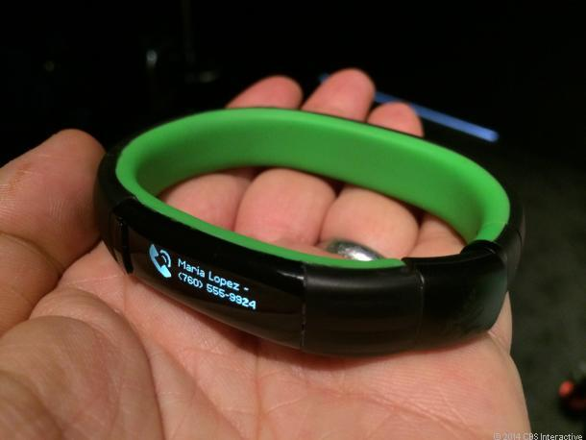
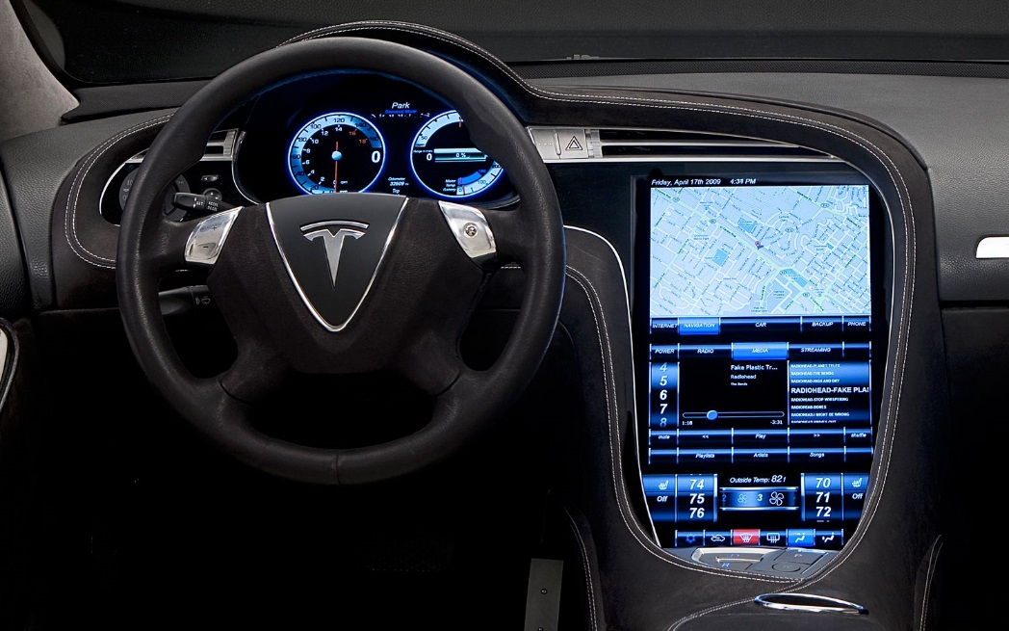

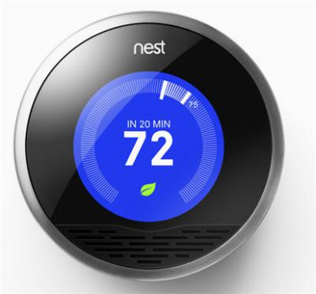
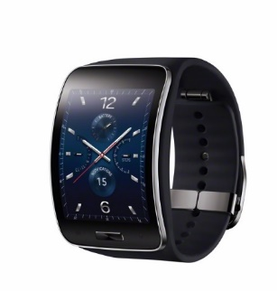
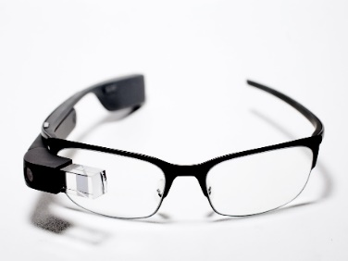
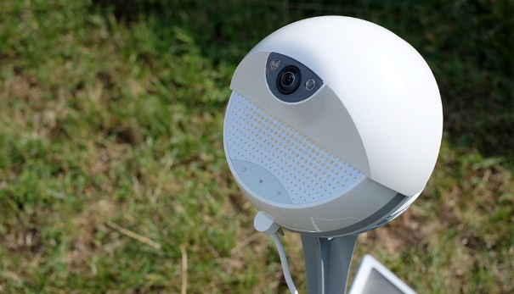
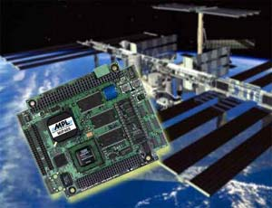
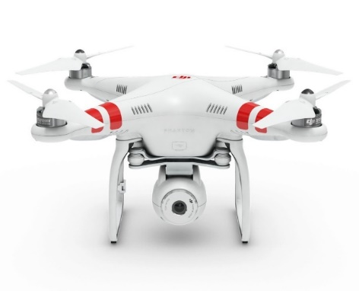
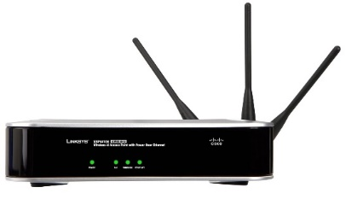
Embedded Systems

Slide 3
Desktop vs. Embedded CPU
General purpose (desktop and server) CPUs have a more complex structure
  Execute up to 4 instructions per cycle
  Instructions executed out-of-order
  Big, complex caches
  All code runs at the same speed, since the processor finds parallelism at runtime
    Exception: single core code will still only use one core, SIMD instructions often require “intrinsics”
Embedded CPUs:
  Generally not reprogrammable except by vendor
  One or two instructions per cycle
  Instructions executed in order, so instructions that depend on previous ones will “hold up the line”
  Small, simple caches
  Performance is dependent on code efficiency
  Sometimes do not run an OS ("bare metal") or limited OS support
  Tightly coupled with peripherials (system-on-chip)

Slide 4
Desktop vs. Embedded CPU
This class vs. 240 and 274:
  Write code in C (vs. Java)
  Write and debug code on a PC that runs on different processor
  Write code that communicates with hardware
This class vs. 274:
  Write code in C (vs. Python)
  Write code that runs on bare metal
  Write code containing features to improve performance
  Code is more performance- and graphics-oriented

Slide 5
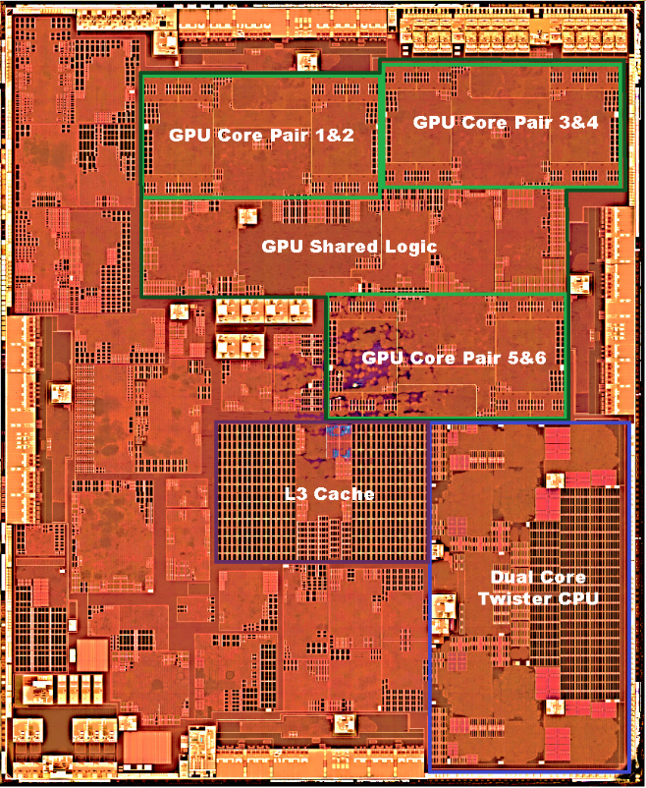
System-on-a-Chip
Most embedded processors contain multiple CPUs and integrated peripherals:
  I/O
  Coprocessors
  Memory
Apple A9

Slide 6
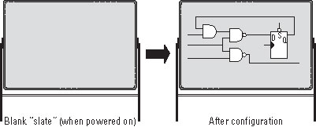
Field Programmable Gate Arrays
Programmable logic device
Contains:
  Ability to implement “soft logic”: programmable logic gates (CLBs) with programmable interconnect
  “Hard cores”: RAMs, multipliers, IOs, PCIe interface, etc.

Slide 7
Field Programmable Gate Arrays
Originally developed for “glue logic”
Now used as system-on a-programmable chip (SoPC)
  Customized “softcore” processor,
  Memory/cache subsystem,
  I/O interfaces,
  Off-chip memory interfaces

Slide 8
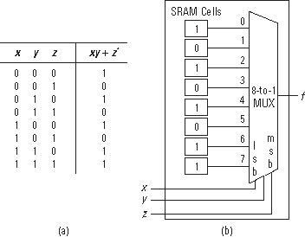
FPGA Lookup Table
Function generator:

Slide 9
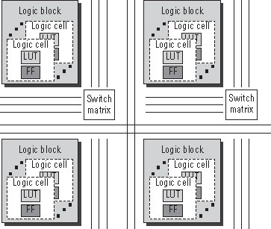
FPGA Fabric
FPGA fabric:

Slide 10
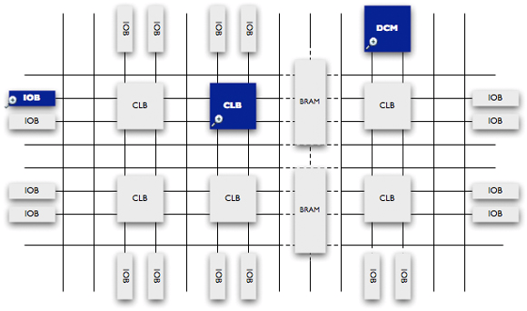
Field Programmable Gate Arrays
On chip resources:
    Logic Elements (LEs)
  LUT
  Register
    Onchip memories (M20Ks)
    Multlipliers
    PLLs

Slide 11
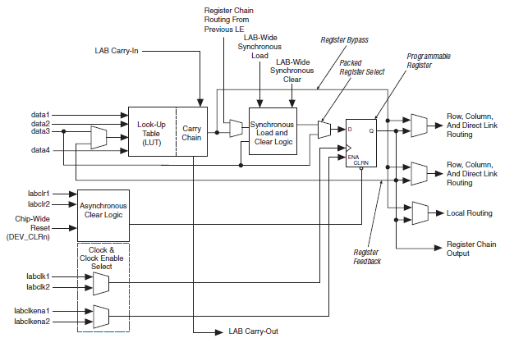
Cyclone 2 Logic Element

Slide 12
Verilog Example
Full adder:
module full_adder (input a,b,ci,output s,co);
assign s = a ^ b ^ ci;
assign cout = (a & b) | (a & ci) | (b & ci);
endmodule
  Synthesize:
  (Compile)
a | b | ci | s | cout
0 | 0 | 0 | 0 | 0
0 | 0 | 1 | 1 | 0
0 | 1 | 0 | 1 | 0
0 | 1 | 1 | 0 | 1
1 | 0 | 0 | 1 | 0
1 | 0 | 1 | 0 | 1
1 | 1 | 0 | 0 | 1
1 | 1 | 1 | 1 | 1

Slide 13
Mapping
Assume our target FPGA has LUT2s
  Can’t map an 3-input function to one LUT2…
a
LUT3
b
s
ci
Encodes information about b, ci
b
LUT2
s0
ci
LUT2
s
a

Slide 14
Mapping
s = a xor b xor c
Equivalent to…
s = (a)(~b)(~c)+ (~a)(b)(~c) + (~a)(~b)(c) + (a)(b)(c)
Transform:
s = (~a)[(b)(~c) + (~b)(c)] + (a)[(~b)(~c) + (b)(c)]
s = (~a)[(b)(~c) + (~b)(c)] + (a)(~[(b+c) (~b+~c)])
s = (~a)[(b)(~c) + (~b)(c)] + (a)(~[(b)(~b)+(b)(~c)+(~b)(c)+(c)(~c)])
s = (~a)[(b)(~c) + (~b)(c)] + (a)(~[(b)(~c)+(~b)(c)])
Set s0 = (b)(~c) + (~b)(c)
s = (~a)(s0) + (a)(~s0)

Slide 15
Verilog Example
a | b | ci | s
0 | 0 | 0 | 0
0 | 0 | 1 | 1
0 | 1 | 0 | 1
0 | 1 | 1 | 0
1 | 0 | 0 | 1
1 | 0 | 1 | 0
1 | 1 | 0 | 0
1 | 1 | 1 | 1
a | b | ci | s0 | s
0 | 0 | 0 | 0 | 0
0 | 0 | 1 | 1 | 1
0 | 1 | 0 | 1 | 1
0 | 1 | 1 | 0 | 0
1 | 0 | 0 | 0 | 1
1 | 0 | 1 | 1 | 0
1 | 1 | 0 | 1 | 0
1 | 1 | 1 | 0 | 1
a | b | ci | s0
X | 0 | 0 | 0
X | 0 | 1 | 1
X | 1 | 0 | 1
X | 1 | 1 | 0
a | b | ci | s0 | s
0 | X | X | 0 | 0
0 | X | X | 1 | 1
1 | X | X | 0 | 1
1 | X | X | 1 | 0

Slide 16
Place and Route
b | ci | s0
0 | 0 | 0
0 | 1 | 1
1 | 0 | 1
1 | 1 | 0
a | s0 | s
0 | 0 | 0
0 | 1 | 1
1 | 0 | 1
1 | 1 | 0

Slide 17
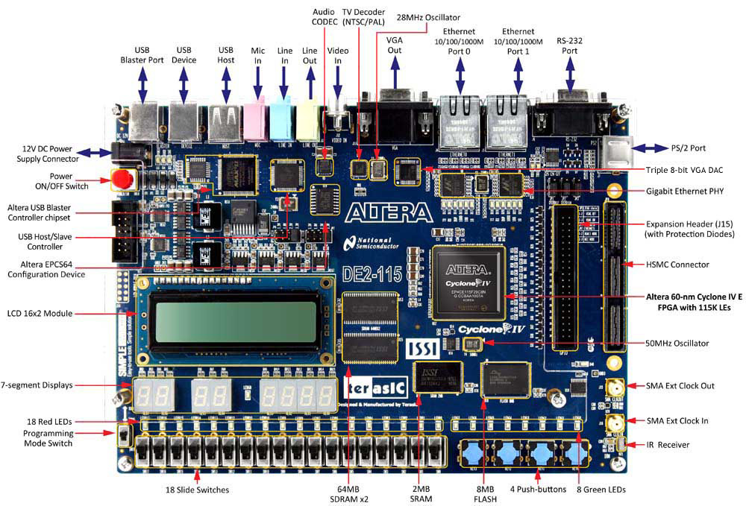
Terasic DE2-115
Altera Cyclone 4 FPGA with 115K gates

Slide 18
System Design
Processors communicate with the outside world using a simple transactional model:
  READ:
    Processor says READ and provides an address
    Operations that depend on this data WAIT until data is returned
  WRITE:
    Processor says WRITE and provides an address and data
These operations correspond to the LOAD and STORE instructions
In this case, we assume that CPU is the master and devices responding to these operations are slaves

Slide 19
Processor Interface
Processor
clock
reset
Instruction interface
InstructionIn
InstructionAddress
InstructionRead
DataIn
DataAddress
DataOut
DataRead
DataWrite
Data interface

Slide 20
Programmed I/O
Loads and stores to specially-mapped address ranges can be used to:
  Read a word from a status register
    Used to poll the state of a peripheral
  Write a word to a control register
    Used to send an “instruction” to a peripheral

Slide 21
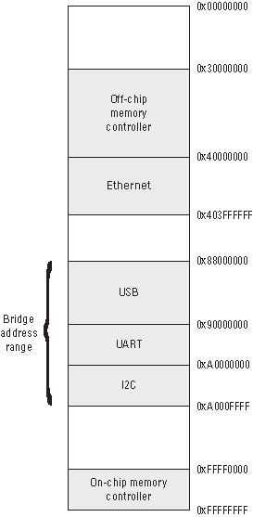
Sample Address Map

Slide 22
Altera Tools
Quartus II
  Starting point for all designs (create and open projects)
  Contains simple editors for HDL design and constraint files
  Has a makefile-like design flow manager for synthesis, map, place and route, bitstream generation, and programming
Platform Designer
  Allows for drag-and-drop creations of platform designs (processors, busses, peripherals)
Command line tools
  Compiler and run code on NIOS2 processor

Slide 23
Platform Designer
Platform Designer allows you to design the portion of your embedded system that is implemented on the FPGA
Using this information, the command-line tools can generate a BSP that corresponds to your system
The BSP includes the interface code for the peripherals that you add in SOPC Builder
  As such, it must be regenerated each time you make a change in your system design

Slide 24
Setup Your Environment
Do this once:
  Open ~/.bashrc
  Add a line:
source /usr/local/3rdparty/cad_setup_files/altera.bash
  Log out, log back in
Launch Quartus:
quartus&

Slide 25
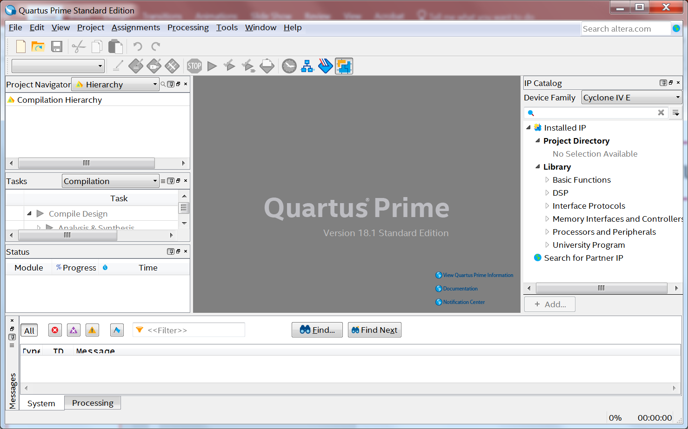
Quartus

Slide 26
Creating a New Project
File | New | New Quartus II Project…
Working directory = /acct/<username>/lights
Project name = “lights”
Top-level design entity = “lights”
“Empty project”
Skip the “Add Files” page
For device, choose
  Family: Cyclone IV E
  Package: FBGA
  Pin count: 780
  Speed grade: 7
  Device: EP4CE115F29C7
Click Finish
Go to Tools | Platform Designer

Slide 27
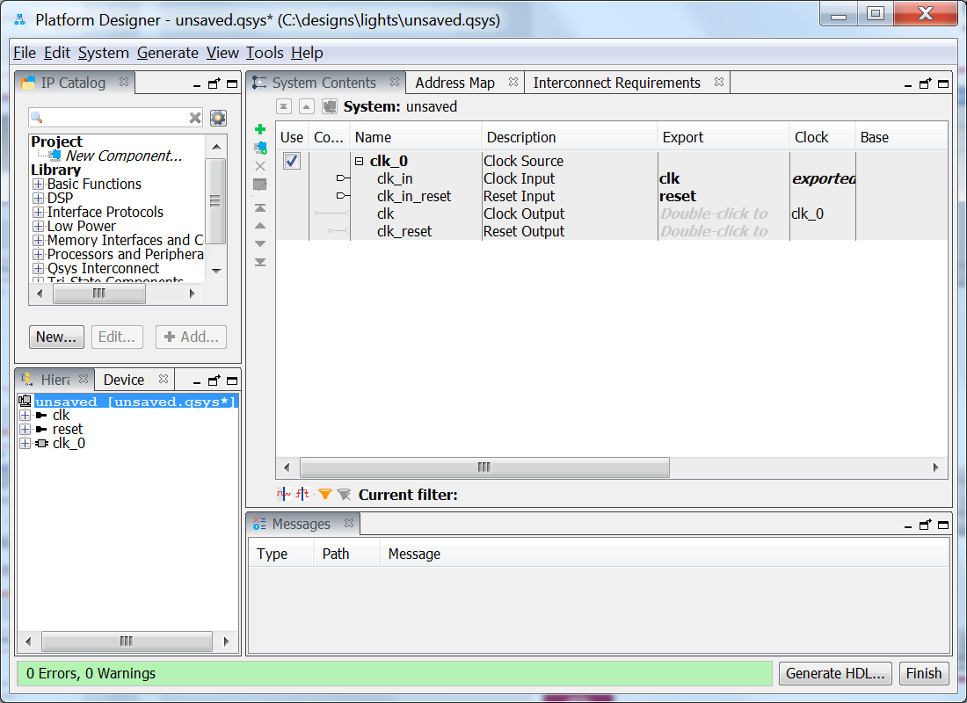
Platform Designer
system configuration pane

Slide 28
Adding Components
Add a processor
  In the component library, search for “nios2”
  Double-click “Nios II Processor”
  Select Nios II/f, then FINISH
Add an interface to the SDRAM
  In the component library, search for “sdram”
  Double-click “SDRAM Controller Intel FPGA IP”
  Presets=
    Bits=32, chip select=1, banks=4, row=13, column=10, then FINISH
Add a clock manager
  In the component library, search for “clocks”
  Double-click “System and SDRAM Clocks for DE-series Boards”
Add another clock source
  In the component library, search for “clock source”
  Double-click “clock source”

Slide 29
Connecting Clock and Reset
Start with the clk_0 component, connect:
  “clock output” to “ref_clk” on sys_sdram_pll_0
  “clk_reset” to “ref_reset” on sys_sdram_pll_0
  “clk_reset” to “reset” on nios2 and sdram_controller
From sys_sdram_pll_0:
  “sys_clk” to “clk” on nios2_gen2_0
  “reset_source” to “reset” to nios2_gen2_0
  “sdram_clock” to “clk” on new_sdram_controllerFrom nios2_gen2_0
  “data_master” and “instruction_master” to “s1” on sdram
From clk_1
  “clk_in” to “sdram_clk” on “sys_sdram_pll_0”
  Double-click the “Export” column for clk
Double-click nios2
  Under “Vectors”
    Reset and Exception vector memory: sdram_controller
System | Assign Base Addresses
File | Save As “nios_system”

Slide 30
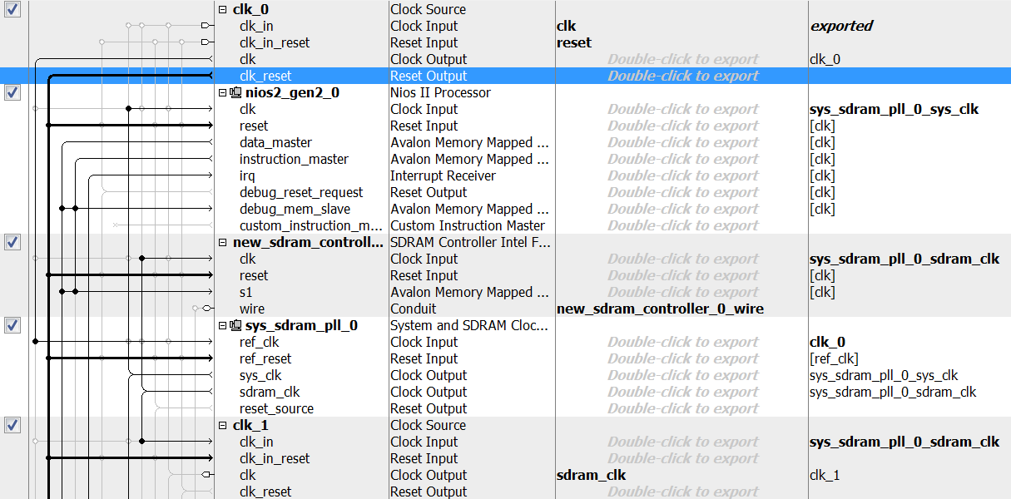
Platform Design

Slide 31
Platform Design
Click “Generate HDL”
  Accept default settings
Go back to Quartus
  Assignments | Import Assignments
    “/usr/local/3rdparty/csce611/CPU_support_files/DE2_115_pin_assignments.qsf”
  Assignments | Settings
    Files | Add | “nios_system.qsys”
  File | New | Synopsys Design Constraint File
    Contents:
      create_clock -name CLOCK_50 -period 20 [get_ports CLOCK_50]
      derive_pll_clocks -create_base_clocks
    Save as SDC1.sdc
  File | New | Verilog HDL File
    Contents:

Slide 32
Top-Level Design
FPGA “lights”
nios_system (“NiosII”)
pins
pins

Slide 33
lights.v
module lights (input CLOCK_50,
input [3:0] KEY,
output [12:0] DRAM_ADDR,
output [1:0] DRAM_BA,
output DRAM_CAS_N,
output DRAM_CKE,
output DRAM_CS_N,
inout [31:0] DRAM_DQ,
output [3:0] DRAM_DQM,
output DRAM_RAS_N,
output DRAM_WE_N,
output DRAM_CLK);
nios_system u0 (
.clk_clk (CLOCK_50), // clk.clk
.reset_reset_n (KEY[0]), // reset.reset_n
.new_sdram_controller_0_wire_addr (DRAM_ADDR), // new_sdram_controller_0_wire.addr
.new_sdram_controller_0_wire_ba (DRAM_BA), // .ba
.new_sdram_controller_0_wire_cas_n (DRAM_CAS_N), // .cas_n
.new_sdram_controller_0_wire_cke (DRAM_CKE), // .cke
.new_sdram_controller_0_wire_cs_n (DRAM_CS_N), // .cs_n
.new_sdram_controller_0_wire_dq (DRAM_DQ), // .dq
.new_sdram_controller_0_wire_dqm (DRAM_DQM), // .dqm
.new_sdram_controller_0_wire_ras_n (DRAM_RAS_N), // .ras_n
.new_sdram_controller_0_wire_we_n (DRAM_WE_N), // .we_n
.sdram_clk_clk (DRAM_CLK)
);
endmodule

Slide 34
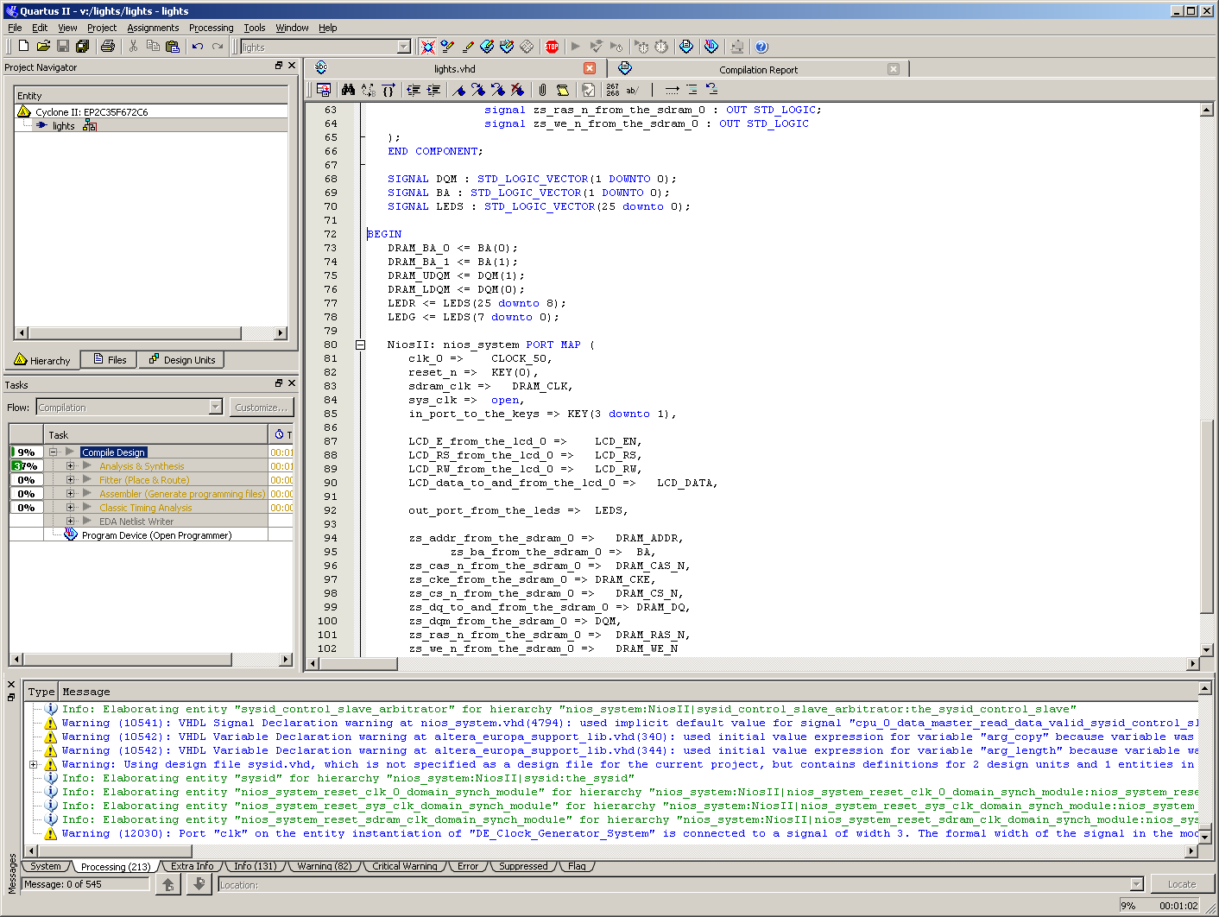
Hardware
Re-compile the design…
Program the FPGA…
  Double-click on Program Device

Slide 35
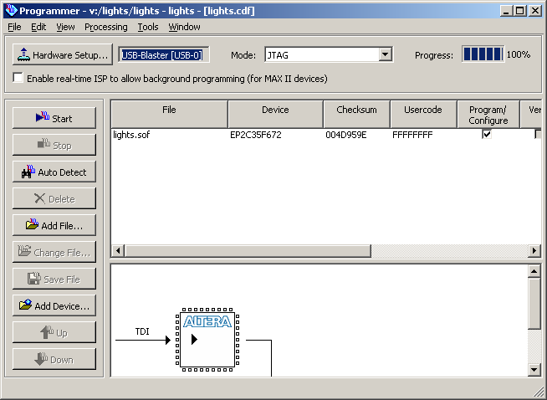
Hardware
Click Start

Slide 36
Building and Running Software
Go back to Quartus and compile your design
Open terminal
  cd lights
  mkdir software
  cd software
  Type:
  nios2-swexample-create --name=lights --sopc-file=../nios_system.sopcinfo --type=hello_world --cpu-name=nios2_gen2_0 --app-dir=lights --bsp-dir=lights_bsp
  cd lights
  ./create-this-app

Slide 37
hello_world.c
Open hello_world.c
  #include <stdio.h>
  int main()
  {
  double new_val = 3.0;
  double val = 0;
  double start = 2.0;
  double temp;
  int i=0,toggle=0;
  while (val != new_val) {
  val = new_val;
  temp = start * (start + 1.0) * (start + 2.0);
  if (!toggle)
  new_val += 4.0 / temp;
  else
  new_val -= 4.0 / temp;
  toggle = !toggle;
  start = start + 2.0;
  i++;
  }
  printf ("value is %0.8f\n",val);
  return 0;
  }

Slide 38
Debugging
make
nios2-gdb-server --tcpport 8888 --tcppersist&
nios2-elf-gdb lights.elf
  target remote localhost:8888
  load
  b hello_world.c:39
  c
  p val (0)
  c
  p val (3)
  c
  p val (3.1667)
  c
  p val (3.1333)
  c
  del
  b 39
  c
  p val (3.1416)
  p i (131072)

Slide 39
Common GDB Commands
p <print expression>
bt (backtrace)
f (frame)
c (continue)
s (step over)
n (step into)
fin (step out)
b (breakpoint)
del (delete breakpoint)

Slide 40
Adding Components
Add a JTAG UART for the console
  use sys_clk and global reset, connect control slave to CPU
  Search “uart”, add “JTAG UART Intel FPGA IP”
  Accept default settings, connect as above
  Also: connect irq to CPU
Add parallel I/O for the LEDs
  Search “pio”, add “PIO (Parallel I/O) Intel FPGA IP”
  Width=26, output ports only, FINISH, rename it as “leds”, then put it on the sys_clk
  Connect as above
  Double-click export column and rename to “leds”
Add parallel I/O for the keys (buttons)
  Same as above, but 3 bits, input only
  Under “Input Options”, turn on “Synchronously capture”, then FINISH
  Rename as “keys” and put it on the sys_clk

Slide 41
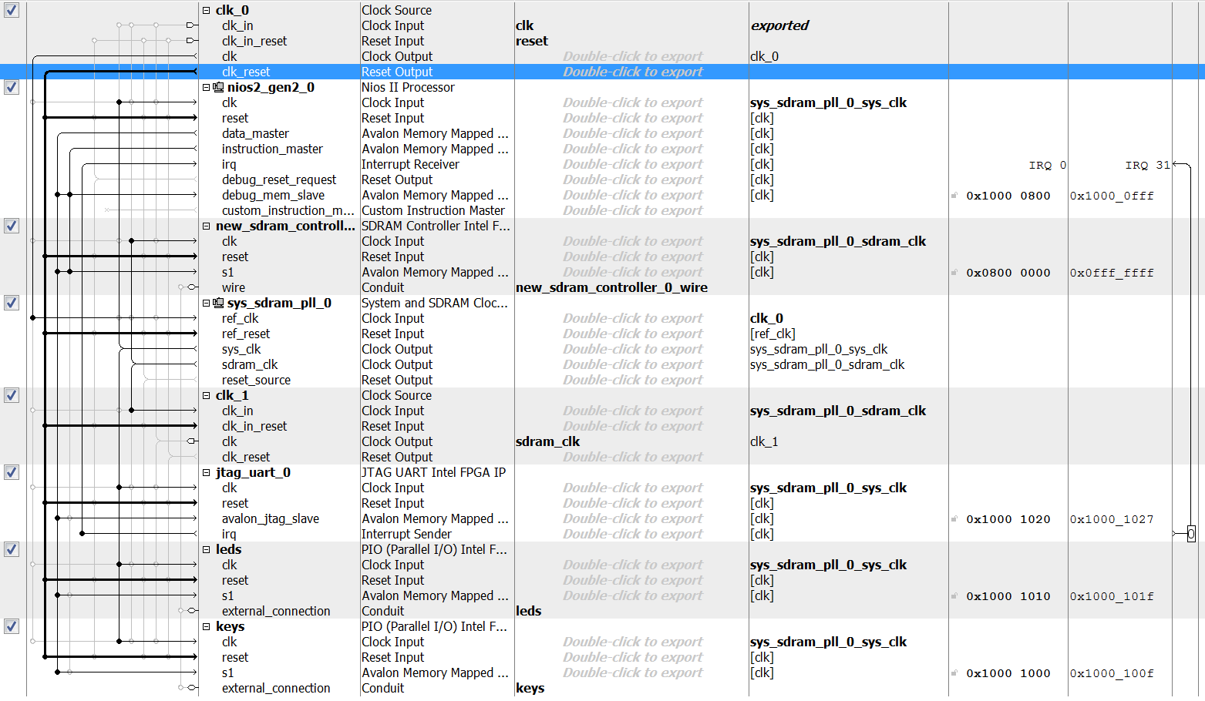
Adding Components

Slide 42
lights.v
module lights (input CLOCK_50,
input [3:0] KEY,
output [12:0] DRAM_ADDR,
output [1:0] DRAM_BA,
output DRAM_CAS_N,
output DRAM_CKE,
output DRAM_CS_N,
inout [31:0] DRAM_DQ,
output [3:0] DRAM_DQM,
output DRAM_RAS_N,
output DRAM_WE_N,
output DRAM_CLK,
output [17:0] LEDR,
output [7:0] LEDG
);
nios_system u0 (
.clk_clk (CLOCK_50), // clk.clk
.reset_reset_n (KEY[0]), // reset.reset_n
.new_sdram_controller_0_wire_addr (DRAM_ADDR), // new_sdram_controller_0_wire.addr
.new_sdram_controller_0_wire_ba (DRAM_BA), // .ba
.new_sdram_controller_0_wire_cas_n (DRAM_CAS_N), // .cas_n
.new_sdram_controller_0_wire_cke (DRAM_CKE), // .cke
.new_sdram_controller_0_wire_cs_n (DRAM_CS_N), // .cs_n
.new_sdram_controller_0_wire_dq (DRAM_DQ), // .dq
.new_sdram_controller_0_wire_dqm (DRAM_DQM), // .dqm
.new_sdram_controller_0_wire_ras_n (DRAM_RAS_N), // .ras_n
.new_sdram_controller_0_wire_we_n (DRAM_WE_N), // .we_n
.sdram_clk_clk (DRAM_CLK),
.keys_export (KEY[3:1]), // keys.export
.leds_export ({LEDR,LEDG}), // leds.export
);
endmodule

Slide 43
lights
Note: if you get the error:
  “XXX (XXX) overlaps XXX (XXX)”
  Select System | Assign Base Addresses
Stop GDB:
  pkill -9 .*gdb.*
Download new SOF:
  nios2-configure-sof ../../output_files/lights.sof
Update bsp:
  cd ../lights_bsp
  nios2-bsp-generate-files --settings="settings.bsp" --bsp-dir=.
  cd lights_bsp
  nios2-bsp-editor

Slide 44
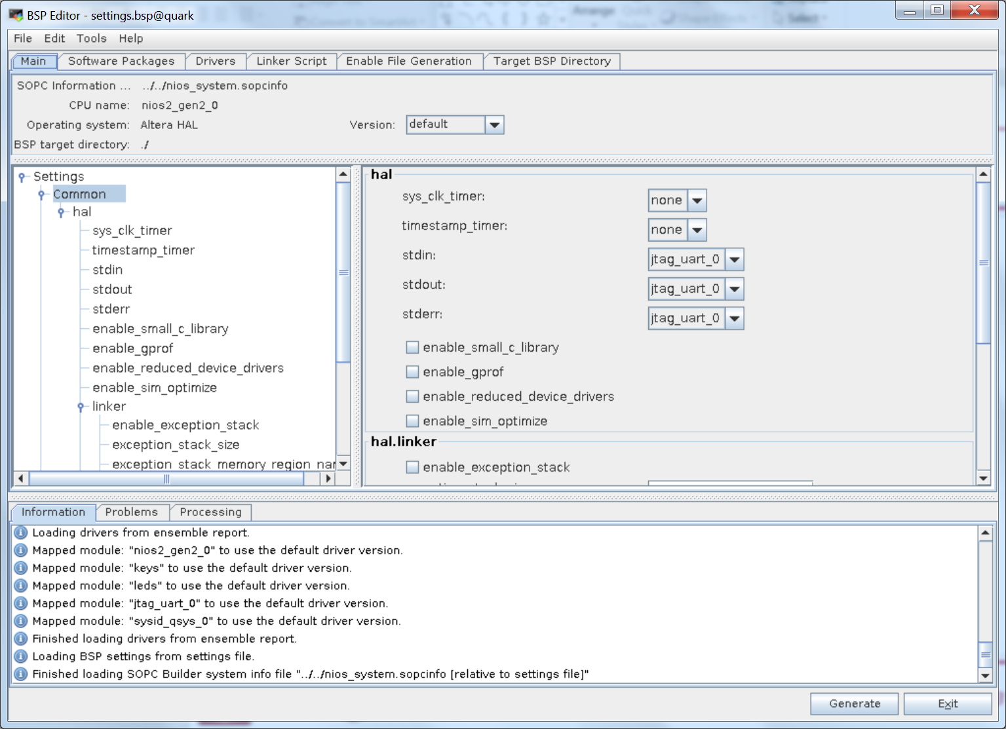
BSP Editor

Slide 45
NIOS Terminal
Open a new terminal
nios2-download -g lights.elf
see results in terminal window!

Slide 46
New hello_world.c
Open hello_world.c
Add header files:
#include <stdio.h>
#include <unistd.h>
#include "system.h"
#include "altera_avalon_pio_regs.h"
#include "alt_types.h"

Slide 47
Software
New main () code:
alt_u32 current_value;
alt_u32 current_state;
alt_u8 current_direction;
alt_u32 keys;
current_state=3;
current_value=1;
current_direction=0;
printf ("Program running (UART)...\n");

Slide 48
Software
while (1) {
// read the current state of the keys
keys=IORD_ALTERA_AVALON_PIO_DATA(KEYS_BASE);
// switch speed if necessary
if ((keys != 7) && (keys != current_state)) {
if (keys == 3) printf ("speed set to 250 ms\n");
else if (keys == 5) printf ("speed set to 150 ms\n");
else if (keys == 6) printf ("speed set to 50 ms\n");
current_state=keys;
}
// switch direction if necessary
if ((current_direction==0) && (current_value==(1 << 25))) current_direction=1;
else if ((current_direction==1) && (current_value==1)) current_direction=0;
// move light
else if (current_direction==0) current_value = current_value << 1;
else current_value = current_value >> 1;
// update lights
IOWR_ALTERA_AVALON_PIO_DATA(LEDS_BASE,current_value);
// wait
if (current_state==3) usleep (250000);
else if (current_state==5) usleep (125000);
else usleep (50000); }

Slide 49
Quartus
Back to Quartus…
Now we need to write a top-level Verilog HDL file for lights
File | New | Verilog HDL File

