Slide 1
Chapter 5
Large and Fast: Exploiting Memory Hierarchy

Slide 2
Grades
Exams 1 and 2
Grade | Exam 2 | Exam 1
Ave | 77.5% | 75.8%
Median | 81.0% | 75.4%
Grade | Exam 2 | Exam 1
90-100 | 14 | 15
80-89 | 10 | 6
70-79 | 7 | 4
60-69 | 4 | 7
< 60 | 8 | 11

Slide 3
“Final” Grades
Grade | Count
A | 12
B+ | 5
B | 3
C+ | 7
C | 3
D+ | 5
D | 2
F | 6
Count | CS | CE | EE
Count | 17 | 7 | 18
Final Score Ave. | 80.1% | 80.1% | 74.9%
Does not include grad/no shows
5 grades > 96%
(11.2%)
Overall ave. =79.2%

Slide 4
Principle of Locality
Programs access a small proportion of their address space at any time
Temporal locality
  Items accessed recently are likely to be accessed again soon
  e.g., instructions in a loop, induction variables
Spatial locality
  Items near those accessed recently are likely to be accessed soon
  E.g., sequential instruction access, array data

Slide 5
Taking Advantage of Locality
Memory hierarchy
Store everything on disk
Copy recently accessed (and nearby) items from disk to smaller DRAM memory
  Main memory
Copy more recently accessed (and nearby) items from DRAM to smaller SRAM memory
  Cache memory attached to CPU

Slide 6
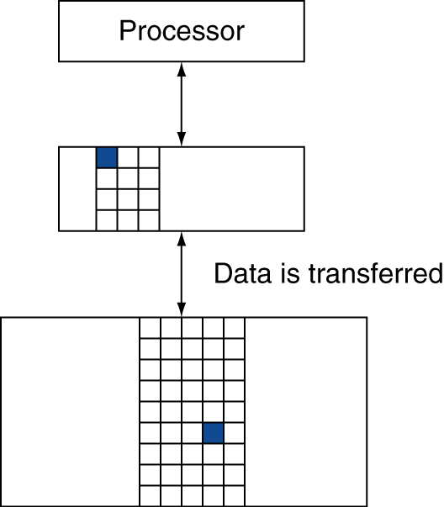
Memory Hierarchy Levels
Block (aka line): unit of copying
  May be multiple words
If accessed data is present in upper level
  Hit: access satisfied by upper level
    Hit ratio: hits/accesses
If accessed data is absent
  Miss: block copied from lower level
    Time taken: miss penalty
    Miss ratio: misses/accesses
    = 1 – hit ratio
  Then accessed data supplied from upper level

Slide 7
Memory Technology
Static RAM (SRAM)
  0.5ns – 2.5ns, $2000 – $5000 per GB
Dynamic RAM (DRAM)
  50ns – 70ns, $20 – $75 per GB
Magnetic disk
  5ms – 20ms, $0.20 – $2 per GB
Ideal memory
  Access time of SRAM
  Capacity and cost/GB of disk

Slide 8
Memory Hierarchy
Desk metaphor (1 inch/cycle):
  CPU registers: index card
  L1 cache: 1 page, 1 inch away
  L2 cache: 31 pages, 3 inches away
  L3 cache: 125 pages, 16 inches away
  Main memory: 200 books, 5 feet away
  Disk: 60,000 books, 950 miles away
  Tertiary storage (tapes): 100 million books, 100 million miles

Slide 9
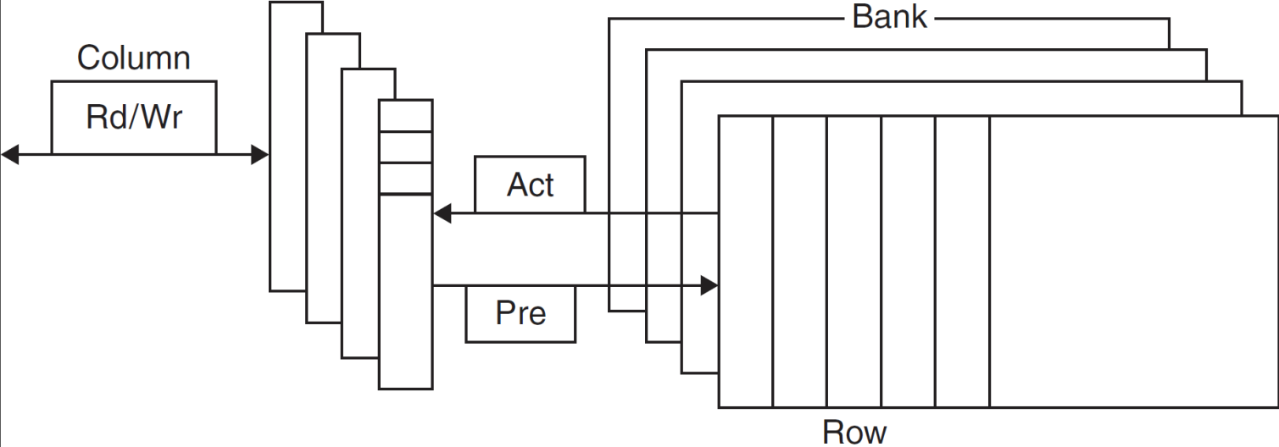
DRAM Technology
Data stored as a charge in a capacitor
  Single transistor used to access the charge
  Must periodically be refreshed
    Read contents and write back
    Performed on a DRAM “row”

Slide 10
Advanced DRAM Organization
Bits in a DRAM are organized as a rectangular array
  DRAM accesses an entire row
  Burst mode: supply successive words from a row with reduced latency
Double data rate (DDR) DRAM
  Transfer on rising and falling clock edges
Quad data rate (QDR) DRAM
  Separate DDR inputs and outputs

Slide 11
DRAM Generations
Year | Capacity | $/GB
1980 | 64Kbit | $1500000
1983 | 256Kbit | $500000
1985 | 1Mbit | $200000
1989 | 4Mbit | $50000
1992 | 16Mbit | $15000
1996 | 64Mbit | $10000
1998 | 128Mbit | $4000
2000 | 256Mbit | $1000
2004 | 512Mbit | $250
2007 | 1Gbit | $50

Slide 12
DRAM Performance Factors
Row buffer
  Allows several words to be read and refreshed in parallel
Synchronous DRAM
  Allows for consecutive accesses in bursts without needing to send each address
  Improves bandwidth
DRAM banking
  Allows simultaneous access to multiple DRAMs
  Improves bandwidth

Slide 13
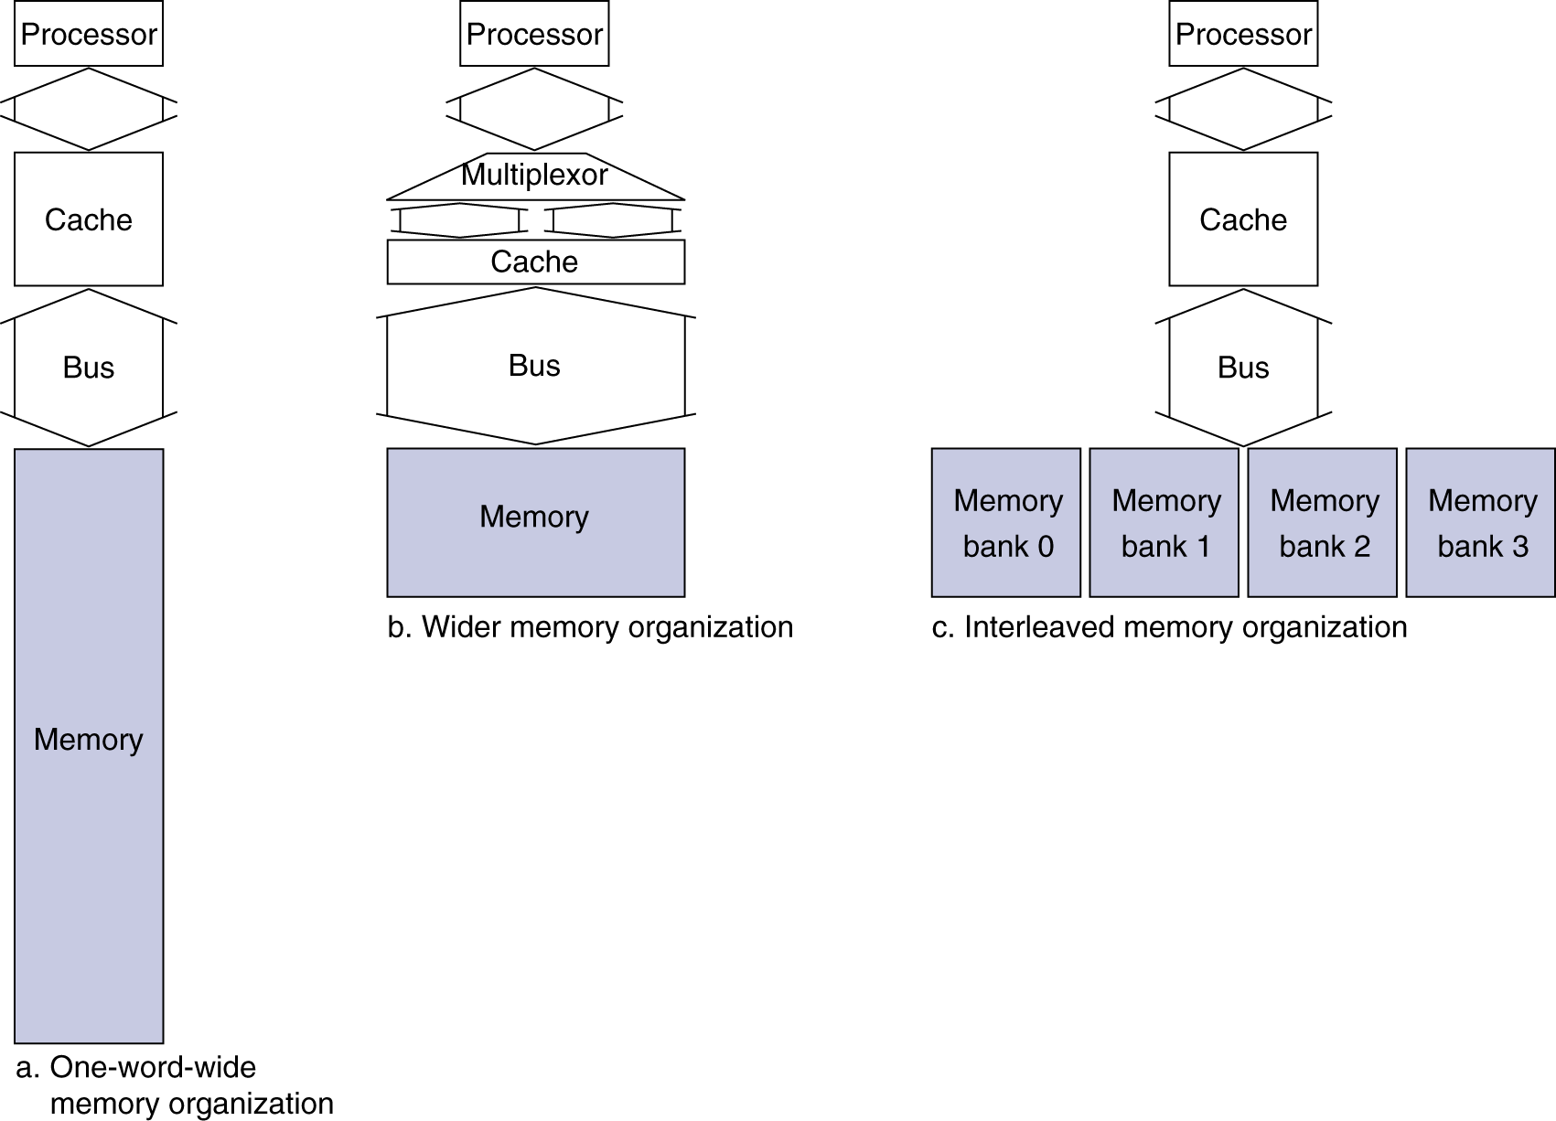
Increasing Memory Bandwidth
4-word wide memory
  Miss penalty = 1 + 15 + 1 = 17 bus cycles
  Bandwidth = 16 bytes / 17 cycles = 0.94 B/cycle
4-bank interleaved memory
  Miss penalty = 1 + 15 + 4×1 = 20 bus cycles
  Bandwidth = 16 bytes / 20 cycles = 0.8 B/cycle

Slide 14
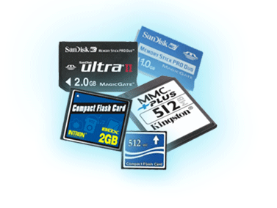
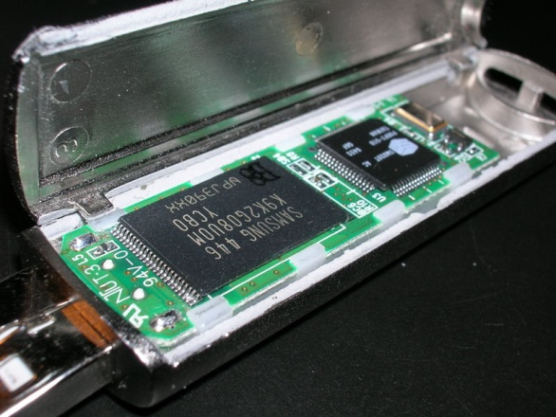
Flash Storage
Nonvolatile semiconductor storage
  100× – 1000× faster than disk
  Smaller, lower power, more robust
  But more $/GB (between disk and DRAM)
Chapter 5 — Large and Fast: Exploiting Memory Hierarchy — 14

Slide 15
Flash Types
NOR flash: bit cell like a NOR gate
  Random read/write access
  Used for instruction memory in embedded systems
NAND flash: bit cell like a NAND gate
  Denser (bits/area), but block-at-a-time access
  Cheaper per GB
  Used for USB keys, media storage, …
Flash bits wears out after 1000’s of accesses
  Not suitable for direct RAM or disk replacement
  Wear leveling: remap data to less used blocks
Chapter 5 — Large and Fast: Exploiting Memory Hierarchy — 15

Slide 16
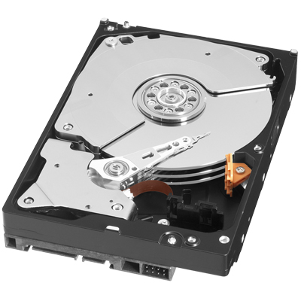
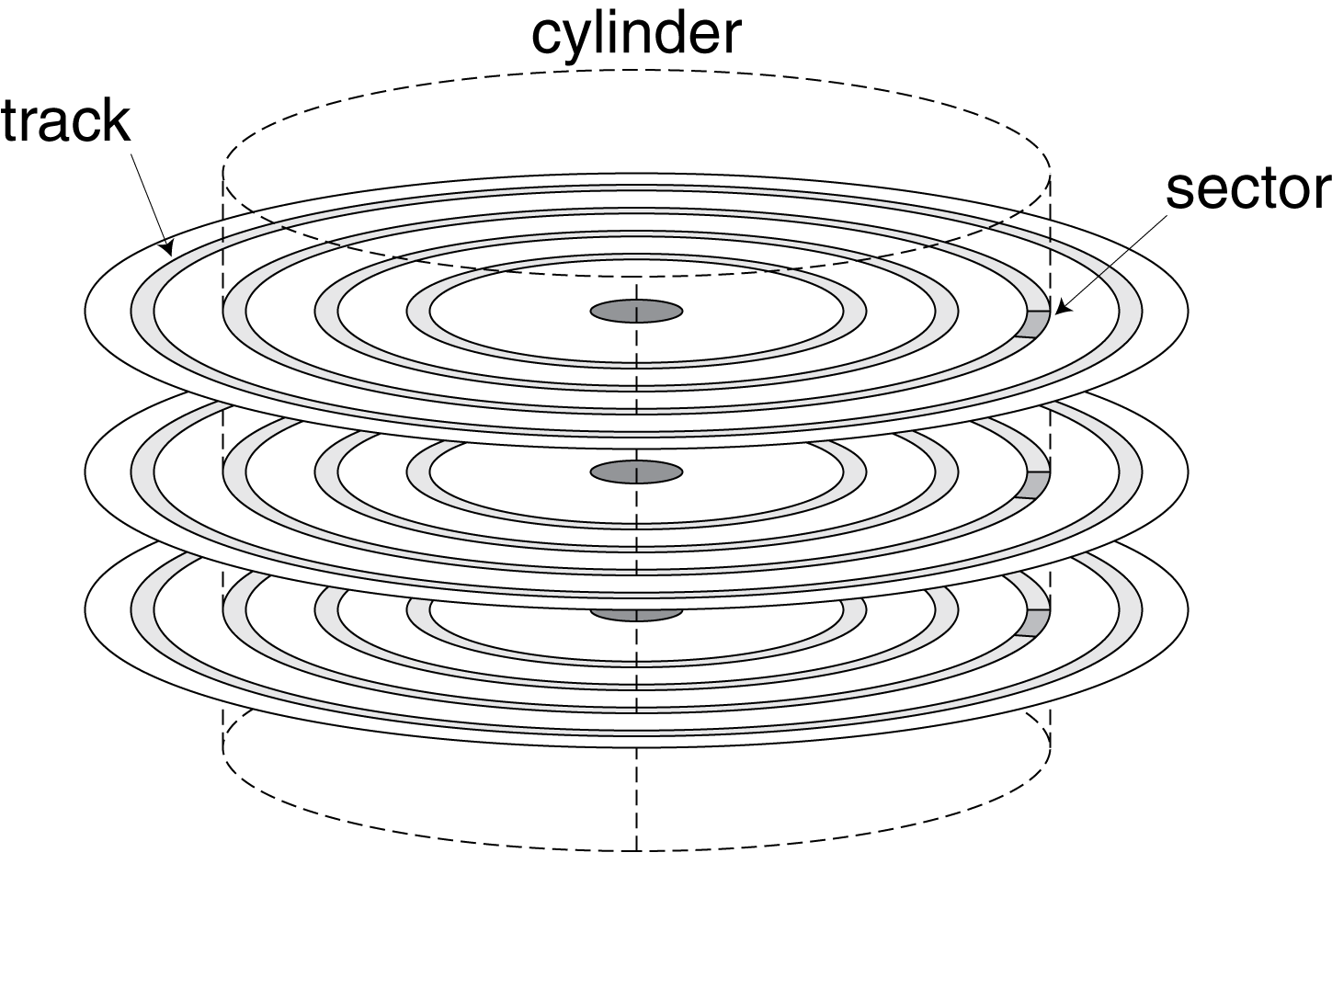
Disk Storage
Nonvolatile, rotating magnetic storage
Chapter 5 — Large and Fast: Exploiting Memory Hierarchy — 16

Slide 17
Disk Sectors and Access
Each sector records
  Sector ID
  Data (512 bytes, 4096 bytes proposed)
  Error correcting code (ECC)
    Used to hide defects and recording errors
  Synchronization fields and gaps
Access to a sector involves
  Queuing delay if other accesses are pending
  Seek: move the heads
  Rotational latency
  Data transfer
  Controller overhead
Chapter 5 — Large and Fast: Exploiting Memory Hierarchy — 17

Slide 18
Disk Access Example
Given
  512B sector, 15,000rpm, 4ms average seek time, 100MB/s transfer rate, 0.2ms controller overhead, idle disk
Average read time
  = queuing delay + seek + rotational latency + transfer time + controller delay
  4ms seek time
  + ½ / (15,000/60) = 2ms rotational latency
  + 512 / 100MB/s = 0.005ms transfer time
  + 0.2ms controller delay
  = 6.2ms
If actual average seek time is 1ms
  Average read time = 3.2ms
Chapter 5 — Large and Fast: Exploiting Memory Hierarchy — 18

Slide 19
Example
A program repeatedly performs the following three-step process:
read in a 4 KB block of data from disk,
do some processing on that data, and
write out the result as another 4 KB block elsewhere on the disk.
Each block is contiguous, located on a random track, and doesn’t span multiple tracks.
The disk rotates at 10,000 RPM, has an average seek time of 8 ms, and has a transfer rate of 50 MB/sec. The controller overhead is 2 ms. No other programs are using the disk or processor, and there is no overlapping of disk operation with processing. The processing step takes 20 million clock cycles, and the clock rate is 5 GHz. What is the overall speed of the system in blocks processed per second?

Slide 20
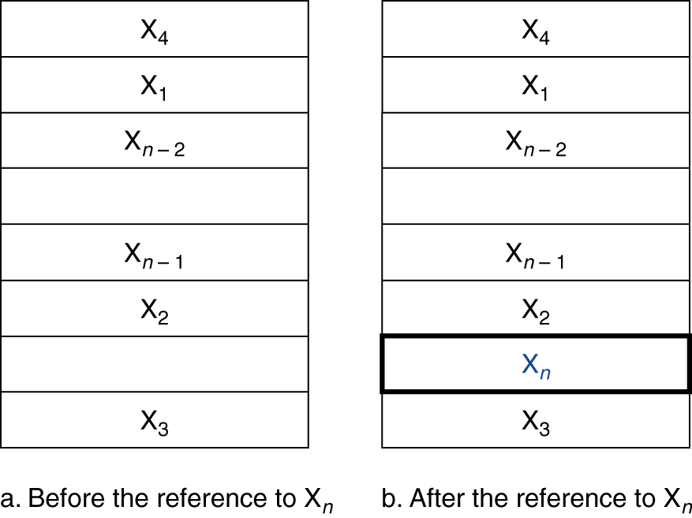
Cache Memory
Cache memory
  The level of the memory hierarchy closest to the CPU
Given accesses X₁, …, X_{n–1}, X_{n}
How do we know if the data is present?
Where do we look?

Slide 21
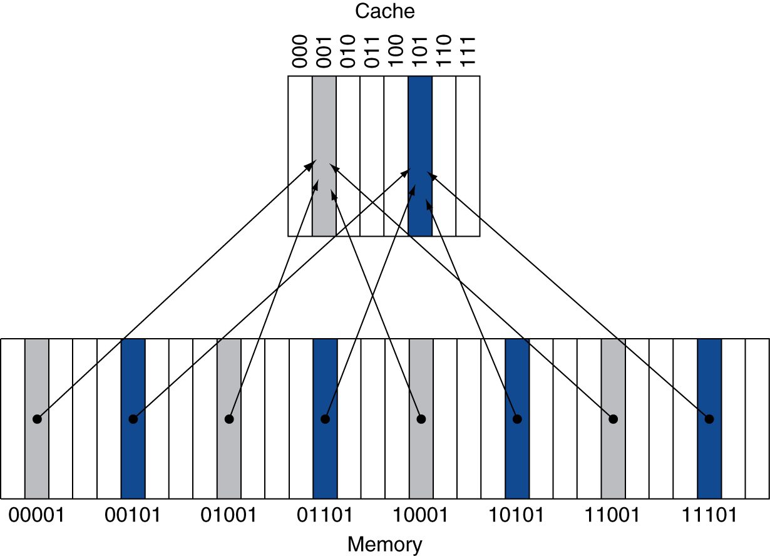
Direct Mapped Cache
Location determined by address
Direct mapped: only one choice
  (Block address) modulo (#Blocks in cache)
#Blocks is a power of 2
Use low-order address bits

Slide 22
Tags and Valid Bits
How do we know which particular block is stored in a cache location?
  Store block address as well as the data
  Actually, only need the high-order bits
  Called the tag
What if there is no data in a location?
  Valid bit: 1 = present, 0 = not present
  Initially 0

Slide 23
Cache Example
8-blocks, 1 word/block, direct mapped
Initial state
Index | V | Tag | Data
000 | N
001 | N
010 | N
011 | N
100 | N
101 | N
110 | N
111 | N

Slide 24
Cache Example
Word addr | Binary addr | Hit/miss | Cache block
22 | 10 110 | Miss | 110
Index | V | Tag | Data
000 | N
001 | N
010 | N
011 | N
100 | N
101 | N
110 | Y | 10 | Mem[10110]
111 | N

Slide 25
Cache Example
Word addr | Binary addr | Hit/miss | Cache block
26 | 11 010 | Miss | 010
Index | V | Tag | Data
000 | N
001 | N
010 | Y | 11 | Mem[11010]
011 | N
100 | N
101 | N
110 | Y | 10 | Mem[10110]
111 | N

Slide 26
Cache Example
Word addr | Binary addr | Hit/miss | Cache block
22 | 10 110 | Hit | 110
26 | 11 010 | Hit | 010
Index | V | Tag | Data
000 | N
001 | N
010 | Y | 11 | Mem[11010]
011 | N
100 | N
101 | N
110 | Y | 10 | Mem[10110]
111 | N

Slide 27
Cache Example
Word addr | Binary addr | Hit/miss | Cache block
16 | 10 000 | Miss | 000
3 | 00 011 | Miss | 011
16 | 10 000 | Hit | 000
Index | V | Tag | Data
000 | Y | 10 | Mem[10000]
001 | N
010 | Y | 11 | Mem[11010]
011 | Y | 00 | Mem[00011]
100 | N
101 | N
110 | Y | 10 | Mem[10110]
111 | N

Slide 28
Cache Example
Word addr | Binary addr | Hit/miss | Cache block
18 | 10 010 | Miss | 010
Index | V | Tag | Data
000 | Y | 10 | Mem[10000]
001 | N
010 | Y | 10 | Mem[10010]
011 | Y | 00 | Mem[00011]
100 | N
101 | N
110 | Y | 10 | Mem[10110]
111 | N

Slide 29
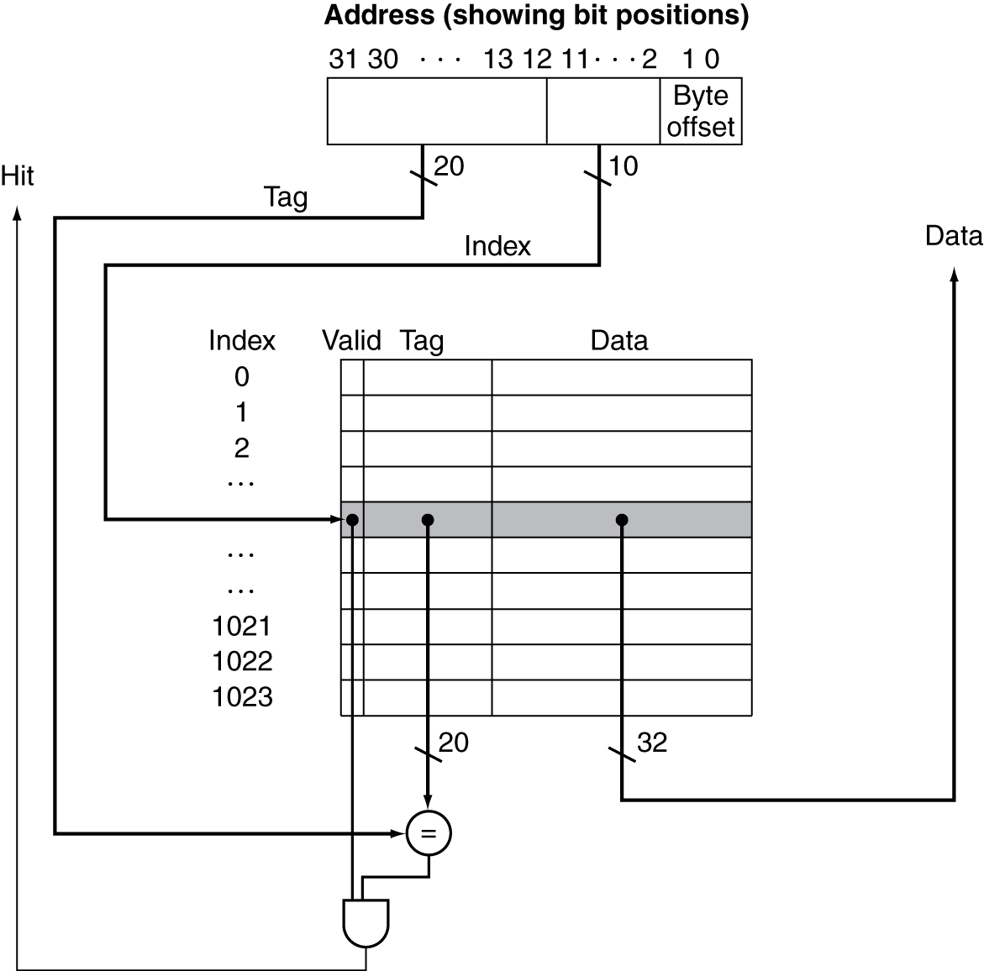
Address Subdivision

Slide 30
Example: Larger Block Size
64 blocks, 16 bytes/block
  To what block number does address 1200 map?
Block address = ⎣1200/16⎦ = 75
Block number = 75 modulo 64 = 11
31
10
9
4
3
0
Tag
Index
Offset
22 bits
6 bits
4 bits

Slide 31
Block Size Considerations
Larger blocks should reduce miss rate
  Due to spatial locality
But in a fixed-sized cache
  Larger blocks ⇒ fewer of them
    More competition ⇒ increased miss rate
  Larger blocks ⇒ pollution
Larger miss penalty
  Can override benefit of reduced miss rate
  Early restart and critical-word-first can help

Slide 32
Cache Misses
On cache hit, CPU proceeds normally
On cache miss
  Stall the CPU pipeline
  Fetch block from next level of hierarchy
  Instruction cache miss
    Restart instruction fetch
  Data cache miss
    Complete data access

Slide 33
Write-Through
On data-write hit, could just update the block in cache
  But then cache and memory would be inconsistent
Write through: also update memory
But makes writes take longer
  e.g., if base CPI = 1, 10% of instructions are stores, write to memory takes 100 cycles
    Effective CPI = 1 + 0.1×100 = 11
Solution: write buffer
  Holds data waiting to be written to memory
  CPU continues immediately
    Only stalls on write if write buffer is already full

Slide 34
Write-Back
Alternative: On data-write hit, just update the block in cache
  Keep track of whether each block is dirty
When a dirty block is replaced
  Write it back to memory
  Can use a write buffer to allow replacing block to be read first

Slide 35
Write Allocation
What should happen on a write miss?
Alternatives for write-through
  Allocate on miss: fetch the block
  Write around: don’t fetch the block
    Since programs often write a whole block before reading it (e.g., initialization)
For write-back
  Usually fetch the block

Slide 36
Measuring Cache Performance
Components of CPU time
  Program execution cycles
    Includes cache hit time
  Memory stall cycles
    Mainly from cache misses
With simplifying assumptions:

Slide 37
Cache Performance Example
Given
  I-cache miss rate = 2%
  D-cache miss rate = 4%
  Miss penalty = 100 cycles
  Base CPI (ideal cache) = 2
  Load & stores are 36% of instructions
Miss cycles per instruction
  I-cache: 0.02 × 100 = 2
  D-cache: 0.36 × 0.04 × 100 = 1.44
Actual CPI = 2 + 2 + 1.44 = 5.44
  Ideal CPU is 5.44/2 =2.72 times faster

Slide 38
Average Access Time
Hit time is also important for performance
Average memory access time (AMAT)
  AMAT = Hit time + Miss rate × Miss penalty
Example
  CPU with 1ns clock, hit time = 1 cycle, miss penalty = 20 cycles, I-cache miss rate = 5%
  AMAT = 1 + 0.05 × 20 = 2ns
    2 cycles per instruction

Slide 39
Associative Caches
Fully associative
  Allow a given block to go in any cache entry
  Requires all entries to be searched at once
  Comparator per entry (expensive)
n-way set associative
  Each set contains n entries
  Block number determines which set
    (Block number) modulo (#Sets in cache)
  Search all entries in a given set at once
  n comparators (less expensive)

Slide 40
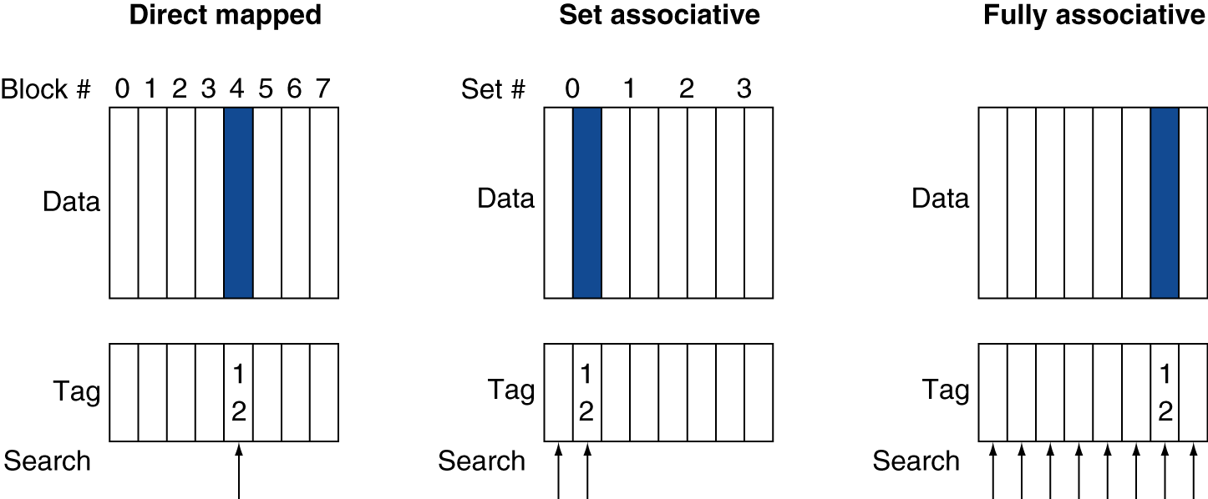
Associative Cache Example

Slide 41
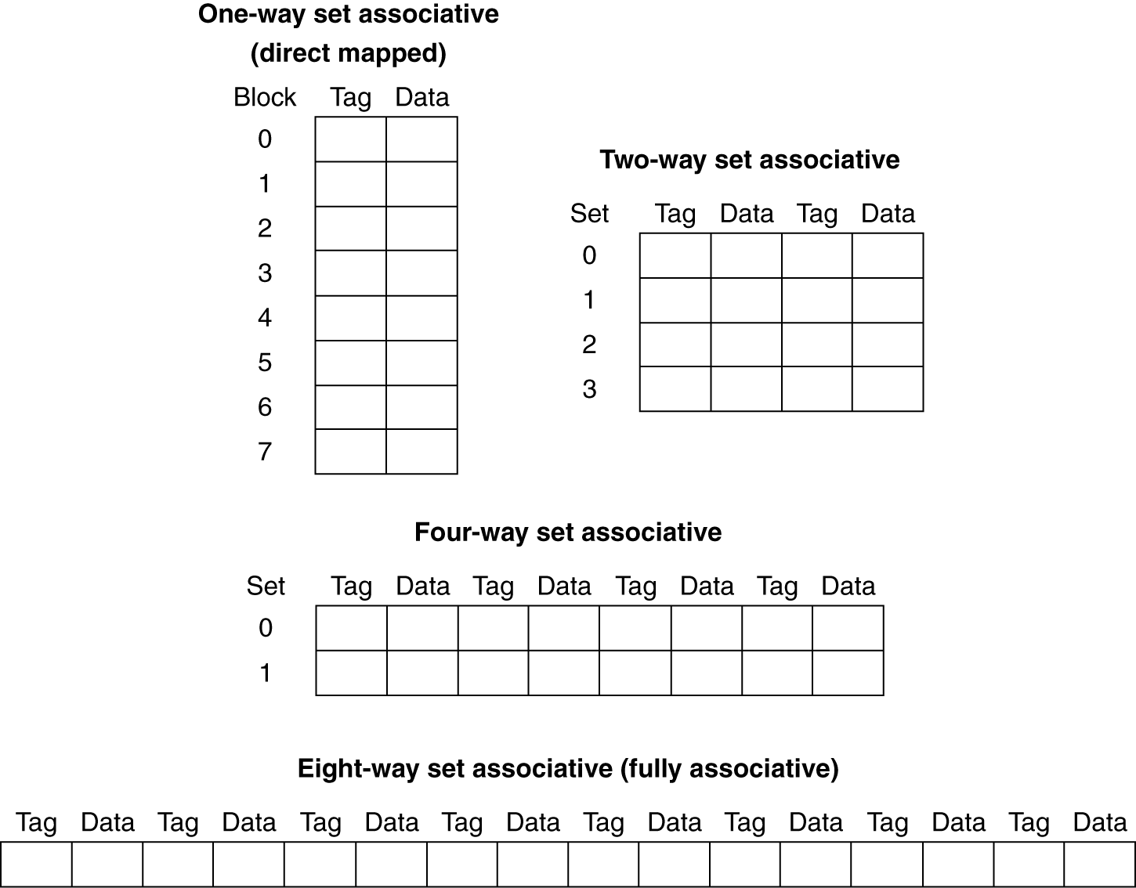
Spectrum of Associativity
For a cache with 8 entries

Slide 42
Associativity Example
Compare 4-block caches
  Direct mapped, 2-way set associative,
  fully associative
  Block access sequence: 0, 8, 0, 6, 8
Direct mapped
Block address | Cache index | Hit/miss | Cache content after access
 |  |  | 0 | 1 | 2 | 3
0 | 0 | miss | Mem[0]
8 | 0 | miss | Mem[8]
0 | 0 | miss | Mem[0]
6 | 2 | miss | Mem[0] |  | Mem[6]
8 | 0 | miss | Mem[8] |  | Mem[6]

Slide 43
Associativity Example
2-way set associative
Block address | Cache index | Hit/miss | Cache content after access
 |  |  | Set 0 |  | Set 1
0 | 0 | miss | Mem[0]
8 | 0 | miss | Mem[0] | Mem[8]
0 | 0 | hit | Mem[0] | Mem[8]
6 | 0 | miss | Mem[0] | Mem[6]
8 | 0 | miss | Mem[8] | Mem[6]
Fully associative
Block address |  | Hit/miss | Cache content after access
0 |  | miss | Mem[0]
8 |  | miss | Mem[0] | Mem[8]
0 |  | hit | Mem[0] | Mem[8]
6 |  | miss | Mem[0] | Mem[8] | Mem[6]
8 |  | hit | Mem[0] | Mem[8] | Mem[6]

Slide 44
How Much Associativity
Increased associativity decreases miss rate
  But with diminishing returns
Simulation of a system with 64KB
D-cache, 16-word blocks, SPEC2000
  1-way: 10.3%
  2-way: 8.6%
  4-way: 8.3%
  8-way: 8.1%

Slide 45
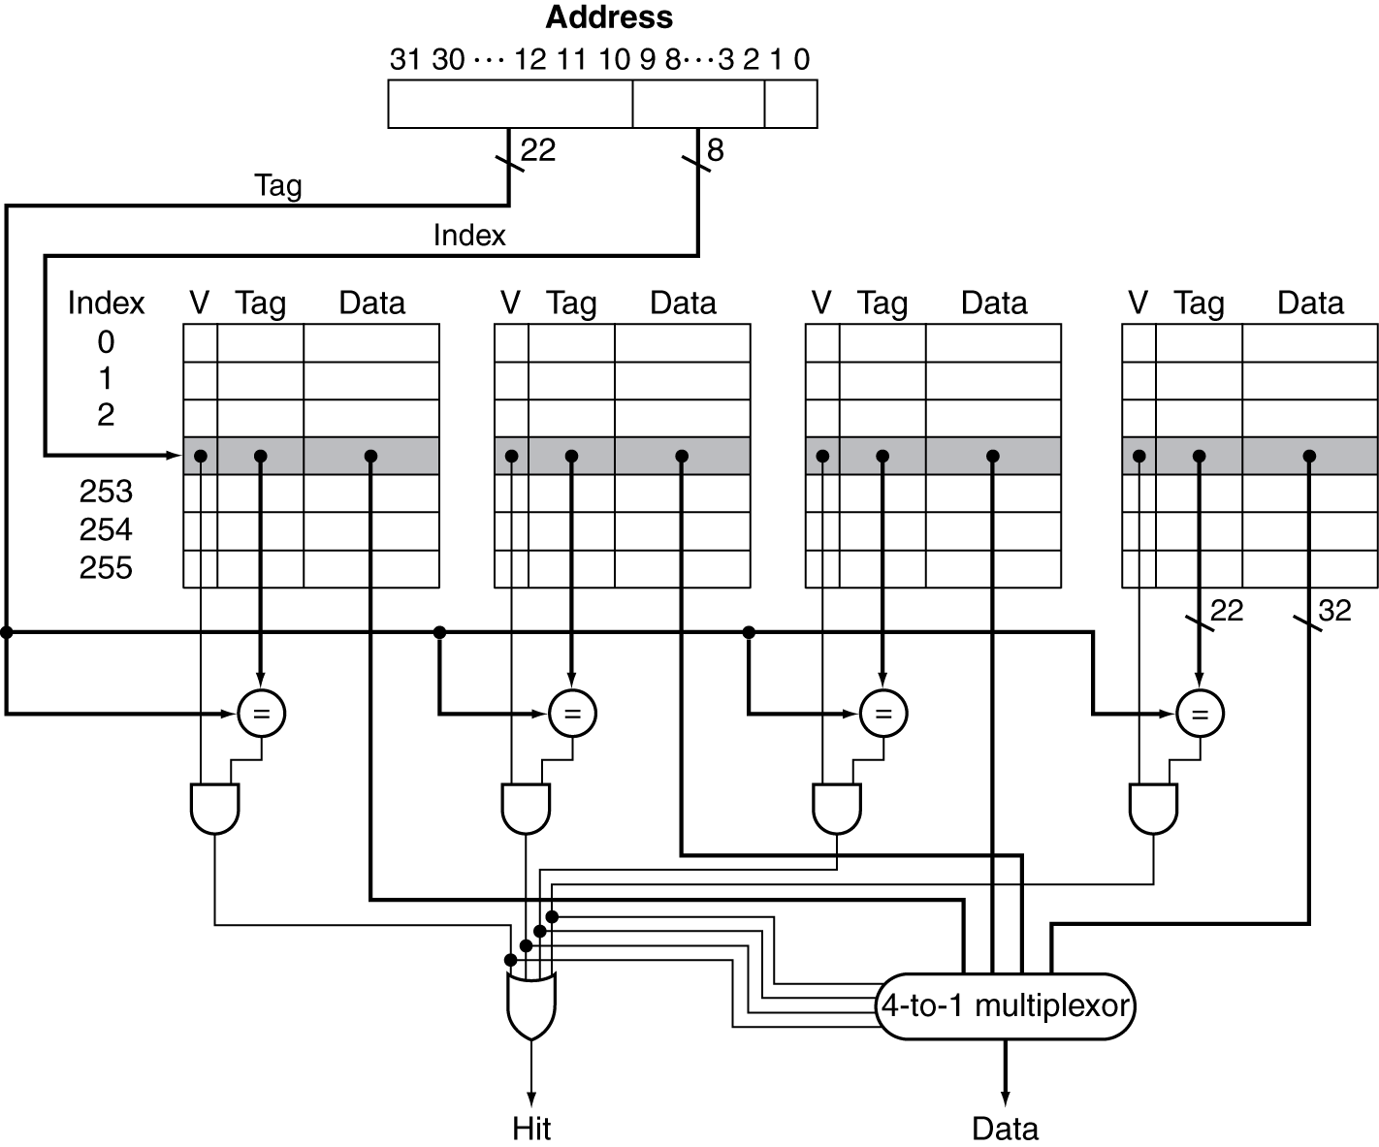
Set Associative Cache Organization

Slide 46
Replacement Policy
Direct mapped: no choice
Set associative
  Prefer non-valid entry, if there is one
  Otherwise, choose among entries in the set
Least-recently used (LRU)
  Choose the one unused for the longest time
    Simple for 2-way, manageable for 4-way, too hard beyond that
Random
  Gives approximately the same performance as LRU for high associativity

Slide 47
Write Policy
Write-through
  Update both upper and lower levels
  Simplifies replacement, but may require write buffer
Write-back
  Update upper level only
  Update lower level when block is replaced
  Need to keep more state
Virtual memory
  Only write-back is feasible, given disk write latency

Slide 48
Sources of Misses
Compulsory misses (aka cold start misses)
  First access to a block
Capacity misses
  Due to finite cache size
  A replaced block is later accessed again
Conflict misses (aka collision misses)
  In a non-fully associative cache
  Due to competition for entries in a set
  Would not occur in a fully associative cache of the same total size

Slide 49
Cache Design Trade-offs
Design change | Effect on miss rate | Negative performance effect
Increase cache size | Decrease capacity misses | May increase access time
Increase associativity | Decrease conflict misses | May increase access time
Increase block size | Decrease compulsory misses | Increases miss penalty. For very large block size, may increase miss rate due to pollution.

Slide 50
Cache Control
Example cache characteristics
  Direct-mapped, write-back, write allocate
  Block size: 4 words (16 bytes)
  Cache size: 16 KB (1024 blocks)
  32-bit byte addresses
  Valid bit and dirty bit per block
  Blocking cache
    CPU waits until access is complete
31
10
9
4
3
0
Tag
Index
Offset
18 bits
10 bits
4 bits

Slide 51
Block Placement
Determined by associativity
  Direct mapped (1-way associative)
    One choice for placement
  n-way set associative
    n choices within a set
  Fully associative
    Any location
Higher associativity reduces miss rate
  Increases complexity, cost, and access time

Slide 52
Finding a Block
Associativity | Location method | Tag comparisons
Direct mapped | Index | 1
n-way set associative | Set index, then search entries within the set | n
Fully associative | Search all entries | #entries
 | Full lookup table | 0
Hardware caches
  Reduce comparisons to reduce cost
Virtual memory
  Full table lookup makes full associativity feasible
  Benefit in reduced miss rate

Slide 53
Replacement
Choice of entry to replace on a miss
  Least recently used (LRU)
    Complex and costly hardware for high associativity
  Random
    Close to LRU, easier to implement
Virtual memory
  LRU approximation with hardware support

Slide 54
Virtual Memory
Use main memory as a “cache” for secondary (disk) storage
  Managed jointly by CPU hardware and the operating system (OS)
Programs share main memory
  Each gets a private virtual address space holding its frequently used code and data
  Protected from other programs
CPU and OS translate virtual addresses to physical addresses
  VM “block” is called a page
  VM translation “miss” is called a page fault

Slide 55
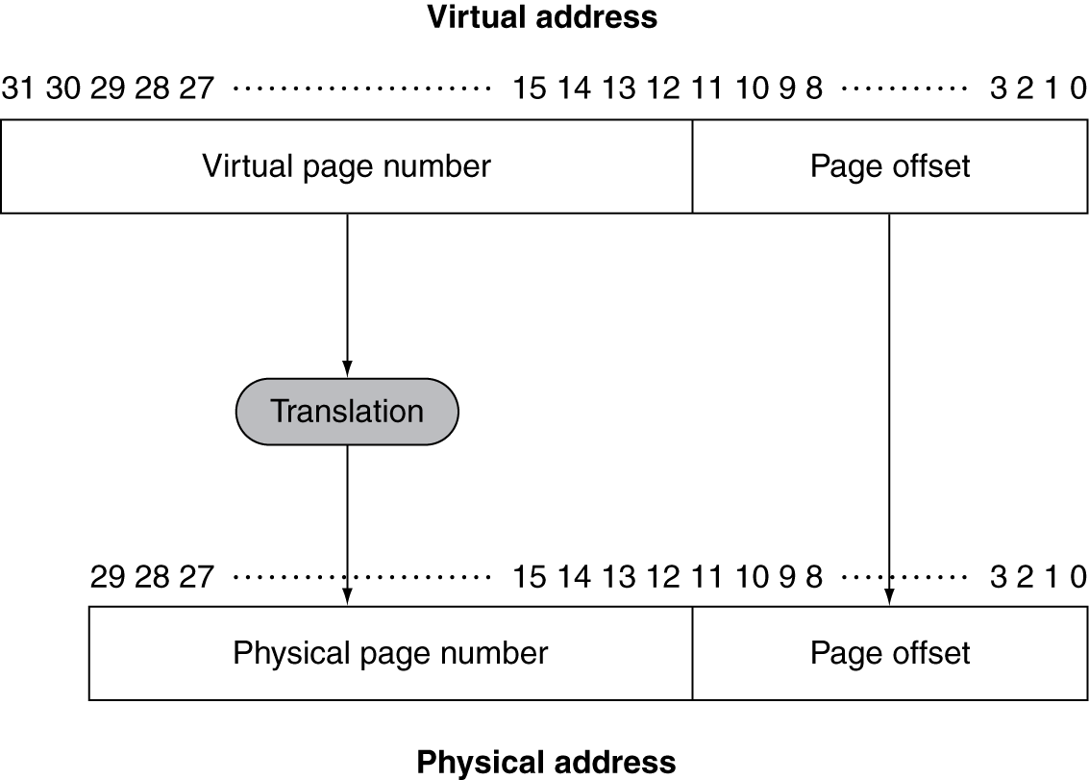
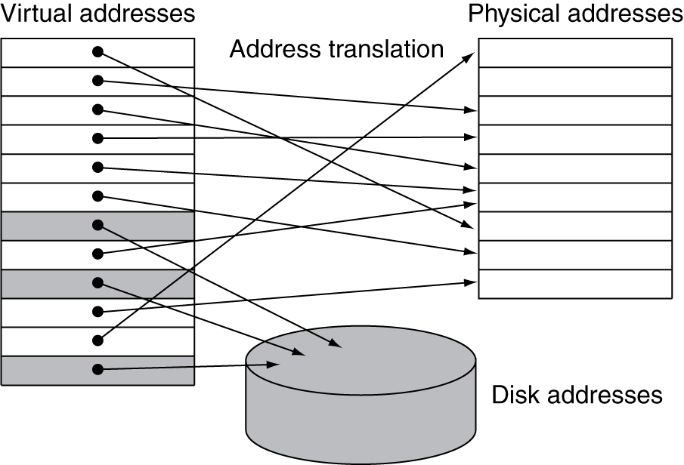
Address Translation
Fixed-size pages (e.g., 4K)

Slide 56
Page Fault Penalty
On page fault, the page must be fetched from disk
  Takes millions of clock cycles
  Handled by OS code
Try to minimize page fault rate
  Fully associative placement
  Smart replacement algorithms

Slide 57
Page Tables
Stores placement information
  Array of page table entries, indexed by virtual page number
  Page table register in CPU points to page table in physical memory
If page is present in memory
  PTE stores the physical page number
  Plus other status bits (referenced, dirty, …)
If page is not present
  PTE can refer to location in swap space on disk

Slide 58
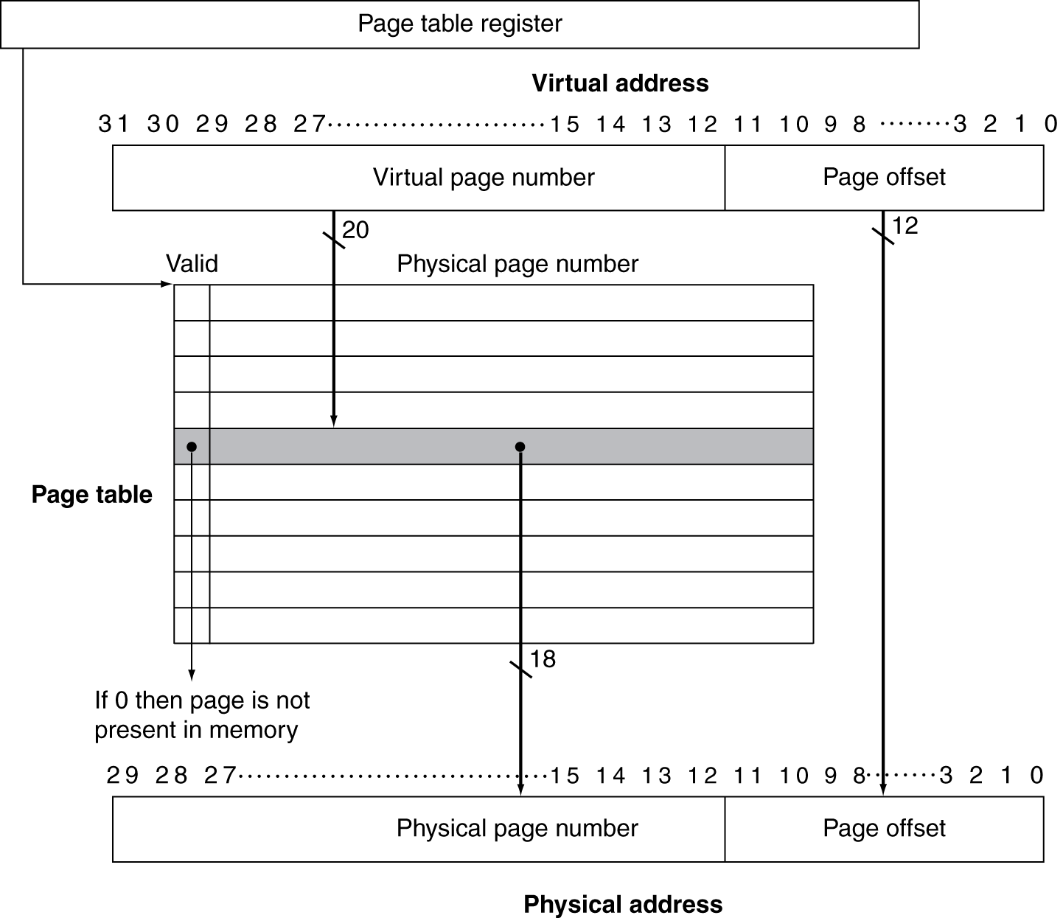
Translation Using a Page Table

Slide 59
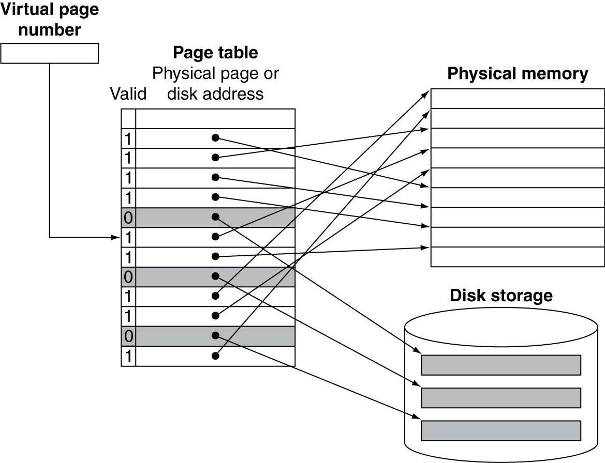
Mapping Pages to Storage

Slide 60
Replacement and Writes
To reduce page fault rate, prefer least-recently used (LRU) replacement
  Reference bit (aka use bit) in PTE set to 1 on access to page
  Periodically cleared to 0 by OS
  A page with reference bit = 0 has not been used recently
Disk writes take millions of cycles
  Block at once, not individual locations
  Write through is impractical
  Use write-back
  Dirty bit in PTE set when page is written

Slide 61
Fast Translation Using a TLB
Address translation would appear to require extra memory references
  One to access the PTE
  Then the actual memory access
But access to page tables has good locality
  So use a fast cache of PTEs within the CPU
  Called a Translation Look-aside Buffer (TLB)
  Typical: 16–512 PTEs, 0.5–1 cycle for hit, 10–100 cycles for miss, 0.01%–1% miss rate
  Misses could be handled by hardware or software

Slide 62
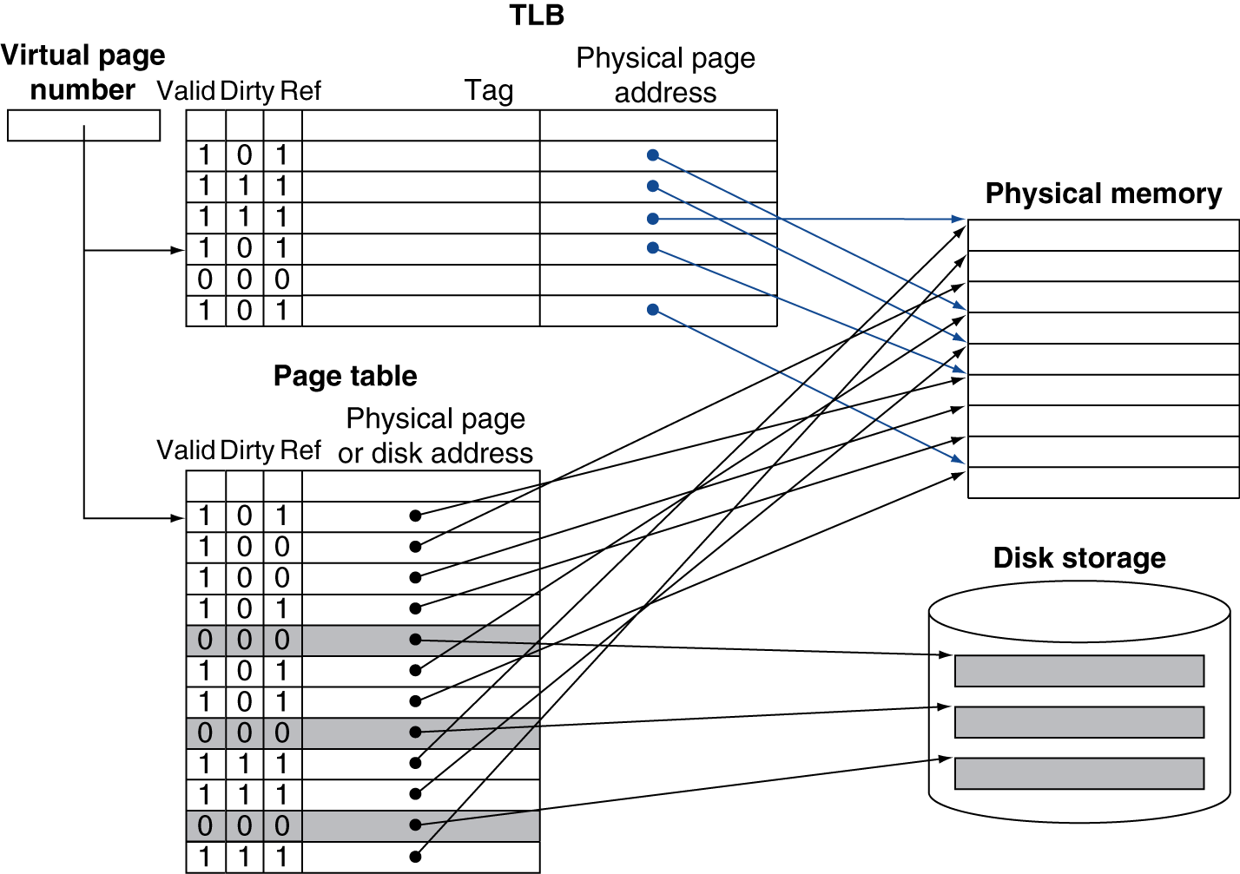
Fast Translation Using a TLB

Slide 63
TLB Misses
If page is in memory
  Load the PTE from memory and retry
  Could be handled in hardware
    Can get complex for more complicated page table structures
  Or in software
    Raise a special exception, with optimized handler
If page is not in memory (page fault)
  OS handles fetching the page and updating the page table
  Then restart the faulting instruction

Slide 64
TLB Miss Handler
TLB miss indicates
  Page present, but PTE not in TLB
  Page not preset
Must recognize TLB miss before destination register overwritten
  Raise exception
Handler copies PTE from memory to TLB
  Then restarts instruction
  If page not present, page fault will occur

Slide 65
Page Fault Handler
Use faulting virtual address to find PTE
Locate page on disk
Choose page to replace
  If dirty, write to disk first
Read page into memory and update page table
Make process runnable again
  Restart from faulting instruction

Slide 66
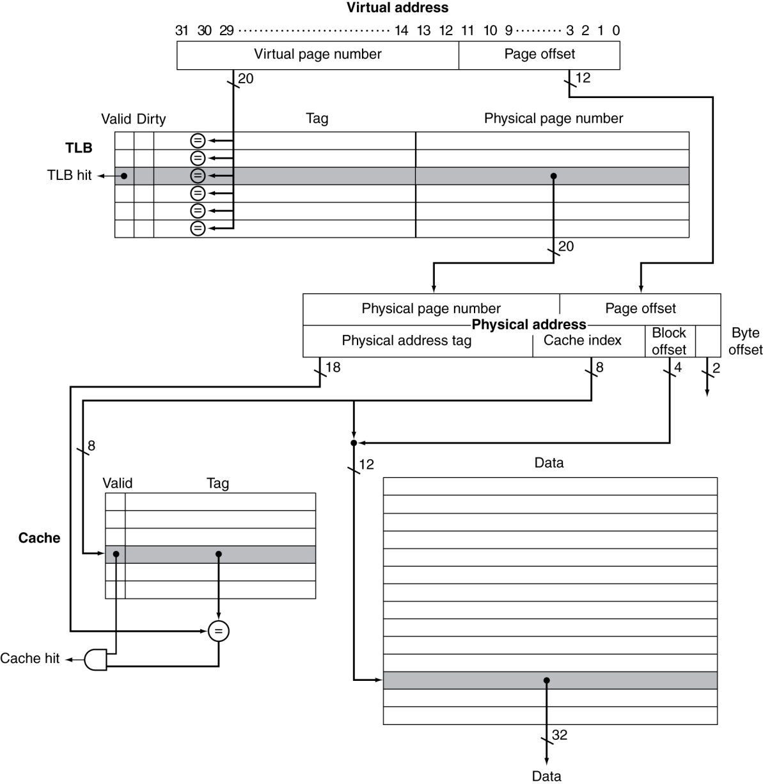
TLB and Cache Interaction
If cache tag uses physical address
  Need to translate before cache lookup
Alternative: use virtual address tag
  Complications due to aliasing
    Different virtual addresses for shared physical address

Slide 67
Concluding Remarks
Fast memories are small, large memories are slow
  We really want fast, large memories ☹
  Caching gives this illusion ☺
Principle of locality
  Programs use a small part of their memory space frequently
Memory hierarchy
  L1 cache ↔ L2 cache ↔ … ↔ DRAM memory
  ↔ disk
Memory system design is critical for multiprocessors

