Slide 1
Chapter 3
Arithmetic for Computers

Slide 2
Exam 1

Slide 3
Arithmetic for Computers
Operations on integers
  Addition and subtraction
  Multiplication and division
  Dealing with overflow
Floating-point real numbers
  Representation and operations

Slide 4
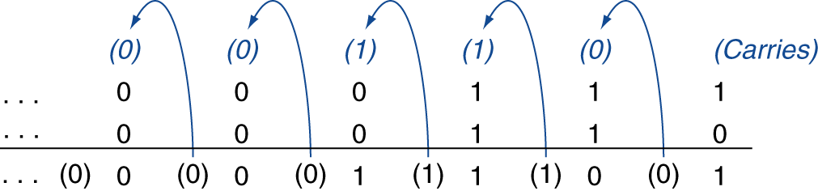
Integer Addition
Example: 7 + 6
Overflow if result out of range
  Adding +ve and –ve operands, no overflow
  Adding two +ve operands
    Overflow if result sign is 1
  Adding two –ve operands
    Overflow if result sign is 0

Slide 5
Integer Subtraction
Add negation of second operand
Example: 7 – 6 = 7 + (–6)
  +7: 0000 0000 … 0000 0111
  –6: 1111 1111 … 1111 1010
  +1: 0000 0000 … 0000 0001
Overflow if result out of range
  Subtracting two +ve or two –ve operands, no overflow
  Subtracting +ve from –ve operand
    Overflow if result sign is 0
  Subtracting –ve from +ve operand
    Overflow if result sign is 1

Slide 6
Dealing with Overflow
Some languages (e.g., C) ignore overflow
  Use MIPS addu, addui, subu instructions
Other languages (e.g., Ada, Fortran) require raising an exception
  Use MIPS add, addi, sub instructions
  On overflow, invoke exception handler
    Save PC in exception program counter (EPC) register
    Jump to predefined handler address
    mfc0 (move from coprocessor reg) instruction can retrieve EPC value, to return after corrective action

Slide 7
Overflow
Overflow for unsigned addition
  Carry-out
Overflow for unsigned subtraction
  No carry-out
Overflow for signed
Overflow causes exception
  Go to handler address 80000080
  Registers BadVAddr, Status, Cause, and EPC used to handle
SPIM has a simple interrupt handler built-in that deals with interrupts
Operation | Operand A | Operand B | Result
A+B | Positive | Positive | Negative
A+B | Negative | Negative | Positive
A-B | Positive | Negative | Negative
A-B | Negative | Positive | Positive

Slide 8
Overflow
Test for signed ADD overflow:
addu $t0,$t1,$t2 # sum but don’t trap
xor $t3,$t1,$t2 # check if signs differ
slt $t3,$t3,$zero # $t3=1 if signs differ
bne $t3,$zero, No_OVF
xor $t3,$t0,$t1 # signs of operands same, compare sign of result
slt $t3,$t3,$zero
bne $t3,$zero,OVF
Test for unsigned ADD overflow:
addu $t0,$t1,$t2 # sum but don’t trap
nor $t3,$t1,$zero # invert bits of $t1 (-$t1–1), 2³²-$t1-1
sltu $t3,$t3,$t2 # 2³²-$t1-1 < $t2, 2³²-1 < $t1+$t2
bne $t3,$zero,OVF

Slide 9
Arithmetic for Multimedia
Graphics and media processing operates on vectors of 8-bit and 16-bit data
  Use 64-bit adder, with partitioned carry chain
    Operate on 8×8-bit, 4×16-bit, or 2×32-bit vectors
  SIMD (single-instruction, multiple-data)
Saturating operations
  On overflow, result is largest representable value
    c.f. 2s-complement modulo arithmetic
  E.g., clipping in audio, saturation in video

Slide 10
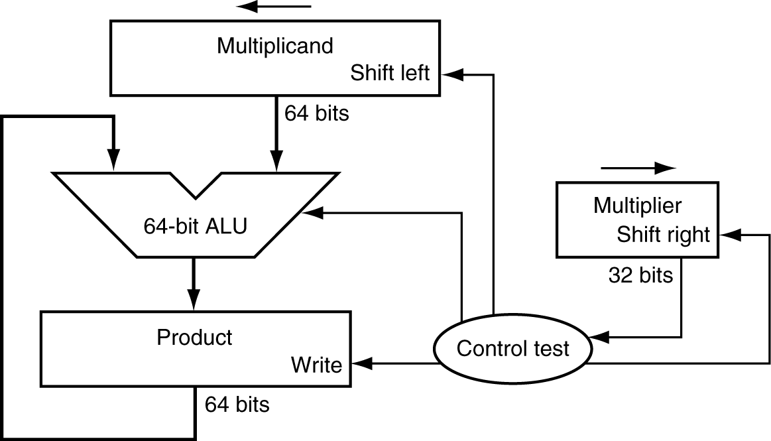
Multiplication
Start with long-multiplication approach
multiplicand
1000
× 1001
1000
0000
0000
1000
1001000
multiplier
product
Length of product is the sum of operand lengths

Slide 11
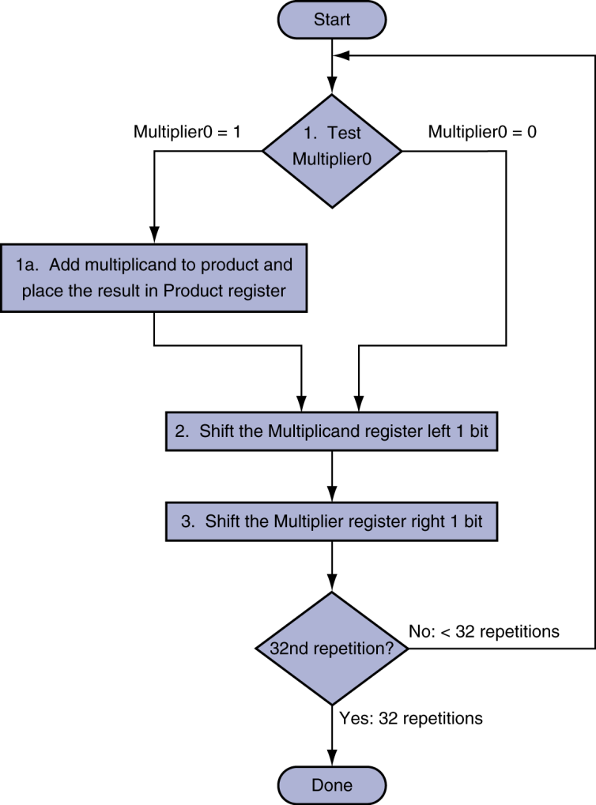
Multiplication Hardware
Initially 0

Slide 12
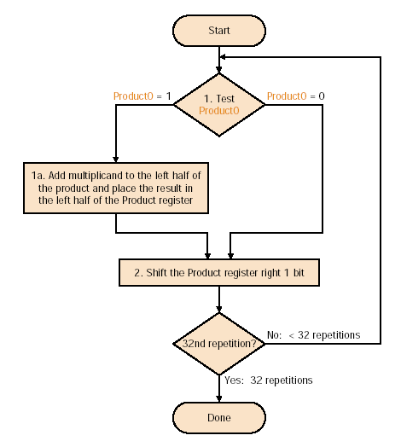
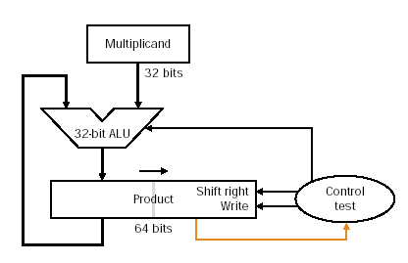
Binary Multiplication
works with signed but must sign extend shifts

Slide 13
Multiplication Example
multiplicand register (MR) | product register (PR) | next action | it
1001 | 0000 0101 | LSB of PR is 1, so PR[7:4]=PR[7:4]+MR | 1
1001 | 1001 0101 | shift PR | 1
1001 | 0100 1010 | LSB of PR is 0, so shift | 2
1001 | 0010 0101 | LSB of PR is 1, so PR[7:4]=PR[7:4]+MR | 3
1001 | 1011 0101 | shift PR | 3
1001 | 0101 1010 | LSB of PR is 0, so shift | 4
1001 | 0010 1101 | PR is 45, done! | X

Slide 14
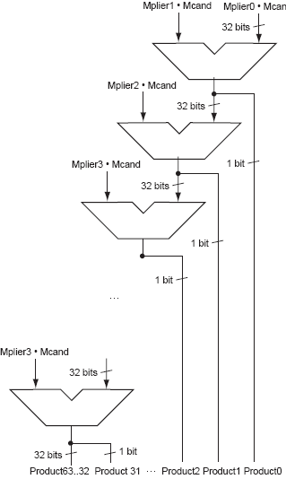
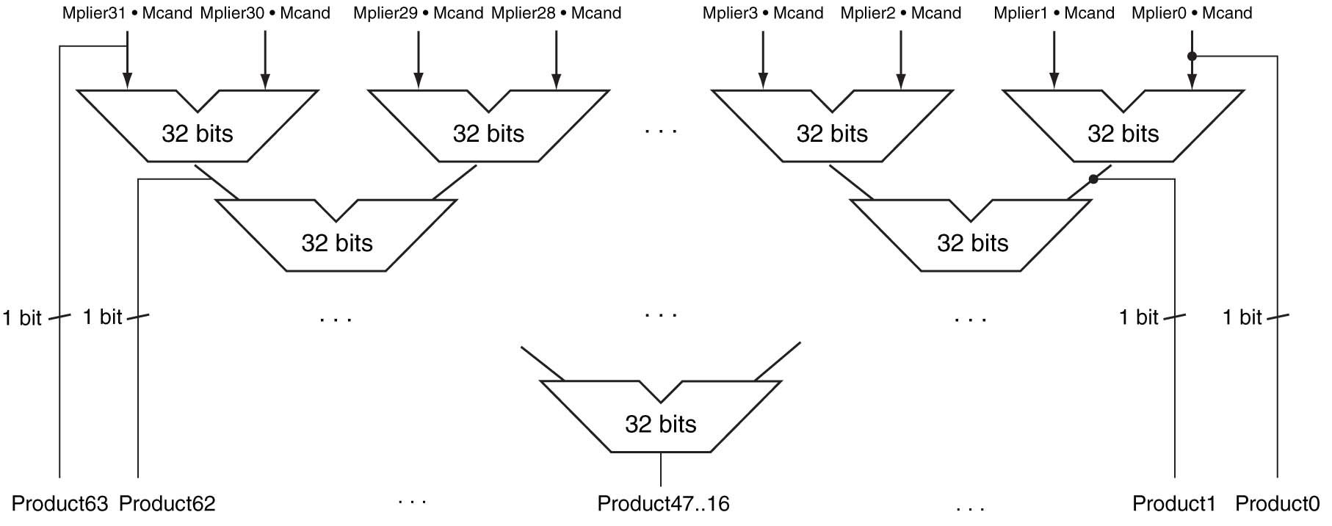
Faster Multiplication

Slide 15
MIPS Multiplication
Two 32-bit registers for product
  HI: most-significant 32 bits
  LO: least-significant 32-bits
Instructions
  mult rs, rt / multu rs, rt
    64-bit product in HI/LO
  mfhi rd / mflo rd
    Move from HI/LO to rd
    Can test HI value to see if product overflows 32 bits
  mul rd, rs, rt
    Least-significant 32 bits of product –> rd

Slide 16
Division
Check for 0 divisor
Long division approach
  If divisor ≤ dividend bits
    1 bit in quotient, subtract
  Otherwise
    0 bit in quotient, bring down next dividend bit
Restoring division
  Do the subtract, and if remainder goes < 0, add divisor back
Signed division
  Divide using absolute values
  Adjust sign of quotient and remainder as required
quotient
dividend
1001
1000 1001010
-1000
10
101
1010
-1000
10
divisor
remainder
n-bit operands yield n-bit
quotient and remainder

Slide 17
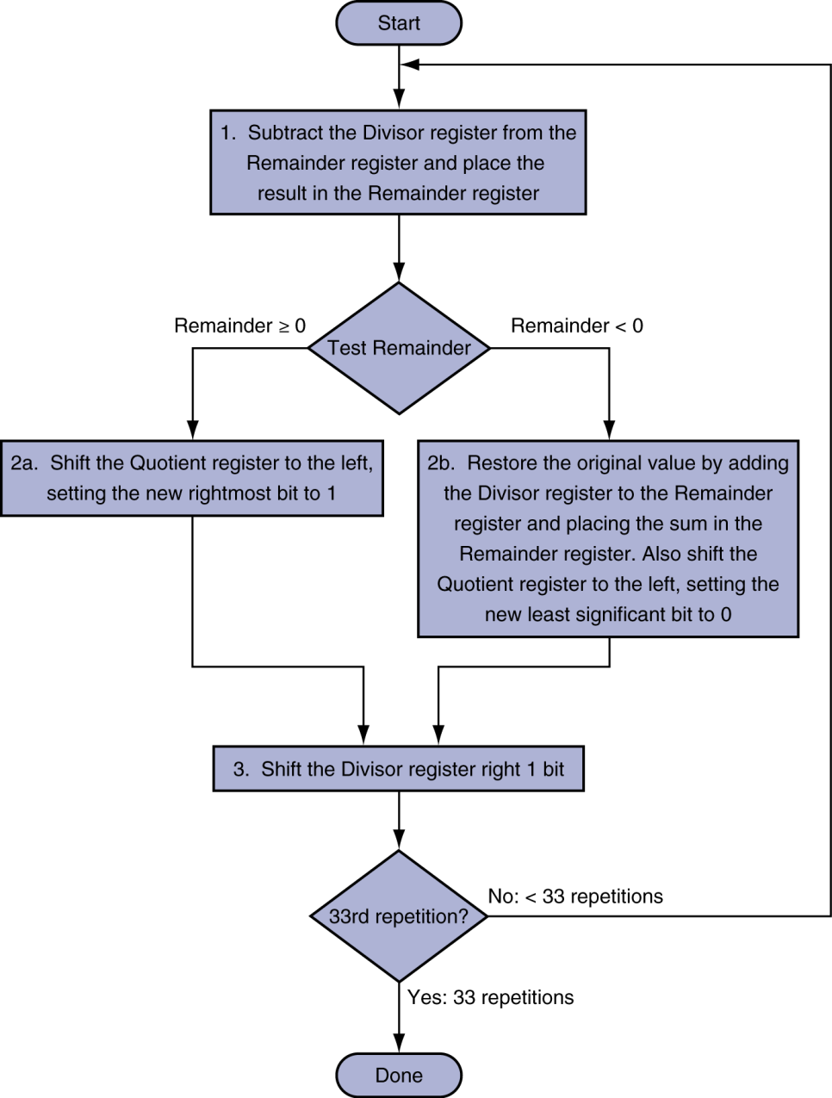
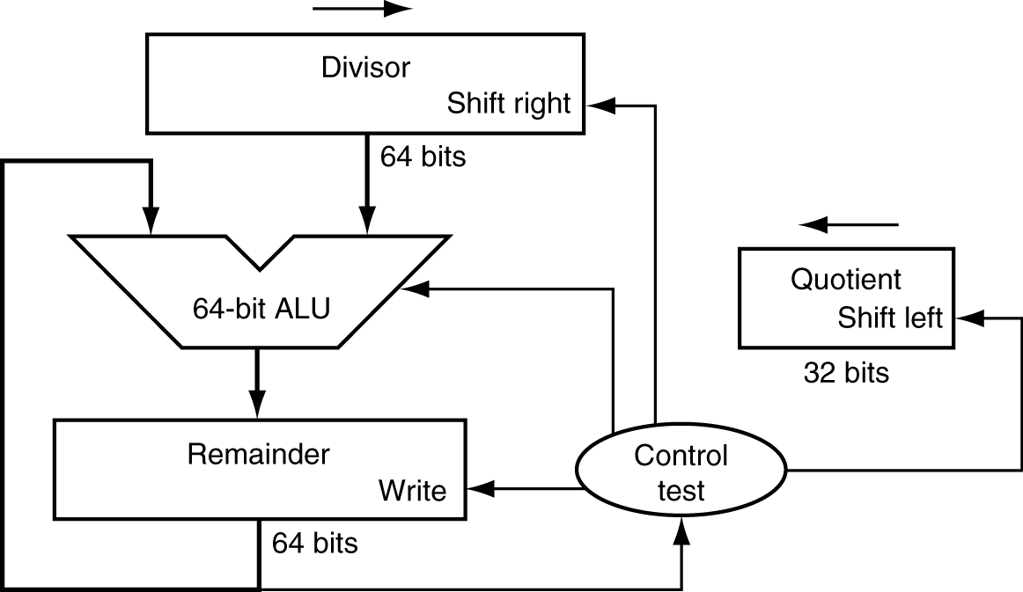
Division Hardware
Initially divisor in left half
Initially dividend

Slide 18
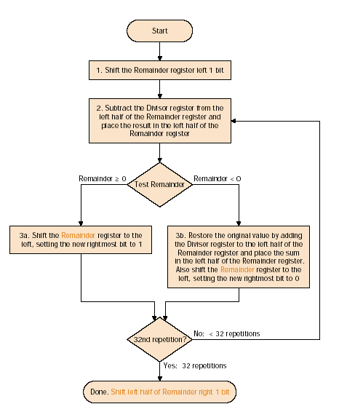
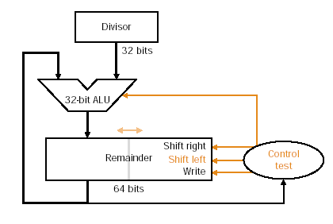
Binary Division
For signed, convert to positive and negate quotient if signs disagree

Slide 19
Division Example
divisor register (DR) | remainder register (RR) | next action | it
0100 | 0000 1011 | shift RR left 1 bit | 0
0100 | 0001 0110 | RR[7:4]=RR[7:4]-DR | 1
0100 | 1101 0110 | RR<0, so RR[7:4]=RR[7:4]+DR | 1
0100 | 0001 0110 | shift RR to left, shift in 0 | 1
0100 | 0010 1100 | RR[7:4]=RR[7:4]-DR | 2
0100 | 1110 1100 | RR<0, so RR[7:4]=RR[7:4]+DR | 2
0100 | 0010 1100 | shift RR to left, shift in 0 | 2
0100 | 0101 1000 | RR[7:4]=RR[7:4]-DR | 3
0100 | 0001 1000 | RR>=0, so shift RR to left, shift in 1 | 3
0100 | 0011 0001 | RR[7:4]=RR[7:4]-DR | 4
0100 | 1111 0001 | RR<0, so RR[7:4]=RR[7:4]+DR | 4
0100 | 0011 0001 | shift RR to left, shift in 0 | 4
0100 | 0110 0010 | shift RR[7:4] to right
0100 | 0011 0010 | done, quotient=2, remainder=3

Slide 20
Faster Division
Can’t use parallel hardware as in multiplier
  Subtraction is conditional on sign of remainder
Faster dividers (e.g. SRT devision) generate multiple quotient bits per step
  Still require multiple steps

Slide 21
MIPS Division
Use HI/LO registers for result
  HI: 32-bit remainder
  LO: 32-bit quotient
Instructions
  div rs, rt / divu rs, rt
  No overflow or divide-by-0 checking
    Software must perform checks if required
  Use mfhi, mflo to access result

Slide 22
Floating Point
Representation for non-integral numbers
  Including very small and very large numbers
Like scientific notation
  –2.34 × 10⁵⁶
  +0.002 × 10^{–4}
  +987.02 × 10⁹
In binary
  ±1.xxxxxxx₂ × 2^{yyyy}
Types float and double in C
normalized
not normalized

Slide 23
Floating Point Standard
Defined by IEEE Std 754-1985
Developed in response to divergence of representations
  Portability issues for scientific code
Now almost universally adopted
Two representations
  Single precision (32-bit)
  Double precision (64-bit)

Slide 24
IEEE Floating-Point Format
single: 8 bits
double: 11 bits
single: 23 bits
double: 52 bits
S
Exponent
Fraction
S: sign bit (0 ⇒ non-negative, 1 ⇒ negative)
Normalize significand: 1.0 ≤ |significand| < 2.0
  Always has a leading pre-binary-point 1 bit, so no need to represent it explicitly (hidden bit)
  Significand is Fraction with the “1.” restored
Exponent: excess representation: actual exponent + Bias
  Ensures exponent is unsigned
  Single: Bias = 127; Double: Bias = 1023

Slide 25
Single-Precision Range
Exponents 00000000 and 11111111 reserved
Smallest value
  Exponent: 00000001
  ⇒ actual exponent = 1 – 127 = –126
  Fraction: 000…00 ⇒ significand = 1.0
  ±1.0 × 2^{–126} ≈ ±1.2 × 10^{–38}
Largest value
  exponent: 11111110
  ⇒ actual exponent = 254 – 127 = +127
  Fraction: 111…11 ⇒ significand ≈ 2.0
  ±2.0 × 2⁺¹²⁷ ≈ ±3.4 × 10⁺³⁸

Slide 26
Double-Precision Range
Exponents 0000…00 and 1111…11 reserved
Smallest value
  Exponent: 00000000001
  ⇒ actual exponent = 1 – 1023 = –1022
  Fraction: 000…00 ⇒ significand = 1.0
  ±1.0 × 2^{–1022} ≈ ±2.2 × 10^{–308}
Largest value
  Exponent: 11111111110
  ⇒ actual exponent = 2046 – 1023 = +1023
  Fraction: 111…11 ⇒ significand ≈ 2.0
  ±2.0 × 2⁺¹⁰²³ ≈ ±1.8 × 10⁺³⁰⁸

Slide 27
Floating-Point Precision
Relative precision
  all fraction bits are significant
  Single: approx 2^{–23}
    Equivalent to 23 × log₁₀2 ≈ 23 × 0.3 ≈ 6 decimal digits of precision
  Double: approx 2^{–52}
    Equivalent to 52 × log₁₀2 ≈ 52 × 0.3 ≈ 16 decimal digits of precision

Slide 28
Floating-Point Addition
Match exponents for both operands by un-normalizing one of them
  Match to the exponent of the larger number
Add significands
Normalize result
Round significand

Slide 29
Example
Assume 11-bit limited representation:
  1 bit sign bit
  6 bit significand (precision 2⁻⁶ = 0.0156)
  4 bit exponent (bias 7)
    range 1 x 2⁻⁷ (7.8 x 10⁻³) to 1.111111 x 2⁸ (5.1 x 10²)
    (assuming no denormalized numbers)

Slide 30
Floating-Point Example
Represent –0.75
  –0.75 = (–1)¹ × 1.1₂ × 2^{–1}
  S = 1
  Fraction = 1000…00₂
  Exponent = –1 + Bias
    Single: –1 + 127 = 126 = 01111110₂
    Double: –1 + 1023 = 1022 = 01111111110₂
Single: 1011111101000…00
Double: 1011111111101000…00

Slide 31
Floating-Point Example
What number is represented by the single-precision float
11000000101000…00
  S = 1
  Fraction = 01000…00₂
  Fxponent = 10000001₂ = 129
x = (–1)¹ × (1 + 01₂) × 2^{(129 – 127)}
  = (–1) × 1.25 × 2²
  = –5.0

Slide 32
Denormal Numbers
Exponent = 000...0 ⇒ hidden bit is 0
Smaller than normal numbers
  allow for gradual underflow, with diminishing precision
Denormal with fraction = 000...0
Two representations of 0.0!

Slide 33
Infinities and NaNs
Exponent = 111...1, Fraction = 000...0
  ±Infinity
  Can be used in subsequent calculations, avoiding need for overflow check
Exponent = 111...1, Fraction ≠ 000...0
  Not-a-Number (NaN)
  Indicates illegal or undefined result
    e.g., 0.0 / 0.0
  Can be used in subsequent calculations

Slide 34
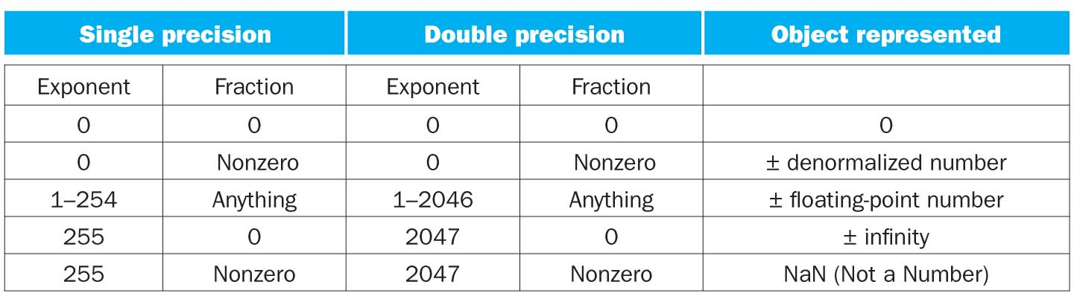
IEEE 754

Slide 35
Floating-Point Addition
Consider a 4-digit decimal example
  9.999 × 10¹ + 1.610 × 10^{–1}
1. Align decimal points
  Shift number with smaller exponent
  9.999 × 10¹ + 0.016 × 10¹
2. Add significands
  9.999 × 10¹ + 0.016 × 10¹ = 10.015 × 10¹
3. Normalize result & check for over/underflow
  1.0015 × 10²
4. Round and renormalize if necessary
  1.002 × 10²

Slide 36
Floating-Point Addition
Now consider a 4-digit binary example
  1.000₂ × 2^{–1} + –1.110₂ × 2^{–2} (0.5 + –0.4375)
1. Align binary points
  Shift number with smaller exponent
  1.000₂ × 2^{–1} + –0.111₂ × 2^{–1}
2. Add significands
  1.000₂ × 2^{–1} + –0.111₂ × 2–1 = 0.001₂ × 2^{–1}
3. Normalize result & check for over/underflow
  1.000₂ × 2^{–4}, with no over/underflow
4. Round and renormalize if necessary
  1.000₂ × 2^{–4} (no change) = 0.0625

Slide 37
FP Adder Hardware
Much more complex than integer adder
Doing it in one clock cycle would take too long
  Much longer than integer operations
  Slower clock would penalize all instructions
FP adder usually takes several cycles
  Can be pipelined

Slide 38
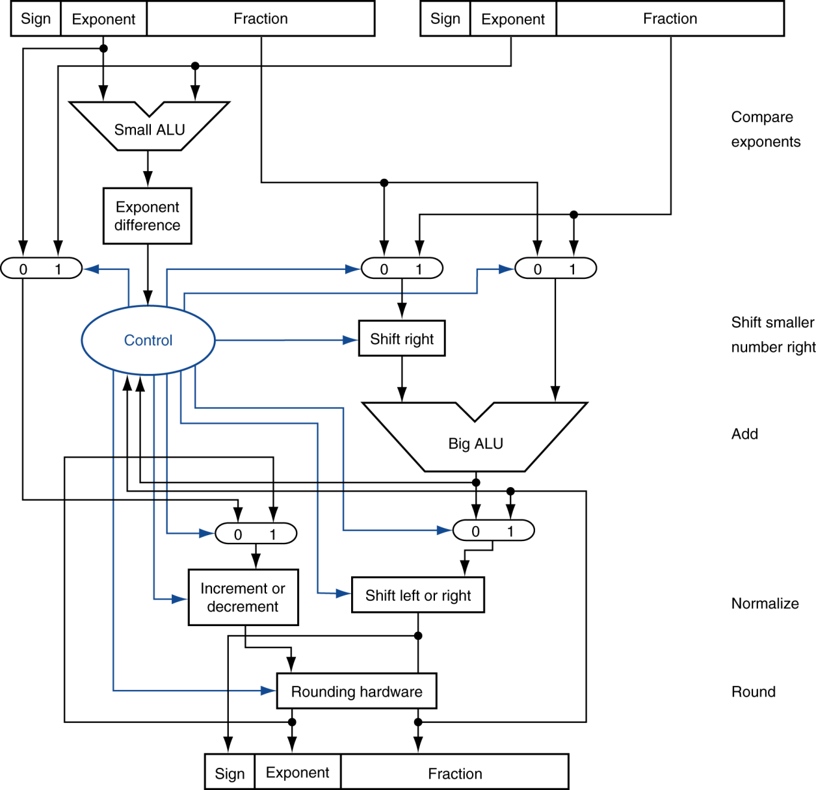
FP Adder Hardware
Step 1
Step 2
Step 3
Step 4

Slide 39
Floating-Point Multiplication
Consider a 4-digit decimal example
  1.110 × 10¹⁰ × 9.200 × 10^{–5}
1. Add exponents
  For biased exponents, subtract bias from sum
  New exponent = 10 + –5 = 5
2. Multiply significands
  1.110 × 9.200 = 10.212 ⇒ 10.212 × 10⁵
3. Normalize result & check for over/underflow
  1.0212 × 10⁶
4. Round and renormalize if necessary
  1.021 × 10⁶
5. Determine sign of result from signs of operands
  +1.021 × 10⁶

Slide 40
Floating-Point Multiplication
Now consider a 4-digit binary example
  1.000₂ × 2^{–1} × –1.110₂ × 2^{–2} (0.5 × –0.4375)
1. Add exponents
  Unbiased: –1 + –2 = –3
  Biased: (–1 + 127) + (–2 + 127) = –3 + 254 – 127 = –3 + 127
2. Multiply significands
  1.000₂ × 1.110₂ = 1.1102 ⇒ 1.110₂ × 2^{–3}
3. Normalize result & check for over/underflow
  1.110₂ × 2^{–3} (no change) with no over/underflow
4. Round and renormalize if necessary
  1.110₂ × 2^{–3} (no change)
5. Determine sign: +ve × –ve ⇒ –ve
  –1.110₂ × 2^{–3} = –0.21875

Slide 41
FP Arithmetic Hardware
FP multiplier is of similar complexity to FP adder
  But uses a multiplier for significands instead of an adder
FP arithmetic hardware usually does
  Addition, subtraction, multiplication, division, reciprocal, square-root
  FP ↔ integer conversion
Operations usually takes several cycles
  Can be pipelined

Slide 42
FP Instructions in MIPS
FP hardware is coprocessor 1
  Adjunct processor that extends the ISA
Separate FP registers
  32 single-precision: $f0, $f1, … $f31
  Paired for double-precision: $f0/$f1, $f2/$f3, …
    Release 2 of MIPs ISA supports 32 × 64-bit FP reg’s
FP instructions operate only on FP registers
  Programs generally don’t do integer ops on FP data, or vice versa
  More registers with minimal code-size impact
FP load and store instructions
  lwc1, ldc1, swc1, sdc1
    e.g., ldc1 $f8, 32($sp)

Slide 43
MIPS Floating-Point
$f0 - $f31 coprocessor registers
  Used in pairs for doubles
Arithmetic: [add | sub | mul | div].[s | d]
Data transfer: lwc1, swc1 (32-bits only)
Conditional branch:
  c.lt.[s | d] (compare less-than)
  bclt (branch if true), bclf (branch if false)
Register transfer:
  mfc1, mtc1 (move to/from coprocessor 1, dest. is first)

Slide 44
FP Instructions in MIPS
Single-precision arithmetic
  add.s, sub.s, mul.s, div.s
    e.g., add.s $f0, $f1, $f6
Double-precision arithmetic
  add.d, sub.d, mul.d, div.d
    e.g., mul.d $f4, $f4, $f6
Single- and double-precision comparison
  c.xx.s, c.xx.d (xx is eq, lt, le, …)
  Sets or clears FP condition-code bit
    e.g. c.lt.s $f3, $f4
Branch on FP condition code true or false
  bc1t, bc1f
    e.g., bc1t TargetLabel

Slide 45
FP Example: °F to °C
C code:
float f2c (float fahr) {
return ((5.0/9.0)*(fahr - 32.0));
}
  fahr in $f12, result in $f0, literals in global memory space
Compiled MIPS code:
f2c: lwc1 $f16, const5($gp)
lwc2 $f18, const9($gp)
div.s $f16, $f16, $f18
lwc1 $f18, const32($gp)
sub.s $f18, $f12, $f18
mul.s $f0, $f16, $f18
jr $ra

Slide 46
FP Example: Array Multiplication
X = X + Y × Z
  All 32 × 32 matrices, 64-bit double-precision elements
C code:
void mm (double x[][],
double y[][], double z[][]) {
int i, j, k;
for (i = 0; i! = 32; i = i + 1)
for (j = 0; j! = 32; j = j + 1)
for (k = 0; k! = 32; k = k + 1)
x[i][j] = x[i][j]
+ y[i][k] * z[k][j];
}
  Addresses of x, y, z in $a0, $a1, $a2, and
  i, j, k in $s0, $s1, $s2

Slide 47
FP Example: Array Multiplication
MIPS code:
li $t1, 32 # $t1 = 32 (row size/loop end)
li $s0, 0 # i = 0; initialize 1st for loop
L1: li $s1, 0 # j = 0; restart 2nd for loop
L2: li $s2, 0 # k = 0; restart 3rd for loop
sll $t2, $s0, 5 # $t2 = i * 32 (size of row of x)
addu $t2, $t2, $s1 # $t2 = i * size(row) + j
sll $t2, $t2, 3 # $t2 = byte offset of [i][j]
addu $t2, $a0, $t2 # $t2 = byte address of x[i][j]
l.d $f4, 0($t2) # $f4 = 8 bytes of x[i][j]
L3: sll $t0, $s2, 5 # $t0 = k * 32 (size of row of z)
addu $t0, $t0, $s1 # $t0 = k * size(row) + j
sll $t0, $t0, 3 # $t0 = byte offset of [k][j]
addu $t0, $a2, $t0 # $t0 = byte address of z[k][j]
l.d $f16, 0($t0) # $f16 = 8 bytes of z[k][j]
…

Slide 48
FP Example: Array Multiplication
…
sll $t0, $s0, 5 # $t0 = i*32 (size of row of y)
addu $t0, $t0, $s2 # $t0 = i*size(row) + k
sll $t0, $t0, 3 # $t0 = byte offset of [i][k]
addu $t0, $a1, $t0 # $t0 = byte address of y[i][k]
l.d $f18, 0($t0) # $f18 = 8 bytes of y[i][k]
mul.d $f16, $f18, $f16 # $f16 = y[i][k] * z[k][j]
add.d $f4, $f4, $f16 # f4=x[i][j] + y[i][k]*z[k][j]
addiu $s2, $s2, 1 # $k k + 1
bne $s2, $t1, L3 # if (k != 32) go to L3
s.d $f4, 0($t2) # x[i][j] = $f4
addiu $s1, $s1, 1 # $j = j + 1
bne $s1, $t1, L2 # if (j != 32) go to L2
addiu $s0, $s0, 1 # $i = i + 1
bne $s0, $t1, L1 # if (i != 32) go to L1

Slide 49
Accurate Arithmetic
IEEE Std 754 specifies additional rounding control
  Extra bits of precision (guard, round, sticky)
  Choice of rounding modes
  Allows programmer to fine-tune numerical behavior of a computation
Not all FP units implement all options
  Most programming languages and FP libraries just use defaults
Trade-off between hardware complexity, performance, and market requirements

Slide 50
Subword Parallellism
Graphics and audio applications can take advantage of performing simultaneous operations on short vectors
  Example: 128-bit adder:
    Sixteen 8-bit adds
    Eight 16-bit adds
    Four 32-bit adds
Also called data-level parallelism, vector parallelism, or Single Instruction, Multiple Data (SIMD)

Slide 51
x86 FP Architecture
Originally based on 8087 FP coprocessor
  8 × 80-bit extended-precision registers
  Used as a push-down stack
  Registers indexed from TOS: ST(0), ST(1), …
FP values are 32-bit or 64 in memory
  Converted on load/store of memory operand
  Integer operands can also be converted
  on load/store
Very difficult to generate and optimize code
  Result: poor FP performance

Slide 52
x86 FP Instructions
Data transfer | Arithmetic | Compare | Transcendental
FILD mem/ST(i) FISTP mem/ST(i) FLDPI FLD1 FLDZ | FIADDP mem/ST(i) FISUBRP mem/ST(i) FIMULP mem/ST(i) FIDIVRP mem/ST(i) FSQRT FABS FRNDINT | FICOMP FIUCOMP FSTSW AX/mem | FPATAN F2XMI FCOS FPTAN FPREM FPSIN FYL2X
Optional variations
  I: integer operand
  P: pop operand from stack
  R: reverse operand order
  But not all combinations allowed

Slide 53
Streaming SIMD Extension 2 (SSE2)
Adds 4 × 128-bit registers
  Extended to 8 registers in AMD64/EM64T
Can be used for multiple FP operands
  2 × 64-bit double precision
  4 × 32-bit double precision
  Instructions operate on them simultaneously
    Single-Instruction Multiple-Data

Slide 54
Matrix Multiply
Unoptimized code:
1. void dgemm (int n, double* A, double* B, double* C)
2. {
3. for (int i = 0; i < n; ++i)
4. for (int j = 0; j < n; ++j)
5. {
6. double cij = C[i+j*n]; /* cij = C[i][j] */
7. for(int k = 0; k < n; k++ )
8. cij += A[i+k*n] * B[k+j*n]; /* cij += A[i][k]*B[k][j] */
9. C[i+j*n] = cij; /* C[i][j] = cij */
10. }
11. }

Slide 55
Matrix Multiply
x86 assembly code:
1. vmovsd (%r10),%xmm0 # Load 1 element of C into %xmm0
2. mov %rsi,%rcx # register %rcx = %rsi
3. xor %eax,%eax # register %eax = 0
4. vmovsd (%rcx),%xmm1 # Load 1 element of B into %xmm1
5. add %r9,%rcx # register %rcx = %rcx + %r9
6. vmulsd (%r8,%rax,8),%xmm1,%xmm1 # Multiply %xmm1, element of A
7. add $0x1,%rax # register %rax = %rax + 1
8. cmp %eax,%edi # compare %eax to %edi
9. vaddsd %xmm1,%xmm0,%xmm0 # Add %xmm1, %xmm0
10. jg 30 <dgemm+0x30> # jump if %eax > %edi
11. add $0x1,%r11d # register %r11 = %r11 + 1
12. vmovsd %xmm0,(%r10) # Store %xmm0 into C element

Slide 56
Matrix Multiply
Optimized C code:
1. #include <x86intrin.h>
2. void dgemm (int n, double* A, double* B, double* C)
3. {
4. for ( int i = 0; i < n; i+=4 )
5. for ( int j = 0; j < n; j++ ) {
6. __m256d c0 = _mm256_load_pd(C+i+j*n); /* c0 = C[i][j] */
7. for( int k = 0; k < n; k++ )
8. c0 = _mm256_add_pd(c0, /* c0 += A[i][k]*B[k][j] */
9. _mm256_mul_pd(_mm256_load_pd(A+i+k*n),
10. _mm256_broadcast_sd(B+k+j*n)));
11. _mm256_store_pd(C+i+j*n, c0); /* C[i][j] = c0 */
12. }
13. }

Slide 57
Matrix Multiply
Optimized x86 assembly code:
1. vmovapd (%r11),%ymm0 # Load 4 elements of C into %ymm0
2. mov %rbx,%rcx # register %rcx = %rbx
3. xor %eax,%eax # register %eax = 0
4. vbroadcastsd (%rax,%r8,1),%ymm1 # Make 4 copies of B element
5. add $0x8,%rax # register %rax = %rax + 8
6. vmulpd (%rcx),%ymm1,%ymm1 # Parallel mul %ymm1,4 A elements
7. add %r9,%rcx # register %rcx = %rcx + %r9
8. cmp %r10,%rax # compare %r10 to %rax
9. vaddpd %ymm1,%ymm0,%ymm0 # Parallel add %ymm1, %ymm0
10. jne 50 <dgemm+0x50> # jump if not %r10 != %rax
11. add $0x1,%esi # register % esi = % esi + 1
12. vmovapd %ymm0,(%r11) # Store %ymm0 into 4 C elements

Slide 58
Right Shift and Division
Left shift by i places multiplies an integer by 2^{i}
Right shift divides by 2^{i}?
  Only for unsigned integers
For signed integers
  Arithmetic right shift: replicate the sign bit
  e.g., –5 / 4
    11111011₂ >> 2 = 11111110₂ = –2
    Rounds toward –∞
  c.f. 11111011₂ >>> 2 = 00111110₂ = +62

Slide 59
Associativity
Parallel programs may interleave operations in unexpected orders
  Assumptions of associativity may fail
Need to validate parallel programs under varying degrees of parallelism

Slide 60
Who Cares About FP Accuracy?
Important for scientific code
  But for everyday consumer use?
    “My bank balance is out by 0.0002¢!” ☹
The Intel Pentium FDIV bug
  The market expects accuracy
  See Colwell, The Pentium Chronicles

Slide 61
Concluding Remarks
Bits have no inherent meaning
  Interpretation depends on the instructions applied
Computer representations of numbers
  Finite range and precision
  Need to account for this in programs

Slide 62
Concluding Remarks
ISAs support arithmetic
  Signed and unsigned integers
  Floating-point approximation to reals
Bounded range and precision
  Operations can overflow and underflow
MIPS ISA
  Core instructions: 54 most frequently used
    100% of SPECINT, 97% of SPECFP
  Other instructions: less frequent

