Slide 1
Chapter 2
Instructions: Language of the Computer

Slide 2
Instruction Set
The repertoire of instructions of a computer
Different computers have different instruction sets
  But with many aspects in common
Early computers had very simple instruction sets
  Simplified implementation
Many modern computers also have simple instruction sets

Slide 3
Instruction Set Architecture
Instruction Set Architecture:
  abtraction that hides the low-level details of a processor from the user
  the interface between the hardware and software
  everything you need to know to “use” the processor:
    instruction set
    instruction representations
    addressing modes
    etc…
“Families” of processors are defined by their ISA:
  Sun Sparc
  Intel IA-32
  MIPS
  IBM 360
  Motorola/IBM PowerPC

Slide 4
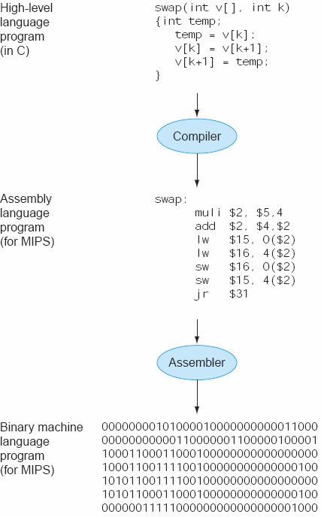
Instruction Set Architecture

Slide 5
RISC vs. CISC
Design “philosophies” for ISAs: RISC vs. CISC
  CISC = Complex Instruction Set Computer
  RISC = Reduced Instruction Set Computer
Tradeoff:
  Execution time =
  instructions per program x cycles per instruction x seconds per cycle
RISC:
  Small instruction set
    Easier for compilers
  Limit each instruction to (at most):
    three register accesses,
    one memory access,
    one ALU operation
    => facilitates parallel instruction execution (ILP)
  Load-store machine: minimize off-chip access

Slide 6
The MIPS Instruction Set
Used as the example throughout the book
Stanford MIPS commercialized by MIPS Technologies (www.mips.com)
Large share of embedded core market
  Applications in consumer electronics, network/storage equipment, cameras, printers, …
Typical of many modern ISAs
  See MIPS Reference Data tear-out card, and Appendixes B and E

Slide 7
MIPS ISA
100 million MIPS processors manufactured in 2002
MIPS processors used in:
  SGI workstations
  Series2 TiVo
  Windows CE devices
  Cisco/Linksys routers
  Nintendo 64
  Sony Playstation 1, PS2 (Emotion), PSP
  Cable boxes
John L. Hennessy (Stanford, 1981)
  1984: MIPS Computer Systems
  R2000 (1985), R3000 (1988), R4000 (64-bit, 1991)
  MIPS Technologies aquired by SGI and later by Imagination Technology
  Transition to licensed IP: MIPS32 and MIPS64 (1999)
  “Heavyweight” embedded processor

Slide 8
Arithmetic Operations
Add and subtract, three operands
  Two sources and one destination
add a, b, c # a gets b + c
All arithmetic operations have this form
Design Principle 1: Simplicity favours regularity
  Regularity makes implementation simpler
  Simplicity enables higher performance at lower cost

Slide 9
Arithmetic Example
C code:
f = (g + h) - (i + j);
Compiled MIPS code:
add t0, g, h # temp t0 = g + h
add t1, i, j # temp t1 = i + j
sub f, t0, t1 # f = t0 - t1

Slide 10
Register Operands
Arithmetic instructions use register
operands
MIPS has a 32 × 32-bit register file
  Use for frequently accessed data
  Numbered 0 to 31
  32-bit data called a “word”
Assembler names
  $t0, $t1, …, $t9 for temporary values
  $s0, $s1, …, $s7 for saved variables
Design Principle 2: Smaller is faster
  c.f. main memory: millions of locations

Slide 11
MIPS Registers
32 x 32-bit general purpose integer registers
  Some have special purposes
  These are the only registers the programmer can directly use
    $0 => constant 0
    $1 => $at (reserved for assembler)
    $2,$3 => $v0,$v1 (expression evaluation and results of a function)
    $4-$7 => $a0-$a3 (arguments 1-4)
    $8-$15 => $t0-$t7 (temporary values)
      Used when evaluating expressions that contain more than two operands (partial solutions)
      Not preserved across function calls
    $16-$23 => $s0->$s7 (for local variables, preserved across function calls)
    $24, $25 => $t8, $t9 (more temps)
    $26,$27 => $k0, $k1 (reserved for OS kernel)
    $28 => $gp (pointer to global area)
    $29 => $sp (stack pointer)
    $30 => $fp (frame pointer)
    $31 => $ra (return address, for branch-and-links)
Program counter (PC) contains address of next instruction to be executed

Slide 12
Register Operand Example
C code:
f = (g + h) - (i + j);
  f, …, j in $s0, …, $s4
Compiled MIPS code:
add $t0, $s1, $s2
add $t1, $s3, $s4
sub $s0, $t0, $t1

Slide 13
Memory Operands
Main memory used for composite data
  Arrays, structures, dynamic data
To apply arithmetic operations
  Load values from memory into registers
  Store result from register to memory
Memory is byte addressed
  Each address identifies an 8-bit byte
Words are aligned in memory
  Address must be a multiple of 4
MIPS is Little Endian
  Least-significant byte at least address of a word
  c.f. Big Endian: most-significant byte at least address

Slide 14
Memory Operand Example 1
C code:
g = h + A[8];
  g in $s1, h in $s2, base address of A in $s3
Compiled MIPS code:
  Index 8 requires offset of 32
    4 bytes per word
lw $t0, 32($s3) # load word
add $s1, $s2, $t0
offset
base register

Slide 15
Memory Operand Example 2
C code:
A[12] = h + A[8];
  h in $s2, base address of A in $s3
Compiled MIPS code:
  Index 8 requires offset of 32
lw $t0, 32($s3) # load word
add $t0, $s2, $t0
sw $t0, 48($s3) # store word

Slide 16
Registers vs. Memory
Registers are faster to access than memory
Operating on memory data requires loads and stores
  More instructions to be executed
Compiler must use registers for variables as much as possible
  Only spill to memory for less frequently used variables
  Register optimization is important!

Slide 17
Immediate Operands
Constant data specified in an instruction
addi $s3, $s3, 4
No subtract immediate instruction
  Just use a negative constant
  addi $s2, $s1, -1
Design Principle 3: Make the common case fast
  Small constants are common
  Immediate operand avoids a load instruction

Slide 18
The Constant Zero
MIPS register 0 ($zero) is the constant 0
  Cannot be overwritten
Useful for common operations
  E.g., move between registers
  add $t2, $s1, $zero

Slide 19
Representing Instructions
Instructions are encoded in binary
  Called machine code
MIPS instructions
  Encoded as 32-bit instruction words
  Small number of formats encoding operation code (opcode), register numbers, …
  Regularity!
Register numbers
  $t0 – $t7 are reg’s 8 – 15
  $t8 – $t9 are reg’s 24 – 25
  $s0 – $s7 are reg’s 16 – 23

Slide 20
MIPS R-format Instructions
op
rs
rt
rd
shamt
funct
6 bits
5 bits
5 bits
5 bits
5 bits
6 bits
Instruction fields
  op: operation code (opcode)
  rs: first source register number
  rt: second source register number
  rd: destination register number
  shamt: shift amount (00000 for now)
  funct: function code (extends opcode)

Slide 21
R-format Example
op
rs
rt
rd
shamt
funct
6 bits
5 bits
5 bits
5 bits
5 bits
6 bits
add $t0, $s1, $s2
special
$s1
$s2
$t0
0
add
0
17
18
8
0
32
000000
10001
10010
01000
00000
100000
00000010001100100100000000100000₂ = 02324020₁₆

Slide 22
Hexadecimal
Base 16
  Compact representation of bit strings
  4 bits per hex digit
0 | 0000 | 4 | 0100 | 8 | 1000 | c | 1100
1 | 0001 | 5 | 0101 | 9 | 1001 | d | 1101
2 | 0010 | 6 | 0110 | a | 1010 | e | 1110
3 | 0011 | 7 | 0111 | b | 1011 | f | 1111
Example: eca8 6420
  1110 1100 1010 1000 0110 0100 0010 0000

Slide 23
MIPS I-format Instructions
op
rs
rt
constant or address
6 bits
5 bits
5 bits
16 bits
Immediate arithmetic and load/store instructions
  rt: destination or source register number
  Constant: –2¹⁵ to +2¹⁵ – 1
  Address: offset added to base address in rs
Design Principle 4: Good design demands good compromises
  Different formats complicate decoding, but allow 32-bit instructions uniformly
  Keep formats as similar as possible

Slide 24
Logical Operations
Instructions for bitwise manipulation
Operation | C | Java | MIPS
Shift left | << | << | sll
Shift right | >> | >>> | srl
Bitwise AND | & | & | and, andi
Bitwise OR | | | | | or, ori
Bitwise NOT | ~ | ~ | nor
Useful for extracting and inserting groups of bits in a word

Slide 25
Shift Operations
op
rs
rt
rd
shamt
funct
6 bits
5 bits
5 bits
5 bits
5 bits
6 bits
shamt: how many positions to shift
Shift left logical
  Shift left and fill with 0 bits
  sll by i bits multiplies by 2^{i}
Shift right logical
  Shift right and fill with 0 bits
  srl by i bits divides by 2^{i} (unsigned only)

Slide 26
AND Operations
Useful to mask bits in a word
  Select some bits, clear others to 0
and $t0, $t1, $t2
$t2
0000 0000 0000 0000 0000 1101 1100 0000
$t1
0000 0000 0000 0000 0011 1100 0000 0000
$t0
0000 0000 0000 0000 0000 1100 0000 0000

Slide 27
OR Operations
Useful to include bits in a word
  Set some bits to 1, leave others unchanged
or $t0, $t1, $t2
$t2
0000 0000 0000 0000 0000 1101 1100 0000
$t1
0000 0000 0000 0000 0011 1100 0000 0000
$t0
0000 0000 0000 0000 0011 1101 1100 0000

Slide 28
NOT Operations
Useful to invert bits in a word
  Change 0 to 1, and 1 to 0
MIPS has NOR 3-operand instruction
  a NOR b == NOT ( a OR b )
nor $t0, $t1, $zero
Register 0: always read as zero
$t1
0000 0000 0000 0000 0011 1100 0000 0000
$t0
1111 1111 1111 1111 1100 0011 1111 1111

Slide 29
Conditional Operations
Branch to a labeled instruction if a condition is true
  Otherwise, continue sequentially
beq rs, rt, L1
  if (rs == rt) branch to instruction labeled L1;
bne rs, rt, L1
  if (rs != rt) branch to instruction labeled L1;
j L1
  unconditional jump to instruction labeled L1

Slide 30
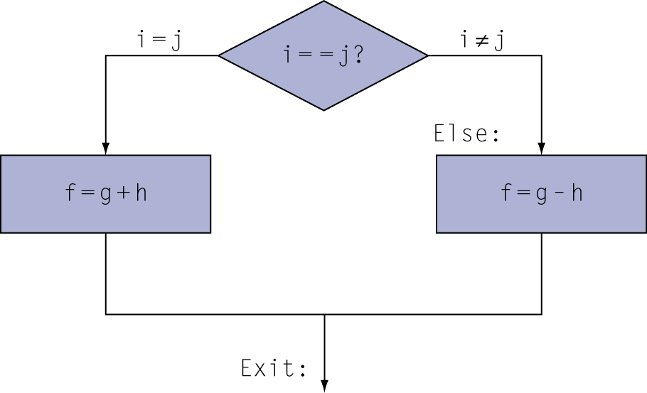
Compiling If Statements
C code:
if (i==j) f = g+h;
else f = g-h;
  f, g, … in $s0, $s1, …
Compiled MIPS code:
bne $s3, $s4, Else
add $s0, $s1, $s2
j Exit
Else: sub $s0, $s1, $s2
Exit: …
Assembler calculates addresses

Slide 31
Compiling Loop Statements
C code:
while (save[i] == k) i += 1;
  i in $s3, k in $s5, address of save in $s6
Compiled MIPS code:
Loop: sll $t1, $s3, 2
add $t1, $t1, $s6
lw $t0, 0($t1)
bne $t0, $s5, Exit
addi $s3, $s3, 1
j Loop
Exit: …

Slide 32
Integer Multiply and Divide
mult $2, $3
  result in hi (32 bits) and lo (32 bits)
  mul $2, $3, $4 is psuedo (low 32 bits)
  madd $2, $3 – multiply and accumulate in hi and lo
div $2, $3
  quotient in lo and reminder in hi
  div $2, $3, $4 is psuedo (quotient)

Slide 33
Complex Arithmetic Example
z=(a*b)+(c/d)-(e+f*g);
lw $s0,a
lw $s1,b
mult $s0,$s1
mflo $t0
lw $s0,c
lw $s1,d
div $s0,$s1
mflo $t1
add $t0,$t0,$t1
lw $s0,e
lw $s1,f
lw $s2,g
mult $s1,$s2
mflo $t1
add $t1,$s0,$t1
sub $t0,$t0,$t1
sw $t0,z

Slide 34
If-Statement
if ((a>b)&&(c==d)) e=0; else e=f;
lw $s0,a
lw $s1,b
bgt $s0,$s1,next0
b nope
next0: lw $s0,c
lw $s1,d
beq $s0,$s1,yup
nope: lw $s0,f
sw $s0,e
b out
yup: xor $s0,$s0,$s0
sw $s0,e
out: …

Slide 35
For Loop
for (i=0;i<a;i++) b[i]=i;
lw $s0,a
li $s1,0
loop0: blt $s1,$s0,loop1
j out
loop1: sll $s2,$s1,2
sw $s1,b($s2)
addi $s1,$s1,1
j loop0
out: …

Slide 36
Pre-Test While Loop
while (a<b) {
  a++;
}
  lw $s0,a
  lw $s1,b
  loop0: blt $s0,$s1,loop1
  b out
  loop1: addi $s0,Ss0,1
  sw $s0,a
  b loop0
  out: …

Slide 37
Post-Test While Loop
do {
  a++;
} while (a<b);
  lw $s0,a
  lw $s1,b
  loop0: addi $s0,$s0,1
  sw $s0,a
  blt $s0,$s1,loop0
  …

Slide 38
Complex Loop
for (i=0;i<n;i++) a[i]=b[i]+10;
li $2,$0 # zero out index register (i)
lw $3,n # load iteration limit
sll $3,$3,2 # multiply by 4 (words)
la $4,a # get address of a (assume < 2¹⁶)
la $5,b # get address of b (assume < 2¹⁶)
j test
loop: add $6,$5,$2 # compute address of b[i]
lw $7,0($6) # load b[i]
addi $7,$7,10 # compute b[i]=b[i]+10
add $6,$4,$2 # compute address of a[i]
sw $7,0($6) # store into a[i]
addi $2,$2,4 # increment i
test: blt $2,$3,loop # loop if test succeeds

Slide 39
Branch Addressing
Branch instructions specify
  Opcode, two registers, target address
Most branch targets are near branch
  Forward or backward
op
rs
rt
constant or address
6 bits
5 bits
5 bits
16 bits
PC-relative addressing
  Target address = PC + offset × 4
  PC already incremented by 4 by this time

Slide 40
Jump Addressing
Jump (j and jal) targets could be anywhere in text segment
  Encode full address in instruction
op
address
6 bits
26 bits
(Pseudo) Direct jump addressing
  Target address = PC_{31…28} : (address × 4)

Slide 41
Target Addressing Example
Loop code from earlier example
  Assume Loop at location 80000
Loop: sll $t1, $s3, 2 | 80000 | 0 | 0 | 19 | 9 | 4 | 0
add $t1, $t1, $s6 | 80004 | 0 | 9 | 22 | 9 | 0 | 32
lw $t0, 0($t1) | 80008 | 35 | 9 | 8 | 0
bne $t0, $s5, Exit | 80012 | 5 | 8 | 21 | 2
addi $s3, $s3, 1 | 80016 | 8 | 19 | 19 | 1
j Loop | 80020 | 2 | 20000
Exit: … | 80024

Slide 42
Branching Far Away
If branch target is too far to encode with 16-bit offset, assembler rewrites the code
Example
  beq $s0,$s1, L1
  ↓
  bne $s0,$s1, L2
  j L1
  L2: …

Slide 43
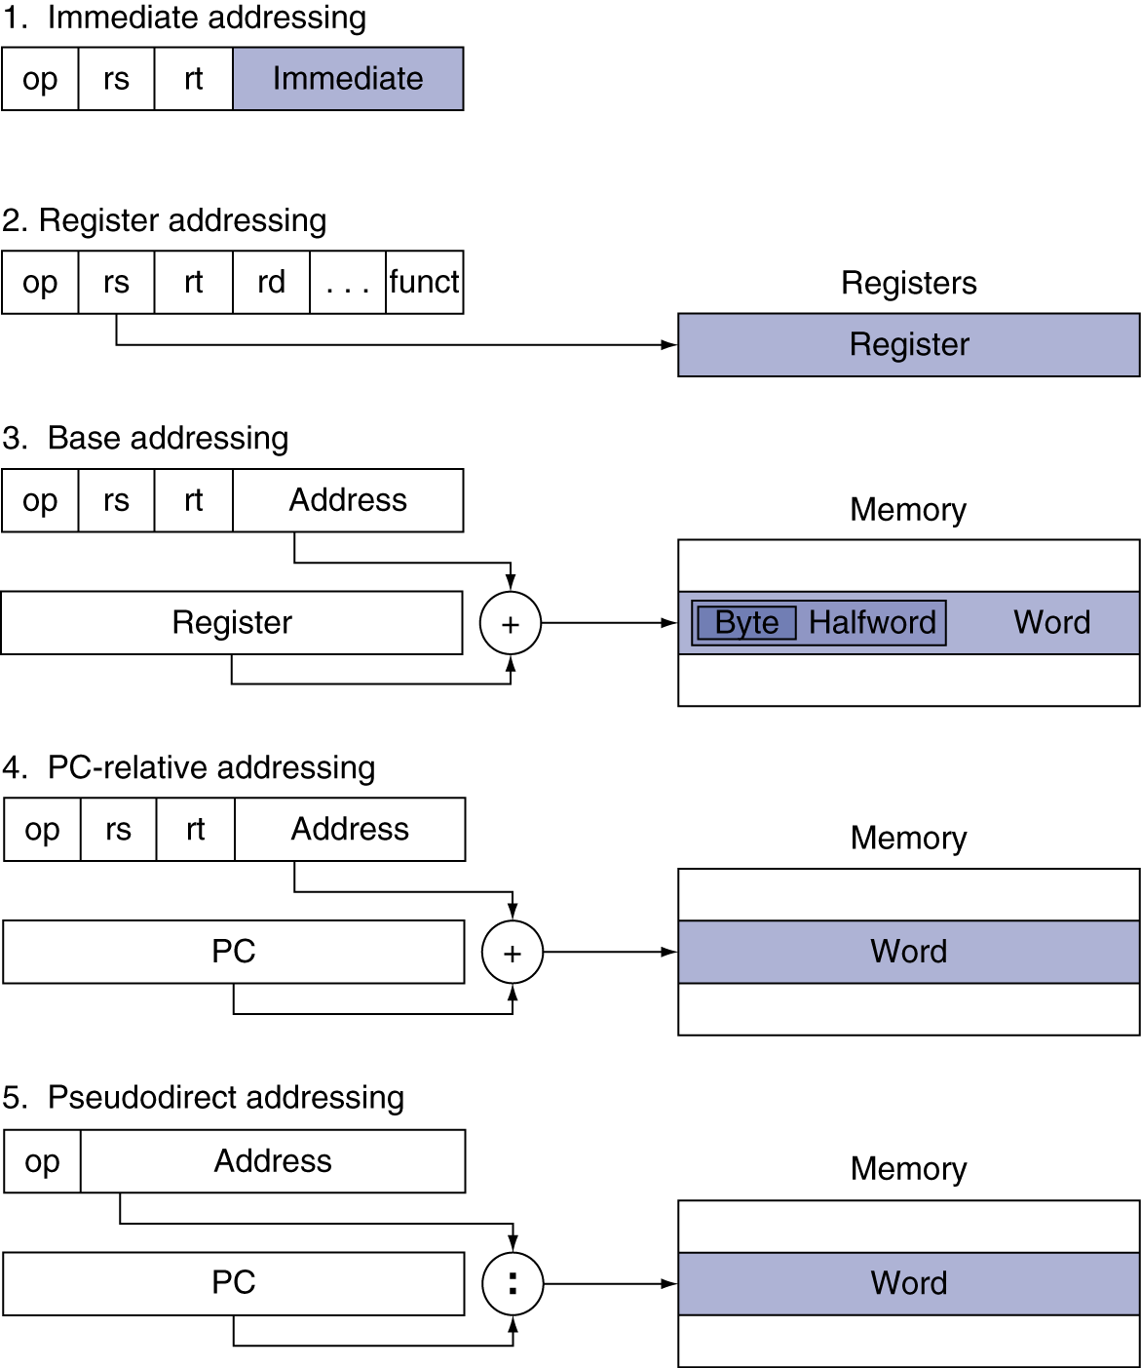
Addressing Mode Summary

Slide 44
More Conditional Operations
Set result to 1 if a condition is true
  Otherwise, set to 0
slt rd, rs, rt
  if (rs < rt) rd = 1; else rd = 0;
slti rt, rs, constant
  if (rs < constant) rt = 1; else rt = 0;
Use in combination with beq, bne
  slt $t0, $s1, $s2 # if ($s1 < $s2)
  bne $t0, $zero, L # branch to L

Slide 45
Branch Instruction Design
Why not blt, bge, etc?
Hardware for <, ≥, … slower than =, ≠
  Combining with branch involves more work per instruction, requiring a slower clock
  All instructions penalized!
beq and bne are the common case
This is a good design compromise

Slide 46
Assembler Pseudoinstructions
Most assembler instructions represent machine instructions one-to-one
Pseudoinstructions: figments of the assembler’s imagination
move $t0, $t1 → add $t0, $zero, $t1
blt $t0, $t1, L → slt $at, $t0, $t1
bne $at, $zero, L
  $at (register 1): assembler temporary

Slide 47
Pseudoinstructions
Some MIPS instructions don’t have direct hardware implementations
  Ex: abs $2, $3
    Resolved to:
      bgez $3, pos
      sub $2, $0, $3
      j out
      pos: add $2, $0, $3
      out: …
  Ex: rol $2, $3, $4
    Resolved to:
      addi $1, $0, 32
      sub $1, $1, $4
      srlv $1, $3, $1
      sllv $2, $3, $4
      or $2, $2, $1

Slide 48
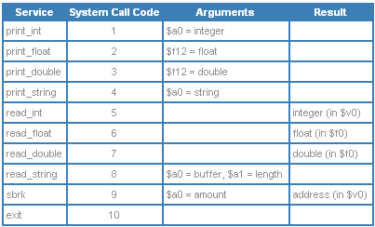
I/O
I/O is performed with reserved instructions / memory space
Performed by the operating system on behalf of user code
Use syscall instruction
Call code in $v0 and argument in $a0
Return value in $v0 (or $f0)
Services:

Slide 49
Example
.data
str: .asciiz “the answer = “
.text
li $v0,4
la $a0, str
syscall
li $v0,1
la $a0,5
syscall

Slide 50
Signed vs. Unsigned
Signed comparison: slt, slti
Unsigned comparison: sltu, sltui
Example
  $s0 = 1111 1111 1111 1111 1111 1111 1111 1111
  $s1 = 0000 0000 0000 0000 0000 0000 0000 0001
  slt $t0, $s0, $s1 # signed
    –1 < +1 ⇒ $t0 = 1
  sltu $t0, $s0, $s1 # unsigned
    +4,294,967,295 > +1 ⇒ $t0 = 0

Slide 51
Procedure Calling
Steps required
  Place parameters in registers
  Transfer control to procedure
  Acquire storage for procedure
  Perform procedure’s operations
  Place result in register for caller
  Return to place of call

Slide 52
Register Usage
$a0 – $a3: arguments (reg’s 4 – 7)
$v0, $v1: result values (reg’s 2 and 3)
$t0 – $t9: temporaries
  Can be overwritten by callee
$s0 – $s7: saved
  Must be saved/restored by callee
$gp: global pointer for static data (reg 28)
$sp: stack pointer (reg 29)
$fp: frame pointer (reg 30)
$ra: return address (reg 31)

Slide 53
Procedure Call Instructions
Procedure call: jump and link
jal ProcedureLabel
  Address of following instruction put in $ra
  Jumps to target address
Procedure return: jump register
jr $ra
  Copies $ra to program counter
  Can also be used for computed jumps
    e.g., for case/switch statements

Slide 54
Leaf Procedure Example
C code:
int leaf_example (int g, h, i, j)
{ int f;
f = (g + h) - (i + j);
return f;
}
  Arguments g, …, j in $a0, …, $a3
  f in $s0 (hence, need to save $s0 on stack)
  Result in $v0

Slide 55
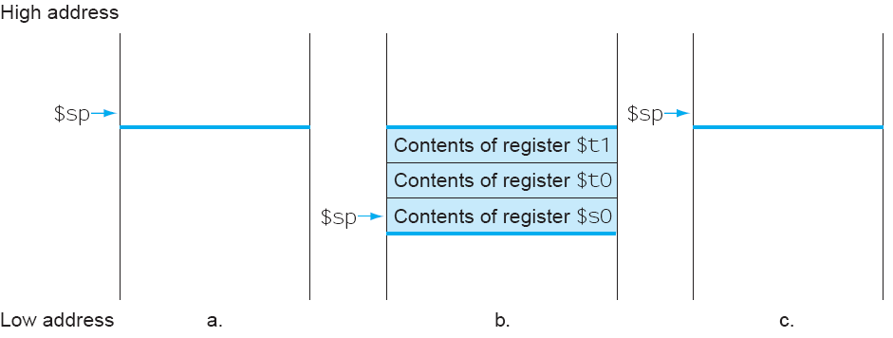
Stack Example

Slide 56
Leaf Procedure Example
MIPS code:
leaf_example:
addi $sp, $sp, -4
sw $s0, 0($sp)
add $t0, $a0, $a1
add $t1, $a2, $a3
sub $s0, $t0, $t1
add $v0, $s0, $zero
lw $s0, 0($sp)
addi $sp, $sp, 4
jr $ra
Save $s0 on stack
Procedure body
Result
Restore $s0
Return

Slide 57
Non-Leaf Procedures
Procedures that call other procedures
For nested call, caller needs to save on the stack:
  Its return address
  Any arguments and temporaries needed after the call
Restore from the stack after the call

Slide 58
Non-Leaf Procedure Example
C code:
int fact (int n)
{
if (n < 1) return f;
else return n * fact(n - 1);
}
  Argument n in $a0
  Result in $v0

Slide 59
Non-Leaf Procedure Example
MIPS code:
fact:
addi $sp, $sp, -8 # adjust stack for 2 items
sw $ra, 4($sp) # save return address
sw $a0, 0($sp) # save argument
slti $t0, $a0, 1 # test for n < 1
beq $t0, $zero, L1
addi $v0, $zero, 1 # if so, result is 1
addi $sp, $sp, 8 # pop 2 items from stack
jr $ra # and return
L1: addi $a0, $a0, -1 # else decrement n
jal fact # recursive call
lw $a0, 0($sp) # restore original n
lw $ra, 4($sp) # and return address
addi $sp, $sp, 8 # pop 2 items from stack
mul $v0, $a0, $v0 # multiply to get result
jr $ra # and return

Slide 60
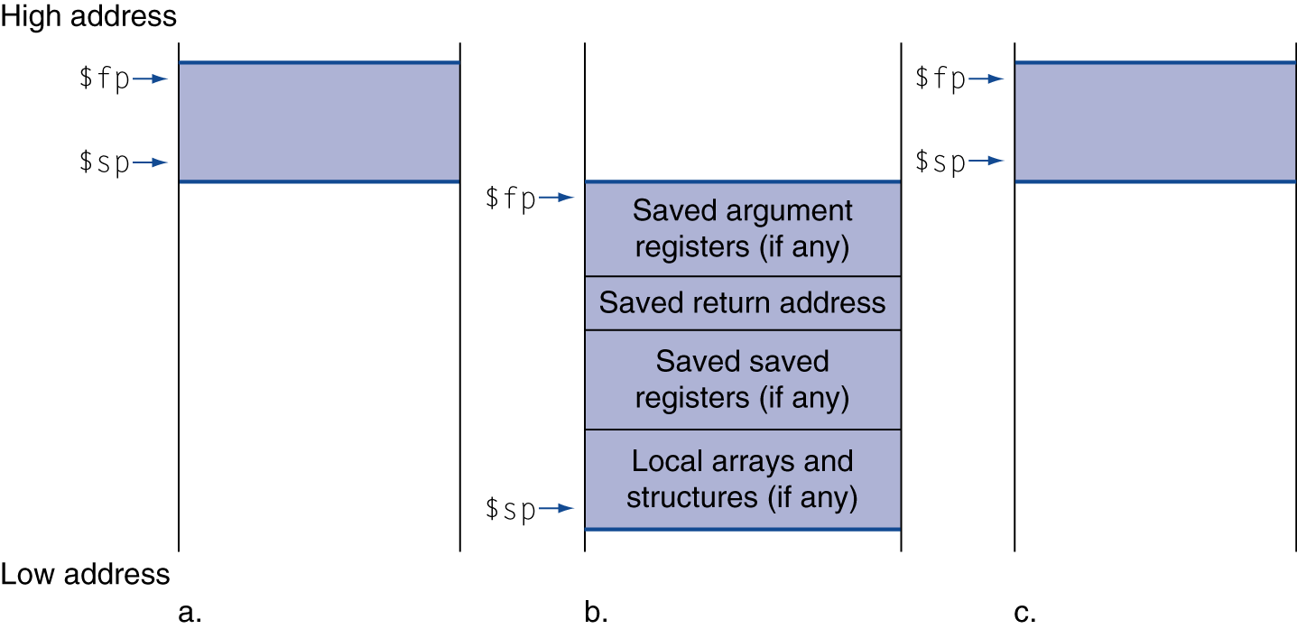
Local Data on the Stack
Local data allocated by callee
  e.g., C automatic variables
Procedure frame (activation record)
  Used by some compilers to manage stack storage

Slide 61
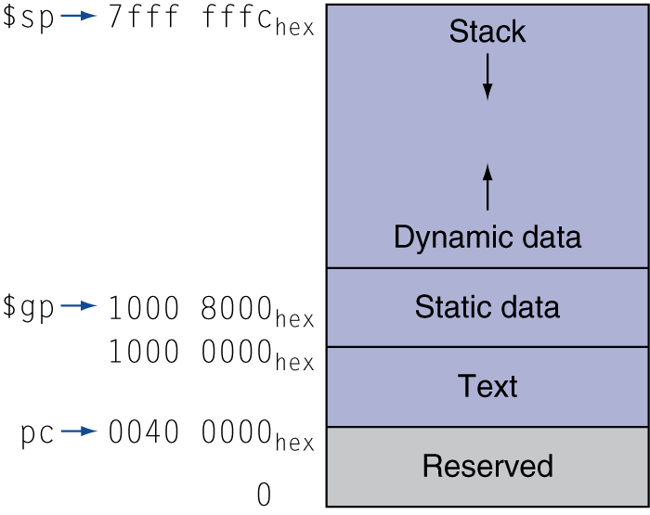
Memory Layout
Text: program code
Static data: global variables
  e.g., static variables in C, constant arrays and strings
  $gp initialized to address allowing ±offsets into this segment
Dynamic data: heap
  E.g., malloc in C, new in Java
Stack: automatic storage

Slide 62
Character Data
Byte-encoded character sets
  ASCII: 128 characters
    95 graphic, 33 control
  Latin-1: 256 characters
    ASCII, +96 more graphic characters
Unicode: 32-bit character set
  Used in Java, C++ wide characters, …
  Most of the world’s alphabets, plus symbols
  UTF-8, UTF-16: variable-length encodings

Slide 63
Byte/Halfword Operations
Could use bitwise operations
MIPS byte/halfword load/store
  String processing is a common case
lb rt, offset(rs) lh rt, offset(rs)
  Sign extend to 32 bits in rt
lbu rt, offset(rs) lhu rt, offset(rs)
  Zero extend to 32 bits in rt
sb rt, offset(rs) sh rt, offset(rs)
  Store just rightmost byte/halfword

Slide 64
String Copy Example
C code (naïve):
  Null-terminated string
void strcpy (char x[], char y[])
{ int i;
i = 0;
while ((x[i]=y[i])!='\0')
i += 1;
}
  Addresses of x, y in $a0, $a1
  i in $s0

Slide 65
String Copy Example
MIPS code:
strcpy:
addi $sp, $sp, -4 # adjust stack for 1 item
sw $s0, 0($sp) # save $s0
add $s0, $zero, $zero # i = 0
L1: add $t1, $s0, $a1 # addr of y[i] in $t1
lbu $t2, 0($t1) # $t2 = y[i]
add $t3, $s0, $a0 # addr of x[i] in $t3
sb $t2, 0($t3) # x[i] = y[i]
beq $t2, $zero, L2 # exit loop if y[i] == 0
addi $s0, $s0, 1 # i = i + 1
j L1 # next iteration of loop
L2: lw $s0, 0($sp) # restore saved $s0
addi $sp, $sp, 4 # pop 1 item from stack
jr $ra # and return

Slide 66
32-bit Constants
Most constants are small
  16-bit immediate is sufficient
For the occasional 32-bit constant
lui rt, constant
  Copies 16-bit constant to left 16 bits of rt
  Clears right 16 bits of rt to 0
lui $s0, 61
0000 0000 0111 1101 0000 0000 0000 0000
ori $s0, $s0, 2304
0000 0000 0111 1101 0000 1001 0000 0000

Slide 67
C Sort Example
Illustrates use of assembly instructions for a C bubble sort function
Swap procedure (leaf)
  void swap(int v[], int k)
  {
  int temp;
  temp = v[k];
  v[k] = v[k+1];
  v[k+1] = temp;
  }
  v in $a0, k in $a1, temp in $t0

Slide 68
The Procedure Swap
swap: sll $t1, $a1, 2 # $t1 = k * 4
add $t1, $a0, $t1 # $t1 = v+(k*4)
# (address of v[k])
lw $t0, 0($t1) # $t0 (temp) = v[k]
lw $t2, 4($t1) # $t2 = v[k+1]
sw $t2, 0($t1) # v[k] = $t2 (v[k+1])
sw $t0, 4($t1) # v[k+1] = $t0 (temp)
jr $ra # return to calling routine

Slide 69
The Sort Procedure in C
Non-leaf (calls swap)
  void sort (int v[], int n)
  {
  int i, j;
  for (i = 0; i < n; i += 1) {
  for (j = i – 1;
  j >= 0 && v[j] > v[j + 1];
  j -= 1) {
  swap(v,j);
  }
  }
  }
  v in $a0, k in $a1, i in $s0, j in $s1

Slide 70
The Procedure Body
move $s2, $a0 # save $a0 into $s2
move $s3, $a1 # save $a1 into $s3
move $s0, $zero # i = 0
for1tst: slt $t0, $s0, $s3 # $t0 = 0 if $s0 ≥ $s3 (i ≥ n)
beq $t0, $zero, exit1 # go to exit1 if $s0 ≥ $s3 (i ≥ n)
addi $s1, $s0, –1 # j = i – 1
for2tst: slti $t0, $s1, 0 # $t0 = 1 if $s1 < 0 (j < 0)
bne $t0, $zero, exit2 # go to exit2 if $s1 < 0 (j < 0)
sll $t1, $s1, 2 # $t1 = j * 4
add $t2, $s2, $t1 # $t2 = v + (j * 4)
lw $t3, 0($t2) # $t3 = v[j]
lw $t4, 4($t2) # $t4 = v[j + 1]
slt $t0, $t4, $t3 # $t0 = 0 if $t4 ≥ $t3
beq $t0, $zero, exit2 # go to exit2 if $t4 ≥ $t3
move $a0, $s2 # 1st param of swap is v (old $a0)
move $a1, $s1 # 2nd param of swap is j
jal swap # call swap procedure
addi $s1, $s1, –1 # j –= 1
j for2tst # jump to test of inner loop
exit2: addi $s0, $s0, 1 # i += 1
j for1tst # jump to test of outer loop
Move
params
Outer loop
Inner loop
Pass
params
& call
Inner loop
Outer loop

Slide 71
The Full Procedure
sort: addi $sp,$sp, –20 # make room on stack for 5 registers
sw $ra, 16($sp) # save $ra on stack
sw $s3,12($sp) # save $s3 on stack
sw $s2, 8($sp) # save $s2 on stack
sw $s1, 4($sp) # save $s1 on stack
sw $s0, 0($sp) # save $s0 on stack
… # procedure body
…
exit1: lw $s0, 0($sp) # restore $s0 from stack
lw $s1, 4($sp) # restore $s1 from stack
lw $s2, 8($sp) # restore $s2 from stack
lw $s3,12($sp) # restore $s3 from stack
lw $ra,16($sp) # restore $ra from stack
addi $sp,$sp, 20 # restore stack pointer
jr $ra # return to calling routine

Slide 72
Effect of Compiler Optimization
Compiled with gcc for Pentium 4 under Linux

Slide 73
Effect of Language and Algorithm

Slide 74
Lessons Learned
Instruction count and CPI are not good performance indicators in isolation
Compiler optimizations are sensitive to the algorithm
Java/JIT compiled code is significantly faster than JVM interpreted
  Comparable to optimized C in some cases
Nothing can fix a dumb algorithm!

Slide 75
Arrays vs. Pointers
Array indexing involves
  Multiplying index by element size
  Adding to array base address
Pointers correspond directly to memory addresses
  Can avoid indexing complexity

Slide 76
Example: Clearing an Array
clear1(int array[], int size) { int i; for (i = 0; i < size; i += 1) array[i] = 0; } | clear2(int *array, int size) { int *p; for (p = &array[0]; p < &array[size]; p = p + 1) *p = 0; }
move $t0,$zero # i = 0 loop1: sll $t1,$t0,2 # $t1 = i * 4 add $t2,$a0,$t1 # $t2 = # &array[i] sw $zero, 0($t2) # array[i] = 0 addi $t0,$t0,1 # i = i + 1 slt $t3,$t0,$a1 # $t3 = # (i < size) bne $t3,$zero,loop1 # if (…) # goto loop1 | move $t0,$a0 # p = & array[0] sll $t1,$a1,2 # $t1 = size * 4 add $t2,$a0,$t1 # $t2 = # &array[size] loop2: sw $zero,0($t0) # Memory[p] = 0 addi $t0,$t0,4 # p = p + 4 slt $t3,$t0,$t2 # $t3 = #(p<&array[size]) bne $t3,$zero,loop2 # if (…) # goto loop2

Slide 77
Comparison of Array vs. Ptr
Multiply “strength reduced” to shift
Array version requires shift to be inside loop
  Part of index calculation for incremented i
  c.f. incrementing pointer
Compiler can achieve same effect as manual use of pointers
  Induction variable elimination
  Better to make program clearer and safer

Slide 78
ARM & MIPS Similarities
ARM: the most popular embedded core
Similar basic set of instructions to MIPS
 | ARM | MIPS
Date announced | 1985 | 1985
Instruction size | 32 bits | 32 bits
Address space | 32-bit flat | 32-bit flat
Data alignment | Aligned | Aligned
Data addressing modes | 9 | 3
Registers | 15 × 32-bit | 31 × 32-bit
Input/output | Memory mapped | Memory mapped

Slide 79
Compare and Branch in ARM
Uses condition codes for result of an arithmetic/logical instruction
  Negative, zero, carry, overflow
  Compare instructions to set condition codes without keeping the result
Each instruction can be conditional
  Top 4 bits of instruction word: condition value
  Can avoid branches over single instructions

Slide 80
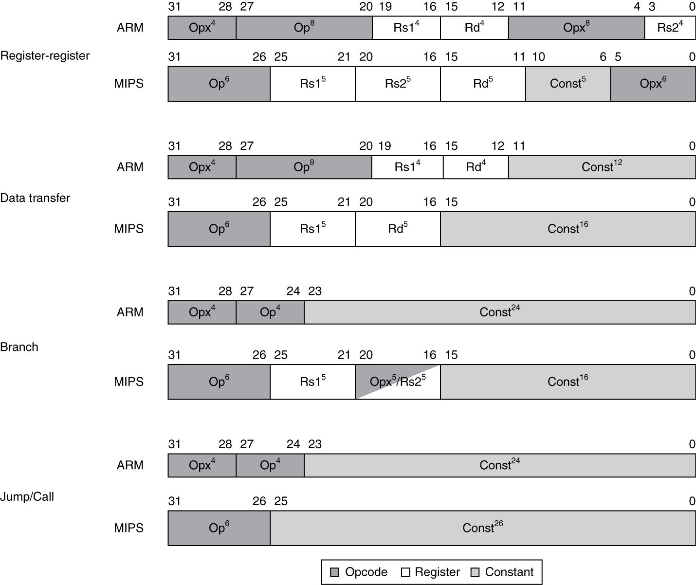
Instruction Encoding

Slide 81
The Intel x86 ISA
Evolution with backward compatibility
  8080 (1974): 8-bit microprocessor
    Accumulator, plus 3 index-register pairs
  8086 (1978): 16-bit extension to 8080
    Complex instruction set (CISC)
  8087 (1980): floating-point coprocessor
    Adds FP instructions and register stack
  80286 (1982): 24-bit addresses, MMU
    Segmented memory mapping and protection
  80386 (1985): 32-bit extension (now IA-32)
    Additional addressing modes and operations
    Paged memory mapping as well as segments

Slide 82
The Intel x86 ISA
Further evolution…
  i486 (1989): pipelined, on-chip caches and FPU
    Compatible competitors: AMD, Cyrix, …
  Pentium (1993): superscalar, 64-bit datapath
    Later versions added MMX (Multi-Media eXtension) instructions
    The infamous FDIV bug
  Pentium Pro (1995), Pentium II (1997)
    New microarchitecture (see Colwell, The Pentium Chronicles)
  Pentium III (1999)
    Added SSE (Streaming SIMD Extensions) and associated registers
  Pentium 4 (2001)
    New microarchitecture
    Added SSE2 instructions

Slide 83
The Intel x86 ISA
And further…
  AMD64 (2003): extended architecture to 64 bits
  EM64T – Extended Memory 64 Technology (2004)
    AMD64 adopted by Intel (with refinements)
    Added SSE3 instructions
  Intel Core (2006)
    Added SSE4 instructions, virtual machine support
  AMD64 (announced 2007): SSE5 instructions
    Intel declined to follow, instead…
  Advanced Vector Extension (announced 2008)
    Longer SSE registers, more instructions
If Intel didn’t extend with compatibility, its competitors would!
  Technical elegance ≠ market success

Slide 84
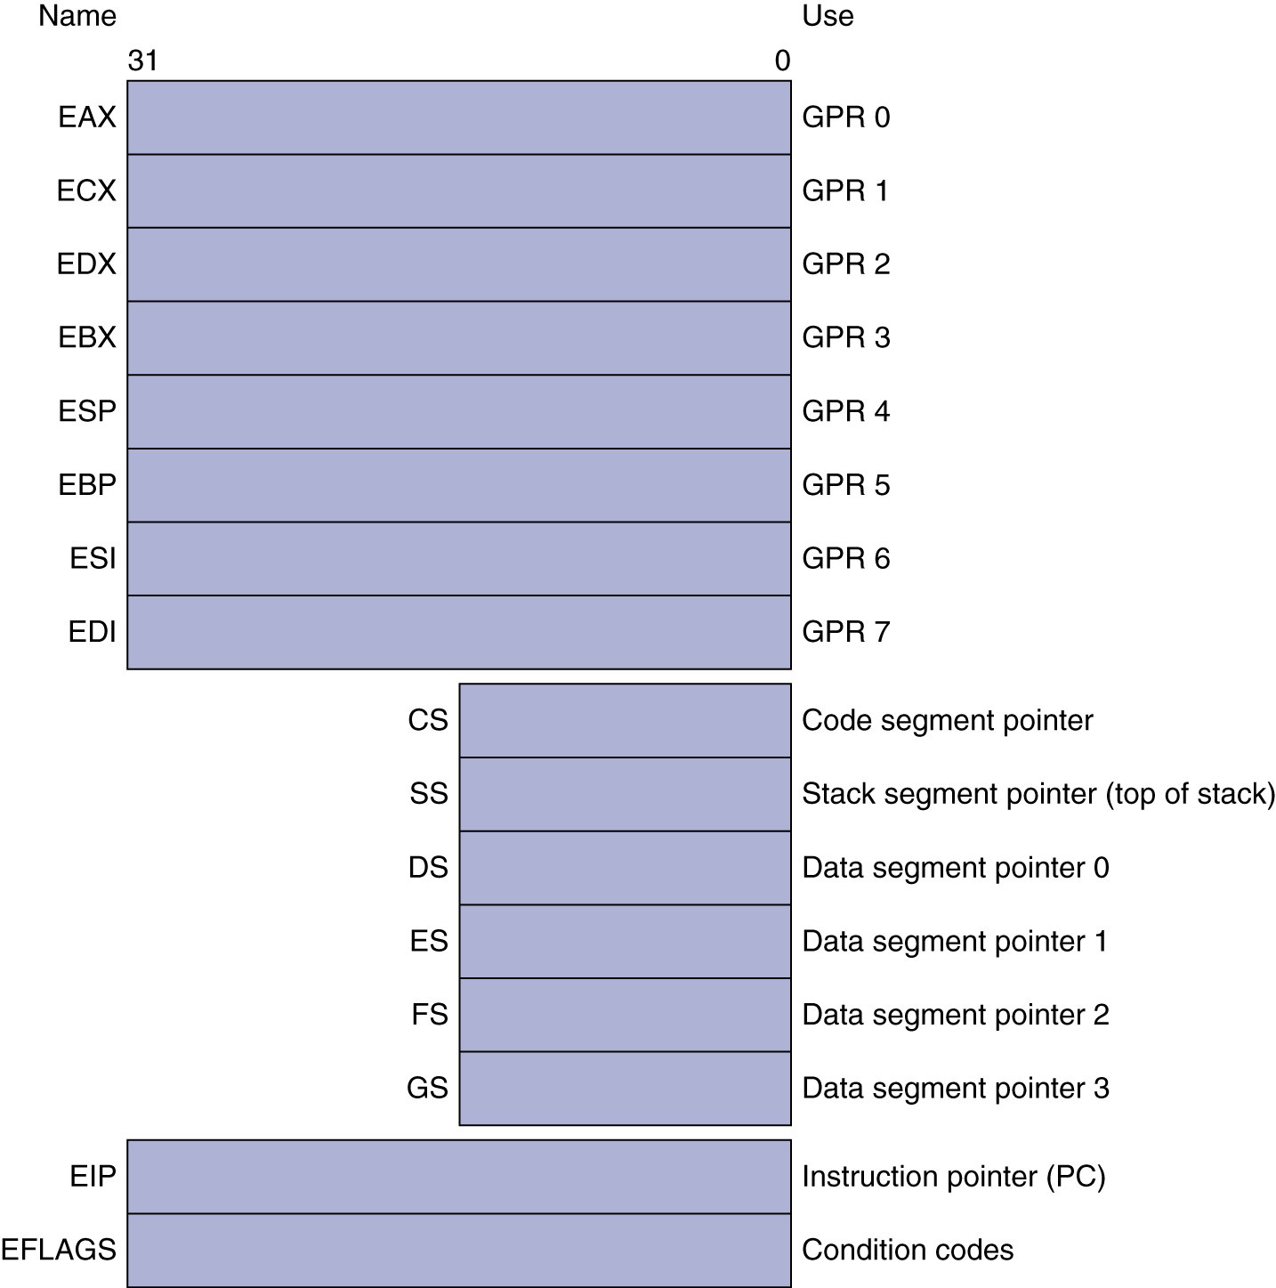
Basic x86 Registers

Slide 85
Basic x86 Addressing Modes
Two operands per instruction
Source/dest operand | Second source operand
Register | Register
Register | Immediate
Register | Memory
Memory | Register
Memory | Immediate
Memory addressing modes
  Address in register
  Address = R_{base} + displacement
  Address = R_{base} + 2^{scale} × R_{index} (scale = 0, 1, 2, or 3)
  Address = R_{base} + 2^{scale} × R_{index} + displacement

Slide 86
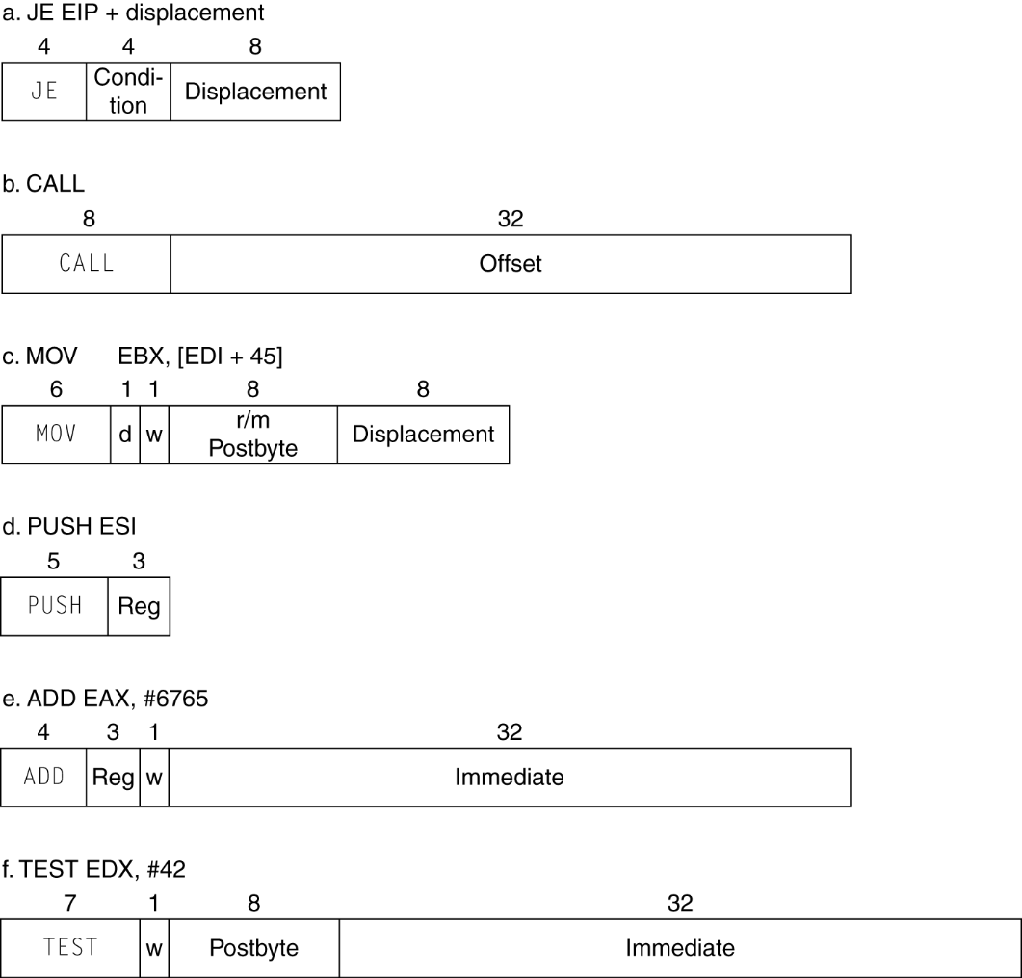
x86 Instruction Encoding
Variable length encoding
  Postfix bytes specify addressing mode
  Prefix bytes modify operation
    Operand length, repetition, locking, …

Slide 87
Implementing IA-32
Complex instruction set makes implementation difficult
  Hardware translates instructions to simpler microoperations
    Simple instructions: 1–1
    Complex instructions: 1–many
  Microengine similar to RISC
  Market share makes this economically viable
Comparable performance to RISC
  Compilers avoid complex instructions

Slide 88
ARM v8 Instructions
In moving to 64-bit, ARM did a complete overhaul
ARM v8 resembles MIPS
  Changes from v7:
    No conditional execution field
    Immediate field is 12-bit constant
    Dropped load/store multiple
    PC is no longer a GPR
    GPR set expanded to 32
    Addressing modes work for all word sizes
    Divide instruction
    Branch if equal/branch if not equal instructions

Slide 89
Fallacies
Powerful instruction ⇒ higher performance
  Fewer instructions required
  But complex instructions are hard to implement
    May slow down all instructions, including simple ones
  Compilers are good at making fast code from simple instructions
Use assembly code for high performance
  But modern compilers are better at dealing with modern processors
  More lines of code ⇒ more errors and less productivity

Slide 90
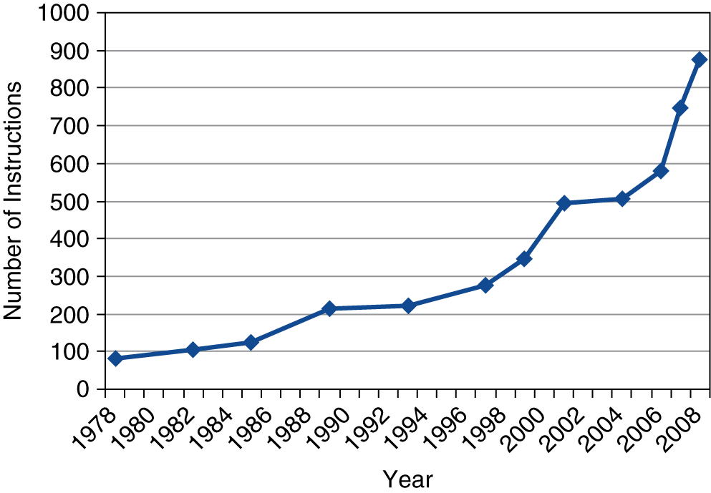
Fallacies
Backward compatibility ⇒ instruction set doesn’t change
  But they do accrete more instructions
x86 instruction set

Slide 91
Pitfalls
Sequential words are not at sequential addresses
  Increment by 4, not by 1!
Keeping a pointer to an automatic variable after procedure returns
  e.g., passing pointer back via an argument
  Pointer becomes invalid when stack popped

Slide 92
Concluding Remarks
Design principles
  1. Simplicity favors regularity
  2. Smaller is faster
  3. Make the common case fast
  Good design demands good compromises
Layers of software/hardware
  Compiler, assembler, hardware
MIPS: typical of RISC ISAs
  c.f. x86

Slide 93
Concluding Remarks
Measure MIPS instruction executions in benchmark programs
  Consider making the common case fast
  Consider compromises
Instruction class | MIPS examples | SPEC2006 Int | SPEC2006 FP
Arithmetic | add, sub, addi | 16% | 48%
Data transfer | lw, sw, lb, lbu, lh, lhu, sb, lui | 35% | 36%
Logical | and, or, nor, andi, ori, sll, srl | 12% | 4%
Cond. Branch | beq, bne, slt, slti, sltiu | 34% | 8%
Jump | j, jr, jal | 2% | 0%

