Slide 1
Chapter 1
Computer Abstractions and Technology

Slide 2
What is Computer Architecture?
The design of computer systems
Goal: improve “performance”:
  Run programs faster
    Execution time: e.g. less waiting time, more simultaneous tasks
    Throughput: e.g. higher framerate, faster downloads
  Use less power, last longer on battery power
  Generate less or more uniformally-distributed heat
  Handle more secure encryption standards
  Software defined networking at higher line speeds
  More scalable
  Less expensive
Chapter 1 — Computer Abstractions and Technology — 2

Slide 3
Computer Architecture
Instruction Set Architecture (“architecture”)
  The native programming language of a processor
    Assembly language
    Machine language
  Openly published to users, licensed for chip makers
Microarchitecture
  The internal organization of a processor
  Executes programs
  Trade secret

Slide 4
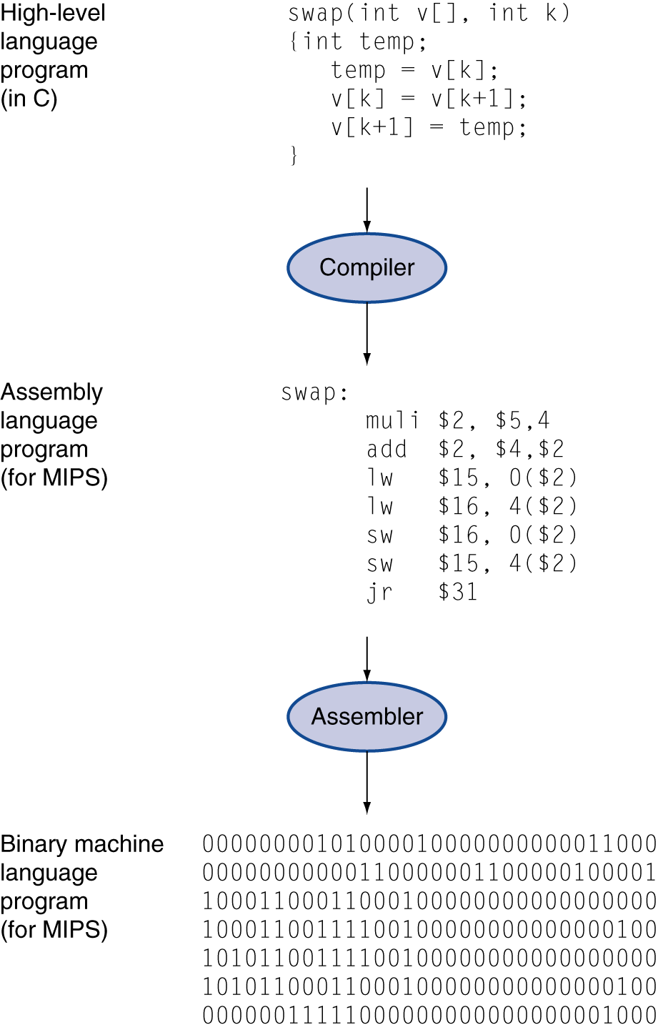
Levels of Program Code
High-level language
  Level of abstraction closer to problem domain
  Provides for productivity and portability
Assembly language
  Textual representation of instructions
Hardware representation
  Binary digits (bits)
  Encoded instructions and data
Instruction Set Architecture (ISA):
  Assembly code / machine code “language”
Microarchitecture:
  ISA implementation

Slide 5
Abstraction
Abstration used to manage complexity of design
  Hide details that are not important
Program code
Machine Instructions
Datapaths
Logic gates
Devices
(Transistors)

Slide 6
Why Study Computer Architecture
Compiling “machine agnostic” code:
  Generally achieve ~1-20% of peak theoretical performance
  Performance tuned code must be explicitly written for the underlying architecture
  Especially for embedded and special purpose processors
  Understanding computer architecture allows for customization:
    Multicore
    More efficient use of registers, instructions
Device drivers must directly interface with peripherals
  Uses CPU-specific, bit-level features to communicate
  E.g. memory-mapped I/O, interrupts, DMA, double buffering, bit fields in status/control registers, memory management, virtual memory
Chapter 1 — Computer Abstractions and Technology — 6

Slide 7
Domains and Levels of Modeling
Structural
Functional
high level of abstraction
low level of abstraction
Geometric
Chapter 1 — Computer Abstractions and Technology — 7

Slide 8
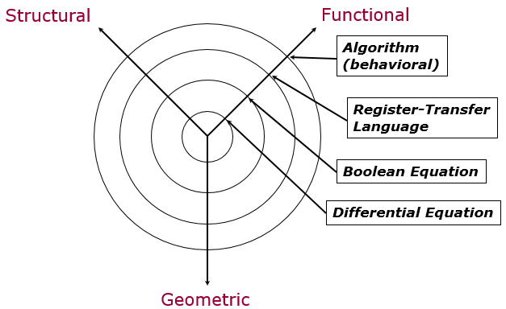


Functional Abstraction
For i=0 to 10
C = C + A[i]
MAR <= PC, memory_read <= 1
PC <= PC + 1
wait until ready = 1
IR <= memory_data
memory_read <= 0
Chapter 1 — Computer Abstractions and Technology — 8

Slide 9
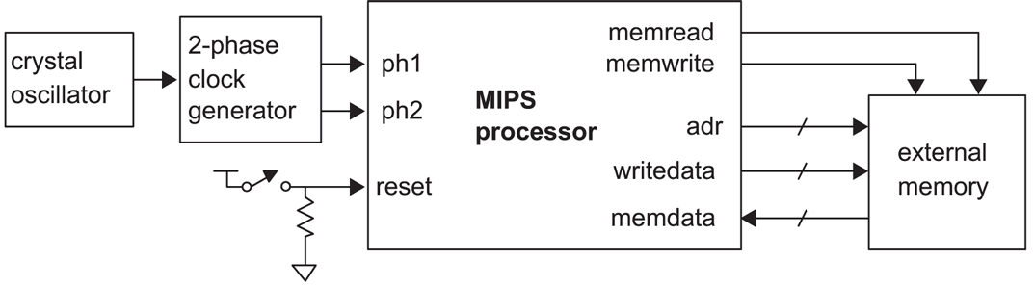
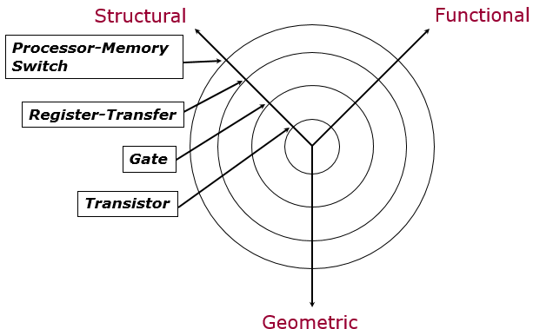
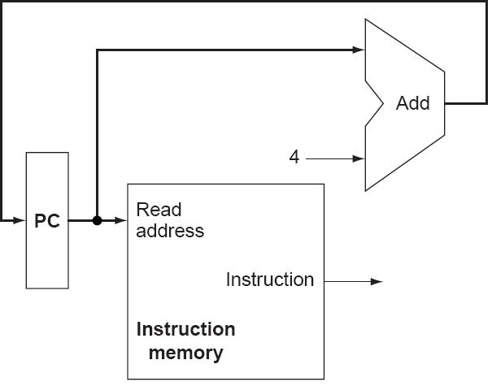
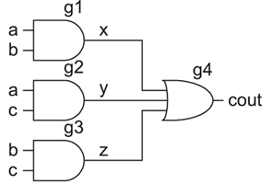
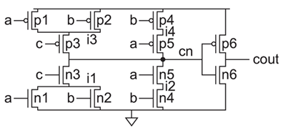
Structural Abstraction
Chapter 1 — Computer Abstractions and Technology — 9

Slide 10
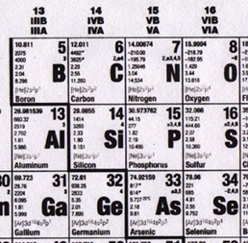
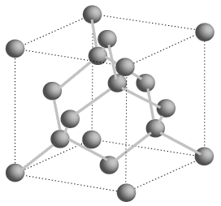
Semiconductors
Silicon is a group IV element
Forms covalent bonds with four neighbor atoms (3D cubic crystal lattice)
Si is a poor conductor, but conduction characteristics may be altered
Add impurities/dopants replaces silicon atom in lattice
  Adds two different types of charge carriers
Spacing = .543 nm
Chapter 1 — Computer Abstractions and Technology — 10

Slide 11
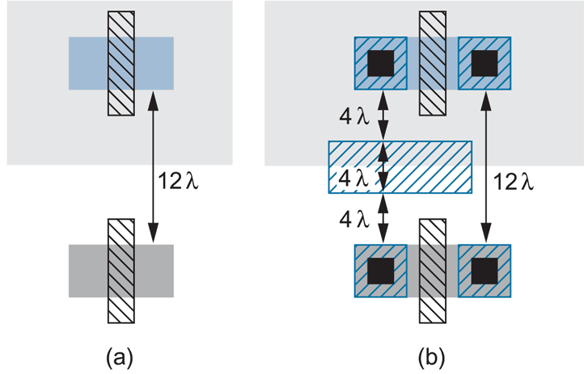
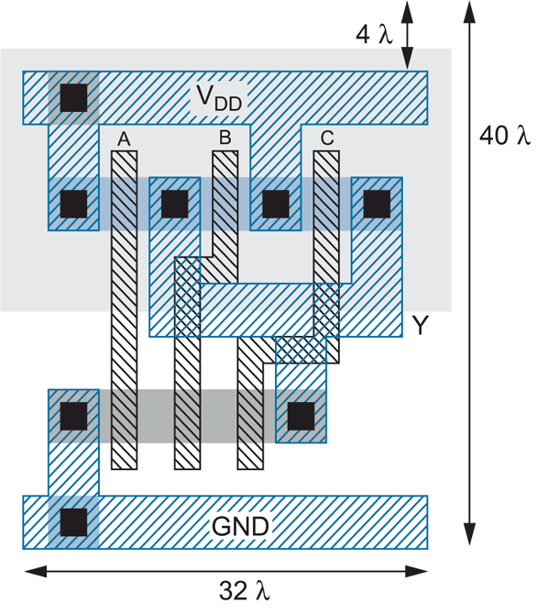
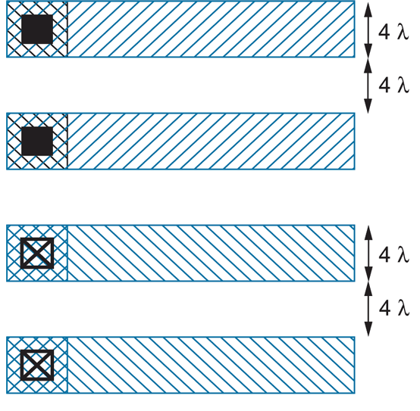
Layout
3-input NAND
Chapter 1 — Computer Abstractions and Technology — 11

Slide 12
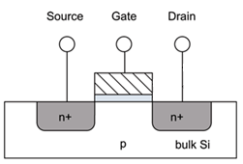
Feature Size
Shrink minimum feature size…
  Smaller L decreases carrier time and increases current
  Therefore, W may also be reduced for fixed current
  C_{g}, C_{s}, and C_{d} are reduced
  Transistor switches faster (~linear relationship)
Chapter 1 — Computer Abstractions and Technology — 12

Slide 13
Minimum Feature Size
Year | Processor | Performance | Transistor Size | Transistors
1982 | i286 | 6 - 25 MHz | 1.5 μm | ~134,000
1986 | i386 | 16 – 40 MHz | 1 μm | ~270,000
1989 | i486 | 16 - 133 MHz | .8 μm | ~1 million
1993 | Pentium | 60 - 300 MHz | .6 μm | ~3 million
1995 | Pentium Pro | 150 - 200 MHz | .5 μm | ~4 million
1997 | Pentium II | 233 - 450 MHz | .35 μm | ~5 million
1999 | Pentium III | 450 – 1400 MHz | .25 μm | ~10 million
2000 | Pentium 4 | 1.3 – 3.8 GHz | .18 μm | ~50 million
2005 | Pentium D | 2 threads/package | .09 μm | ~200 million
2006 | Core 2 | 2 threads/die | .065 μm | ~300 million
2008 | “Nehalem” | 8 threads/die | .045 μm | ~800 million
2009 | “Westmere” | 8 threads/die | .045 μm | ~1 billion
2011 | “Sandy Bridge” | 12 threads/die | .032 μm | ~1.2 billion
2013 | “Ivy Bridge” | 16 threads/die | .022 μm | ~1.4 billion
Year | Processor | Speed | Transistor Size | Transistors
2008 | NVIDIA Tesla (GT200) | 240 threads/die | .065 μm | 1.4 billion
2010 | NVIDIA Fermi (GF110) | 512 threads/die | .040 μm | 3.0 billion
2012 | NVNDIA Kepler (GK104) | 1536 threads/die | .028 μm | 3.5 billion
Chapter 1 — Computer Abstractions and Technology — 13

Slide 14
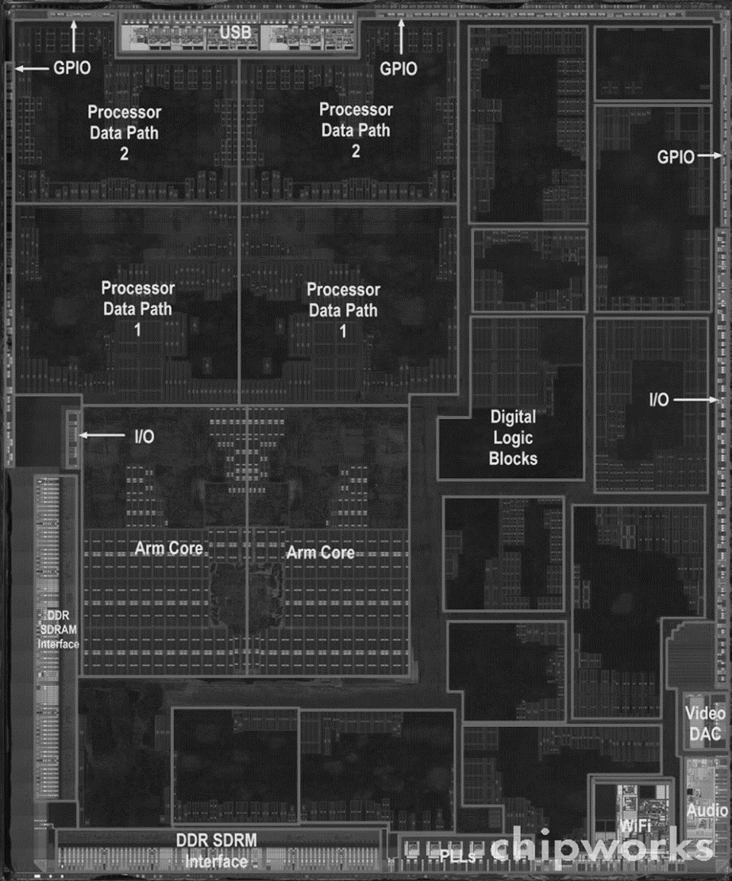
Inside the Processor
Apple A5

Slide 15
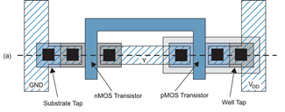
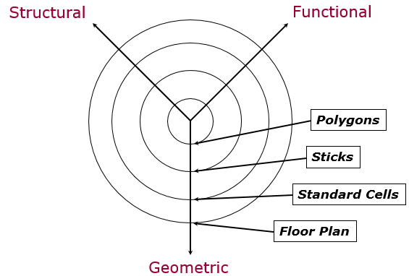

Geometric Abstraction
Chapter 1 — Computer Abstractions and Technology — 15

Slide 16
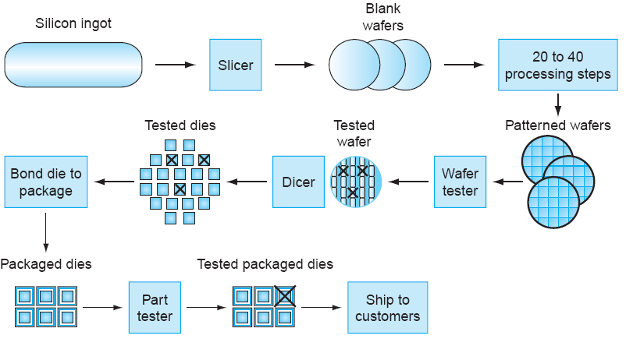
IC Fabrication
Chapter 1 — Computer Abstractions and Technology — 16

Slide 17
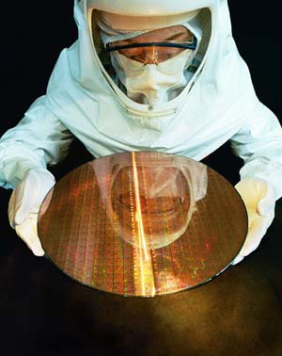
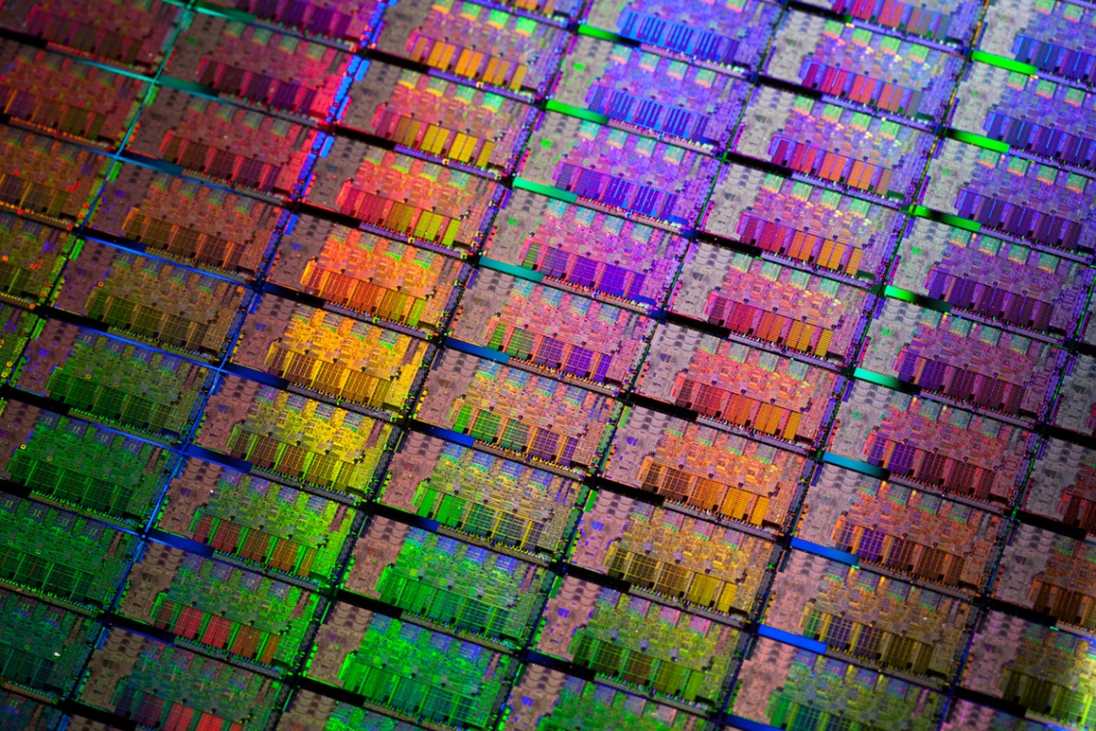
Si Wafer
Chapter 1 — Computer Abstractions and Technology — 17

Slide 18
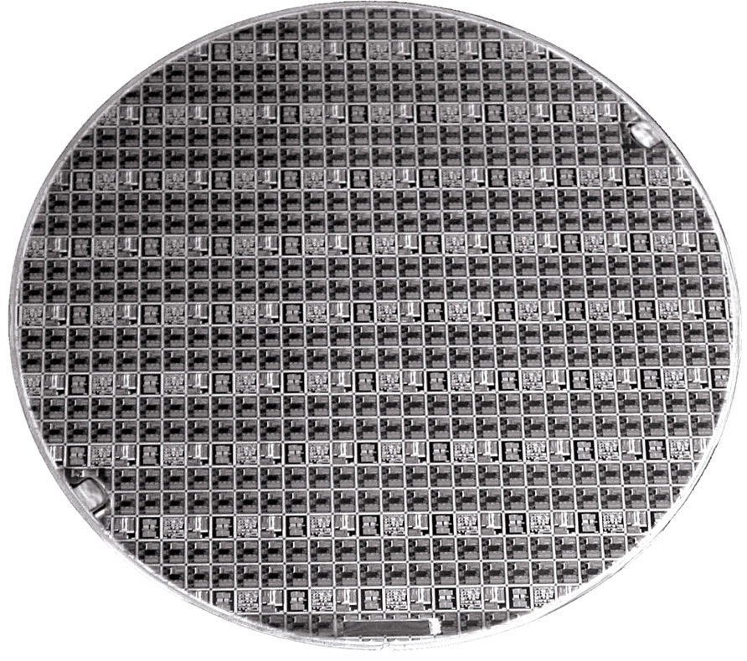
8” Wafer
Chapter 1 — Computer Abstractions and Technology — 18

Slide 19
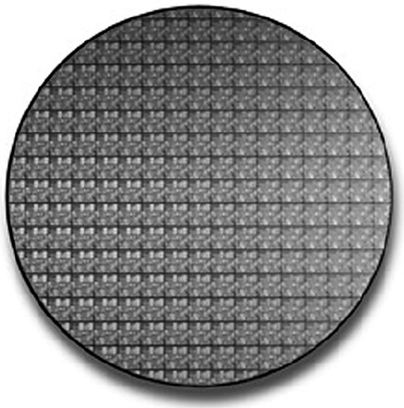
8” Wafer
8 inch (200 mm) wafer containing Pentium 4 processors
  165 dies, die area = 250 mm², 55 million transistors, .18μm
Chapter 1 — Computer Abstractions and Technology — 19

Slide 20
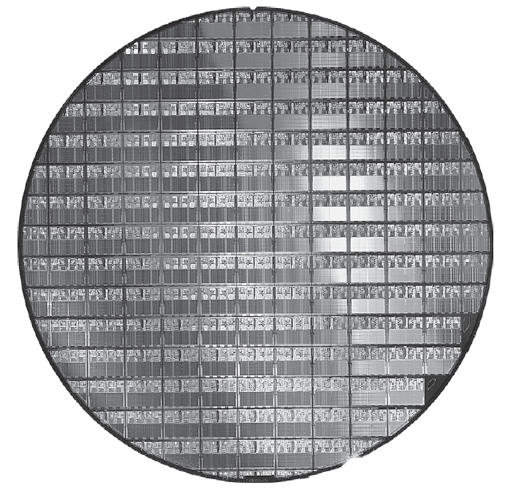
Intel Core i7 Wafer
300mm wafer, 280 chips, 32nm technology
Each chip is 20.7 x 10.5 mm

Slide 21
Speedup / Relative Performance
Define Performance = 1/Execution Time
“X is n time faster than Y”
Example: time taken to run a program
  10s on A, 15s on B
  Execution Time_{B} / Execution Time_{A}
  = 15s / 10s = 1.5
  So A is 1.5 times faster than B

Slide 22
Integrated Circuit Cost
Nonlinear relation to area and defect rate
  Wafer cost and area are fixed
  Defect rate determined by manufacturing process
  Die area determined by architecture and circuit design

Slide 23
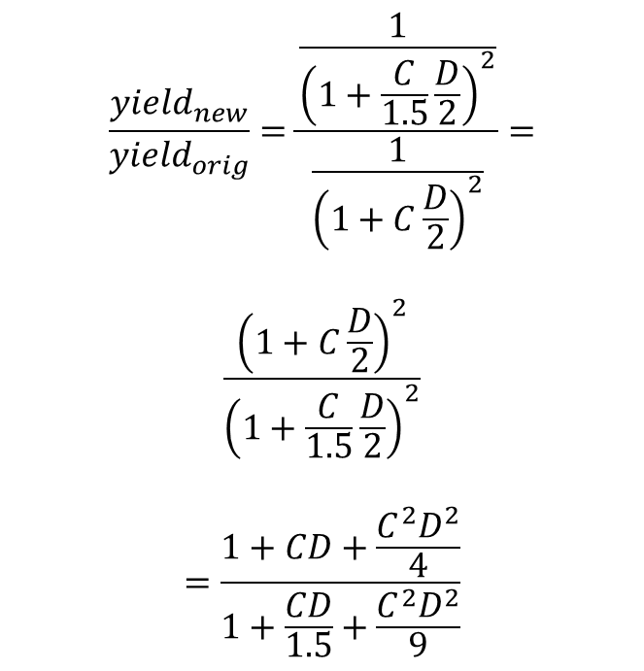
Example
Assume C defects per area and a die area of D. Calculate the improvement in yield if the number of defects is reduced by 1.5.
$$\frac{{yield}_{new}}{{yield}_{orig}}=\frac{\frac{1}{{\left(1+\frac{C}{1.5}\frac{D}{2}\right)}^{2}}}{\frac{1}{{\left(1+C\frac{D}{2}\right)}^{2}}}=$$
$$\frac{{\left(1+C\frac{D}{2}\right)}^{2}}{{\left(1+\frac{C}{1.5}\frac{D}{2}\right)}^{2}}$$
$$=\frac{1+CD+\frac{C^{2}D^{2}}{4}}{1+\frac{CD}{1.5}+\frac{C^{2}D^{2}}{9}}$$

Slide 24
Example
Assume a 20 cm diameter wafer has a cost of 15, contains 100 dies, and has 0.031 defects/cm².
  If the number of dies per wafer is increased by 10% and the defects per area unit increases by 15%, find the die area and yield.
die area_{20cm} = wafer area / dies per wafer = pi*10^2 / (100*1.1) = 2.86 cm²
yield_{20cm} = 1/(1+(0.03*1.15* 2.86/2))^2 = 0.9082
Assume a fabrication process improves the yield from 0.92 to 0.95. Find the defects per area unit for each version of the technology given a die area of 200 mm².
defects per area_{0.92} = (1-y^.5)/(y^.5*die_area/2) =
(1-0.92^.5)/(0.92^.5*2/2) = 0.043 defects/cm²
defects per area_{0.95} = (1-y^.5)/(y^.5*die_area/2) =
(1-0.95^.5)/(0.95^.5*2/2) = 0.026 defects/cm²

Slide 25
Response Time and Throughput
Response time
  How long it takes to do a task
Throughput
  Total work done per unit time
    e.g., tasks/transactions/… per hour
How are response time and throughput affected by
  Replacing the processor with a faster version?
  Adding more processors?
We’ll focus on response time for now…

Slide 26
Measuring Execution Time
Elapsed time
  Total response time, including all aspects
    Processing, I/O, OS overhead, idle time
  Determines system performance
CPU time
  Time spent processing a given job
    Discounts I/O time, other jobs’ shares
  Comprises user CPU time and system CPU time
  Different programs are affected differently by CPU and system performance

Slide 27
CPU Clocking
Operation of digital hardware governed by a constant-rate clock
Clock period
Clock (cycles)
Data transfer
and computation
Update state
Clock period: duration of a clock cycle
  e.g., 250ps = 0.25ns = 250×10^{–12} s
Clock frequency (rate): cycles per second
  e.g., 4.0GHz = 4000MHz = 4.0×10⁹ Hz

Slide 28
CPU Time
Performance improved by
  Reducing number of clock cycles
  Increasing clock rate
  Hardware designer must often trade off clock rate against cycle count

Slide 29
CPU Time Example
Computer A: 2GHz clock, 10s CPU time
Designing Computer B
  Aim for 6s CPU time
  Can do faster clock, but causes 1.2 × clock cycles
How fast must Computer B clock be?

Slide 30
Instruction Count and CPI
Instruction Count for a program
  Determined by program, ISA and compiler
Average cycles per instruction
  Determined by CPU hardware
  If different instructions have different CPI
    Average CPI affected by instruction mix

Slide 31
CPI Example
Computer A: Cycle Time = 250ps, CPI = 2.0
Computer B: Cycle Time = 500ps, CPI = 1.2
Same ISA
Which is faster, and by how much?
A is faster…
…by this much

Slide 32
CPI in More Detail
If different instruction classes take different numbers of cycles
Weighted average CPI
Relative frequency

Slide 33
CPI Example
Alternative compiled code sequences using instructions in classes A, B, C
Class | A | B | C
CPI for class | 1 | 2 | 3
IC in sequence 1 | 2 | 1 | 2
IC in sequence 2 | 4 | 1 | 1
Sequence 1: IC = 5
  Clock Cycles
  = 2×1 + 1×2 + 2×3
  = 10
  Avg. CPI = 10/5 = 2.0
Sequence 2: IC = 6
  Clock Cycles
  = 4×1 + 1×2 + 1×3
  = 9
  Avg. CPI = 9/6 = 1.5

Slide 34
Performance Summary
Performance depends on
  Algorithm: affects IC, possibly CPI
  Programming language: affects IC, CPI
  Compiler: affects IC, CPI
  Instruction set architecture: affects IC, CPI, T_{c}

Slide 35


Example
Suppose one machine, A, executes a program with an average CPI of 2.1
Suppose another machine, B (with the same instruction set and an enhanced compiler), executes the same program with 25% less instructions and with a CPI of 1.8 at 800MHz
In order for the two machines to have the same performance, what does the clock rate of the first machine (machine A) need to be?
$$\frac{I_{A}{CPI}_{A}}{R_{A}}=\frac{I_{B}{CPI}_{B}}{R_{B}}$$
$$\frac{I_{A}∙2.1}{R_{A}}=\frac{{0.75I}_{A}∙1.8}{800∙{10}^{6}}$$

Slide 36
Example
Suppose a program has the following instruction classes, CPIs, and mixtures:
Instruction type CPI ratio
A 1.4 55%
B 2.4 15%
C 2 30%
Your engineers give you the following options:
Option A: Reduce the CPI of instruction type A to 1.1
Option B: Reduce the CPI of instruction type B to 1.2
Which option would you choose and why?
$${CPI}_{A}=.55\left(1.1\right)+.15\left(2.4\right)+.30\left(2\right)=1.565$$
$${CPI}_{B}=.55\left(1.4\right)+.15\left(1.2\right)+.30\left(2\right)=1.550$$

Slide 37
Pitfall: MIPS as a Performance Metric
MIPS: Millions of Instructions Per Second
  Doesn’t account for
    Differences in ISAs between computers
    Differences in complexity between instructions
  CPI varies between programs on a given CPU

Slide 38
Example
Consider two different implementations, M1 and M2, of the same instruction set. There are three classes of instructions (A, B, and C) in the instruction set. M1 has a clock rate of 800 MHz and M2 has a clock rate of 2 GHz. The average number of cycles for each instruction class and their frequencies (for a typical program) are as follows:
Instruction class Machine M1 CPI Frequency Machine M2 CPI Frequency
A 1 50% 2 60%
B 2 20% 3 30%
C 4 30% 4 10%
Calculate the average CPI for each machine, M1, and M2.
Calculate the average MIPS ratings for each machine, M1 and M2.
Hint: MIPS = (clock rate / CPI) / 10⁶.
M1 => .5(1) + .2(2) + .3(4) = 2.1
M2 => .6(2) + .3(3) + .1(4) = 2.5
M1 => 800 * 2.1 = 1680
M2 => 2000 * 2.5 = 5000

Slide 39
Example (Con’t)
How many less instructions would M1 need to execut to match the speed of M2?
M1 => 800 * 2.1 = 1680
M2 => 2000 * 2.5 = 5000
5000/1680

Slide 40
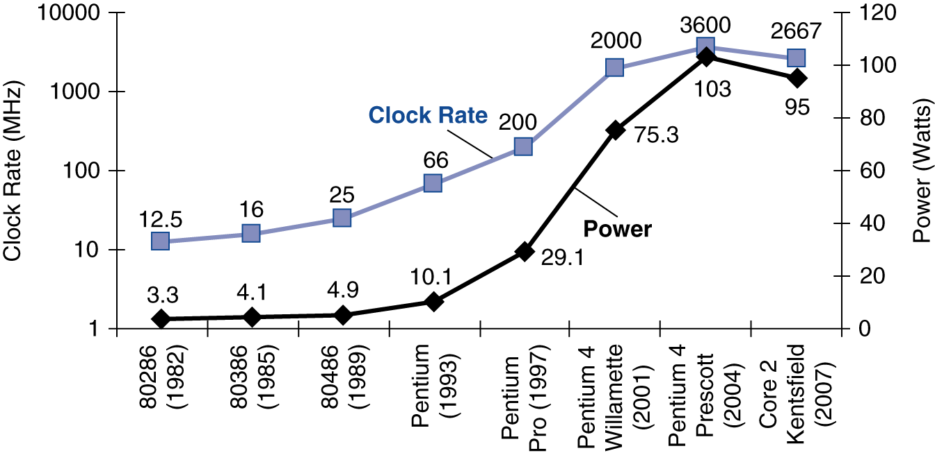
Power Trends
In CMOS IC technology
×30
5V → 1V
×1000

Slide 41
Reducing Power
Suppose a new CPU has
  85% of capacitive load of old CPU
  15% voltage and 15% frequency reduction
The power wall
  We can’t reduce voltage further
  We can’t remove more heat
How else can we improve performance?

Slide 42
Example
Assume:
Processor Clock Voltage Dynamic P Static P
Pentium 4 3.6 GHz 1.25 V 90 W 10 W
Core i5 3.4 GHz 0.9 V 40 W 30 W
Calculate capacitive load of each processor.
If total power is to be reduced by 10%, how much should the voltage be reduced?

Slide 43

Example
For given processor, assume we reduce the voltage by 10% and increase the frequency by 5%. What is the improvement to dynamic power consumption?
$$\frac{{power}_{orig}}{{power}_{new}}=\frac{CV^{2}F}{C{\left(.9V\right)}^{2}(1.05)F}=\frac{V^{2}}{\left.{\left(.9V\right)}^{2}(1.05\right)}$$
$$=\frac{V^{2}}{\left..81V^{2}(1.05\right)}=\frac{1}{\left..81(1.05\right)}=1.18$$

Slide 44
Fallacy: Low Power at Idle
i7 power benchmark
  At 100% load: 258W
  At 50% load: 170W (66%)
  At 10% load: 121W (47%)
Google data center
  Mostly operates at 10% – 50% load
  At 100% load less than 1% of the time
Consider designing processors to make power proportional to load

Slide 45
SPEC Power Benchmark
Power consumption of server at different workload levels
  Performance: ssj_ops/sec
    ssj_ops = server side Java operations per second
  Power: Watts (Joules/sec)

Slide 46
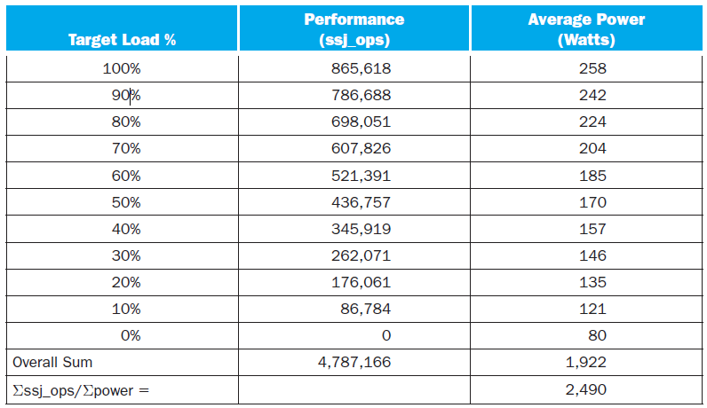
SPECpower_ssj2008 for Xeon X5650

Slide 47
SPEC CPU Benchmark
Programs used to measure performance
  Supposedly typical of actual workload
Standard Performance Evaluation Corp (SPEC)
  Develops benchmarks for CPU, I/O, Web, …
SPEC CPU2006
  Elapsed time to execute a selection of programs
    Negligible I/O, so focuses on CPU performance
  Normalize relative to reference machine
  Summarize as geometric mean of performance ratios
    CINT2006 (integer) and CFP2006 (floating-point)

Slide 48
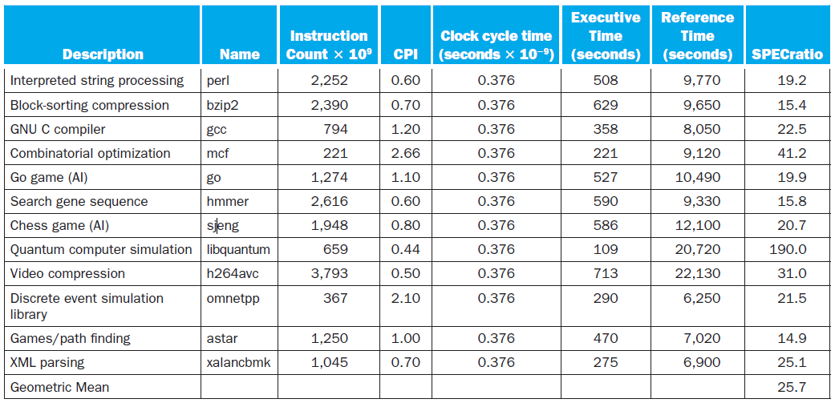
CINT2006 for Intel Core i7 920

Slide 49
Pitfall: Amdahl’s Law
Improving an aspect of a computer and expecting a proportional improvement in overall performance
Example: multiply accounts for 80s/100s
  How much improvement in multiply performance to get 5× overall?
  Can’t be done!
Corollary: make the common case fast

Slide 50
Example
Use Amdahl’s Law to compute the new execution time for an architecture that previously required 25 seconds to execute a program, where 15% of the time was spent executing load/store instructions, if the time required for a load/store operation is reduced by 40% (amount of improvement for load/stores = 1/.60 = 1.67).

Slide 51
Example
Suppose you have a machine which executes a program consisting of 50% multiply instructions, 20% divide instructions, and the remaining 30% are other instructions. Management wants the machine to run 4 times faster. You can make the divide run at most 3 times faster and the multiply run at most 8 times faster. Can you meet management’s goal by making only one improvement, and which one?

Slide 52
Multiprocessors
Multicore microprocessors
  More than one processor per chip
Requires explicitly parallel programming
  Compare with instruction level parallelism
    Hardware executes multiple instructions at once
    Hidden from the programmer
  Hard to do
    Programming for performance
    Load balancing
    Optimizing communication and synchronization

Slide 53
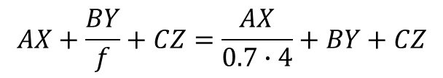
Example
Assume the following instruction classes and corresponding CPIs and dynamic execution counts:
When run on > 1 processors, the number of executed arithmetic instructions is divided by 0.7p (where p = number of processors) but the number of other instructions executed remains the same.
To what factor would the CPI of load/store instructions need to be reduced (sped up) in order for a single processor to match the performance of four processors each having the original CPI?
Type | CPI | Count
arithmetic | A | X
load/store | B | Y
branch | C | Z
$$AX+\frac{BY}{f}+CZ=\frac{AX}{0.7∙4}+BY+CZ$$

Slide 54
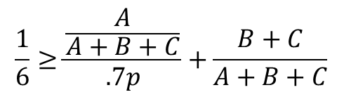
Example
Assume the following instruction classes and corresponding CPIs and dynamic execution counts:
As compared to a single processor, under what condition is it possible to achieve an overall speedup of 6 by using multiple processors? Express this as an inequality.
Type | CPI | Count
arithmetic | A | X
load/store | B | Y
branch | C | Z
$$\frac{1}{6}≥\frac{\frac{A}{A+B+C}}{.7p}+\frac{B+C}{A+B+C}$$

Slide 55
Concluding Remarks
Cost/performance is improving
  Due to underlying technology development
Hierarchical layers of abstraction
  In both hardware and software
Instruction set architecture
  The hardware/software interface
Execution time: the best performance measure
Power is a limiting factor
  Use parallelism to improve performance

