Slide 1
Enabling Secure and Efficient Ranked Keyword Search over Outsourced Cloud Data
Cong Wang, Ning Cao, Kui Ren, and Wenjing Lou
Presented by:
Alireza Salahirad
NOV 2011

Slide 2
Outline :
1, Introduction
2, Problem Statement
3, The Definition and Basic Scheme
4, Efficient Ranked Searchable Symmetric Encryption Scheme
5, Security Analysis
6, Further Enhancement and Investigations
7, Performance Analysis
8, Related Work
9, Conclusion
NOV 2011

Slide 3
1,Introduction
NOV 2011

Slide 4
Cloud Computing is Important!
Due to the rapid expansion of data, the data owners tend to store their data into the cloud to release the burden of data storage and maintenance.
NOV 2011

Slide 5
Security in Cloud Servers is Important Too!
The cloud customers and the cloud server are not in the same trusted domain, the outsourced data may be under the exposure to the risk.
NOV 2011

Slide 6
Sensitive data have to be encrypted prior to outsourcing for data privacy and combating unsolicited accesses.
NOV 2011

Slide 7
One of The Most Important Computation on Cloud Servers is
Keyword-Based Search on a Demanded Data
NOV 2011

Slide 8
Such keyword search technique allows users to selectively retrieve files of interest and has been widely applied in plaintext search scenarios
NOV 2011

Slide 9
In this research authors want the server search on encrypted data
NOV 2011

Slide 10
Traditional searchable encryption schemes
support only
conventional Boolean keyword search, without capturing any relevance of the files in the search result.
NOV 2011

Slide 11
lacking of effective mechanisms to ensure the file
retrieval accuracy
is a significant drawback of existing searchable encryption
NOV 2011

Slide 12
Therefore
NOV 2011

Slide 13
How to enable a searchable encryption system with support of secure ranked search
is
the problem tackled
in this paper.
NOV 2011

Slide 14
2, Problem Statement
NOV 2011

Slide 15
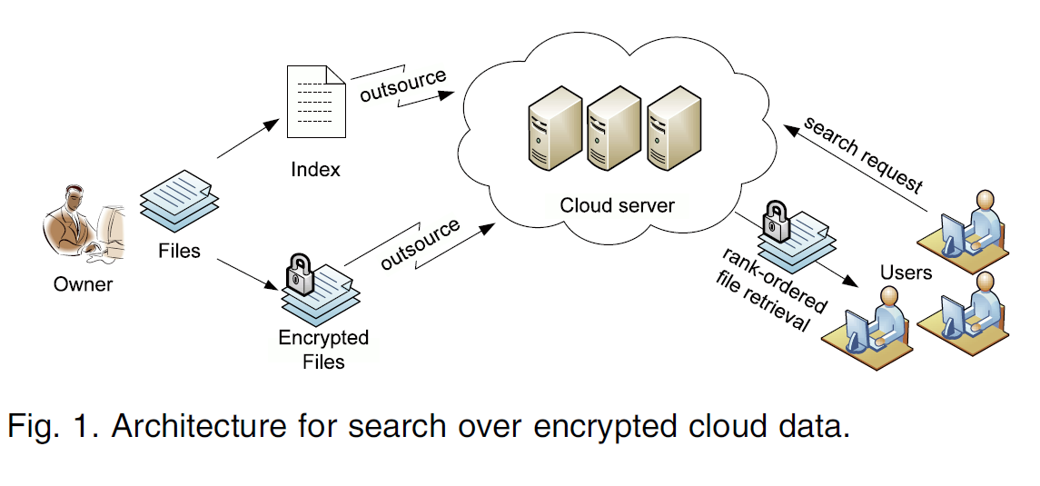
NOV 2011

Slide 16
Data owner has a
collection of n data files
C=(F1,F2,…,Fn)
that he wants to
outsource on the cloud server in encrypted form.
NOV 2011

Slide 17
Data owner will first build a secure searchable index I from a set of m distinct keywords
W=(w1, w2,…, wm)
Extracted from the file collection C, and store both the index I and the
encrypted file collection C on the cloud server.
NOV 2011

Slide 18
To search the file collection
for a given keyword w:
An authorized user generates and submits a search request in a secret form, a trapdoor Tw of the keyword w, to the cloud server.
Upon receiving the search request Tw, the cloud server is responsible to search the index I and return the corresponding set of files to the user.
NOV 2011

Slide 19
To reduce bandwidth, the user may send an
optional value k along with the trapdoor Tw and cloud
server only sends back the top-k most relevant files to the
user’s interested keyword w.
NOV 2011

Slide 20
The authors consider that server is an
“honest-but-curious”
Honest: Server correctly follows the designated protocol specification.
Curious: server is curious to infer and analyze the message flow received during the protocol so as to learn additional information.
NOV 2011

Slide 21
Notation
NOV 2011

Slide 22
C—the file collection to be outsourced, denoted as a set of n data files
C = (F1, F2, …, Fn).
W: the distinct keywords extracted from file collection C, denoted as a set of m words W = (w1,w2,…,wm).
id(Fj): the identifier of file Fj that can help uniquely locate the actual file.
I: the index built from the file collection, including a set of posting lists {I(wi)}.
Twi: the trapdoor generated by a user as a search request of keyword wi.
F(wi): the set of identifiers of files in C that contain keyword wi.
Ni: the number of files containing the keyword wi and Ni = |F(wi)|.
NOV 2011

Slide 23
Ranking function:
In information retrieval, a ranking
function is used to calculate relevance scores of matching files to a given search request.
NOV 2011

Slide 24

They use this general formula as their reference:
Q denotes the searched keywords; fd,t denotes the term frequency(the number of times a given term or keyword appears within a file) of term t in file Fd; ft denotes the number of files that contain term t; N denotes the total number of files in the collection; and |Fd| is the length of file Fd, obtained by counting the number of indexed terms, functioning as the normalization factor.
Score(Q, Fd) =$\sum_{t∊Q}{\frac{1}{\left|Fd\right|}.\left(1+Ln fd,t\right).ln⁡(1+\frac{N}{Ft})}$
NOV 2011

Slide 25
3, The Definitions and Basic Scheme
NOV 2011

Slide 26
Access pattern refers to the outcome of the search result, i.e., which files have been retrieved.
In order to achieve more efficient solutions, their scheme resort to the weakened security guarantee, i.e., revealing the access pattern and search pattern but nothing else.
They leak the relative relevance order but not the relevance score.
NOV 2011

Slide 27
Definitions and Framework of ranked searchable symmetric encryption (RSSE) System
NOV 2011

Slide 28
Their ranked searchable encryption system can be constructed from:
(KeyGen, BuildIndex, TrapdoorGen, SearchIndex)
in two phases: Setup and Retrieval
NOV 2011

Slide 29
Setup. The data owner initializes the public and secret parameters of the system by executing KeyGen, and pre-processes the data file collection C by using BuildIndex to generate the searchable index from the unique words extracted from C. The owner then encrypts the data file collection C, and publishes the index including the keyword frequency-based relevance scores in some encrypted form, together with the encrypted collection C to the Cloud. As part of Setup phase, the data owner also needs to distribute the necessary secret parameters (in their case, the trapdoor generation key) to a group of authorized users by employing off-the-shelf public key cryptography or more efficient primitive such as broadcast encryption.
NOV 2011

Slide 30
Retrieval. The user uses TrapdoorGen to generate a secure trapdoor corresponding to his interested keyword, and submits it to the cloud server. Upon receiving the trapdoor, the cloud server will derive a list of matched file IDs and their corresponding encrypted relevance scores by searching the index via SearchIndex. The matched files should be sent back in a ranked sequence based on the relevance scores. However, the server should learn nothing or little beyond the order of the relevance scores.
NOV 2011

Slide 31

In this paper they focus on single keyword search.
Thus, search results can be accurately ranked based only on
Score(t , Fd) = $\frac{1}{\left|Fd\right|}$.(1+Ln fd,t)
t denotes the searched keyword; fd,t denotes the term frequency(the number of times a given term or keyword appears within a file). |Fd| is the length of file Fd, obtained by counting the number of indexed terms, functioning as the normalization factor.
NOV 2011

Slide 32
Data owner can keep a record of these two values and precalculate the relevance score, which introduces little overhead regarding to the index building.
NOV 2011

Slide 33
Before giving their main result, they first start with a
straightforward yet ideal scheme.
NOV 2011

Slide 34
This scheme, can be considered as the most simplified version of
searchable symmetric encryption
NOV 2011

Slide 35
The Basic Scheme
NOV 2011

Slide 36
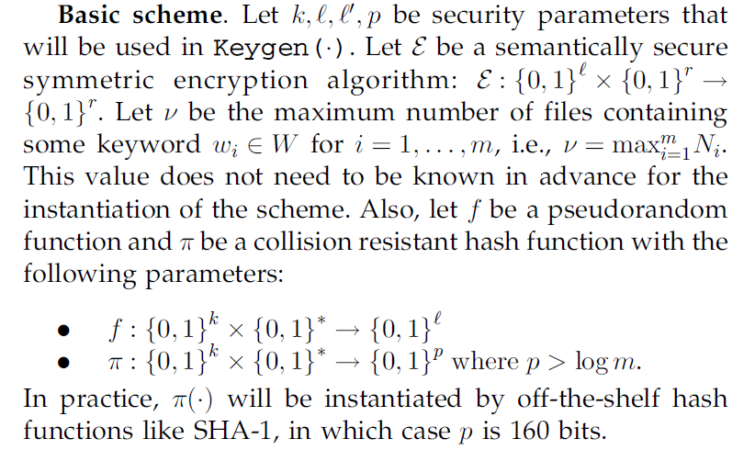
NOV 2011

Slide 37
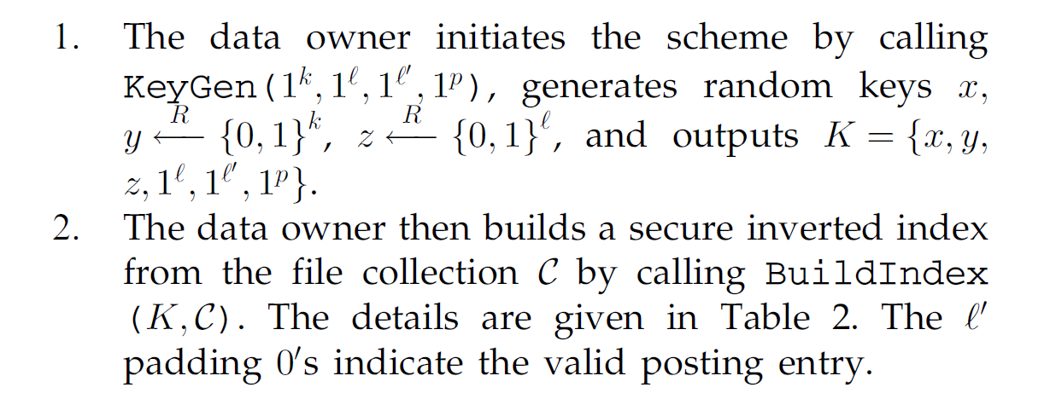
In the Setup phase
NOV 2011

Slide 38
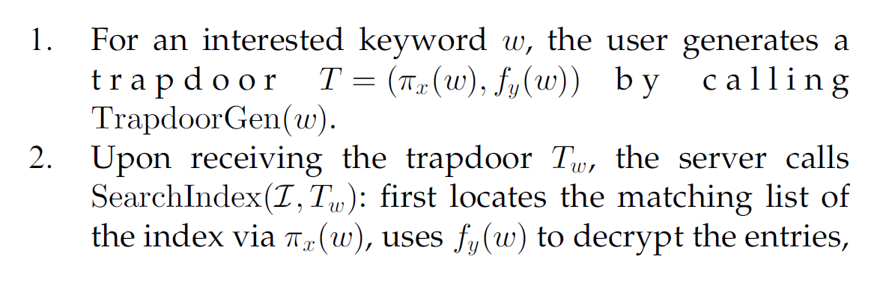
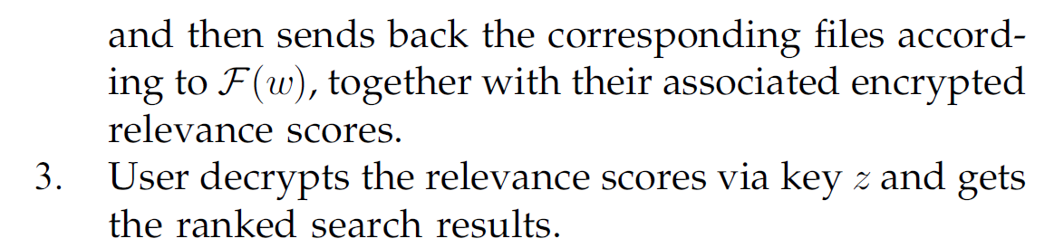
In the Retrieval phase
NOV 2011

Slide 39
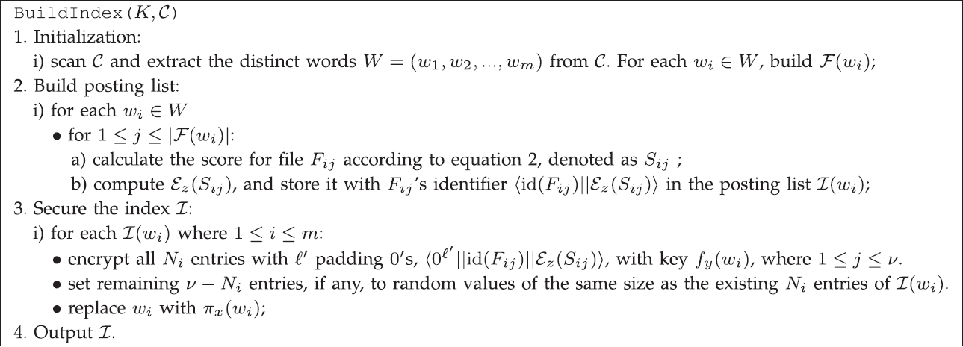
The Details of BuildIndex() for Basic Scheme
NOV 2011

Slide 40
The user gets the ranked results without letting cloud server learn any additional information more than the access pattern and search pattern.
NOV 2011

Slide 41
In the basic scheme, the ranking is done on the user side, which may bring in huge post processing overhead. Moreover, sending back all the files consumes large undesirable bandwidth.
NOV 2011

Slide 42
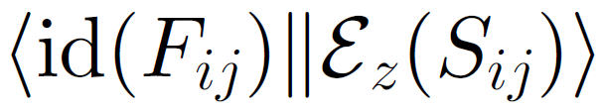
One possible way to reduce the communication overhead is that server first sends back all the valid entries , where 1 ≤ j ≤Ni.
User then decrypts the relevance score and sends cloud server another request to retrieve the most relevant files (top-k retrieval) by the rank-ordered decrypted scores.
NOV 2011

Slide 43
As the size of valid entries is far less than the corresponding files, significant amount of bandwidth is expected to be saved, as long as user does not retrieve all
the matching files.
NOV 2011

Slide 44
However, the most obvious disadvantage is the two round-trip time for each search request of every user. Also note that in this way, server still learns nothing about the value of relevance scores, but it knows the requested files are more relevant than the unrequested ones, which inevitably leaks more information than the access pattern and search pattern.
NOV 2011

Slide 45
Afterward, they resort to the newly developed cryptographic Primitive:
Order Preserving Symmetric Encryption
to achieve more practical performance.
NOV 2011

Slide 46
Note that by resorting to
Order Preserving Symmetric Encryption (OPSE)
, the security guarantee of RSSE is inherently weakened compared to SSE, since now the relevance order is known by the server . However, this is the information they want to trade off for efficient RSSE
NOV 2011

Slide 47
The OPSE is a deterministic encryption scheme, so
if not treated appropriately, will still leak a lot of information as any deterministic encryption scheme will do.
NOV 2011

Slide 48
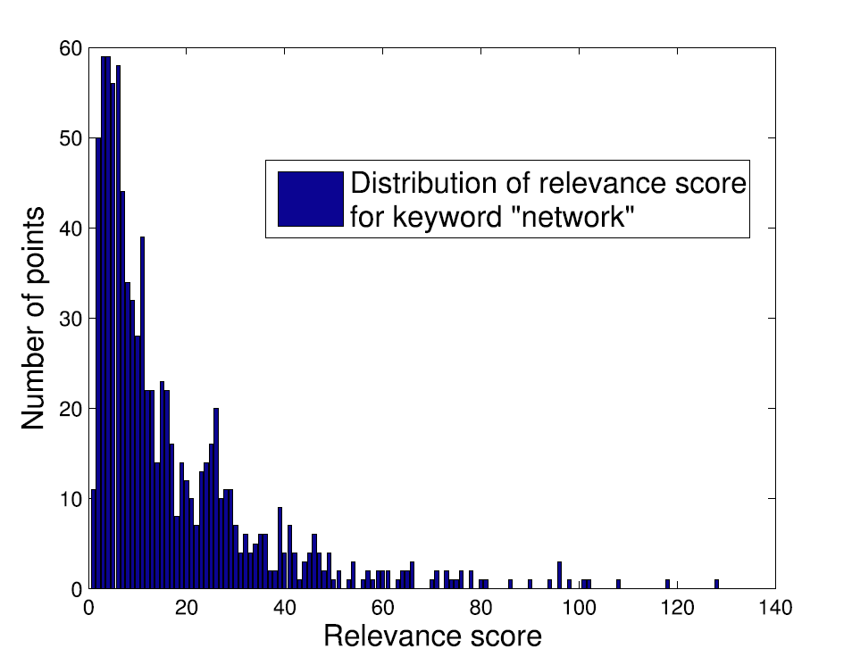
If someone use OPSE directly over sampled relevance scores, the resulting ciphertext shall share exactly the same distribution as the relevance score in below figure.
NOV 2011

Slide 49
Thus, with certain background information on the file collection, such as knowing it contains only technical research papers, the adversary may be able to reverse engineer the keyword “network” directly from the encrypted score distribution without actually breaking the trapdoor construction, nor does the adversary need to break the OPSE.
NOV 2011

Slide 50
In order to reduce the amount of information leakage from
the deterministic property, an one-to-many OPSE scheme is
thus desired, which can flatten or obfuscate the original
relevance score distribution, increase its randomness, and
still preserve the plaintext order.
NOV 2011

Slide 51
To do so, they first briefly review the encryption process of original deterministic OPSE, where a plaintext m in domain D is always mapped to the same random-sized non overlapping interval bucket in range R, determined by a keyed binary search over the range R and the result of a random hypergeometric probability distribution (HGD) sampling function. A ciphertext c is then chosen within the bucket by using m as the seed for some random selection function.
NOV 2011

Slide 52
Their one-to-many order-preserving mapping employs the
random plaintext-to-bucket mapping of OPSE, but incorporates
the unique file IDs together with the plaintext m as the
random seed in the final ciphertext chosen process. Due to
the use of unique file ID as part of random selection seed, the same plaintext m will no longer be deterministically assigned to the same ciphertext c, but instead a random value within the randomly assigned bucket in range R.
NOV 2011

Slide 53
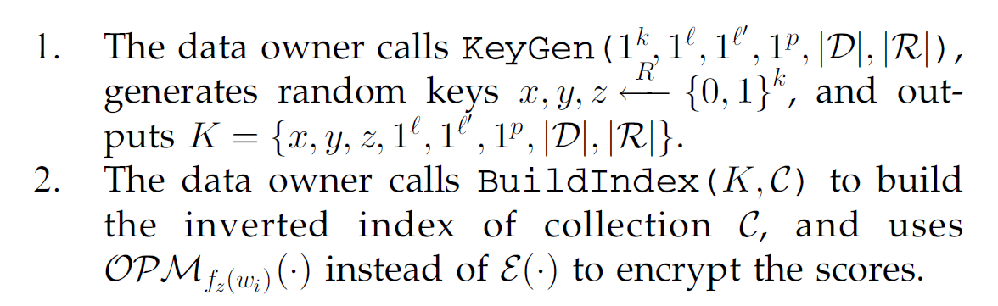
In the Setup phase
NOV 2011

Slide 54
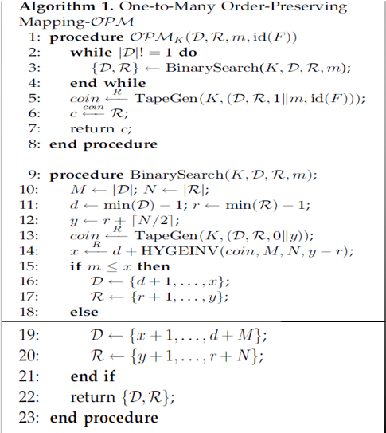
TapeGen() is a random coin generator and HYGEINV() is
the efficient function implemented in Matlab as their instance for the HGD() sampling function.
NOV 2011

Slide 55
With the help of order-preserving mapping, now the server can accordingly rank the files as efficiently as for the unencrypted score. The reason that they use different keys (fz(wi)) to encrypt the relevance score for different posting lists is to make the one-to-many mapping more indistinguishable. Therefore, the same relevance score appearing in different lists of the index I will be mapped to different “bucket” in R. Combining this with their
one-to-many mapping will randomize the encrypted values from an overall point of view.
NOV 2011

Slide 56
Thus, they can further mitigate the useful information revealed to the cloud server, who may be consistently interested at the statistical analysis on the encrypted numeric value to infer the underlying information.
NOV 2011

Slide 57
8, Related Work
NOV 2011

Slide 58
The authors list twelve different schemes which support only Boolean
keyword search, and none of them support the ranked search problem which they are focusing on in this paper.
NOV 2011

Slide 59
9, Conclusion
NOV 2011

Slide 60
In this paper, as an initial attempt, they motivate and solve the problem of supporting efficient ranked keyword search for achieving effective utilization of remotely stored encrypted data in Cloud Computing.
NOV 2011

Slide 61
They first give a basic scheme and show that by following the same existing searchable encryption framework, it is very inefficient to achieve ranked search.
NOV 2011

Slide 62
They then appropriately weaken the security guarantee, resort to the newly developed crypto primitive OPSE, and derive an efficient one-to-many order preserving mapping function, which allows the effective RSSE to be designed.
NOV 2011

Slide 63
They also investigate some further enhancements of their ranked search mechanism, but unfortunately, I did not have enough time to cover them.
NOV 2011

Slide 64
Furthermore, through thorough security analysis, they show that their proposed solution is secure and privacy preserving; their extensive experimental results demonstrate the efficiency of their solution.
Unluckily, In this lecture I did not cover these two parts too.
NOV 2011

Slide 65
Some new papers in this topic
With their links for more study!
NOV 2011

Slide 66
1, Enabling Efficient Multi-Keyword Ranked Search over Encrypted Mobile Cloud Data through Blind Storage.
http://www.computer.org/csdl/trans/ec/2015/01/06983613.pdf
2, EnDAS: Efficient Encrypted Data Search as a Mobile Cloud Service
http://www.computer.org/csdl/trans/ec/2015/03/07122893.pdf
3, PaRQ: A Privacy-Preserving Range Query Scheme over Encrypted Metering Data for Smart Grid
http://www.computer.org/csdl/trans/ec/2013/01/06566055.pdf
NOV 2011

Slide 67
4, Toward Secure Multi keyword Top-k Retrieval over Encrypted Cloud Data
http://www.computer.org/csdl/trans/tq/2013/04/ttq2013040239.html
5, Scalable Architecture for Multi-User Encrypted SQL Operations on Cloud Database Services
http://www.computer.org/csdl/trans/cc/2014/04/06977940.pdf
6, Private Searching on Streaming Data Based on Keyword Frequency
http://www.computer.org/csdl/trans/tq/2014/02/ttq2014020155.html
NOV 2011

Slide 68
Questions?
NOV 2011

Slide 69
Thank you!
NOV 2011

