Slide 1
SHUFFLING-SLICING IN DATA MINING
Presented by SaiVenkataNikhil Nimmagadda

Slide 2
Security Problem
Slicing has limitations as random shuffling has certain probability of disclosing sensitive attributes when certain tuples after shuffling retains the same old tuple position.
The proposed algorithm tries to improve accuracy and protect privacy so that random shuffling does not retain the same position

Slide 3
Importance of Problem
Solution is implemented in two phases:
First phase is focused on providing privacy in Slicing technique through random shuffling of the data until they cannot be recognized.
Second phase is focused on accuracy of the dataset by maintaining a copy of the dataset before its shuffled

Slide 4
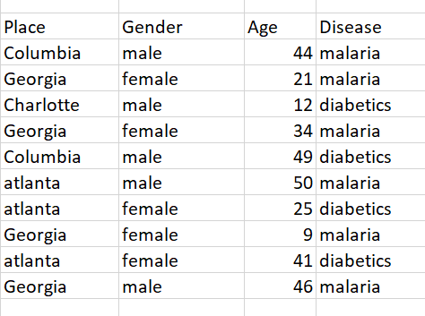
Proposed Method

Slide 5
Challenges during problem solving
Decision of how to divide components with respect to quasi-identifier and sensitive attribute is challenging as applying random shuffling to every component can lead to privacy disclosure
How to maintain the accuracy of the data even after shuffling the sensitive component to retrieve the correlation between attributes?
This slicing extension technique should be applied on various data visualization tools such as tableau, zolo,qlic and making analysis of privacy preservation and accuracy of data

Slide 6
Conclusion
Privacy is restored in Shuffling method for tuples replacing in the same position through this method
Privacy Preservation in Data Mining is extended further by applying these technique in slicing datasets.
Accuracy is maintained by storing a copy of unshuffled data in the first component.

