Slide 1
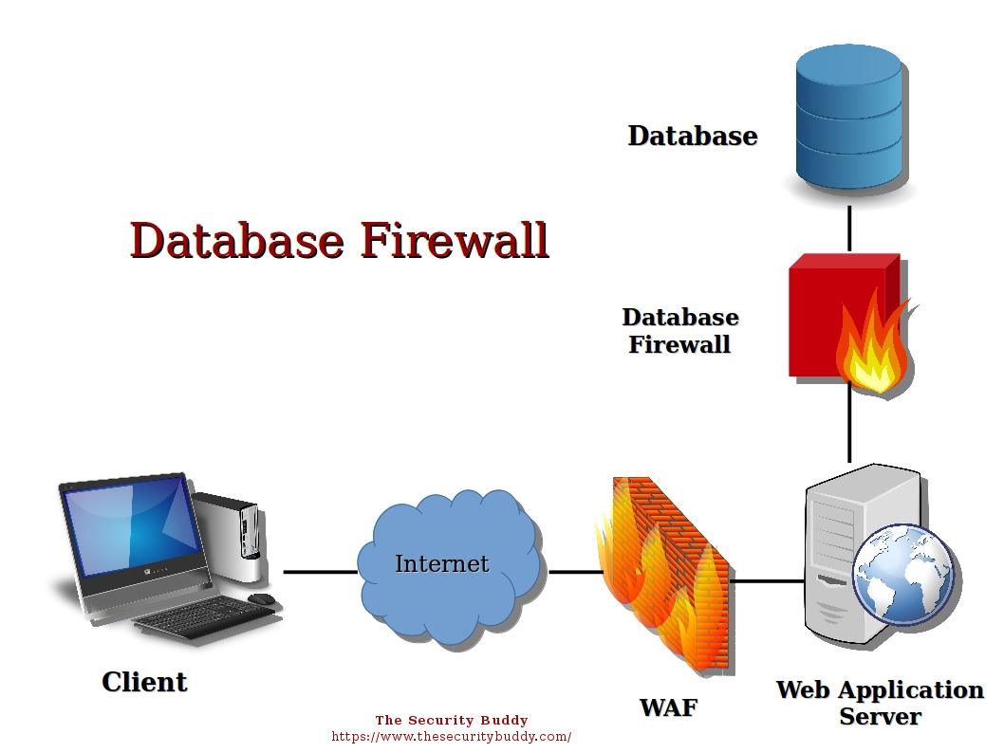
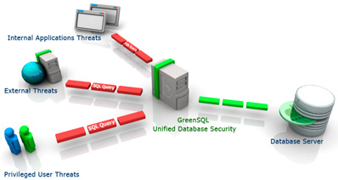
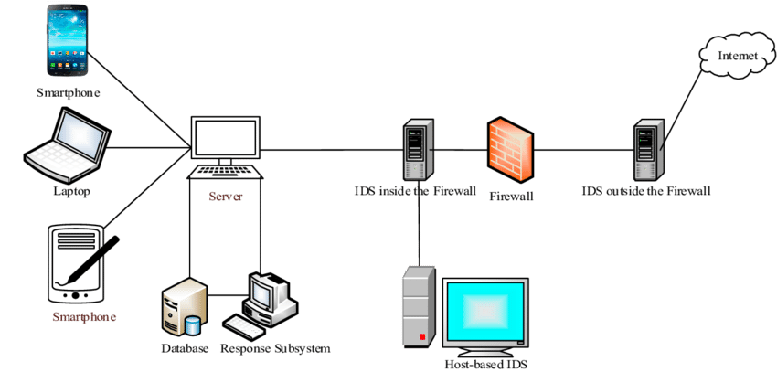
Improving Data Security & Protection Using Data Provenance
Figure 1
Figure 2
Figure 3

Slide 2
Improving Data Security & Protection Using Data Provenance
Challenges:
Threats caused by internal users cause more harm than the threats posed by external attackers
Identifying the Internal attackers is always a problem (if preventive action is to be taken).
The response time of the system should be considerably better.
Solution:
Create specific user profiles as per the roles and responsibilities give to each user respectively
Real-time activity monitoring of each user at a given point of time accessing the respective files
Integrate the system into the OS itself to improve performance and reaction time.

Slide 3
Improving Data Security & Protection Using Data Provenance
Conclusion:
The system can perform considerably well if the integration is done according to procedures.
The intrusion detection system should be able to provide a considerably improved response time to update and counter any Intrusions.
Future:
Should aim to provide counter measure the system can implement against internal threats.
Should try to improve the method of integrating both the system, in a better and easier way.
References:
Fig 1: https://www.helpnetsecurity.com/images/articles/greensql-enterprise.jpg
Fig 2: https://www.thesecuritybuddy.com/database-security/what-is-database-firewall/
Fig 3: https://www.researchgate.net/figure/Intrusion-detection-system-architecture-37_fig2_315662151

