Slide 1
Access Control for High Availability in AWS
Harrison Howell

Slide 2
Security Problem
HA failover outside of AWS Region
Peering Connections
AWS IAM roles

Slide 3
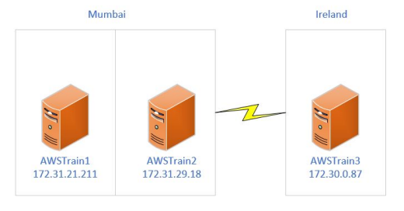
Importance
High Availability service requirements
Critical Systems/Enterprise Software
AWS EC2 regions
Cross region failover
Risk of Peering Connection

Slide 4
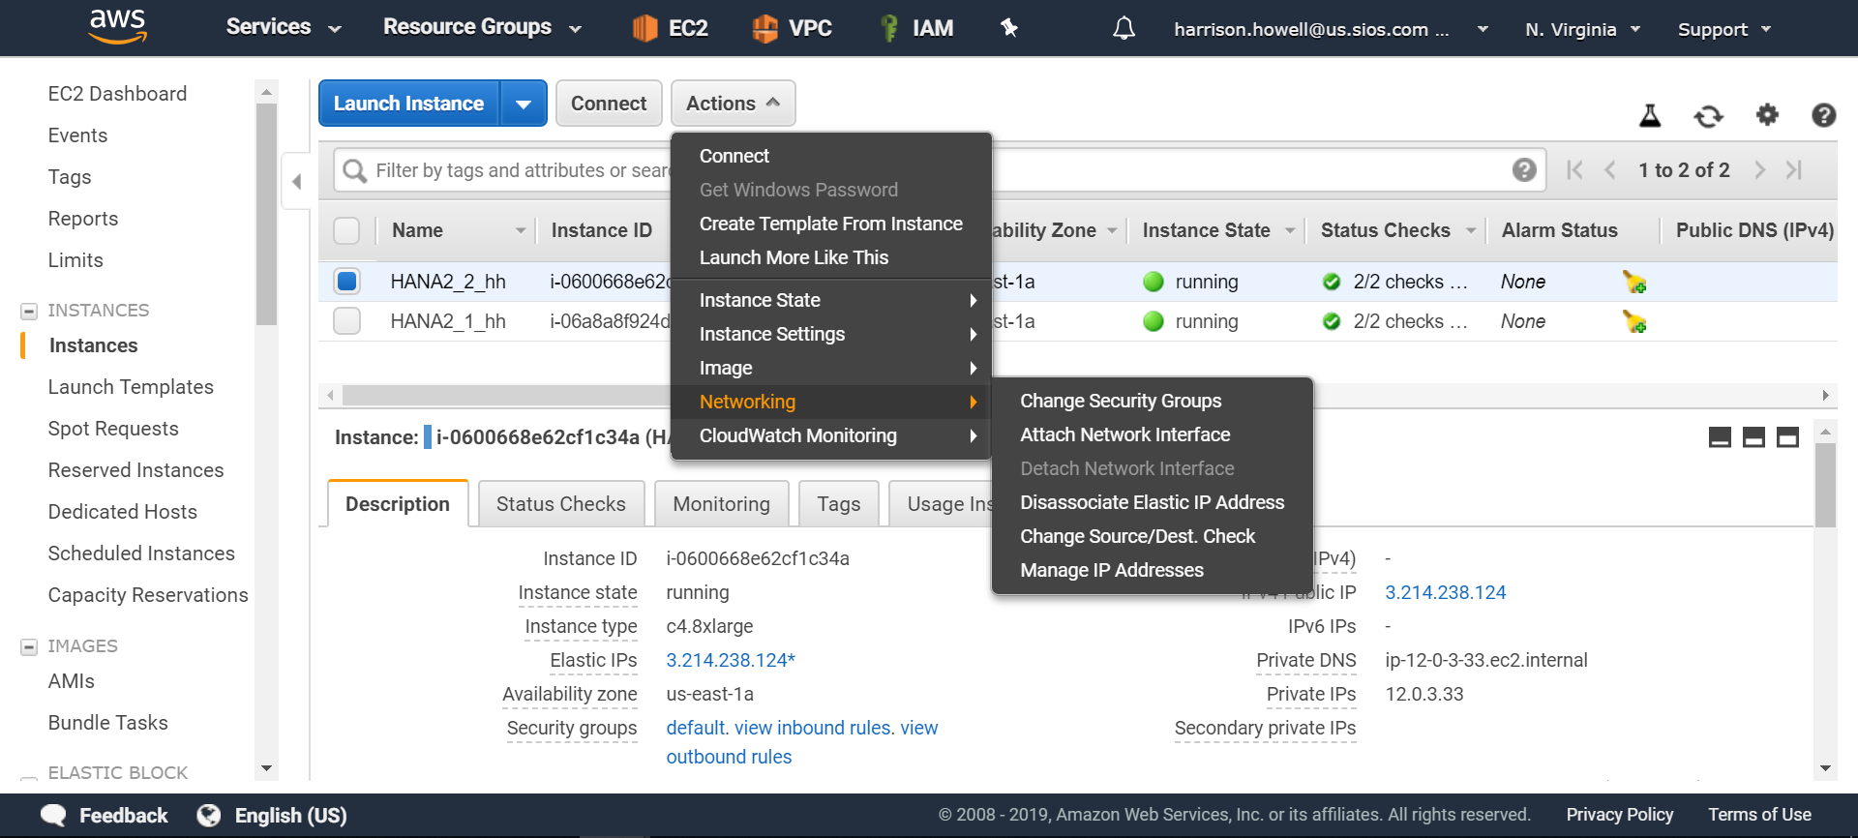
Challenge - Establishing Communication local nodes

Slide 5
Challenge - Failover Time

Slide 6
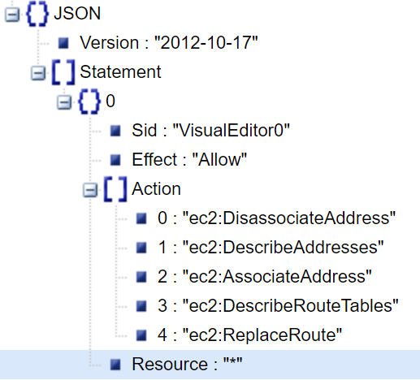
Challenge - Correct IAM policy permissions

Slide 7
Contributions
Increased security for applications
(Possibly) Maintain availability
Cross region failover in AWS

Slide 8
Questions?

Slide 9
Sources
Amazon EC2 Instance Types - Amazon Web Services. (n.d.). Retrieved from https://aws.amazon.com/ec2/instance-types/
Florian Haas. 2012. Replicate everything! highly available iSCSI storage with DRBD and pacemaker. Linux J. 2012, 217, pages.
Fawzy, M., & Fawzy, M. (2018, July 29). Create Cluster using docker swarm. Retrieved from https://medium.com/tech-tajawal/create-cluster-using-docker-swarm-94d7b2a10c43
Jaemyung Kim, Kenneth Salem, Khuzaima Daudjee, Ashraf Aboulnaga, and Xin Pan. 2015. Database high availability using SHADOW systems. In Proceedings of the Sixth ACM Symposium on Cloud Computing (SoCC '15). ACM, New York, NY, USA, 209-221. DOI: https://doi.org/10.1145/2806777.2806841
Sabrina De Capitani di Vimercati, Pierangela Samarati, and Sushil Jajodia. 2005. Policies, models, and languages for access control. In Proceedings of the 4th international conference on Databases in Networked Information Systems (DNIS'05), Subhash Bhalla (Ed.). Springer-Verlag, Berlin, Heidelberg, 225-237. DOI=http://dx.doi.org/10.1007/978-3-540-31970-2_18
Violeta Medina and Juan Manuel García. 2014. A survey of migration mechanisms of virtual machines. ACM Comput. Surv. 46, 3, Article 30 (January 2014), 33 pages. DOI=http://dx.doi.org/10.1145/2492705
Vlado Stankovski, Salman Taherizadeh, Ian Taylor, Andrew Jones, Bruce Becker, Carlo Mastroianni, and Heru Suhartanto. 2015. Towards an environment supporting resilience, high-availability, reproducibility and reliability for cloud applications. In Proceedings of the 8th International Conference on Utility and Cloud Computing (UCC '15). IEEE Press, Piscataway, NJ, USA, 383-386. DOI: https://doi.org/10.1109/UCC.2015.61
What is Infrastructure as a Service (IaaS)? - Definition from WhatIs.com. (n.d.). Retrieved from https://searchcloudcomputing.techtarget.com/definition/Infrastructure-as-a-Service-IaaS
Zahoor, Ehtesham, Asma, Zubaria, Perrin, Olivier, De Paoli, Flavio, Schulte, Stefan, Broch Johnsen, Einar, Conference Proceedings, A Formal Approach for the Verification of AWS IAM Access Control Policies, Service-Oriented and Cloud Computing, 2017, Springer International Publishing, Cham, 978-3-319-67262-5, 10.1007/978-3-319-67262-5_5,59-74

