Slide 1
Matthew Heightland mheightl@uscb.edu
Database Intrusion Detection in Web-Based Applications
OWASP TOP 10 – 2004 to 2017
Entries (unordered) | 2004 | 2007 | 2010 | 2013 | 2017
Unvalidated Inputs | A1 | X
Broken Access Control | A2
Broken Authentication and Session Management | A3 | A7 | A3 | A2 | A2
Cross Site Scripting (XSS) Flaws | A4 | A1 | A2 | A3 | A7
Buffer Overflows | A5 | X
Injection Flaws | A6 | A2 | A1 | A1 | A1
Improper Error Handling | A7 | A6 | X
Insecure Storage | A8 | A8 | A7
Denial of Service | A9 | X
Insecure Configuration Management | A10 | X
Malicious File Execution |  | A3 | X
Insecure Direct Object Reference |  | A4 | A4 | A4
Cross Site Request Forgery |  | A5 | A5 | A8
Insecure Communications |  | A9 | A9
Failure to Restrict URL Access |  | A10 | A8
Security Misconfiguration |  |  | A6 | A5 | A6
Unvalidated Redirects and Forwards |  |  | A10 | A10
Sensitive Data Exposure |  |  |  | A6 | A3
Missing Function Level Access Control |  |  |  | A7
Using Known Vulnerable Components |  |  |  | A9 | A9
XML External Entities |  |  |  |  | A4
Broken Access Control |  |  |  |  | A5
Insecure Deserialization |  |  |  |  | A8
Insufficient Logging & Monitoring |  |  |  |  | A10
Notes:
Security problem and your credentials to solve the problem – layman's terms only
Importance of the problem and the impact of the technology you are proposing – layman's terms only

Slide 2
Database Intrusion Detection in Web-Based Applications
Challenges
Legacy Applications
User Acceptance
Data Availability
Solutions
Risk Adaptive Access Control paired with a Machine Learning-Based Intrusion Detection Systems
Application Wrapper
Matthew Heightland mheightl@uscb.edu

Slide 3
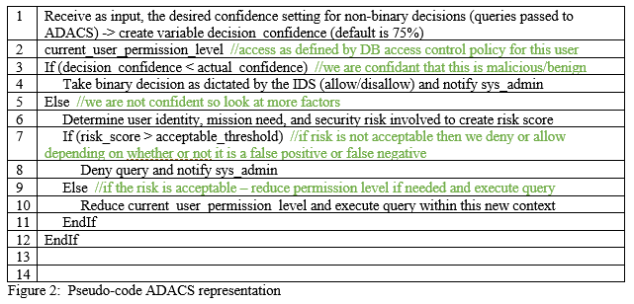
Database Intrusion Detection in Web-Based Applications
Future Work
Implementation
Testing with and without Adaptive Database Access Control
Matthew Heightland mheightl@uscb.edu
Notes:
recap your contribution and emphasize your contributions

