Slide 1
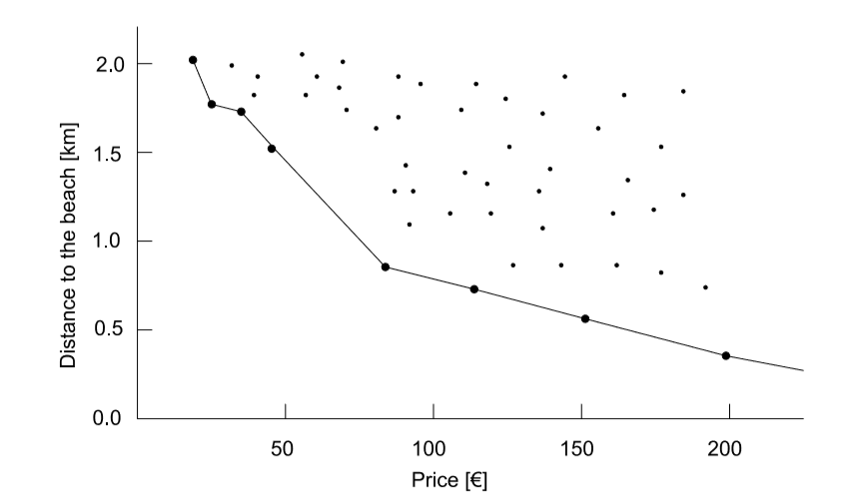
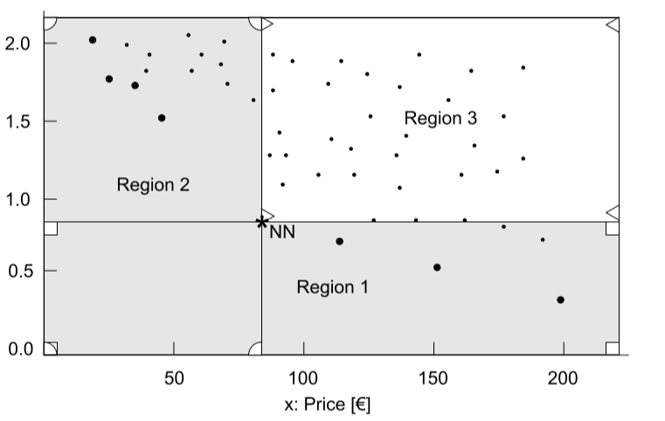
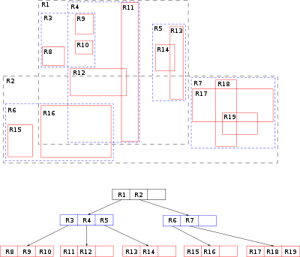
Fengyao Yan fyan@email.sc.edu
Faster skyline searching using Hilbert R-tree
Improvement of the existing shooting star algorithm
Fig. 1 An example of Skyline[1]
Fig. 2 shoot stars algorithm for skyline searching[1]
R-tree was invented in 80s and is extremely use for nearest neighbors searching, but It is not the fastest Data-structure.
Fig. 3 R-tree example
[1] Kossmann, D., Ramsak, F. and Rost, S., 2002, August. Shooting stars in the sky: An online algorithm for skyline queries. In Proceedings of the 28th international conference on Very Large Data Bases (pp. 275-286). VLDB Endowment.
Notes:
Security problem and your credentials to solve the problem – layman's terms only
Importance of the problem and the impact of the technology you are proposing – layman's terms only

Slide 2
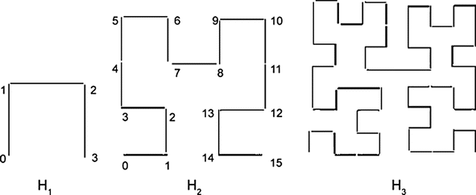
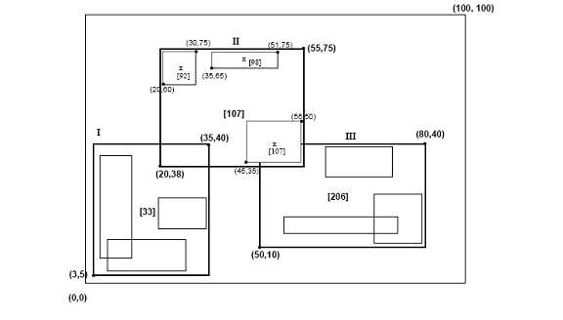
Faster skyline searching using Hilbert R-tree
Property of Hilbert Curve:
If two points in a 2D space is close to each other, then they are close on a Hilbert curve (they have similar Hilbert value).
Fig. 4 An example of Hilbert Curve
Adopt Hilbert Curve and construct R-tree according to pre-calculated Hilbert Value
The Hilbert R-tree is much faster than Original the R-tree.
Fig. 4 An example of Hilbert R-tree
R-tree
Your Name Email

Slide 3
Conclusion
 | ED. 10^4 | ED. 10^5 | ED. 10^6 | UEDL. 10^6 | UEDM. 10^5
Brute-force | 0.0026 | 0.0717 | 0.5109 | 0.0654 | 0.3712
R-tree | 0.0172 | 0.0239 | 0.0279 | 0.0247 | 10.1514
Hilbert R-tree | 0.0099 | 0.0158 | 0.0195 | 0.0205 | 0.3700
By adopting Hilbert R-tree the original Shooting Stars Algorithm shows 20%-1005% performance improvements
Note that we are not modifying the original Shooting Stars algorithm, we improve the performance by using an improved data structure which is heavily used by the original Shooting Stars algorithm.
ED: evenly distributed dataset
UEDL: Unevenly distributed dataset less skyline points
UEDM: Unevenly distributed dataset more skyline points
Unit: seconds
Your Name Email
Notes:
recap your contribution and emphasize your contributions

