Slide 1
Privacy and Data Security in Telepresence Robot System for Assisting Old Adults At Home
Jiexi Wang
Master of Computer Science Program
Department of Computer Science and Engineering
University of South Carolina

Slide 2
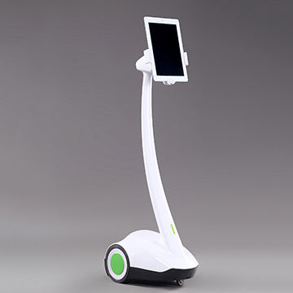
Jiexi Wang wang372@email.sc.edu
Problems
Data not secured when putting all the data in one database or during transmission
Privacy not protected when the camera and GPS are recording

Slide 3
Jiexi Wang wang372@email.sc.edu
Importance of the Problems
Other than functions, privacy is the other greatest concerns to old adults
Old Adults will be very hesitated to use telepresence robot without a solution to privacy exposure

Slide 4
Jiexi Wang wang372@email.sc.edu
Three Most Challenging Aspects and Solutions
Data security when saving data in one database, data transmission, access
Multiple database, Encrypted, RBAC
Camera recording and location limitations
Video filter
Online GPS tracking
Radio Global Map or Offline Map

Slide 5
Jiexi Wang wang372@email.sc.edu
Conclusion
Saving data on separate database, transmitting encrypted data, and using role based access control will help protect data security
Installing multiple filters and enabling old adults to make options of filter under different scenarios will protect their privacy
Using offline map instead of online GPS keeps old adult’s location from being exposed to the public

Slide 6
Jiexi Wang wang372@email.sc.edu
Future Work
Testing variable filters or methods to manipulate the video by considering both function and privacy
More research on Radio global map or offline map
Market Needs: Survey to old adults about their opinions to new features

