Slide 1
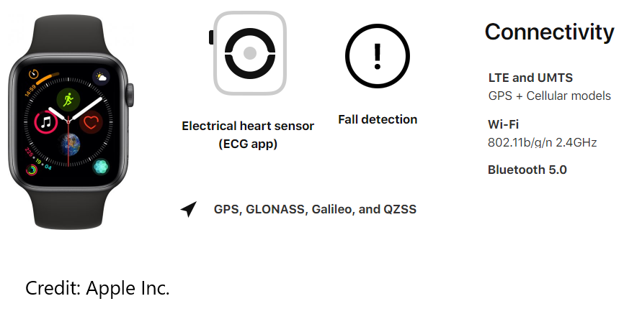
Theppatorn Rhujittawiwat theppatorn@gmail.com
Semantic Security Policy for Stream Data

Slide 2
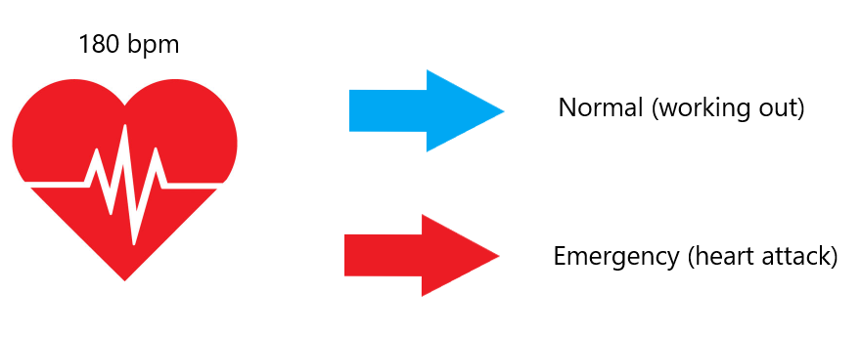
Theppatorn Rhujittawiwat theppatorn@gmail.com
Semantic Security Policy for Stream Data

Slide 3
Theppatorn Rhujittawiwat theppatorn@gmail.com
Semantic Security Policy for Stream Data

Slide 4
Semantic Security Policy for Stream Data
Challenges
To protect sensitive information
To express needed security policy
To convert values into meaning
Theppatorn Rhujittawiwat theppatorn@gmail.com

Slide 5
Semantic Security Policy for Stream Data
Contributions
Address issues
Introduce possible functionalities and approach to provide them
Future work
Implementation and testing
Theppatorn Rhujittawiwat theppatorn@gmail.com

