Slide 1
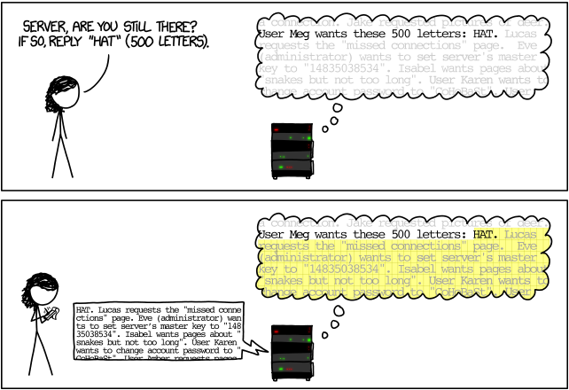
Kim Redmond redmonkm@email.sc.edu
Can Embeddings Detect Heartbleed?
Source code isn't available to analyze proprietary software for security vulnerabilities.
We can use binary code analysis (BCA) on binary executables. However, most BCA methods are inefficient and unscalable.
Solution: use machine learning to generate semantic instruction embeddings using assembly code from the binary!
Source: https://xkcd.com/1354/
Notes:
Security problem and your credentials to solve the problem – layman's terms only
Importance of the problem and the impact of the technology you are proposing – layman's terms only

Slide 2
Can Embeddings Detect Heartbleed?
1. What available program has a version with a known vulnerability, and another version that has fixed the vulnerability?
- OpenSSL (v 1.0.1g and Heartbleed (v 1.0.1c))
2. How do we compile and disassemble this program?
- config and llvm-objdump
3. How do we distinguish between insecure and secure code patterns?
- train instruction embeddings and project a visualization to observe where they don’t overlap
Kim Redmond redmonkm@email.sc.edu

Slide 3
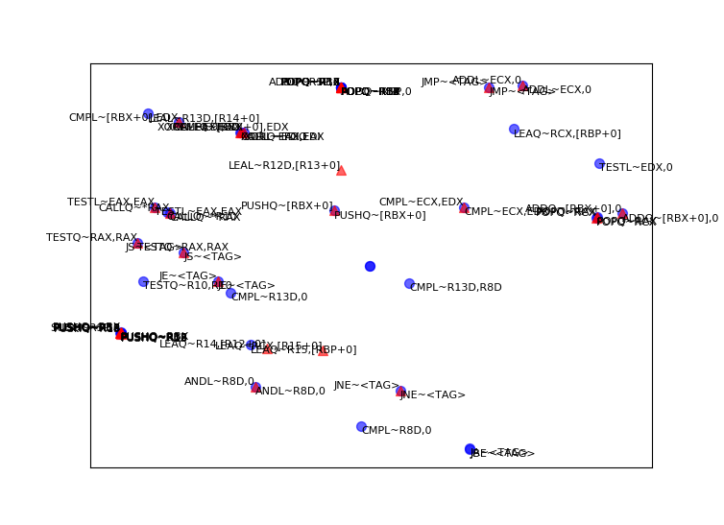
Can Embeddings Detect Heartbleed?
Instruction embeddings do display a meaningful difference between secure and insecure versions of the same program: the bounds check!
Future work: more vulnerabilities; larger set of training instructions; identify security-related embedding features/patterns
Kim Redmond redmonkm@email.sc.edu
Notes:
recap your contribution and emphasize your contributions

