Slide 1
Dark Data
Are we at risk?

Slide 2
CSCE 824
End of Course Review

Slide 3
Course Objectives
The objective of this course is to
introduce the security challenges and threats in database systems
provide an understanding of the state-of-the art security technologies and research
policies, models and technologies for
access control
integrity models and mechanisms
multi-level secure database architectures
inference problem
distributed transaction processing
recovery and fault tolerance
security problems raised by data warehousing and data mining.

Slide 4
Traditional Database Management Systems
Focus on business data management
Provide uniform capabilities regardless of the data characteristics
Last decade: capabilities to meet new application requirements, such as
Stream Data Processing
Large scale scientific database
Data warehousing → Big Data

Slide 5
Traditional Data Security
Independent from system and network
Database Management System (DBMS) is responsible for protecting data items
Main database types:
Enterprise
Statistical
NEW
Adversarial
Machine Learning

Slide 6
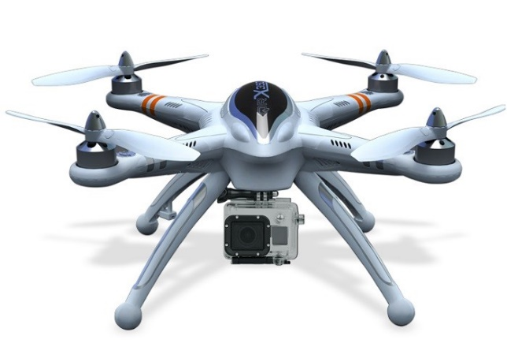
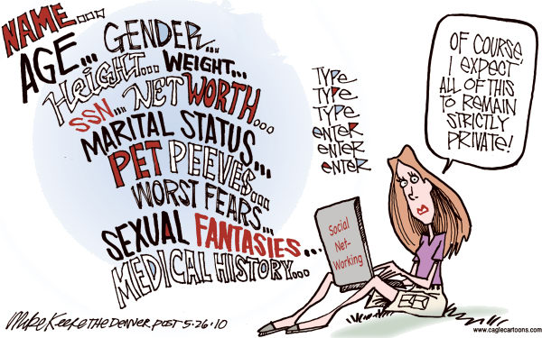
What is Big Data?
Source: http://www.cagle.com/2010/05/internet-privacy/

Slide 7
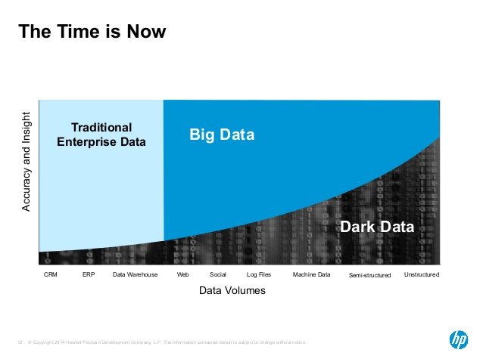
What is Dark Data?
Only 1-10% of the data generated, collected, processed, and stored
is used by businesses

Slide 8
How valuable Dark Data is?
We don’t know
It may be a security risk
More data, more to protect
Are companies become “digital hoarders”
It may be a compliance risk
Sensitive (dark) data that violates regulations
Not storing data may also violate regulations
How to filter it our?
Coordinate cloud storage with on-premises storage

Slide 9
Dark Data Characteristics
Unstructured
Difficult to categorize and analyze
Lack of confidence in data quality and relevance
Lack of tools to analyze dark data
Human analysts ??
Timeliness (data looses its value quickly)

Slide 10
NEW NEED
Technology to make sense of dark data
Convert to structured data
Add annotation and semantics
Efficiency
Address security protection

Slide 11
See you on May 7th
4:00 – 6:30 pm

