Slide 1
Big Data – Data Lakes
Are we at risk?
Dr. Csilla Farkas
Director
Center for Information Assurance Engineering (CIAE)
Department of Computer Science and Engineering
University of South Carolina, Columbia

Slide 2
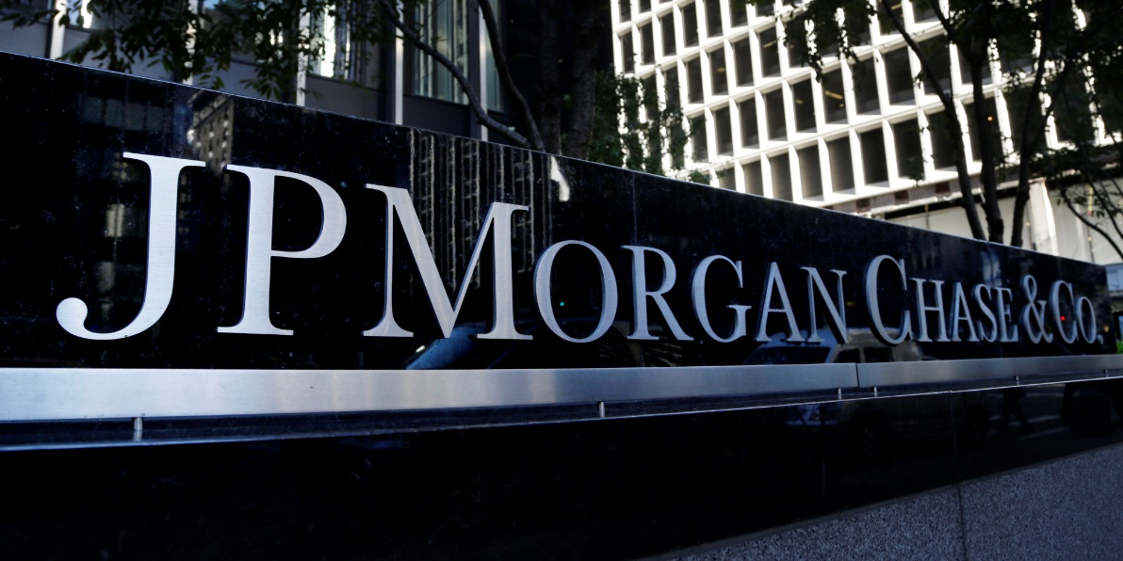

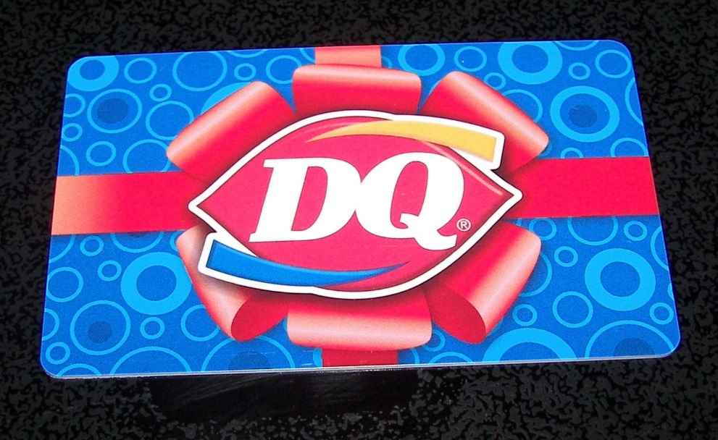
Who is Impacted by Cyber Attacks?

Slide 3


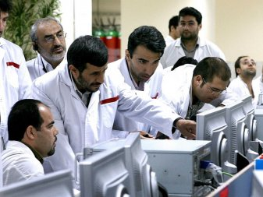


Who is Impacted by Cyber Attacks?

Slide 4


Who is Impacted by Cyber Attacks?

Slide 5


Risk Assessment
Business Policy Decision
Communication between technical and administrative employees
Internal vs. external resources
Legal and regulatory requirements
Developing security capabilities
Optimal level of security
at a minimum cost
Cost
Security Investment
Cost of Breaches
0 %
Security level
100%

Slide 6

Traditional Data Security
Independent from system and network
Database Management System (DBMS) is responsible for protecting data items
Main database types:
Enterprise
Statistical

Slide 7

Sensitive Data
Inherently sensitive
From a sensitive source
Declared sensitive
Part of a sensitive attribute or record
In relation to previously disclosed information

Slide 8

Types of Disclosures
Exact data
Range of data
Negative results
Existence
Probable values
SSN: 111-22-3333

Slide 9
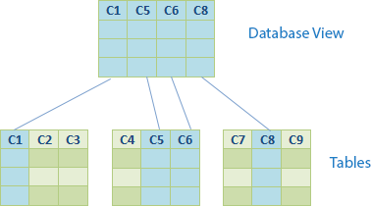
Access Control Mechanisms
Cryptography
Security through Views
Stored Procedures
Grant and Revoke
Query modification

Slide 10

Statistical Databases
Goal: provide aggregate information about groups of individuals
E.g., average grade point of students
Security risk: specific information about a particular individual
E.g., grade point of student John Smith

Slide 11

Statistical Data Protection
Query restriction
Data perturbation
Output perturbation
?
?

Slide 12
Database Inference Attacks
General Purpose Database:
Non-confidential data + Metadata →
Undesired Inferences
Web Enabled Data:
Non-confidential data + Metadata (data and application semantics) + Computational Power + Connectivity → Undesired Inferences

Slide 13


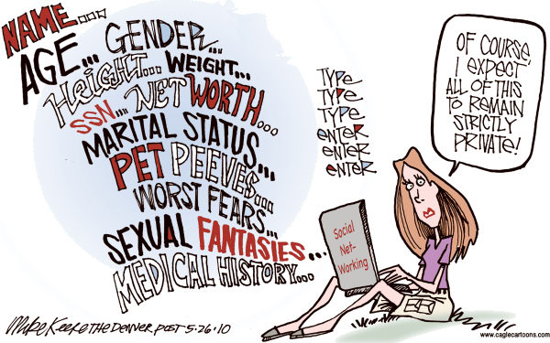



What is Big Data?
Source: http://www.cagle.com/2010/05/internet-privacy/

Slide 14

Big Data Characteristics
Volume
Simple SQL analytics (data warehouse)
Complex analytics (clustering, trend detection, etc.)
Variety
Enterprise data: spreadsheets, documents, web pages
Public data
Velocity
Live database
Fast growth
Hadoop

Slide 15
Big Data Security
Access Control
Distributed, massively parallel processing
Data at rest, in transit, during processing
Inference control
Discovery
Sensitive metadata
Use of discovered knowledge

Slide 16
Inference Example
Latanya Sweeney, Director of Data Privacy Lab, Harvard
Only You, Your Doctor, and Many Others May Know, Technology Science, 2015092903. September 29, 2015.

Slide 17
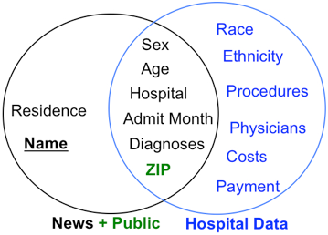
Data Matching
Source: L. Sweeney, http://techscience.org/a/2015092903/

Slide 18




Present: Big Data Inferences
Private ?
Data Integration and
Inferences
Ontology
Web Data
Secure ?

Slide 19
Data Lakes
Increasing amount of data
Stored in original (natural) format
Data management issues
Data Curation
Data transformation
Automated tools to identify constraints
Scalability

Slide 20
Data Lakes Technologies
Apache Hadoop
Azure Data Lake
Amazon S3
Services provided by these technologies?
Learning curve?

Slide 21
Future: Research Challenges
Security for raw data
Flexible access control
Data removal
Data quality
Security for metadata
Protection need of novel, new concept
Metadata guided attacks
Cross-context attacks
Correlate data across multiple contexts
Semantic
Web
Technologies

Slide 22

Usability and Visualization
Facebook
Online Banking
Gmail

Slide 23
Next Class Data Provenance

