Slide 1
Data Stream
Theppatorn rhujittawiwat

Slide 2
Outline
The world is overflowing with data
Problem with DBMS
Introduction to DSMS
Data model
DSMS architecture
Continuous queries example
Issues in DSMS
Questions

Slide 3
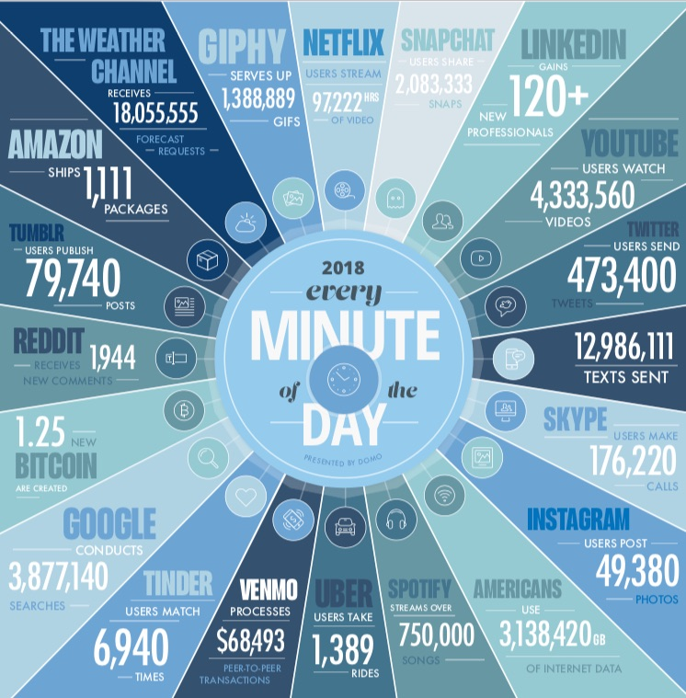
The world is overflowing with data
Source: www.domo.com

Slide 4
Problem with DBMS
Analyze those data can be useful to discover knowledge or predict future outcome
We want to use those data so we need a way to process it
Processing those data are problematic for DBMS
The new data is continuous coming
The new data has to be stored before processing
The maximum space to store data is unbound
DBMS is inefficient in this case

Slide 5
Introduction to DSMS
Specialize to process continuous incoming data
Support continuous queries
Process data in real-time
No overhead from storing data

Slide 6
Data model
A stream is a sequence of tuples with uniform schema
Schema is corresponding to data field with additional timestamp (ts)
A stream tuples have the form
(ts, v₁, …, v_{n})
Each value v_{i} is corresponding to attribute A_{i} of application-specific metadata
(A₁ = v₁, …, A_{n} = v_{n})

Slide 7
DSMS architecture

Slide 8
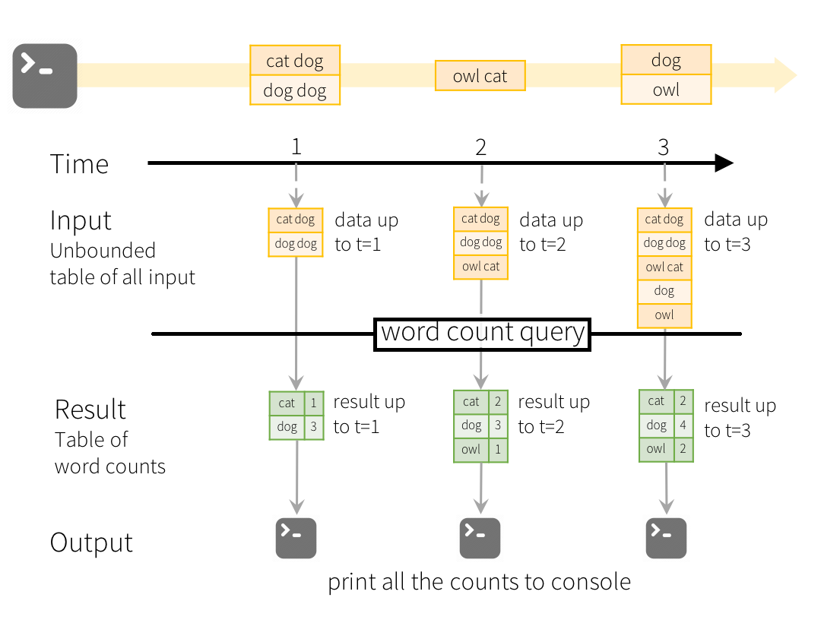
Continuous queries example
A continuous query which count how many time
each word show up
Source: spark.apache.org

Slide 9
Issues in DSMS
Data arrives through network
Data can be lost or arrives with wrong order
Data stream is still unbound in size
Many query operators are problematic
For example, aggregation operators such as SUM, COUNT, MIN, MAX, and AVG
The entire input has to be seen to produce their output
Queries referencing past data

Slide 10
Questions

