Slide 1
Data Provenance

Slide 2
What is Data Provenance?
Lineage and pedigree
History of data
Origin of Data
Etc.
… record trail that accounts for the origin of a piece of data (in a database, document or repository) together with an explanation of how and why it got to the present place.
(Encyclopedia of Database Systems, 2009)

Slide 3
Data History
Origin of data (input, publish)
Date of creation
Data processing information (modification, extension, etc.)
Metadata
What data do I need to collect?

Slide 4
Workflow Provenance
Coarse-grain provenance
Record of history of the derivation of the final result
May include:
tracking interaction of programs
input from external devices, e.g., sensors, and
human interactions
Performed for complex processing tasks

Slide 5
Data Provenance
Fine-grain provenance
Derivation of part of the resulting data set
Description of the origin of the data and the process on how it arrived to the database
Where-provenance: identifies the source elements where the data in the target is originated
Why-provenance: justification for the data elements appearing in the output and how some parts of the input influenced certain parts of the output

Slide 6
Example
From: Peter Buneman and Wang-Chiew Tan. 2007. Provenance in databases. In Proceedings of the 2007 ACM SIGMOD international conference on Management of data (SIGMOD '07). ACM, New York, NY, USA, 1171-1173.
emp(ssn, name, deptid)
dept(id, dname)
SELECT emp.name, dept.name
FROM emp, dept
WHERE emp.deptid=dept.id;
Answer(Kim, CS)
What is the where-provenance?
What is the why-provenance?

Slide 7
Provenance Applications
Scientific Publications: regenerating results
Input data information
Process specific information: software used, system used, control flow, etc.
Parameters of the experiment
Different results? Why?
Capture how results were achieved
Reproducibility?
Community sharing?

Slide 8
Trustworthiness and Accountability
Origin and processing of data recorded
Can enforce accountability on malicious sources/processing
Can detect malfunctioning sources/processing components
Can attribute high quality source/processing

Slide 9
Current Applications of Provenance data
Databases:
Data sharing and integration
Web of data
Linked data
Digital Humanities
Science
Art
Publishing
IoT

Slide 10
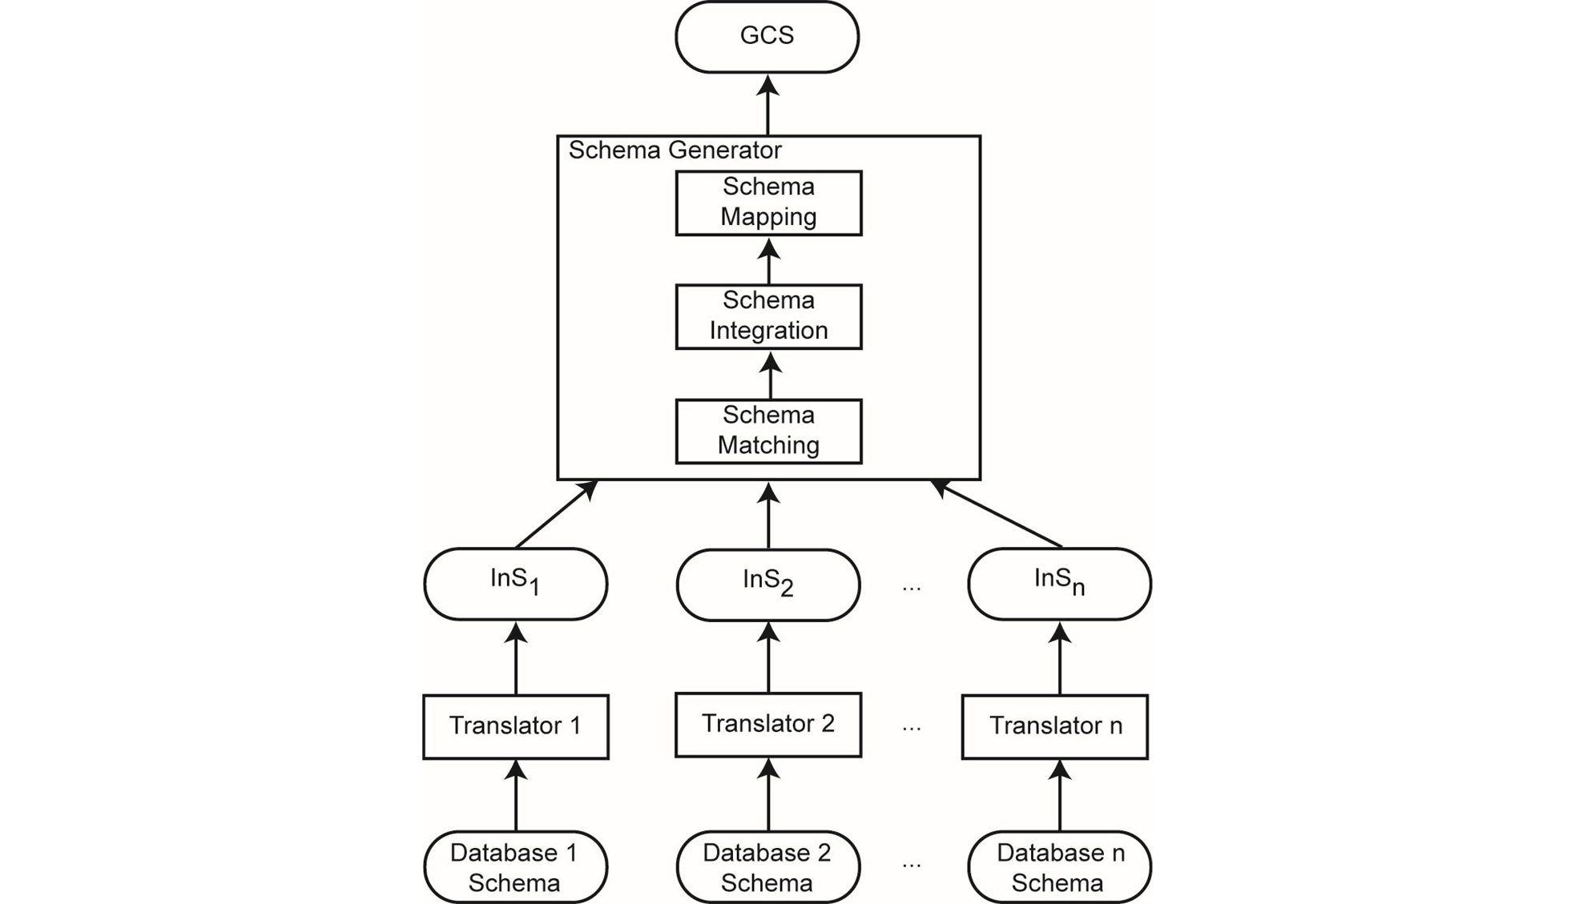
Data Integration
How to map ontologies?
How to annotate data with
semantics?
How to propagate changes
Back to the local database?

Slide 11
Web Evolution
Past: Human usage
HTTP
Static Web pages (HTML)
Current: Human and some automated usage
Interactive Web pages
Web Services (WSDL, SOAP, SAML)
Semantic Web (RDF, OWL, RuleML, Web databases)
XML technology (data exchange, data representation)
Future: Semantic Web Services

Slide 12
Provenance Data Model
Dataset Description level
Data analysis level
Experimental specification level
Institutional level
Provenance Vocabulary

Slide 13
Provenance Data Management
Directly linked to data and follows data
Represented in data dictionary
Stored at separate location
Usability?

Slide 14
Provenance Data Protection
Accountability
Piracy
Malicious intent

Slide 15
Metadata Security
No security model exists for metadata
Can we use existing security models to protect metadata?
RDF/S is the Basic Framework for SW
RDF/S supports simple inferences

Slide 16
Correlated Inference
Concept Generalization: weighted concepts, concept abstraction level,
range of allowed abstractions
Object[].
waterSource :: Object
basin :: waterSource
place :: Object
district :: place
address :: place
base :: Object
fort :: base
Public
fort
address
Public
basin
district
?
Confidential
base
Water source

Slide 17
Correlated Inference (cont.)
Object[].
waterSource :: Object
basin :: waterSource
place :: Object
district :: place
address :: place
base :: Object
fort :: base
Base
Place
base
place
Public
fort
address
Water source
Public
basin
district
Water Source
Confidential
base
Water source
Notes:
f

Slide 18
RDF/S Entailment Rules
Example RDF/S Entailment Rules (http://www.w3.org/TR/rdf-mt/#rules )
Rdfs2:
(aaa, rdfs:domain, xxx) + (uuu, aaa, yyy) → (uuu, rdf:type, xxx)
Rdfs3:
(aaa, rdfs:range, xxx) + (uuu, aaa, vvv) →(vvv, rdf:type, xxx)
Rdfs5:
(uuu, rdfs:subPropertyOf, vvv) + (vvv, rdfs:subPropertyOf, xxx)→ (uuu,rdfs:subPropertyOf, xxx)
Rdfs11:
(uuu, rdfs:subClassOf, vvv)+(vvv, rdfs:subClassOf, xxx)→(uuu,rdfs:subClassOf, xxx)

Slide 19
Example Graph Format
RDF Triples:
(Student, rdfs:subClassOf, Person)
(University, rdfs:subClassOf, GovAgency)
(studiesAt, rdfs:domain, Student)
(studiesAt, rdfs:range,University)
(studiesAt, rdfs:subPropertyOf, memberAt)
(John, studiesAt, USC)

Slide 20
Example Graph Format

Slide 21
Example Graph Format

Slide 22
Example Graph Format

Slide 23
RDF Access Control
Security Policy
Subject
Object – Object pattern
Access Mode
Default policy
Conflict Resolution
Classification of entailed data
Flexible granularity

Slide 24
Next Class
Febr. 28, XML

