Slide 1
High-Availability, Reproducibility, and Reliability Architecture in the Cloud
Harrison Howell
CSCE 824
Dr. Farkas

Slide 2
Outline
Cloud Computing Background
Relevance
High Level Proposed Architecture
Technical and logistical limitations
Conclusions
Questions

Slide 3
Types of Cloud Computing
On premise - High upfront cost, poor scalability, total control
IaaS - Bare computing resources, install manage and maintain layers, scalable
PaaS - Deploy applications on provider’s framework, virtualization of OS
SaaS - Simple to start, low upfront cost, no control over the infrastructure

Slide 4
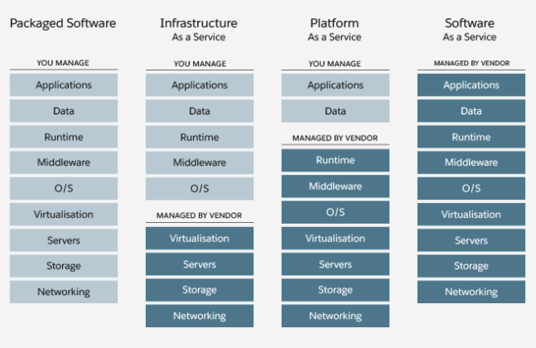
Background

Slide 5
Key Terms
What makes a “good” cloud-based application?
Availability
Reproducibility
Reliability

Slide 6
Goal
Address potential instability of Cloud services by providing an overall architecture
Architecture will contribute to high-availability, reproducibility, and reliability of cloud based services
Take advantage of existing open source technologies
Guarantee a Quality of Service similar to a locally hosted application

Slide 7
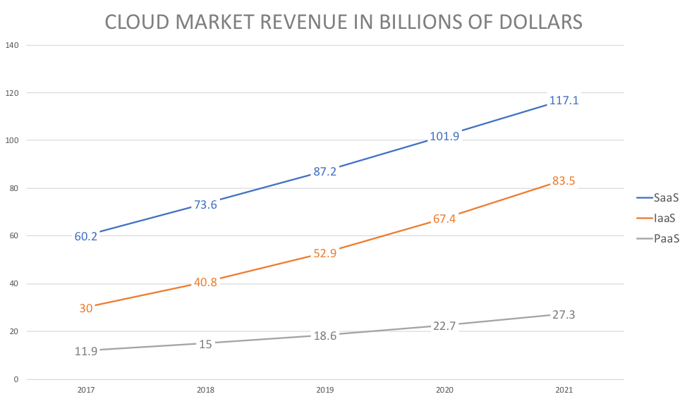
Why is this important?
Increasing popularity of cloud services
Reduces infrastructure cost and management burdens at varying levels
Scalability
Results of failing QoS
Financial Penalty
Customer trust

Slide 8
83%
The amount of workload that will be done in the cloud by 2020

Slide 9
Quality of Service
Checkpointing
Migration
Replication

Slide 10
Containers vs Virtual Machines
Containers
Abstraction of the app layer
Packaged with code and dependencies
Share the OS kernel amongst themselves
Virtual Machines
Abstraction of the physical hardware
Hypervisor orchestrates instances on a machine
Every instance has a copy of the OS

Slide 11
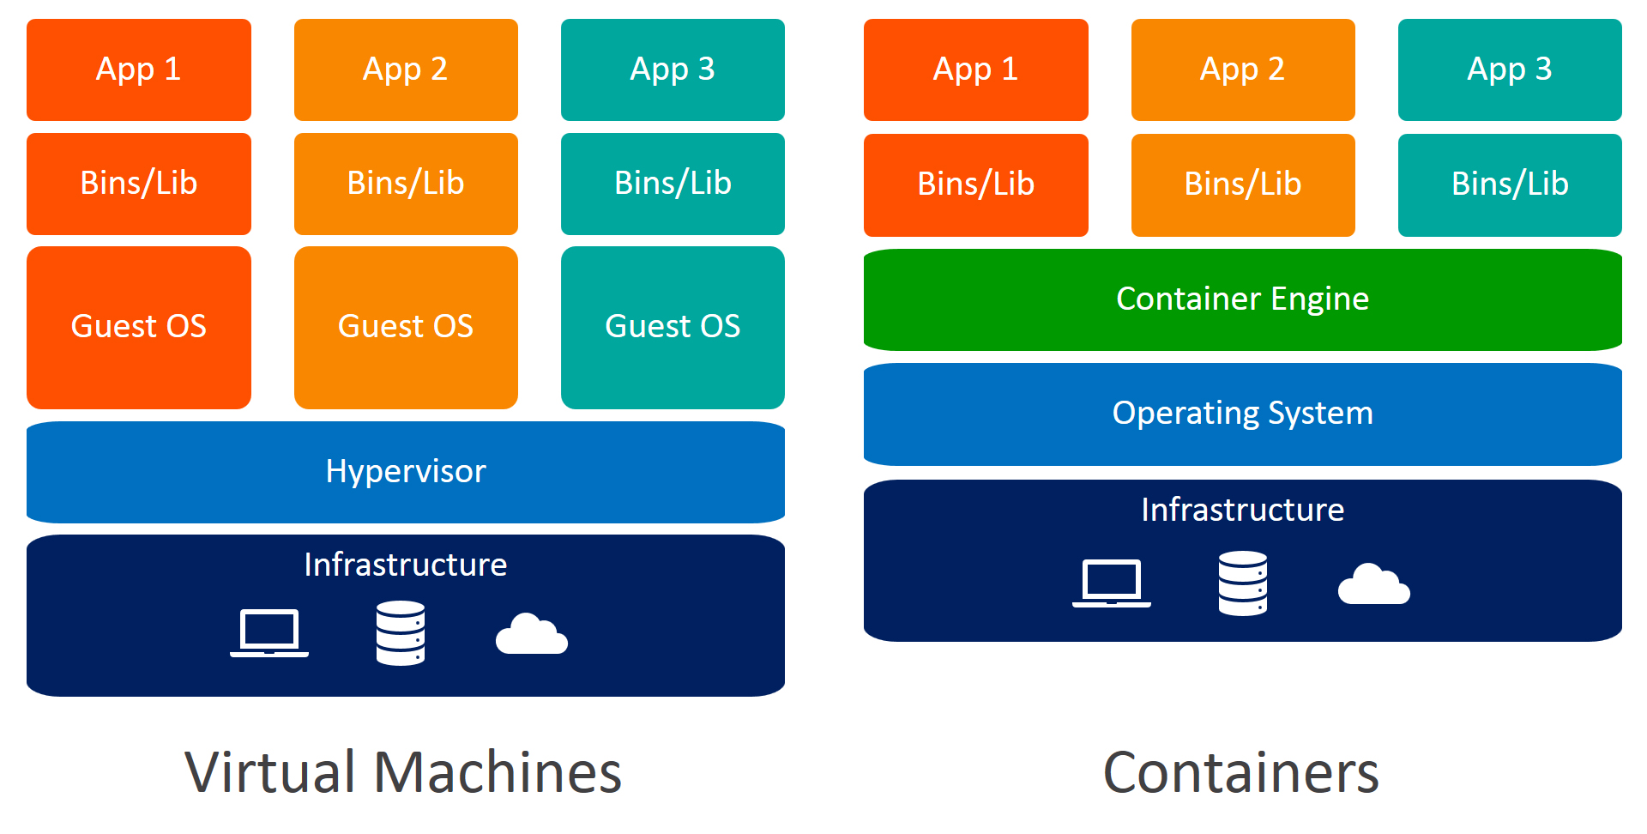

Slide 12
Setting up the architecture
Cloud applications will provide
Application Code
Data
Quality of Service requirements

Slide 13
Creating the architecture
Application code containerized
Data set hosted on scalable distributed storage and retrieval system
Dataset accessible from any container on the network
Containers will be deployed via a container hub and made available through the dashboard
QoS parameters can be attached to the application from the dashboard
Checkpoint scheduler will maintain file system within QoS constraint

Slide 14
Detection of Failure
Live migration tool notifies the user and requests permission to move the application
Live migration tool checks for most recent checkpoint
Provision a new server to run containers from last checkpoint
Update backend DB that migration occured

Slide 15
Container related components
CRIU - Checkpoint/Restore in Userspace
Live checkpoint scheduler will maintain both file system within QoS constraint
Useful for maintenance as well
Container monitor
Application snapshot interface
Ability to create and store snapshot of multi-container system

Slide 16
Cloud related components
Docker Hub - hub tracking container implementation
Used for tracking what to snapshot
Docker commit - receives pushes from containers with memory snapshots and container shaaphots
Docker image library - Collection of containers built for specific applications
Data Repository - REST API for storing container snapshots
Live Migration Service - Uses Data repository. If QoS is not satisfied, migrates the application from last known snapshot to a new location
Distributed file system - allow application containers access to the dataset

Slide 17
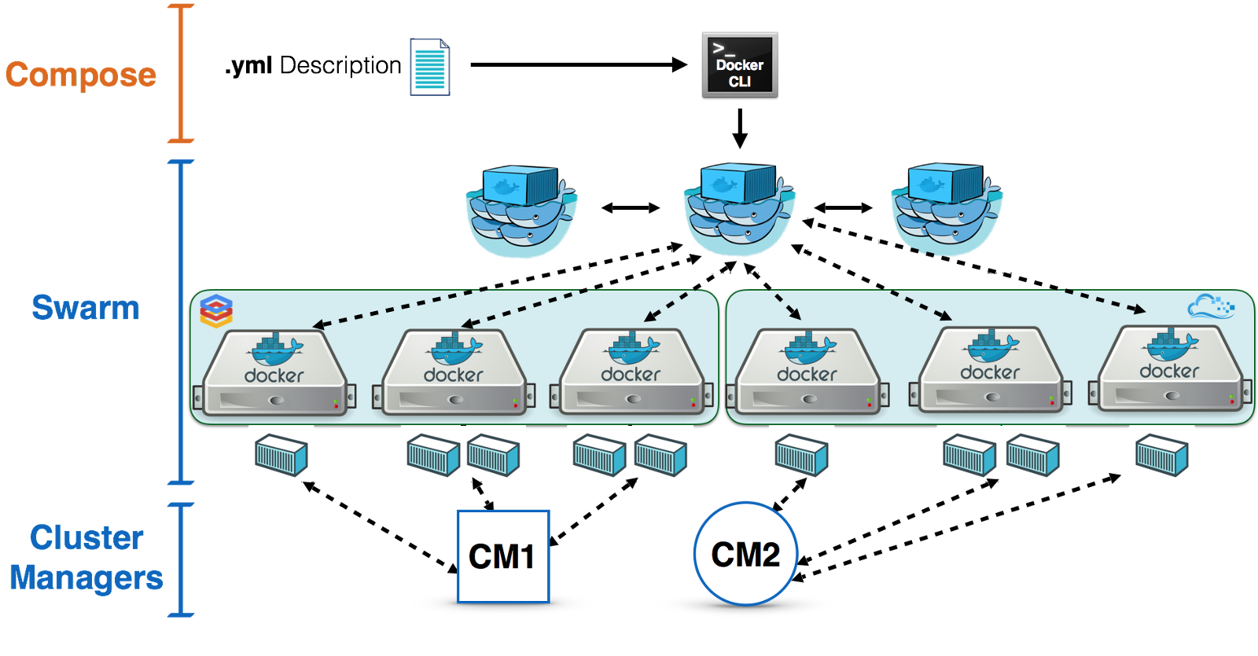

Slide 18
Dashboard related components
User accounts with authentication and authorization
Provides role-based access to the system
Application/QoS submission interface
Visual application monitoring
Inspection and access to running containers
CPU, load, and disk space of application
Snapshot rollback functionality

Slide 19
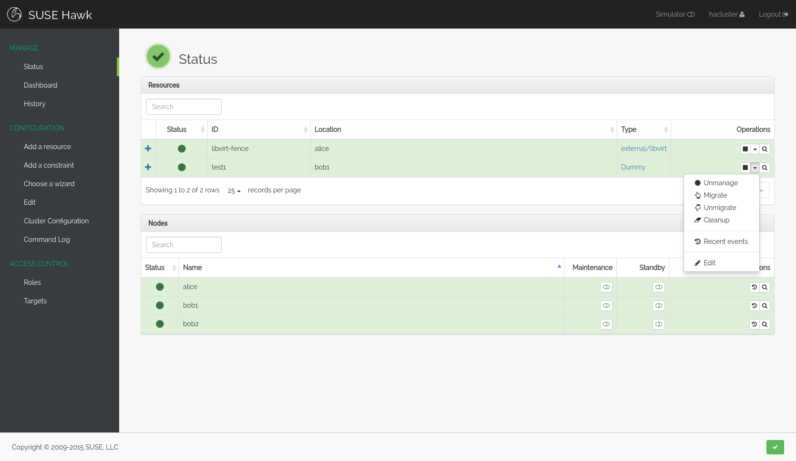

Slide 20
Technical and logistical issues with this approach
When to migrate
Which containers to migrate
Where to migrate
How to migrate
Which metrics to monitor
Translation of QoS into specific metrics
Architecture has not been implemented in the field

Slide 21
Conclusions
Cloud applications must to confirm to a QoS like hosted applications
Large scale systems are likely to experience a number of faults multiple times per day
Current approaches are built for homogeneous clouds
This approach aims to perform application level checkpoint-restart in a diverse cloud environment

Slide 22
Resources and Paper
Vlado Stankovski, Salman Taherizadeh, Ian Taylor, Andrew Jones, Bruce Becker, Carlo Mastroianni, and Heru Suhartanto. 2015. Towards an environment supporting resilience, high-availability, reproducibility and reliability for cloud applications. In Proceedings of the 8th International Conference on Utility and Cloud Computing (UCC '15). IEEE Press, Piscataway, NJ, USA, 383-386. DOI: https://doi.org/10.1109/UCC.2015.61
https://www.logicmonitor.com/resource/the-future-of-the-cloud-a-cloud-influencers-survey/
https://searchcloudcomputing.techtarget.com/definition/Infrastructure-as-a-Service-IaaS
https://searchcloudapplications.techtarget.com/definition/application-migration
https://www.docker.com/resources/what-container
https://hawk-ui.github.io/
https://docs.docker.com/engine/swarm/

Slide 23
Questions?

