Slide 1
Anomalous Database Transaction Detection
Presented by
Harshith Reddy Sarabudla

Slide 2
Attacks against Databases
Attacks aiming at corrupting data (integrity attacks)
Attacks aiming at stealing information (confidentiality attacks)
Attacks aiming at making the database unavailable (availability attacks).

Slide 3
Importance of data
Data represent today a valuable asset for organizations and companies and must be protected. Ensuring the security and privacy of data assets is a crucial and very difficult problem in our modern networked world.
Databases may store extremely sensitive business information, making them a major target for attackers. Therefore, securing their data from damage or leakage is a critical issue. To manage this, enterprises typically implement several layers of protection between users and data, working at the network, host, and database levels.

Slide 4
Protection of data
Protection of data in database is usually enforced at the application and database level.
The data protection at database level includes the Access control models to limit the permissions to of legitimate users to read, write data and encryption at times.
These security models are sometimes insufficient to prevent misuse, especially insider abuse by legitimate users.
So, a database intrusion detection system may be used at the database layer to detect any transactions that access the data without permission or any malicious activity in the database.

Slide 5
Intrusion detection system
An intrusion detection system (IDS) is a device or a software that monitors a network or systems for malicious activity or policy violations
Any malicious activity or violation is typically reported either to an administrator or collected centrally using a Security information and event management (SIEM) system.
Types of ID’s
Network intrusion detection systems
Host based intrusion detection systems
Database intrusion detection systems

Slide 6
Signature-based detection
- Identify known attack patterns
- Detects only previously known attacks.
Anomaly based detection
- looks for deviations from typical user behavior
- identify new attacks

Slide 7
Types of Intruders
Insider attackers - Authorized user can misuses database access privileges
Outsider attackers - Persons external to the organization who have gained unauthorized access to the database by exploiting its security vulnerabilities.

Slide 8
Data centric approach
Mohammad Saiful Islam, Mehmet Kuzu, and Murat Kantarcioglu. 2015. A Dynamic Approach to Detect Anomalous Queries on Relational Databases. In Proceedings of the 5th ACM Conference on Data and Application Security and Privacy (CODASPY ‘15)
This approach considers the amount of sensitive information a query result contains.
Usage profiles are built for group of users based on their roles using the Hidden Markov model
Sensitivity score is calculated for each query submitted to the database using various pattern matching techniques.
If the sensitivity score is greater than a particular threshold, anomaly alarm is raised

Slide 9
“DetAnom: Detecting Anomalous Database Transactions by Insiders”
.
Syed Rafiul Hussain, Asmaa M. Sallam, Elisa Bertino
Builds a profile of the application program and checks at run-time incoming queries against that profile
Profile creation phase - For each query, the profile keeps a signature and the corresponding constraints that the application program must satisfy to submit that query
Anomaly Detection phase - Whenever the application issues a query the corresponding signature and constraints are checked against the current context of the application. If there is a mismatch, the query is marked as anomalous.

Slide 10
Profile creation phase
For each query, Signature and constraints are recorded
These pairs are organized in a hierarchical data structure which represents the control-flow of the application
This data structure is referred to as the Profile

Slide 11
Query Signature Representation
SQL query is represented as a signature of the form (C, T, R, Q, N).
SELECT {TARGET-LIST} FROM {RELATION-LIST} WHERE {QUALIFICATION}
C - Type of the SQL command (SELECT, INSERT, UPDATE, and DELETE)
T - Identifiers (IDs) of the attributes projected in the query
(Attributes are identified by two values: the ID of the table that the attribute belongs to and the ID of the attribute relative to that table)
R - IDs of the tables being accessed in the query
Q - IDs of attributes referenced in QUALIFICATION
N - Number of predicates in the WHERE clause

Slide 12
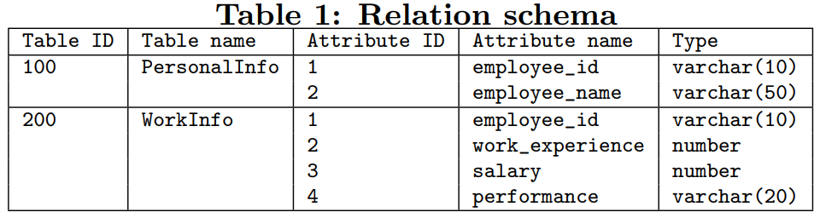

Example
Signature of the above query :
{1, {{200, 1}, {200, 2}}, {200}, {{200, 2}}, 1}

Slide 13
Profile Creation
P = (sig(q), c)
P - profile of an application program
q - query
sig(q) - signature of q
c - set of constraints to execute q

Slide 14
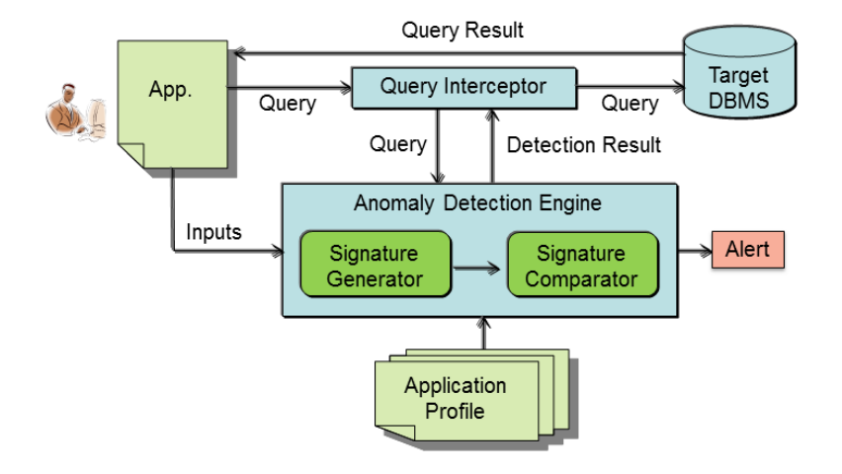
Fig. 1

Slide 15
Anomaly detection phase
ADE takes inputs from the executing application and verifies whether the inputs satisfy the constraint
SG sub-module generates the signature of the received query and the SC sub-module compares it with the signatures stored in QR
For a legitimate query, the signatures match. The verification outcome is then passed to the QI module which then sends the legitimate query to the target database for execution.
In case of an anomalous query, SC sub-module raises a flag and query is not passed to QI for execution.

Slide 16
Design of Anomaly detection system
The design of an anomaly detection system is challenging, as the system should fulfill the following requirements:
• Should require minimal modifications to the code of the application program and the DBMS.
• Should not introduce significant delays that may negatively impact the performance.
• Should have the least possible number of false positives and false negatives

Slide 17
References
[1] Mohammad Saiful Islam, Mehmet Kuzu, Murat Kantarcioglu, “A Dynamic Approach to Detect Anomalous Queries on Relational Databases”. 5th ACM Conference on Data and Application Security and Privacy 2015.
[2] Syed Rafiul Hussain, Asmaa M. Sallam, Elisa Bertino, “DetAnom: Detecting Anomalous Database Transactions by Insiders”. 5th ACM Conference on Data and Application Security and Privacy 2015.
Fig. 1. Syed Rafiul Hussain, Asmaa M. Sallam, Elisa Bertino, “DetAnom: Detecting Anomalous Database Transactions by Insiders”.

