Slide 1
Privacy in Data Mining
Presented by :
SaiVenkatanikhil Nimmagadda

Slide 2
What is Data Mining?
Data mining is the process of uncovering patterns and finding anomalies and relationships in large datasets that can be used to make predictions about future trends.
The main purpose of data mining is extracting valuable information from available data.
Data mining has been successfully applied to many domains, such as business intelligence, Web search, scientific discovery, digital libraries, etc.

Slide 3
Data Mining Process
Data Provider: the user who owns some data that are desired by the data mining task.
Data Collector: the user who collects data from data providers and then publish the data to the data miner.
Data Miner: the user who performs data mining tasks on the data.
Decision Maker: the user who makes decisions based on the data mining results in order to achieve certain goals

Slide 4
Importance of Privacy
Privacy preserving data mining has become increasingly popular because it allows sharing of privacy-sensitive data for analysis purposes.
Laws and regulations require that some collected data must be made public such as Census data
data mining techniques can reveal critical information about business transactions, compromising the free competition in a business setting.

Slide 5
Examples for motivation on privacy in data- mining
Research studies in 2000 estimates that 87% of the US population in the United States had reported characteristics that likely made them unique based on ZIPCODE, gender, date of birth
The U.S. retailer Target once received complaints from a customer who was angry that Target sent coupons for baby clothes to his teenager daughter

Slide 6
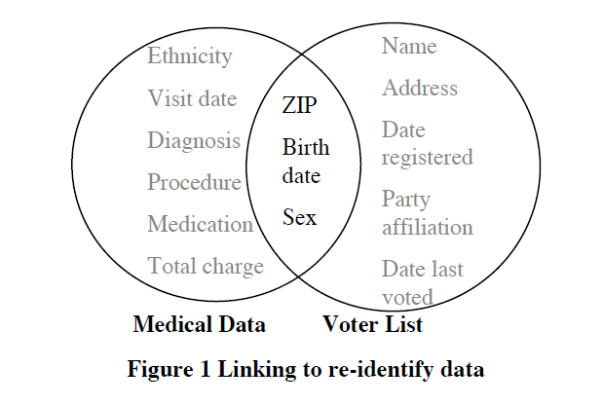
Re-Identification by Linking

Slide 7
Quasi-Identifier
Key attributes: Attributes which can be uniquely identified.Always remove before release
Example:name,address,phone number
Quasi Attributes: Attributes that in combination can uniquely identify individuals such as
birth date and gender. The set of such attributes has been termed .
Example:ZipCode
Sensitive Attributes:Attributes which researchers need.They are released unmodified
Example:Medical Records

Slide 8
K-anonymity
The information for each person contained in the released table cannot be distinguished from at least k-1 individuals whose information also appears in the release
each record is indistinguishable from at least k-1 other records (“equivalence class”)

Slide 9
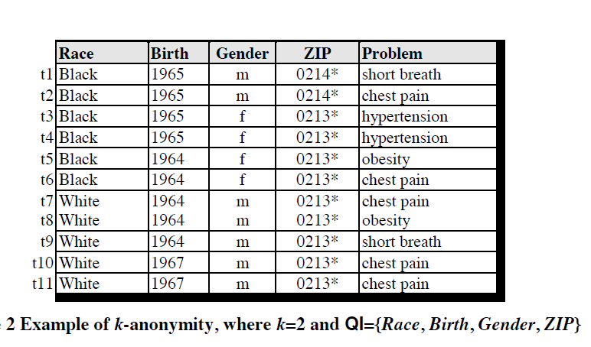
K-anonymity Example

Slide 10
Achieving k-Anonymity
Generalization:
Replace quasi-identifiers with less specific and general value within a certain range.
Example:10-20
• Suppression
When generalization causes too much information loss,quasi-identifiers are replaced by ‘*’

Slide 11
Limitations of k-anonymity
k-Anonymity does not provide privacy if
The data is homongenuous,there are 100% probability that the identity of row can be revealed
Adding additional information with k-anonymity table can reveal the identity of all rows.
It does not provide protection against attribute disclosure

Slide 12
L-diversity
Sensitive attributes must be “diverse” within each quasi-identifier equivalence class
Each equivalence class has at least l wellrepresented sensitive values
Doesn’t prevent probabilistic inference attacks

Slide 13
Types of l-diversity
Probabilistic l-diversity
– The frequency of the most frequent value in an equivalence class is bounded by 1/l
Entropy l-diversity
– The entropy of the distribution of sensitive values in each equivalence class is at least log(l)
• Recursive (c,l)-diversity
– – r1<c(Rl+Rl+1) where ri is the frequency of the i th most frequent value

Slide 14
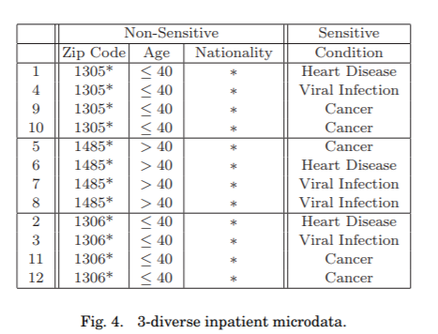
L-diversity example

Slide 15
Limitations of l-diversity
Adversary can attain knowledge on a sensitive attribute if the attribute distribution is known.
Distribution skewness and semantic similarity of the sensitive values in the equivalence class are possible attacks faced by the l-diversity technique

Slide 16
T-closeness
Distribution of a sensitive attribute in any equivalence class is close to the distribution of the attribute in the overall table
Earth Mover Distance (EMD) measure is used for verifying t-closeness requirement of equivalent class with the overall table.
An equivalence class is said to have t-closeness if the distance between the distribution of a sensitive attribute in this class and the distribution of the attribute in the whole table is no more than a threshold t
value = 0;

Slide 17
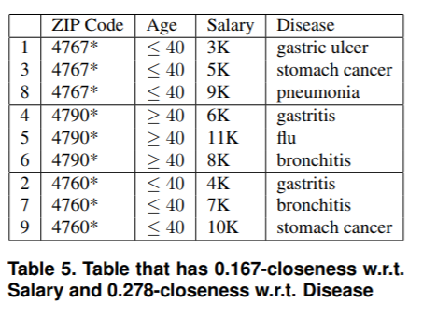
T-closeness example

Slide 18
Limitations of t-closeness
Information about correlation between quasi-identifier attributes and sensitive attributes is lost
It looses the co relation between different attributes since each attribute is generalized separately.
Compulsion that sensitive attribute spread in the equivalence class to be close to that in the overall table

Slide 19
Slicing
Slicing is proposed to overcome drawbacks in Generalization and bucketization
Source data table is divided column wise. which brings certain quasi identifiers together on one side (vertical X) and the other with a combination of quasi identifier and sensitive attribute
This creates an opportunity for realizing an efficient shuffling technique.

Slide 20
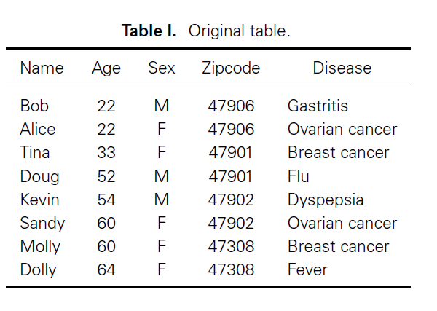
Slicing Example-1

Slide 21
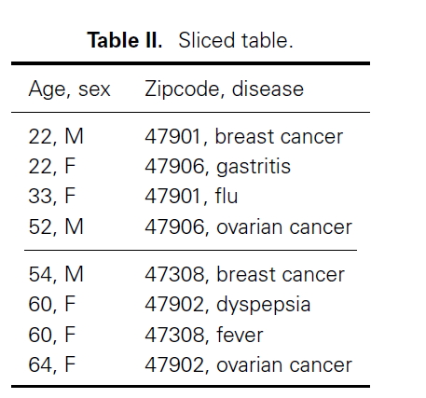
Slicing Example-2

Slide 22
Limitations of Slicing
Slicing creates invalid records during the slicing process
Invalid record leads to disclose the individual privacy.
Utility and risk measure is not matched. It may break association between attributes.
Slicing Complexity is high

Slide 23
References
A. Machanavajjhala, D. Kifer, J. Gehrke, and M. Venkitasubramaniam. `l-diversity: privacy beyond k-anonymity. ICDE, 2006.
P. Samarati and L. Sweeney. Generalizing data to provide anonymity when disclosing information. In Proc. of the 17th ACM SIGMOD-SIGACT-SIGART Symposium on the Principles of Database Systems, 188, 1998
N. Li, T. Li, and S. Venkatasubramanian. t-closeness: Privacy beyond k-anonymity and l-diversity. In ICDE, 2007
T. Li, N. Li, J. Zhang, and I. Molloy. Slicing: a new approach to privacy preserving data publishing. TKDE, 24(3):561-574, 2012.

