Slide 1
AIQL: Enabling Efficient Attack Investigation from System Monitoring Data
Peng Gao¹ Xusheng Xiao² Zhichun Li³ Kangkook Jee³ Fengyuan Xu⁴ Sanjeev R. Kulkarni¹ Prateek Mittal¹
1. Princeton University
2. Case Western Reserve University
3. NEC Laboratories America, Inc.
4. National Key Lab for Novel Software Technology, Nanjing University

Slide 2
advanced PERSISTANT THREAT (apt) ATTACKS
Conducted in multiple steps, involving many individual attack steps across many hosts.
Each individual step is not suspicious enough, and the attack keep stealthy for a long period of time.

Slide 3
Ubiquitous System Monitoring
Record system behaviors from kernel
Enable attack investigation via query collected data

Slide 4
Challenge 1: Attack Behavior Specification
Multi-step attack: multiple system activities and their relationships
Dependency tracking: chaining constraints among system activities
Abnormal system behavior: sliding windows and statistical aggregation methods

Slide 5
Challenge 2: Timely “Big Data” Security Analysis
Collect and store system monitoring data for hosts in an organization (~50 GB for 100 hosts per day)
Data storage optimization
Query data in a central server for attack investigation
Query execution optimization

Slide 6
AIQL System ARCHITECTURE
Novel query system for attack investigation
Built on top of existing mature tools
System-level monitoring tools: auditd, ETW, DTrace
Relational databases: PostgreSQL, Greenplum
System Components -System Optimizations
Data Collection and Storage
Domain-Specific Query Language
Query Execution Engine

Slide 7
Data Collection
Data collection agent: system calls as a sequence of system events
Windows: Event Tracing for Windows (ETW)
Linux: Audit Framework (auditd)
Mac: Dtrace
System Event: <subject, operation, object>
Collect critical attributes for security analysis

Slide 8
Data storage
Store data in relational databases powered by PostgreSQL
Challenges in handling high ingestion rate of massive system monitoring data
Data storage optimizations
Time and Space Partitioning
Hypertable: scale the data storage using MPP( massively parallel processing) databases Greenplum

Slide 9
Query Language Design
Multi-event AIQL Query
Dependency AIQL Query
Anomaly AIQL Query

Slide 10
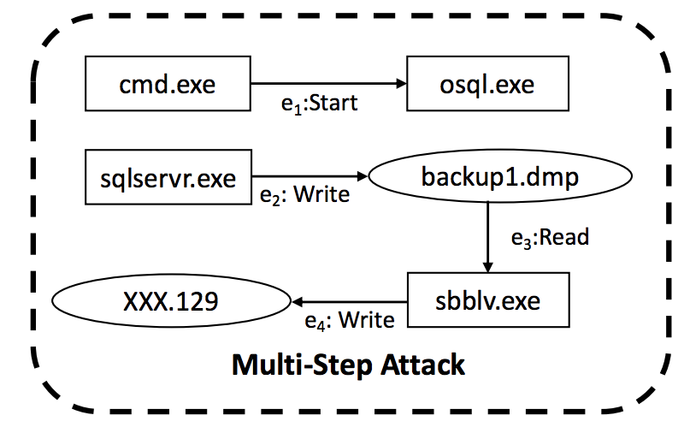
Multi-event AIQL Query
Multiple system events involved in the attack
Temporal order of events: e1->e2->e3->e4

Slide 11
Multi-event AIQL Query
Global constraints: e.g., agent ID, time window
Event pattern: <subject, operation, object >
Temporal relationship: e.g., enforce the event order
Attribute relationship: e.g., two events linked by the same entity
Syntax shortcuts: e.g., context-aware attribute inference

Slide 12
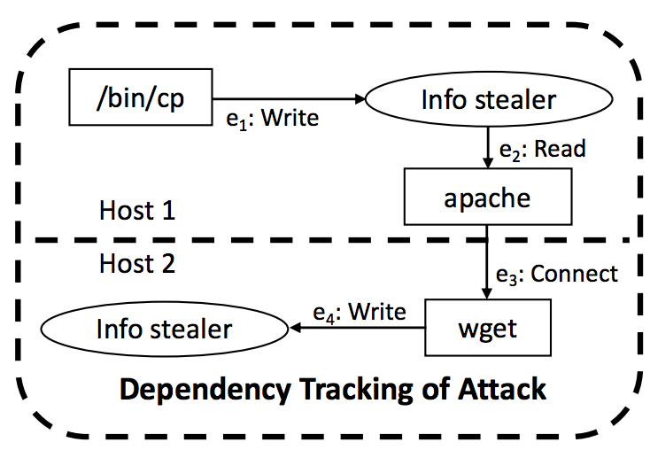
Dependency AIQL Query
Dependency tracking direction: forward/backward, ->/<-
Cross host dependency tracking

Slide 13
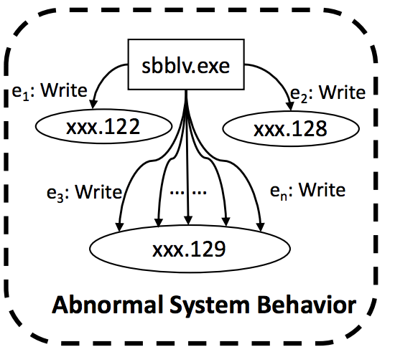
Anomaly AIQL Query
Sliding windows
Access to history states
Frequency-based anomaly models

Slide 14
Query execution engine
Execution of Multi-event Query
Domain-specific optimizations

Slide 15
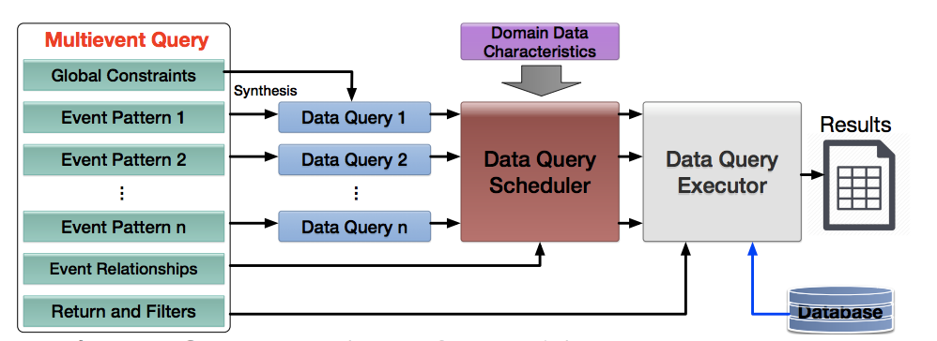
Execution of Multi-event Query
Synthesize a SQL data query for every event pattern
Schedule the data queries using domain-specific optimizations

Slide 16
Data Query Scheduler
Relationship-based scheduling
Leverage event relationships for optimizing search strategies
Prioritize event search based on estimated pruning power
Prune search space of related events
Time window partition

Slide 17
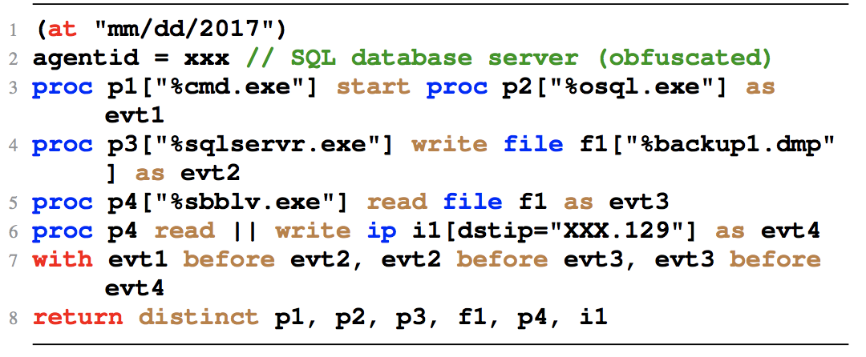
Time window partition
Leverage temporal properties of the data
Partition the time window of a data query into subqueries with smaller time windows
Execute the subqueries in parallel

Slide 18
Evaluation

Slide 19
Conciseness Evaluation: 19 queries on four major types of attack behaviors
The conciseness improvements of AIQL over SQL, Neo4j Cypher, and Splunk SPL are:
the number of constraints: 3.0x, 2.4x, and 4.2x;
the number of words : 3.9x, 3.1x, and 3.8x;
the number of characters : 5.3x, 4.7x, and 4.7x.

Slide 20
Scheduling Efficiency in the Optimized Storage
Efficiency in PostgreSQL: 40X speedup
Efficiency in Greenplum: 16X speedup

Slide 21
Conclusion
AIQL is a system for efficient attack investigation from system monitoring data
Expressive and concise domain-specific query language
Efficient query execution based on domain-specific data characteristics

Slide 22
Thank you!

