Slide 1
Use of Provenance for Intrusion Detection
By Rohit Naini

Slide 2
Provenance
Meaning:
  The place of origin or earliest known history of something (or)
  he beginning of something's existence; something's origin (or)
  a record of ownership of a work of art or an antique, used as a guide to authenticity or quality.

Slide 3
Data Provenance
Data provenance can be defined as the origins, custody, and ownership of research data. Because datasets are used and reformulated or reworked to create new data, provenance is important to trace newly designed or repurposed data back to their original datasets.
The concept of provenance guarantees that data creators are held accountable for their work, and provides a chain of information where data can be tracked as researchers use other researchers’ data and adapt it for their own purposes.

Slide 4
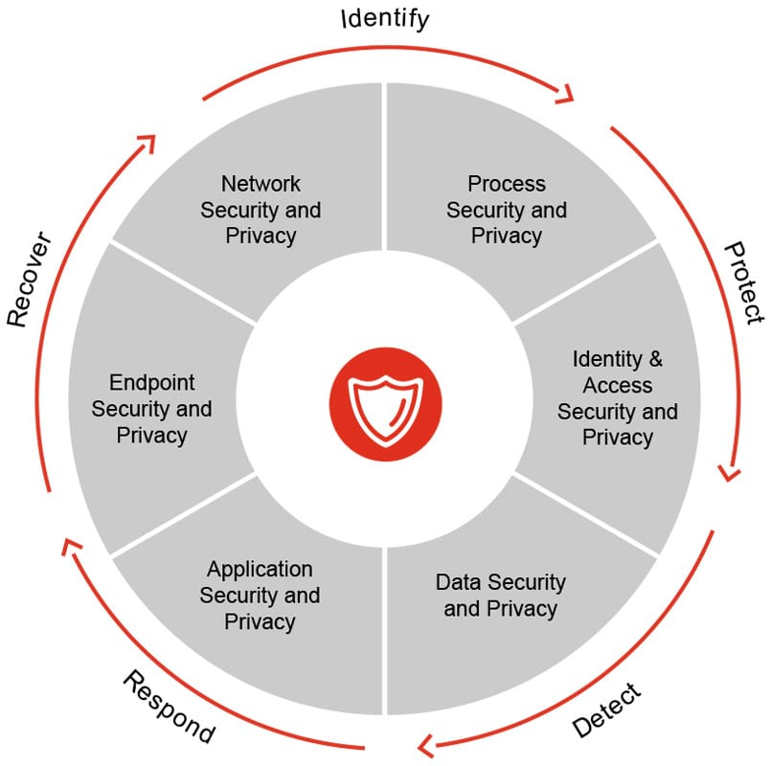
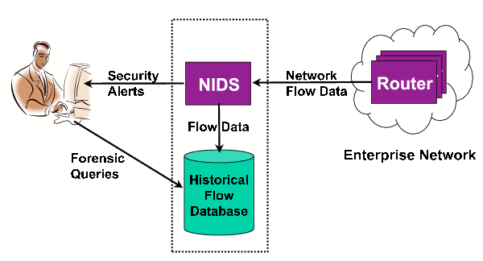
Databases often support enterprise business and store
its secrets. This means that securing them from data
damage and information leakage is critical. In order to
deal with intrusions against database systems, Database
Intrusion Detection Systems (DIDS) are frequently
used.
Data Warehouses (DWs) store extremely
sensitive business information, making them a major
target for attackers.
Although data access policies and standard
encryption algorithms are widely used, and relatively
simple to configure in today’s DataBase Management
Systems (DBMS), choosing which DIDS to use in
certain environments is not a trivial task.
Detecting illicit access and malicious actions are the
main goals of Intrusion Detection Systems (IDS).
There are mainly two approaches: misuse detection,
looking for well-known attack patterns; and anomaly
detection, looking for deviations from typical user
behavior.
Fig 1 & 2

Slide 5
Attacks aiming at corrupting data (integrity attacks). In these types of attack, the intruder seeks access to the database for executing actions that compromise its integrity, such as corrupting or deleting the data in a given database object (e.g. such as modifying the contents of a table)
Attacks aiming at stealing information(confidentiality attacks). In these attacks, the intruder focuses on breaking confidentiality issues, such as stealing business information, rather than damaging data.
Attacks aiming at making the database unavailable(availability attacks). These attacks aim on making database services unavailable to users, i.e., they are mainly Denial of Service (DoS) attacks (e.g. flooding database services and bandwidth with a large number of requests, crashing database server instances, deleting database objects, etc).

Slide 6
As increasing amounts of valuable information are produced and persist digitally, the ability to determine the origin of data becomes important. In science, medicine, commerce, and government, data provenance tracking is essential for rights protection, regulatory compliance, management of intelligence and medical data, and authentication of information as it flows through workplace tasks.
While significant research has been conducted in this area, the associated security and privacy issues have not been explored, leaving provenance information vulnerable to illicit alteration as it passes through untrusted environments.
Digital provenance mechanisms support the collection and persistence of information about the creation, access, and transfer of data. Provenance mechanisms enable authorized parties to later evaluate rights claims, data flow integrity, authenticity, and ultimately, establish an acceptable level of trust in the data.

Slide 7

Example:
Lets Consider a medical litigation scenario, illustrated in Figure 3. Dana visited Dr. Alice for consultation. Dr. Alice referred her to Dr. Bob for tests and sent Dana’s medical records to Dr. Bob, who failed to analyze the test results properly. Dr. Bob provided these reports along with other information to Dr. Charlie, who treated Dana accordingly. When Dana subsequently suffered from health problems related to the incorrect diagnosis, she sued Alice and Charlie for malpractice. To establish Bob’s liability for the misdiagnosis, Alice and Charlie hired Audrey as an expert witness. Audrey used the provenance information in Dana’s medical records to establish the exact sequence of events, which in this case implicated Bob. If Bob had been innocent, Alice and Charlie should not be able to collude and falsely implicate him. Similarly, if Bob altered his faulty diagnosis in Dana’s medical records after the fact, Audrey should be able to detect that.
Figure 3

Slide 8
Making provenance records trustworthy is challenging. Ideally, we need to guarantee completeness—all relevant actions pertaining to a document are captured; integrity—adversaries cannot forge or alter provenance records; availability—auditors can verify the integrity of provenance information; confidentiality—only authorized parties should read provenance records; and efficiency—provenance mechanisms should have low overheads.
We use the term document to refer to the data item for which provenance information is collected, such as a file or database tuple. At the IT layer, the provenance of a document is the record of actions taken on that document over its lifetime.
Each access to a document D may generate a provenance record P. The types of access that should generate a provenance record depend on the domain, as do the exact contents of the record, but in general P may include the identity of the accessing principal; a log of the access actions (e.g., read, write) and their associated data (e.g., the bytes of the document or its metadata that were read/written); a description of the environment at the time of the action, such as the time of day and the software environment; and confidentiality- and integrity-related components, such as cryptographic signatures, checksums, and keying material.
A provenance chain for document D is a nonempty time-ordered sequence of provenance records P1| ・ ・ ・ |Pn.

Slide 9
In general, provenance collection mechanisms become harder to subvert when they are implemented at lower levels of a system. However, we can never track provenance perfectly, because a provenance tracking system implemented at a particular level of the system is oblivious to attacks that take place outside the view of that level.
For example, suppose that we implement provenance tracking for tuples inside a database management system. An adversary can subvert provenance collection by opening the database file with a private copy of the database management system that has provenance collection turned off, or by using a file editor to modify the database file. Suppose instead that we implement provenance tracking in the OS kernel. If the kernel is not running on hardware that offers special security guarantees, an intruder can take over the machine, subvert the kernel, and circumvent the provenance system.
we could reliably track all information flows by recording all information that each user reads, in addition to what they write. Unfortunately, provenance tracking for read operations is especially easy to subvert. Even with a trusted pervasive hardware infrastructure and provenance tracking at every level of the system, a malicious user who can read a document can always memorize and replicate portions of it later, minus the appropriate provenance information.

Slide 10
Provenance refers to meta-data describing how digital objects came to be in their current state. It provides a complete, structured view of what happened on the system by presenting complex dependencies and causality relationships between digital objects as a directed acyclic graph (DAG). As such, it is well suited for intrusion detection. An intrusion manifests in anomalous interdependencies among data objects that deviate from those found in non-malicious execution. In fact, in attack causality analysis, provenance has long been used to explain intrusions
Provenance graph analysis strengthens adversarial robustness, because the graphs exhibit long-range correlations and dependencies allowing for causal reasoning about intrusions. Such causal reasoning enables detection of sophisticated attacks, such as network attacks, that remain undetected for long periods of time.
Data provenance has seen use in areas such as databases and computational sciences. While it now also appears as part of real-time security analysis, most approaches are variations of dynamic taint analysis of provenance data. While simple and effective on their own merits, they are limited to constraining information flows within a system (e.g., data loss prevention, access control, and regulatory compliance); little work has been done to detect intrusions from outside the system.

Slide 11
Host-based anomaly detection systems define some baseline normal behavior and then classify as abnormal any behavior that significantly deviates from the baseline. The approach is predicated on the assumption that intrusions are highly correlated to abnormal behavior. Many existing systems use unstructured collections of multidimensional data (e.g., audit logs) to detect outlying points in a high-dimensional feature space, formulating intrusion detection as point-based outlier detection to leverage various learning and data mining techniques.
Provenance, however, is structured graph data that represents relationships between a digital item (i.e., data entity), a transformation on that item (i.e., activity), and agents (i.e., persons and organizations) associated with the item and the transformation.
Using a provenance graph-based approach to intrusion detection is suitable for various reasons:
Provenance captures complete access to security-sensitive kernel objects: State-of-the-art provenance whole-system capture systems leverage the Linux Security Module (LSM) interface to record provenance for every security-related interaction, rather than intercepting system calls. They can be extended to verifiably monitor all information flows in a system.

Slide 12
Provenance makes explicit the relationships among objects: One powerful feature of provenance is its native graphical representation to show system execution as interactions between data objects. However, such interdependencies are innate to every execution trace, even in seemingly unstructured audit data from logging systems such as audited. In fact, there exist frameworks that reconstruct graph-based provenance from flat audit data to allow for reasoning about system execution [6]. However, this post hoc approach comes with a caveat: it is harder to ensure completeness or correctness of the graph built from flat audit data
Intrusions result from unexpected interactions: The entry point to a victim system may be a single, isolated event, but its effects must propagate for an intrusion to be fruitful to an attacker. For example, consider an insider attacker who wishes to steal sensitive information from a data server under his control. He first installs a malicious BASH script that discovers and collects all documents (i.e., a single entry point to the server). However, to successfully steal the information, he needs to either transfer it to a foreign machine or write it to an external storage device. The key to detecting the data leak is to connect the collection of the data to the transmission of the data, which in a provenance graph is clearly represented as a chain of dependencies between processes, files, and sockets.
Graph representation improves robustness: graphs are generally more adversarial robust, i.e., it is harder for an attacker to camouflage her behavior to fit into the reference graph structures [2]. In fact, we claim that the provenance graph of an intrusion must differ from that of a valid execution when we use an LSM-based whole-system provenance capture system. As LSM places hooks on any execution path that generates an information flow [2], if the capture system records provenance on every such path, violations of security policies will be evident from the provenance graph. Moreover, the attacker must also have the knowledge of the substructures that are referenced by the IDS, which alone requires significant effort.

Slide 13
Opportunities:
It is difficult to obtain a good graph summary: A useful intrusion detection system learns detailed normal behavior from the past. Given flat audit data with no completeness guarantee, an IDS is limited by the data recorded in the audit logs. It is also difficult to obtain higher order dependencies
In some cases, the type of information it learns from is determined empirically by the attack vectors it is designed to detect.
1: Identify semantically meaningful substructures.
2: Incorporate time.
3: Keep history in mind
Provenance graphs are topologically and partially ordered: This property follows naturally from the fact that provenance graphs are DAGs and that they truthfully reflect the causal relationships of events that occurred on the system
In particular, a vertex-centric graph framework facilitates provenance graph analysis with its correctness guaranteed by the two partial ordering properties: 1) once an outgoing edge to a vertex arrives, we know that we have observed all incoming edges to that vertex; 2) we receive all edges and vertices along a path in order.

Slide 14
Provenance graphs enrich attack attribution and sense-making: Attribution is an important feature that allows system administrators to quickly understand the source of an intrusion so that they can remedy the issue in a timely fashion and effectively control the damage.
Many intrusion detection systems suffer from a high false positive rate. Attribution helps administrators quickly reject false positive alarms, effectively making the IDS more usable.
Provenance graphs are causality graphs that naturally allow for sense-making, providing a causal chain of events for reasoning. For example, King et al. designed a system that structures OS-level audit logs to automatically identify sequences of steps that occurred in an intrusion, starting from a single detection point.
Based on the analysis we identify the following keys to provenance-based intrusion detection:
Understand the provenance capture mechanism and the graph it produces: It is important to understand what information is captured, how it is captured, and at what level of granularity. These all affect graph interpretation.
Build datasets to benchmark IDSes: Sometimes, existing provenance capture systems may not fulfill the needs of an IDS; jointly developing a provenance capture system and a provenance-based IDS is most likely to improve the performance of both systems.

Slide 15
Thank you
References:
Image 1 taken from https://www.pwc.ch/en/images/info/Cybersecurity-graphic-en.jpg
Image 2 Taken from https://www.usenix.org/legacy/events/netdb07/tech/full_papers/geambasu/geambasu_html/index.html On-Demand View Materialization and Indexing for Network Forensic Analysis Roxana Geambasu, Tanya Bragin, Jaeyeon Jung, and Magdalena Balazinska Mazu Networks
Papers used: Preventing History Forgery with Secure Provenance By RAGIB HASAN, RADU SION and MARIANNE WINSLETT https://dl.acm.org/citation.cfm?id=1629082
Provenance-based Intrusion Detection: Opportunities and Challenges Xueyuan Han, Thomas Pasquier, Margo Seltzer TaPP’18, July 2018, London, United Kingdom https://arxiv.org/pdf/1806.00934.pdf

