Slide 1
Cloud-Based Identity Management
Marc Bowman
April 16, 2019
CSCE 824

Slide 2
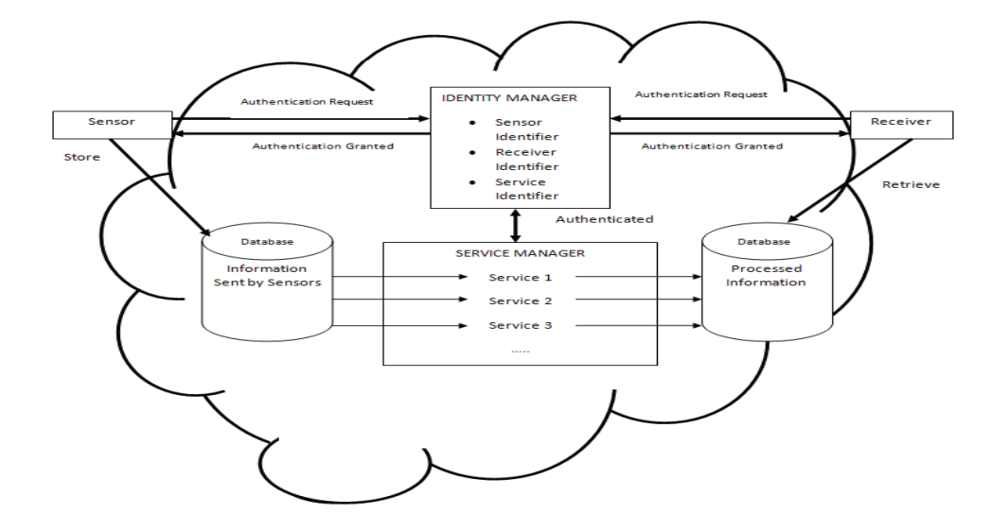
Identity Management and Authentication
How is identity management different in the cloud?
Why is there a need for identity management?
What would a basic framework look like?

Slide 3
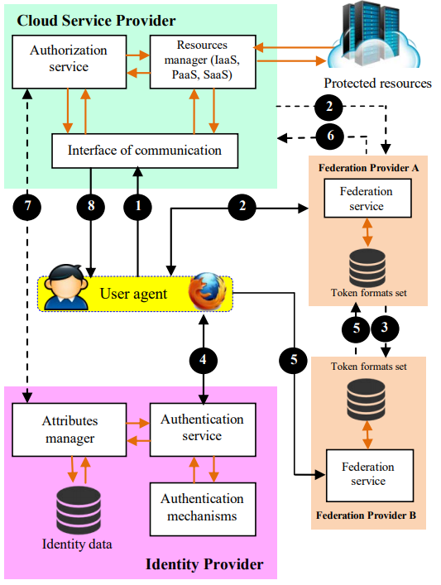
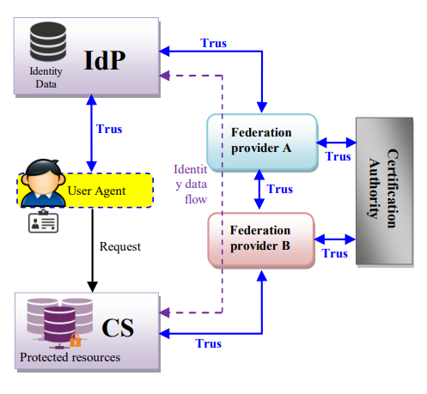
Federated Identity Management Approach

Slide 4
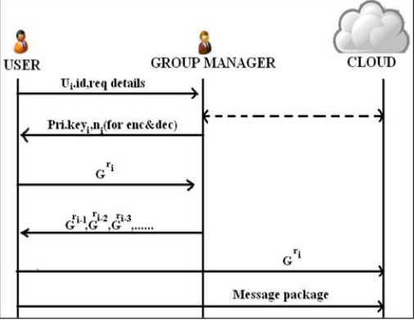
Identification through group signature.
Group Manager
Anonymization
Encryption/Decryption with RSA

Slide 5
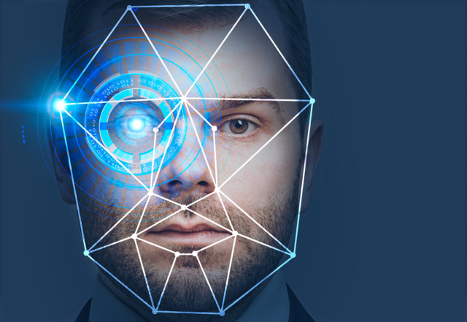
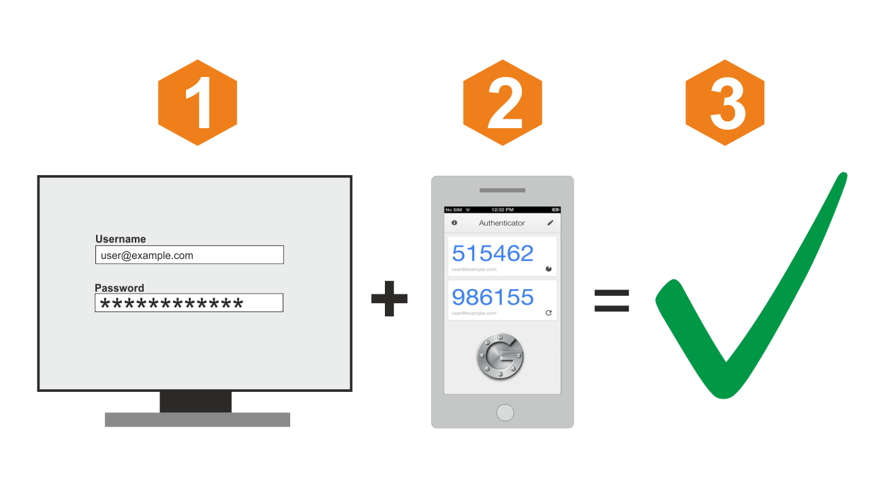
Biometrics/Dual-Factor.
Biometrics: retina scanner, fingerprint scanner, face recognition software.
Dual-Factor: Phone apps, texts, emails.

Slide 6
Identification as a service.
Cloud –Based Support
Third-Party Management.
Risk and Benefits.

Slide 7
References:
S. Harrow, A. Sardana: Identity Management Framework for Cloud Based Internet of Things, SecurIT '12: Proceedings of the First International Conference on Security of Internet of Things, ACM
M. Medhioub, M. Hamdi, T. Kim: A New Authentication Scheme for Cloud-based Storage Applications, SIN '16: Proceedings of the 9th International Conference on Security of Information and Networks, ACM
Govinda K., P. Ravitheja: Identity Anonymization and Secure Data Storage using Group Signature in Private Cloud, ICACCI '12: Proceedings of the International Conference on Advances in Computing, Communications and Informatics, ACM
https://www.securitymagazine.com/articles/88804-beyond-passwords-how-security-can-improve-identity-in-2018

Slide 8
Questions?

