Slide 1
Program & Application Security . . .
Through Binary Code Analysis
Kim Redmond
April 2, 2019
USC Department of Computer Science & Engineering

Slide 2
By 2020, there will be 20 billion connected devices worldwide.
All these devices use software. We have programs and apps on smartphones, laptops, trackers, etc. We often don’t know if they exploit our data or have hidden vulnerabilities.
Is our data safe?
What are the risks involved with these applications?
How do we analyze closed-source software for security vulnerabilities?
Notes:
Netflix was a mail service. We’ve come a long way in a short time and are not equipped to handle it

Slide 3
Security Risks
Android. ~40 million global malware attacks in 2016:
Infected apps
Adware
Banker malware
Sideloading
Trojans
iOS. Also not immune to application vulnerabilities. XcodeGhost sent device info to C&C server, which could hijack actions and perform reads/writes. Noticed by iOS developers.
Code Obfuscation. Malware is more creative. As many previous security methods have identified malicious code signatures, or bug signatures, code is getting obfuscated so it is harder to detect.
Packing
Control flow changes
Junk code
Encryption
Polymorphism
Trigger-based behaviors
Notes:
Info from wifi signals

Slide 4
Security Risks
Android. ~40 million global malware attacks in 2016:
Infected apps
Adware
Banker malware
Sideloading
Trojans
iOS. Also not immune to application vulnerabilities. XcodeGhost sent device info to C&C server, which could hijack actions and perform reads/writes. Noticed by iOS developers.
Code Obfuscation. Malware is more creative. As many previous security methods have identified malicious code signatures, or bug signatures, code is getting obfuscated so it is harder to detect.
Packing
Control flow changes
Junk code
Encryption
Polymorphism
Trigger-based behaviors
Traditional analysis techniques often require source code. But all we have are these executable programs . . . how do we examine them?
Notes:
Info from wifi signals

Slide 5
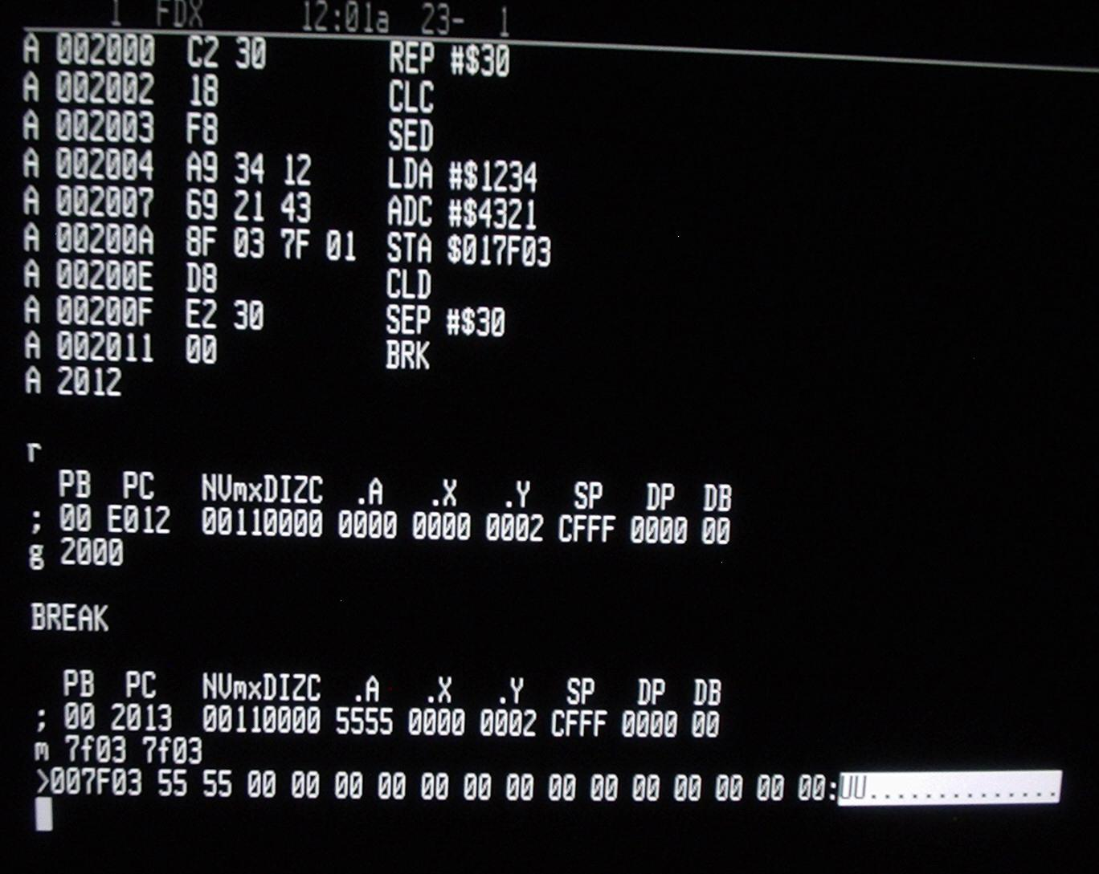
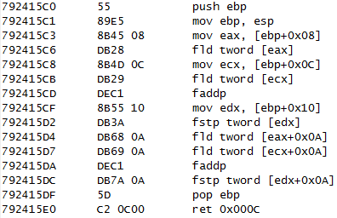
Closed-Source Software
We are left with binaries after a program is compiled.
Machine code binaries vary with architecture. When disassembled, they may be expressed in different assembly languages.

Slide 6
What is Binary Code Analysis?
BCA analysis is a form of static code analysis that examines compiled binaries, not source code. You can “reverse engineer” control-flow graphs from binaries, and evaluate those paths for security and correctness.
Benefits: source language does not matter; few possible assembly languages; identifies low-level vulnerabilities at the machine level
Discovers: buffer overflows, injections, backdoors, rootkits

Slide 7
Binary Code Analysis
Static code analysis
Symbolic execution (unscalable)
Function/sequence vectors
Bad if features chosen manually
Compared to known signatures
Instruction frequency
Bad frequencies can be benign
Junk code subverts this
Dynamic Code Analysis
Test multiple execution paths
Precise, but tedious
Dynamic birthmarks

Slide 8
Problems with BCA
Binary code analysis tends to have limitations:
Packed malware is unreadable until decompressed in memory
Malicious code is assumed to have function-level signatures
Compiler optimizations vary
Thorough models are computationally expensive
Kang, et al. propose a Major Block Comparison (MBC) system that reduces overhead by identifying the core parts of binaries that probably contain malware and extracting their features.
Notes:
Works with unpacking tools

Slide 9
Methodology
Each binary is disassembled into instructions.
Instruction sequences are divided into sections based on function implementations. Each section is divided into blocks. Blocks with user-defined functions, library function or API calls, or malicious instructions are major blocks.
Major blocks with function call instructions are selected.
Their similarity is calculated with malware family blocks in the database.

Slide 10
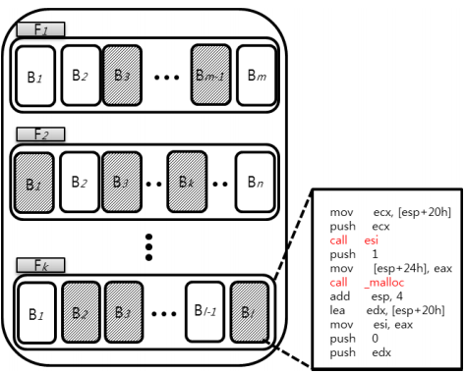
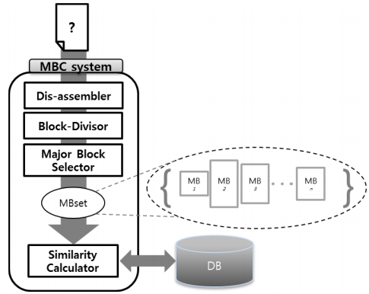

Slide 11
Block Similarity
Each B is a set of opcodes; operands are file-dependent and disregarded.
Each set element is a 2-gram of consecutive opcodes (i.e., MOV, JMP).
NgramSet is the full set of instruction sequences from a block.

Slide 12
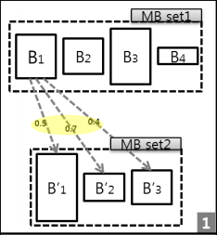
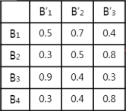
Block Similarity
Similarities between two block sets are then aggregated.
Each block from Set1 is compared with each block from Set2. Similarity scores are added to a table (right).
The Hungarian algorithm calculates the max similarity sum based on the highest sum of edge weights (scores) for a node (block).

Slide 13
Results
High similarity scores were computed for malware contained in the same family (e.g., trojans). And correspondingly, similarities were much lower when comparing different malware families.
To reduce overhead, the results also conclude that 76% of a file’s original blocks are excluded from evaluation.
However… this research only examines similarities for pre-computed malware examples.

Slide 14
Machine Learning
As malware continues to evolve and dodge detection…
What’s a method that can keep up with identifying new malware?
Another Approach

Slide 15
Machine Learning Approaches
Some attempts have been made using machine learning:
Instruction2vec represents instructions as feature vectors
Asm2Vec creates vectors for assembly functions
Innereye-BB can convert basic blocks into vectors for multiple architectures, but each architecture must first be separately trained
...But some models exploit statistics, not semantics, of manually chosen features. Some only work on one architecture. And some are too broad!

Slide 16
Natural Language Processing
NLP: a field of machine learning that processes and analyzes text. Efficient at extracting semantic meaning from words and documents.
If we regard assembly as a language and assembly instructions as words, then we can analyze disassembled binaries as if they were documents.
We can use binaries to train a model, and learn how each instruction is unique. Then we can figure out how they contribute to the program!

Slide 17
Word Embeddings
Word embeddings are high-dimensional vectors that encode word meanings.
A simple example is one-hot encoding. Given a dictionary of 100 words, each word occupies one dimension out of 100 in an all-0 vector.
Consider a document about animals:
Cat = [ 1 0 0 0 0 … ] Bird = [ 0 0 1 0 0 … ]
Dog = [ 0 1 0 0 0 … ] Pig = [ 0 0 0 1 0 … ]

Slide 18
Word Embeddings
Cat = [ 3 0 0 0 0 … ] Bird = [ 0 0 3 0 0 … ]
Dog = [ 0 1 0 0 0 … ] Pig = [ 0 0 0 5 0 … ]
If you treat each dimension as a count of how often that animal appears in the document, then the resulting vector could express them all!
Document embedding = [ 3 1 3 5 … ] (but what does this mean?)
This also does not tell us how words are similar or different.

Slide 19
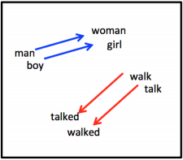
Word Embeddings
In order to reflect what words mean, dimensions can encode statistical patterns of how words are distributed across a text.
In unsupervised word embedding models, word clusters are used to “learn” what kinds of words tend to appear together as neighbors.
Insight: if two different words tend to appear in the same contexts, then those words are probably similar in meaning.
Notes:
Adding dimensions… king - man + woman = queen

Slide 20
Instruction Embeddings
We can apply this logic to assembly language to generate instruction embeddings. Instructions are generally composed of opcodes and operands:
ADD SP, SP, 0
When training on disassembled binary, an embedding model should learn how the opcodes are distinct and how operands tend to appear in certain orders within code blocks. Put together, the combination of instruction embeddings for a program should reflect what that program does.

Slide 21
What This Means for Malware
If each instruction has a unique embedding, and each program a unique embedding signature, then a vulnerable program should have a distinct signature from similar, secure programs. Machine learning could detect . . .
Programs with vulnerabilities vs those with none
Obfuscated malware, which will have a certain execution but achieve it with different instruction patterns
When vulnerabilities are distributed in sections of a program
Transformation patterns for malware

Slide 22
BCA Tools
http://bitblaze.cs.berkeley.edu/
https://github.com/BinaryAnalysisPlatform
https://www.grammatech.com/products/binary-analysis
https://en.wikipedia.org/wiki/List_of_tools_for_static_code_analysis

Slide 23
Images, Resources, and References
[2]: https://pixabay.com/en/smartphone-mobile-phone-display-1717163/, https://pixabay.com/en/laptop-black-blue-screen-monitor-33521/, https://www.flickr.com/photos/121483302@N02/14019907992
[3]: https://commons.wikimedia.org/wiki/File:W65C816S_Machine_Code_Monitor.jpeg, https://commons.wikimedia.org/wiki/File:X86_Assembly_Listing_for_ComplexAdd.png
Kang, Boojoong, et al. "Malware classification method via binary content comparison." Proceedings of the 2012 ACM Research in Applied Computation Symposium. ACM, 2012. https://dl-acm-org.pallas2.tcl.sc.edu/citation.cfm?id=2401672
Vectors: S. Gouws, Y. Bengio, and G. Corrado, “Bilbowa: Fast bilingual distributed representations without word alignments,” in International Conference on Machine Learning, 2015, pp. 748–756.
https://www.gartner.com/en/newsroom/press-releases/2017-02-07-gartner-says-8-billion-connected-things-will-be-in-use-in-2017-up-31-percent-from-2016
https://www.wandera.com/mobile-security/mobile-malware/malware-on-android/
https://www.preemptive.com/obfuscation
https://www.synopsys.com/software-integrity/resources/knowledge-database/binary-code.html

