Slide 1
Big Data: Four Vs
Salhuldin Alqarghuli

Slide 2
What is Big Data ?
Big data is any collection of data that is too big to be analyzed with conventional data management.
The term big data remains difficult to understand because it means so many different things depending on who you are.

Slide 3
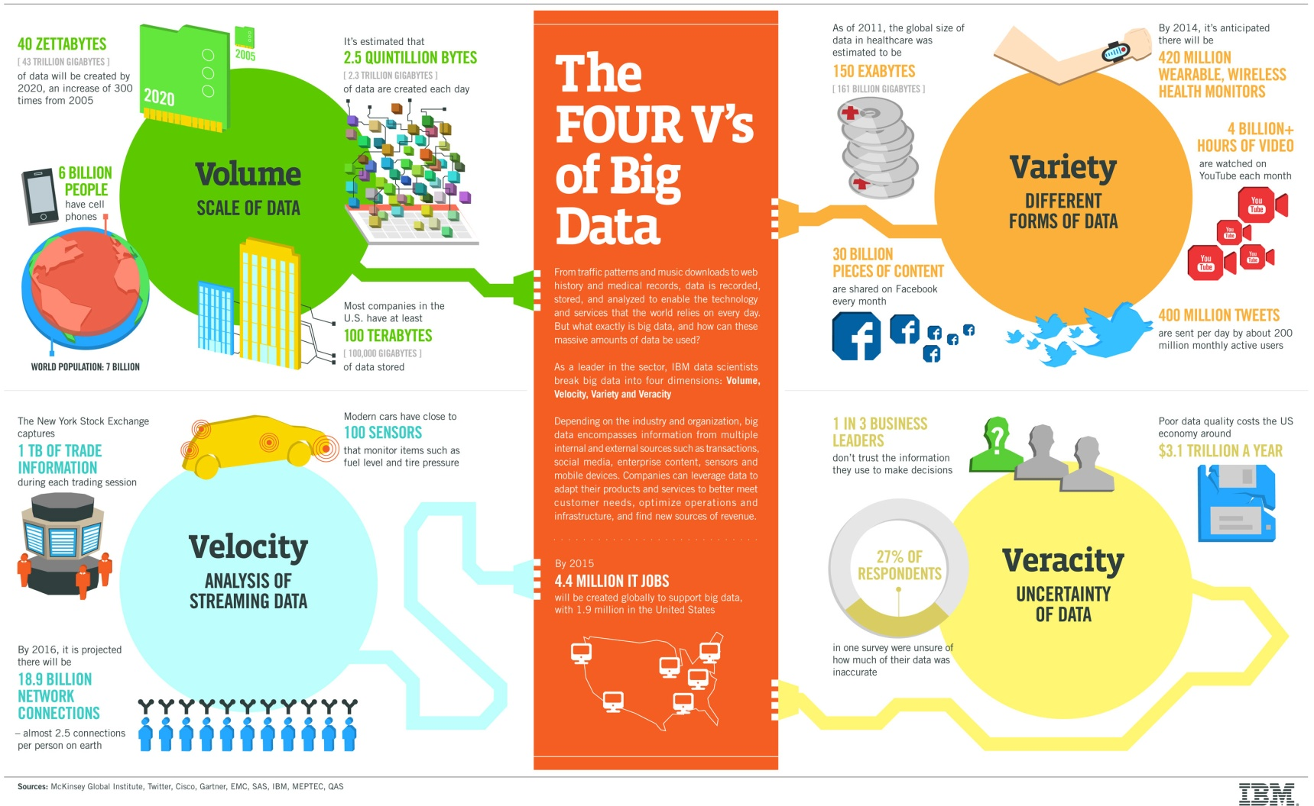
Four Vs

Slide 4
Definition
Four Vs are created by IBM to provide a general mechanism for identifying various big data challenges:
Volume
Velocity
Variety
Veracity

Slide 5
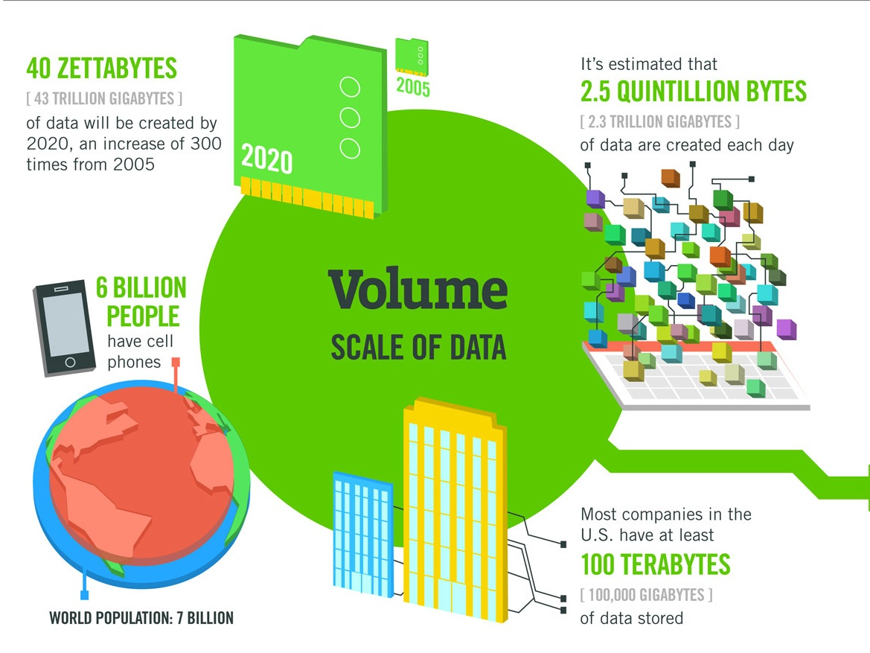
Volume:
Volume refers to the amount of data (Size of the data).

Slide 6
Example
40 Zettabytes will be created in 2020, one zetabyte equals 1000 exabytes, five exabytes equal to all the words ever spoken by mankind.

Slide 7
More examples
Analysts predict that by 2020, there will be 5,200 gigabytes of data on every person in the world.
On average, people send about 500 millions tweets per day.
Walmart processes one million customer transactions per hour.
Amazon sells 600 items per second.

Slide 8
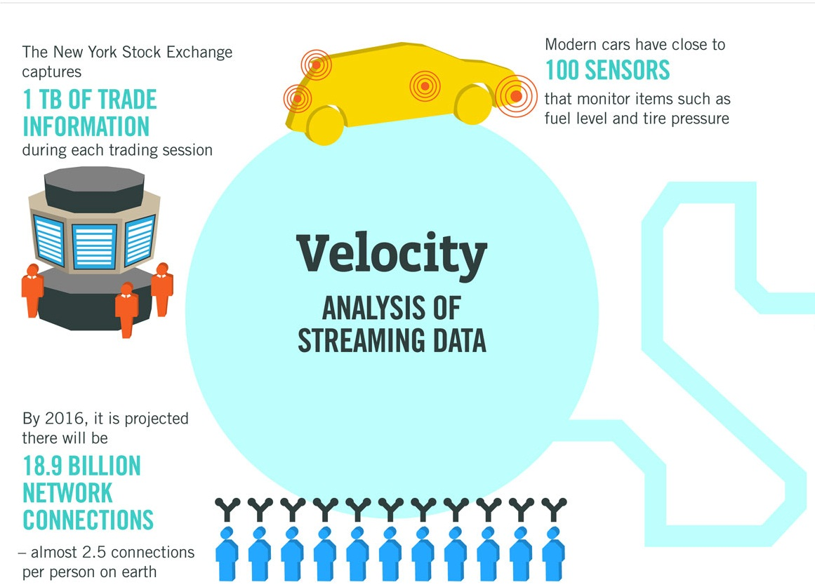
Velocity:
Velocity is the measure of how fast the data is coming in or the speed and rate that the data is moving around as well as how fast you need to be able to analyze and utilize this data.

Slide 9
Examples:
Modern cars have an excess of 100 sensors all piping data to a central network for processing and analysis and this is part of IOT movement.
Facebook has to handle a tsunami of photographs every day. It has to ingest it all, process it, file it, and somehow, later, be able to retrieve it.

Slide 10
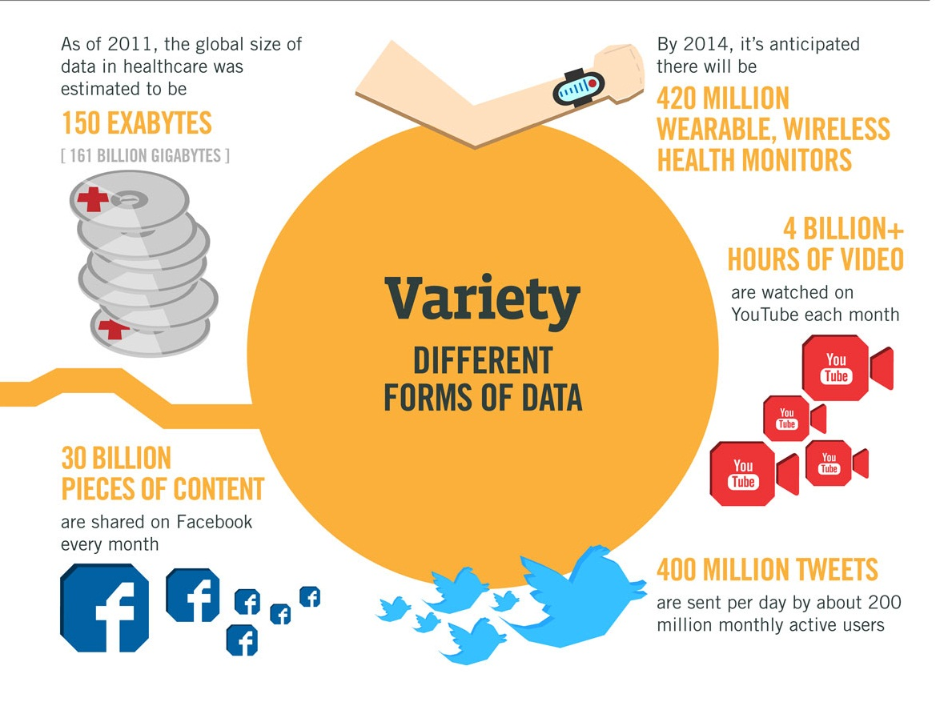
Variety:
It means the different types of data, structured data, unstructured data and semi-structured data.

Slide 11
Three types:
Structured data: data that fits into a relational database model. Organized data in tables, rows and easy to query.
Unstructured data: 80% of the world's data today is unstructured for example, tweets and Facebook posts.
Semi-structured: somewhere between structured and unstructured, we can categorize various pieces but it stills not structured.

Slide 12
Evamples:
Healthcare data, Facebook content, youtube video streams , tweets, satellite sensors data, all of these types are different data types which require special prep-work before processing.

Slide 13
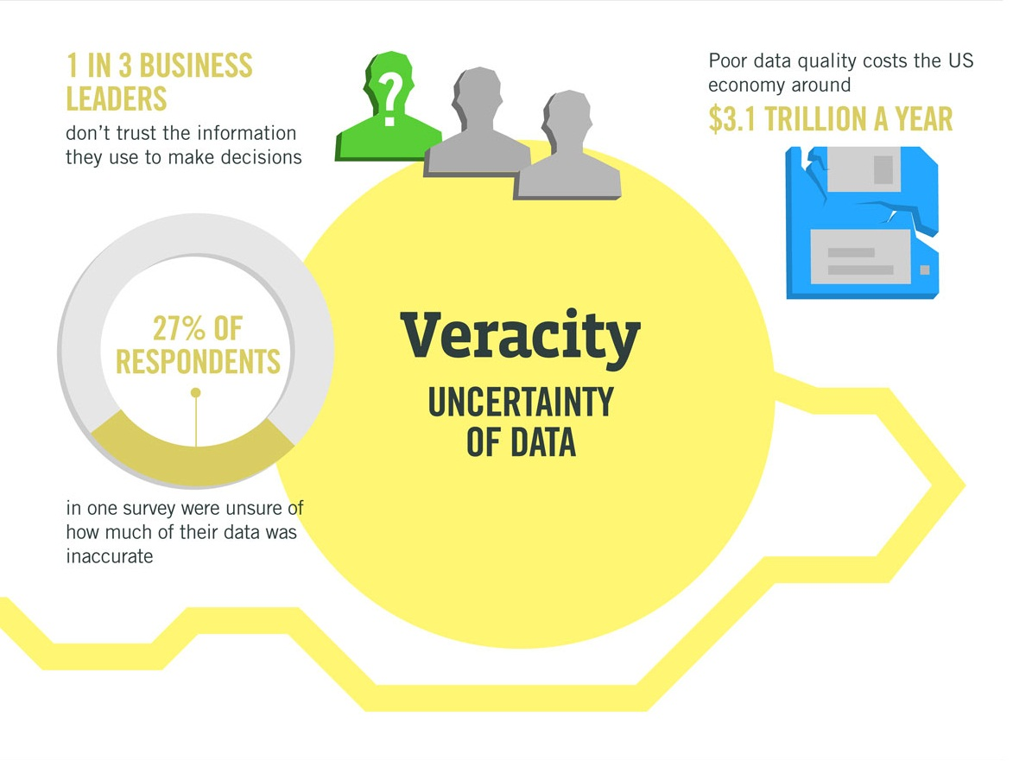
Veracity:
Data veracity, in general, is how accurate or truthful a data set may be. it’s not just the quality of the data itself but how trustworthy the data source, type, and processing of it is.

Slide 14
Data veracity is the one area that still has the potential for improvement and poses the biggest challenge when it comes to big data.
veracity helps to filter through what is important and what is not, and in the end, it generates a deeper understanding of data and how to contextualize it in order to take action.
We cannot rely on inaccurate, falsified or exaggerated data to be able to make decisions.

Slide 15
How you might measure the customer lifetime value (CLV) impact of big data used for customer relationship management?

Slide 16
Volume-based value:
The more comprehensive your 360-degree view of customers and the more historical data you have on them, the more insight you can extract from it all and, all things considered, the better decisions you can make in the process of acquiring, retaining, growing and managing those customer relationships.

Slide 17
Velocity-based value:
The more customer data you can ingest rapidly into your big-data platform and the more questions that a user can pose more rapidly against that data (via queries, reports, dashboards, etc.) within a given time period prior, the more likely you are to make the right decision at the right time to achieve your customer relationship management objectives.

Slide 18
Variety-based value:
The more varied customer data you have – from the CRM system, social media, call-center logs, etc. – the more nuanced portrait you have on customer profiles, desires and so on, hence the better-informed decisions you can make in engaging with them.

Slide 19
Veracity-based value:
The more consolidated, conformed, cleansed, consistent current the data you have on customers, the more likely you are to make the right decisions based on the most accurate data.

Slide 20
Resources
https://enterprisersproject.com/sites/default/files/Data's%20Credibility%20Problem.pdf
https://ir.lib.uwo.ca/cgi/viewcontent.cgi?article=1267&context=fimspub
https://www.ibmbigdatahub.com/infographic/four-vs-big-data
https://www.dummies.com/careers/find-a-job/the-4-vs-of-big-data

Slide 21
Thank you

