Slide 1
Microsoft Azure

Slide 2
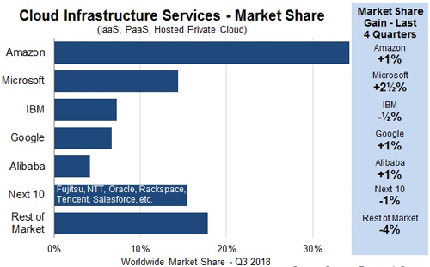
overview
Azure is Microsoft’s cloud offering
2nd most popular, far behind AWS
Wide variety of servers, apps, services, and virtual machines available to set up quickly and take down quickly
Can manage different levels of computing depending on needs
Everything is pay-as-you-go, with multiple options
Centralized and tracked

Slide 4
storage
File – can be used instead of or to help with traditional file servers
Disk – virtual machines
Blob – storing huge amount of unstructured data
Data Lake – blobs for analytics
Suited for Hadoop
Archive – meant for seldom access, encrypted by default
Tables – traditional databases

Slide 5
Azure regions

Slide 8
security
Platform offers more built-in security than you would have without cloud computing
Access Control is done through active directory, so perhaps less control and more caveats here
Still possible to make mistakes – “security by obscurity” works even worse than usual

Slide 9
Azure portal
Everything can be accessed at https://portal.azure.com/
Also integrates with other Microsoft programs and services
Visual Studio
Defender ATP
Active Directory

Slide 10
Azure web app example
Deployed a simple web app from Visual Studio which connects to a SQL Database
Accessible through the internet, can write entries into database
https://testapp32719.azurewebsites.net/

Slide 11
Questions?

Slide 12
Sources
https://awsinsider.net/articles/2018/11/01/azure-fastest-but-aws-biggest.aspx
https://rhinosecuritylabs.com/cloud-security/common-azure-security-vulnerabilities/
https://docs.microsoft.com/en-us/azure/architecture/reference-architectures/iot/
https://azure.microsoft.com/en-us/overview/what-is-paas/
https://azure.microsoft.com/en-us/solutions/architecture/demand-forecasting-and-price-optimization/
https://docs.microsoft.com/en-us/azure/app-service/app-service-web-tutorial-dotnet-sqldatabase

