Slide 1
Internet of Things
Andrew Cox

Slide 2
Outline
Overview
Applications
Security Concerns
Security of Data Storage
Access Control
References

Slide 3
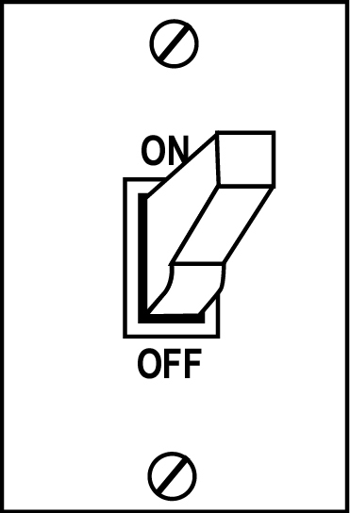
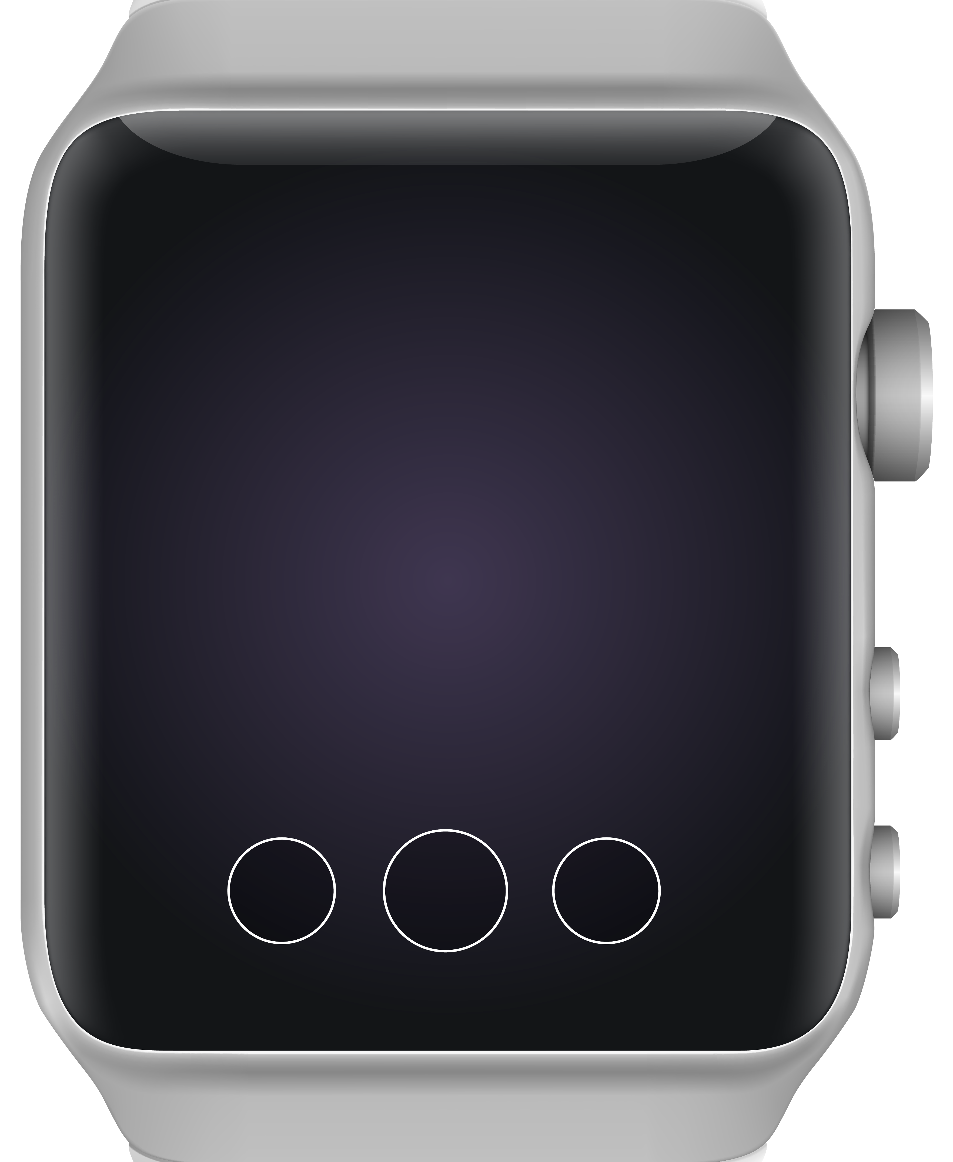
Overview
The Internet of Things (IoT) is a network of physical objects, each of which transmits data

Slide 4
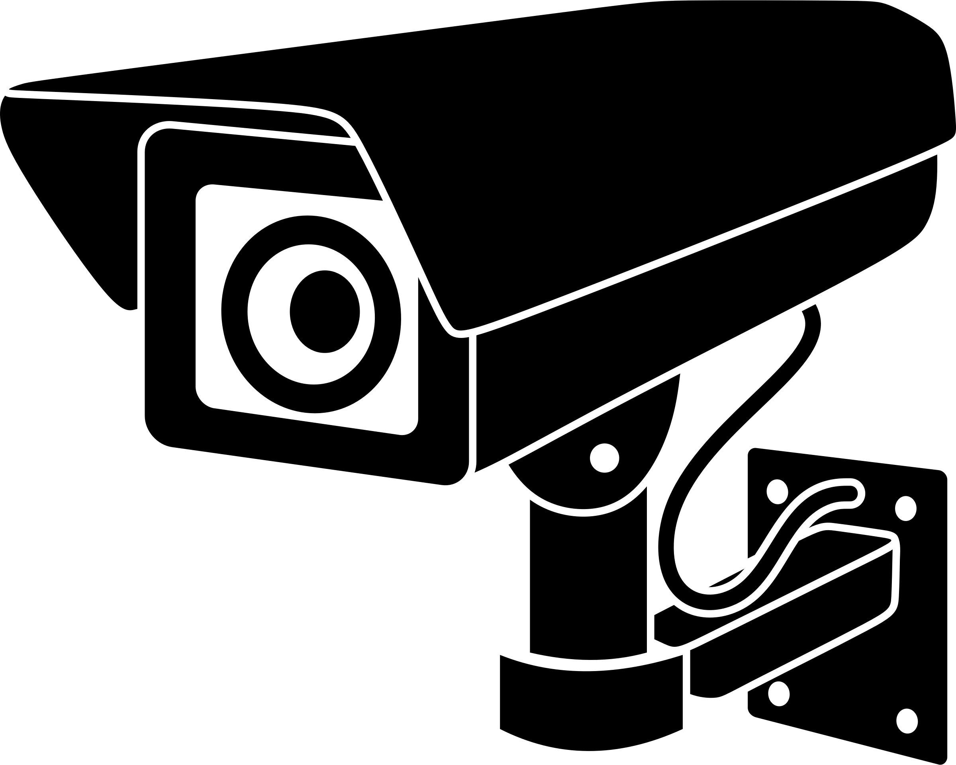
Applications
Personal
Business
Healthcare
🏠
🏥
📺
Fig 1. Diagram of a Pacemaker (Mayo).

Slide 5
Security Concerns
The primary focus of my research is the "Storage" Phase.
Fig. 2 - Attacks based on Phase (Ferreira).

Slide 6
Security of Data Storage
Scope
Attacks
Lack of standardization for data storage
Inability to easily determine/control the type of data being stored
Privacy
Denial of Service (DoS)
Data/Identity Theft
Man-in-the-Middle

Slide 7
Access Control
Access controls restrict the access which machines, users, and other entities have to data and systems.
Primary Models:
Mandatory Access Control (MAC)
Discretionary Access Control (DAC)
Role-Based Access Control (RBAC)
Attribute-Based Access Control (ABAC)

Slide 8
Access Control (DAC)
Example of an ACL for a Single Object
Control over data access is granted to the data's owner.
Access is typically regulated through an access control list (ACL).
User_ID | PERMISSIONS
Andrew (OWNER) | R,W,E,D,AC
Adam | R,E
REBEcca | R,W,E
Sam | E
Key: R = "read"; W = "write"; E = "execute"; D = "delete"; AC = "access control"

Slide 9
Access Control (MAC)
The highest level of control over all data/resources is granted to the system administrator.
The security model is standardized.
DAC Security Example
Users | Security Level
ADAM | TS
REBECCA | S
JOE | C
Sam | S
Objects | Security Level
DOC_1 | TS
App_2 | S
Doc_3 | C
SPREADSHEET_4 | S
Key: TS = "Top Secret"; S = "Secret"; C = "Confidential"
TS > S > C

Slide 10
Access Control (RBAC)
Roles (College Example)
Roles | Permissions | Objects
Dept_Head | R,W | All Data for All Students in the Department
Advisor | R | All Data for Their Advisees
 | R,W | Courses for Their Advisees (Overrides)
Instructor | R,W | Rosters for Their Courses
 |  | Grades
Student | R | Their Own Courses and Grades
 | R,W | Personal Information
Permissions are grouped by "roles." Each user is assigned a role which allows them to access different resources.
RBAC is primarily used in businesses/organizations.

Slide 11
Access Control (ABAC)
ABAC regulates access to data based on multiple attributes (e.g. time, location, device, etc.).
This can be used to implement all three access control models previously discussed.
"Due to its flexibility, the ABAC model has been widely used for implementing access control for IoT." (Bertin, 2019)

Slide 12
Issues with Access Control
Even though the ABAC model can check for multiple attributes to prevent unauthorized access, it is still limited when using IoT.
Most IoT devices have limited processing capabilities and might not be able to provide the necessary attributes. They might also be formatted differently.

Slide 13
References
Ferreira, Roberto. "Internet of Things: Privacy and Security Implications." Proceedings of the Digital Privacy and Security Conference, 2019, privacyandsecurityconference.pt/proceedings.html.
Bertin, Emmanuel, et al. "Access Control in the Internet of Things: a Survey of Existing Approaches and Open Research Questions." Annals of Telecommunications, 2019, doi:10.1007/s12243-019-00709-7.
Belim, Sergey, et al. "A Precedent Approach to Assigning Access Rights." Cornell University, 2018, arxiv.org/abs/1812.10961.

Slide 14
References (cont.)
"IPhone 8." Buy IPhone 8 and IPhone 8 Plus - Apple, www.apple.com/shop/buy-iphone/iphone-8.
"Cartoon Light Switch #1581757." Clipart Library, clipart-library.com/clipart/LidoBAEdT.htm.
Johnett. "A Thermostat Clipart." Kisspng, www.kisspng.com/png-thermostat-computer-icons-clip-art-1907585/.
"Modern SmartWatch PNG Clipart." Clipart PNG Pictures, clipartpng.com/?768,modern-smartwatch-png-clipart.
"Pacemaker." Pacemaker - Mayo Clinic, Mayo Foundation for Medical Education and Research, 2019, www.mayoclinic.org/tests-procedures/pacemaker/about/pac-20384689.
Oksmith. "Security Camera (#1)." OpenClipart, 11 Feb. 2018, openclipart.org/detail/296461/security-camera.

