Slide 1
Security Issues in Cloud Computing
Vamshi Vivek

Slide 2
Content
An Overview of Security Issues in Cloud Computing
Side channels
How does it work??

Slide 3
Notorious Nine
Data Breach
Malicious Insiders
Abuse of Cloud Services
Data Loss
DoS
Account Hijacking
Insecure APIs
Insufficient Due Diligence
Shared Technology Issues

Slide 4
Shared Technology Issues
Information about multiple tenants runs on the same server.
Server divided into VMs(Virtual Machine)
Problem : Co residency

Slide 5
Side Channels
  ElectroMagnetic Emissions
  Processor Speed
  Cache response
Two steps in the attack :
Placement & Extraction

Slide 6
Placement
Invest some more dollars-- 40%
Domain 0 -responsible for mapping physical resource and access control rights.

Slide 7
Virtual Machines
unique account - user email
--one or more VM images
3 degrees of Freedom
Region
available zone
instance type
Each available zone use separate physical infrastructure

Slide 8
Exploiting Placements
1.Brute Force Attack
Not effective when targeting a single victim.
2. Instance Flooding

Slide 9
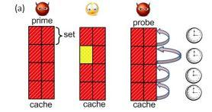
Cache response based attacks
Two VMs
Victim and Adversary
copyright@IEEE Computer Society

Slide 10
Load based Co residence detection
observing diﬀerences in load samples taken when externally inducing load on the
target versus when not

Slide 11
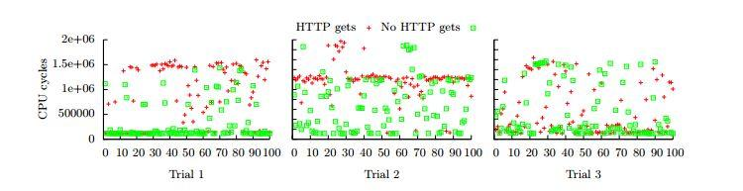
Load Based Co-residence detection
copyright@dl.acm.org

Slide 12
My project work
Takes PTP into consideration
Effectively disable the comparision

Slide 13


