Slide 1
Spam Image Detection based on Geographic Area Preference
Theppatorn Rhujittawiwat

Slide 2
Introduction
Spam problem
~70% of electronic mails are spam
60-80 billion spam messages are sent daily
The worldwide expenses to deal with spam problem are estimated to cost ~$20 billion per year

Slide 3
How to detect spam
Rule-based filtering
Pattern detection
Checksum-based filtering
Enforcing RFC standards
Others

Slide 4
Proposed Approach (1)
Each area have different kind of popular spam topics
Each spam filtering word have different efficiency in different area
Using only high efficiency filtering words can reduce the computational cost

Slide 5
Area Comparison
Table 1: Comparing spam images by category
Table 2: Comparing finance and health between Thailand and United States
 | Accessory | Adult content | Education | Finance | Health | Computer | Other
Thailand | 4.52% | 0% | 0% | 67.90% | 24.69% | 0% | 2.88%
United States | 12.77% | 14.66% | 2.68% | 9.47% | 40.62% | 7.88% | 11.92%
 | Average annual household income | Health care cost per person | Prevalence of obesity | Consumer price index (Jan, 2014)
Thailand | $8654 | $202 | 8.5% | 106.46
United States | $50,054 | $8608 | 31.8% | 233.916

Slide 6
Result (1)
The average income of population in US is 578.39% of those in Thailand
The consumer price of US is 219.72% of Thailand so the population in US have 263.32% purchasing power of those in Thailand.

Slide 7
Result (2)
The health care cost in US is 3361.39% of Thailand
The obesity problem in US is 374.12% of Thailand.

Slide 8
Result (3)
Each area have different distribution of spam topics
The distribution of spam topics does reflect the topics that are the problems of those area or look appealing for the population in those area

Slide 9
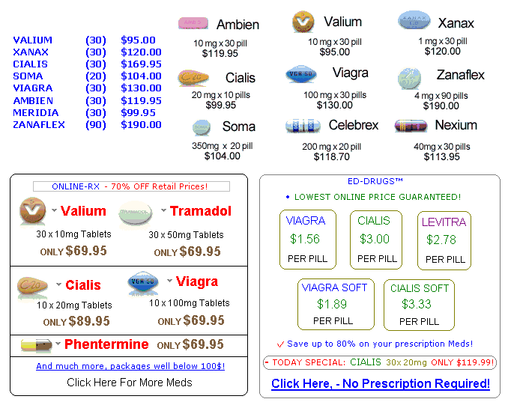
Spam Image
Figure 1: Spam image

Slide 10
Detection Techniques
Optical character recognition based detection (OCR)
Visual features based detection
Image properties based detection
Spammer based detection

Slide 11
OCR Based Detection (1)
How OCR processing
Clean up the image; remove noises, smoothing edge
Detect lines
Character segmentation
Pattern recognition

Slide 12
OCR Based Detection (2)
Figure 2: Character segmentation

Slide 13
Proposed Approach (2)
Collect the line pattern of the filtering words
Use those pattern in the process of OCR instead of transforming the image into text and apply the filtering words

Slide 14
Conclusion
Spam is one of the major problem of electronic communication
Each area have different distribution of spam topics
It is possible to use this characteristic to reduce the computational cost of spam detection

Slide 15
Questions

