Slide 1
Stock Market Prediction
using Linear Regression and Big Data Sentiment Analysis
-Surya Bhatt
(NOTE: The actual formatting of my PPT has changed because I had made it in a different editor. Which I'll be using in the class)

Slide 2
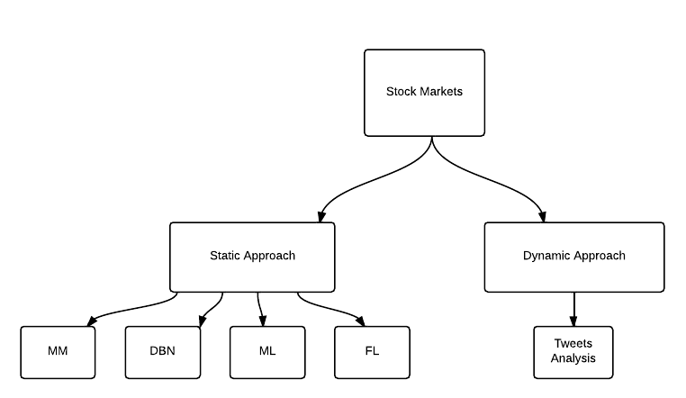
Researches Done to-date

Slide 3
Markov Models
Used for dependent random events
Markov chains depend only on the immediate preceding event
It won’t predict situations which have never occurred before

Slide 4
Dynamic Bayesian Networks
Extension of Hidden Markov Models
Predict something based on history
Assume that all states are described by same variables and same dependencies

Slide 5
Machine Learning
Learn from data
The machines are taught to identify patterns
Which can further be used to predict future instances

Slide 6
Support Vector Machines
It is a discriminative classifier defined by a separating hyperplane
The algorithm outputs an optimal hyperplane which categorizes new examples

Slide 7
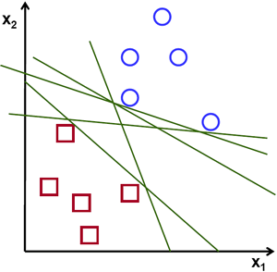
For a linearly separable set of 2-D points which belong to one of the 2 classes , find a separating straight line

Slide 8
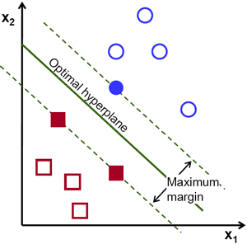
A line is bad if it passes too close to the points because it will be noise sensitive and it will not generalize correctly. Therefore, our goal should be to find the line passing as far as possible from all points.
.

Slide 9
SVM or DBN or Linear Regression?
SVM is useful mostly for 1 or 2 class classifiers
DBNs produce HMM equivalent results
Linear Regression improves accuracy with increase in data input.

Slide 10
Linear Regression
The independent variable in this case is time, with minute values
The dependent variable is the stock price
Weka is used to predict future values

Slide 11
Forecast Plugin[1]: Weka[2]
Time series analysis used for forecast
Plugin developed by Pentaho corporation
Based on simple linear regression model
[1]- http://wiki.pentaho.com/display/DATAMINING/Time+Series+Analysis+and+Forecasting+with+Weka
[2]- Mark Hall, Eibe Frank, Geoffrey Holmes, Bernhard Pfahringer, Peter Reutemann, Ian H. Witten (2009); The WEKA Data Mining Software: An Update; SIGKDD Explorations, Volume 11, Issue 1.

Slide 12
Time Series Analysis
Time series forecasting is the process of using a model to generate predictions for future events based on known past events
Ex- Sales forecasting, DNA sequence prediction, speech recognition etc.

Slide 13
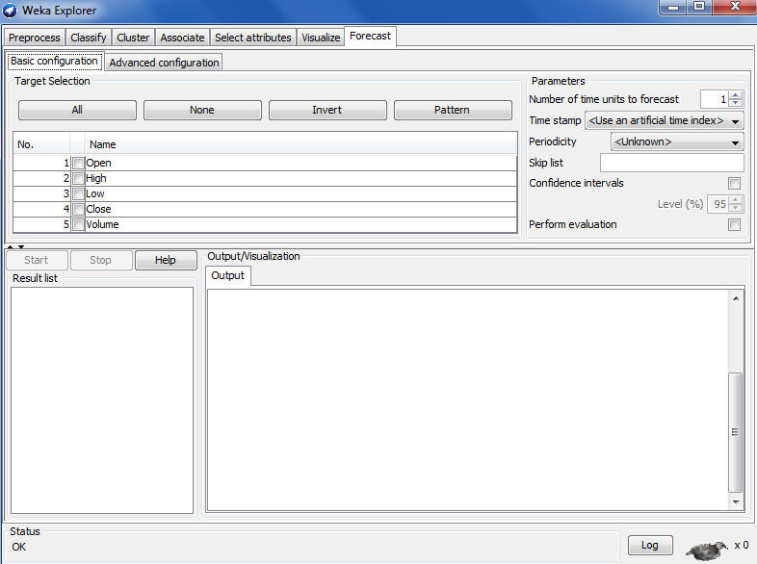

Slide 14
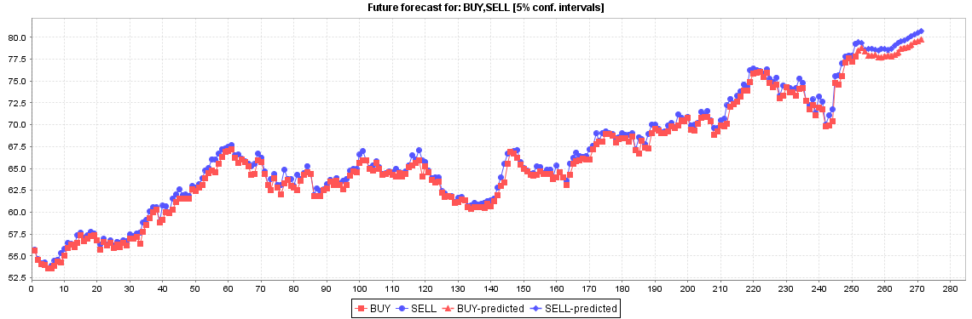
Output with 5% confidence level

Slide 15
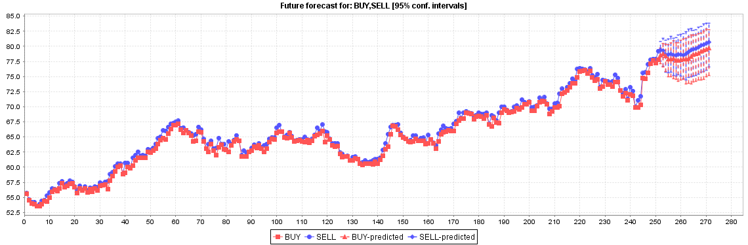
Output with 95% confidence level

Slide 16
Natural Language Processing Toolkit (NLTK)[3]
Python based platform for Human Language Analysis
Breaks the input text into tokens, which can be handled as we want
A live demo will be better…
[3]- Bird, Steven, Edward Loper and Ewan Klein (2009), Natural Language Processing with Python. O’Reilly Media Inc.

Slide 17
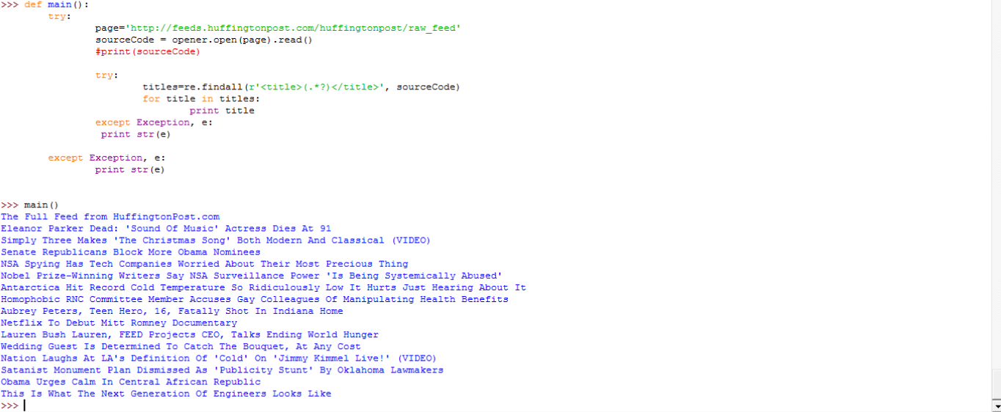
Results of streaming sample data

Slide 18
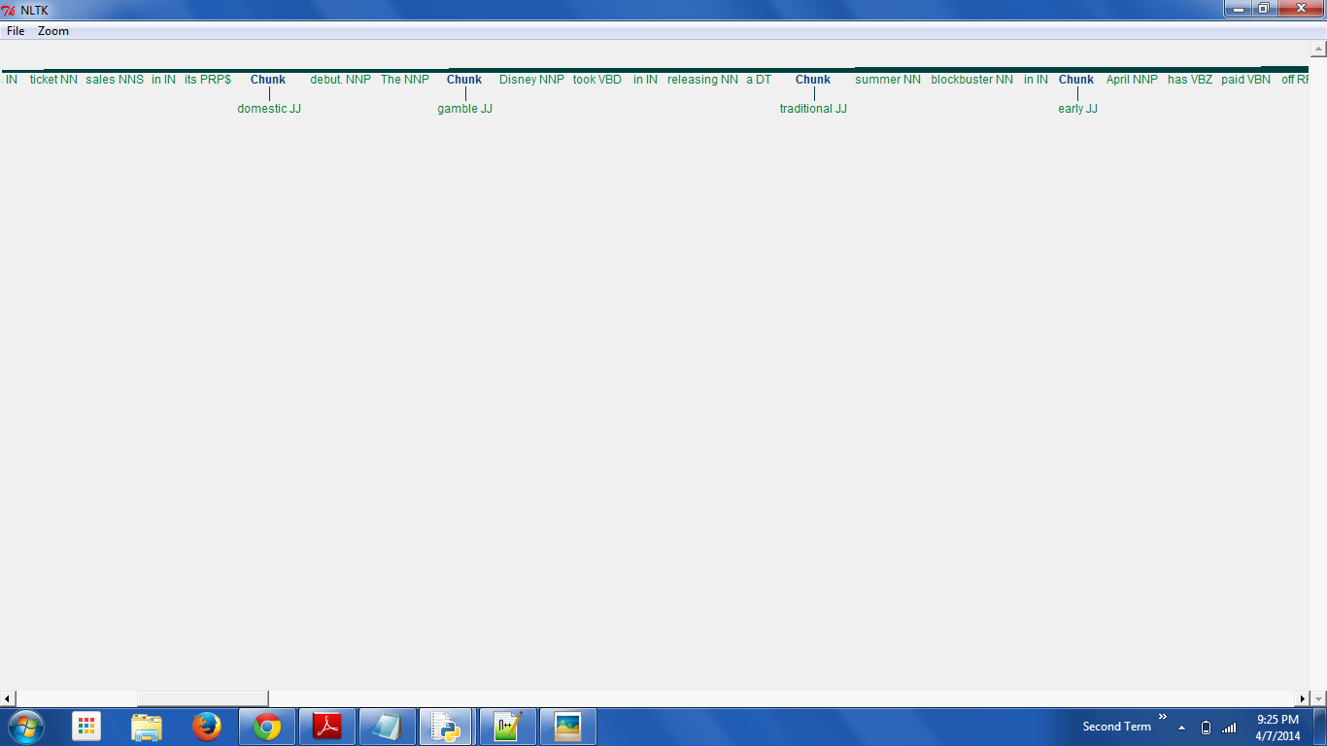

Slide 19
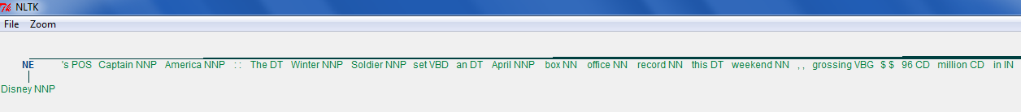
Another classification

Slide 20
Integrating and validating the results
For the present test case, the stock prices were omitted for the last 40 days and were left for prediction.
The linear regression showed a significant accuracy in finding the stock prices for all of those days.

Slide 21
Integrating and validating the results
Also the sentiment analysis showed positive sentiments for those days.
This analysis was as expected for the test data set

Slide 22
Scope for thesis research
For the big data sentiment analysis, there is a lot to be done
Presently the data is taken only from a stream of input of a web page
Future study shall include data from all the tweets and further, from other social media

Slide 23
Scope for thesis research
Further improvement in the validation methods can be brought about.
Use of Artificial Neural Networks to check the levels of accuracy between methods

Slide 24
Thank You!

