Slide 1
XML Rewrite Attacks in The Context of SOAP Messages, Evaluating The Current Solutions
AHMED ALGHAMDI
CSCE 813

Slide 2
Outlines
Introduction
SOA, SOAP messages, XML signature.
XML Rewrite Attacks
XML rewrite attacks scenarios, available solutions, recommended solution
References
Presentation figures are from references given on slides 15 & 16.

Slide 3
Introduction
SOA ( Services Oriented Architecture )
- Architecture style to build the system as a group of web services.
- Group of rules for service encapsulation, modularity, reusability and loose coupling.
SOAP (Simple Object Access Protocol )
- XML-based protocol to define the structure of exchanged messages.
- Can be used with different underlying protocols, such as HTTP.

Slide 4
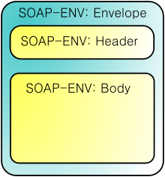
Introduction
SOAP Messages:
<Envelope>:
The root element.
Contains two elements:
- <Header> element: (optional)
Contains information that will be
processed by SOAP nodes
during transmission.
- <Body> element: (mandatory)
Contains call and response information.
( Source: Wikipedia )

Slide 5
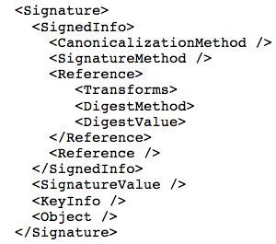
Introduction
XML signature :
- Digital signature used to provide
authentication and integrity for
SOAP messages.
- Applied to specific parts of the SOAP
message or the whole message.
- It refers to the signed object without
any further information about
its location
( Source: [5], from references given on slides 15 & 16 )

Slide 6
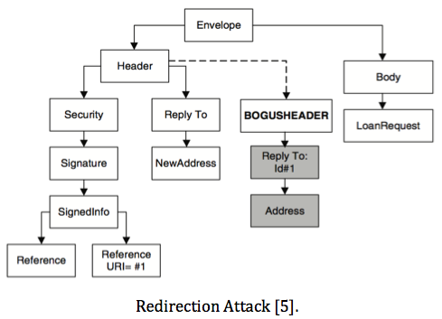
XML Rewrite Attacks
XML rewrite attacks :
Adding new elements to the SOAP header without compromising the contents of the message.
Redirection attack:
- The attacker inserts a new
element into the message’s
header to direct the message
to other addresses.

Slide 7
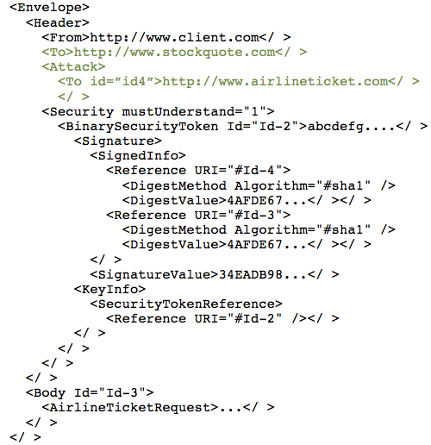
XML Rewrite Attacks
SOAP message after XML rewrite attack:
( Source: [6], from references given on slides 15 & 16 )

Slide 8
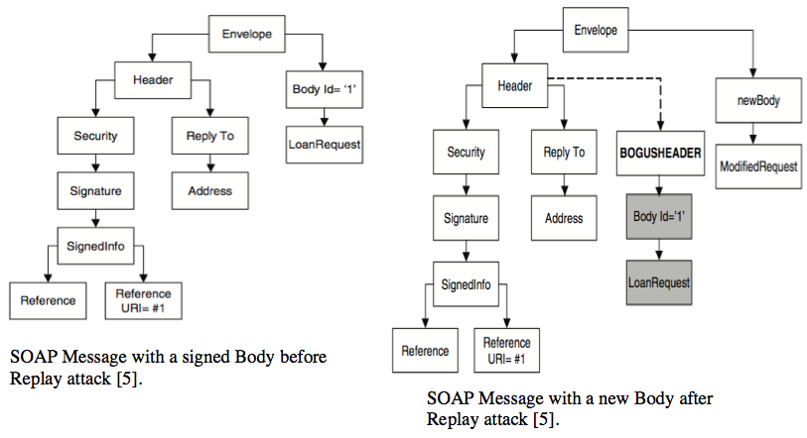
XML Rewrite Attacks
Replay Attack:

Slide 9
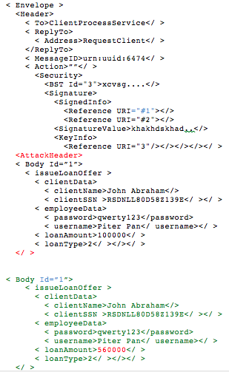
XML Rewrite Attacks
SOAP message after XML rewrite attack:
( Source: [5], from references given on slides 15 & 16 )

Slide 10
XML Rewrite Attacks
The Available Solutions:-
1- The formal solution :
- Create new context- sensitive signature (CSS), to use in place of the regular context-free signature (CFS).
- Generate context to allow the context of the signed elements to be captured at the same time as signing.
- The limitation:
The context of the signed message can be lost in some situations, when the context in the reference element of the signature must be stored before signing.

Slide 11
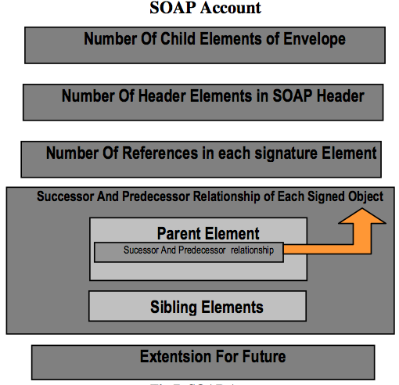
XML Rewrite Attacks
2-The Inline Approach (SOAP Accounts) :-
- Adding a new element called SOAP
account to the header of the outgoing
SOAP message.
- SOAP account records the element
structure information of the SOAP
message.
( Source: [3] )

Slide 12
XML Rewrite Attacks
The limitations:-
In this solution all the parent elements of signed elements are not uniquely identified.
SOAP account itself is vulnerable for some types of rewrite attack. The numbers of SOAP account elements are not specified and cannot be fixed.
This solution does not detect the replay attack.

Slide 13
XML Rewrite Attacks
To avoid SOAP Account vulnerability there are three recommendations:
To prevent the attacker from creating a fake header to wrap elements, more information about the depth of each signed element should be stored.
We have to store information for the parent for each signed element.
The element's parent should be uniquely identified. This will help detect fake elements inserted by an attacker

Slide 14
References
Mohammad Ashiqur Rahaman, Andreas Schaad, and Maarten Rits. 2006. Towards secure SOAP message exchange in a SOA. In Proceedings of the 3rd ACM workshop on Secure web services (SWS '06). ACM, New York, NY, USA, 77-84.
Michael McIntosh and Paula Austel. 2005. XML signature element wrapping attacks and countermeasures. In Proceedings of the 2005 workshop on Secure web services (SWS '05). ACM, New York, NY, USA, 20-27.
M. A. Rahaman, R. Marten, and A. Schaad. An inline approach for secure soap requests and early validation. OWASP AppSec Europe, 2006.
Mike P. Papazoglou and Willem-Jan Heuvel. 2007. Service oriented architectures: approaches, technologies and research issues. The VLDB Journal 16, 3 (July 2007), 389-415.
Smriti Kumar Sinha and Azzedine Benameur. 2008. A formal solution to rewriting attacks on SOAP messages. In Proceedings of the 2008 ACM workshop on Secure web services (SWS '08). ACM, New York, NY, USA, 53-60.

Slide 15
References
S. Fenet, A. Benameur and F. A. Kadir, “XML Rewriting Attacks: Existing Solutions and their Limitations”, Proceeding of the International Conference on Applied Computing, (2008) April; Algavre, Portugal.
S. Gajek, M. Jensen, L. Liao, and J. Schwenk, "Analysis of signature wrapping attacks and countermeasures," in ICWS, 2009, pp. 575-582.
SOAP Security Extensions: Digital Signature http://www.w3.org/TR/SOAP-dsig/#XML-Signature. 2/25/2014.
IBM Software Information Center, CICS Transaction Server for z/OS http://publib.boulder.ibm.com/infocenter/cicsts/v3r1/index.jsp?topic=%2Fcom.ibm.cics.ts31.doc%2Fdfhws%2Fconcepts%2Fsoa%2Fdfhws_message.h tm. 3/09/2014.
Web Services Security: What’s Required To Secure A Service-Oriented Architecture http://www.oracle.com/us/products/middleware/identity- management/059410.pdf. 3/2/2014.
Faisal Abdul Kadir,”RewritingHealer: An approach for securing web service communication”, KTH Royal Institute Of Technology, 2007.

Slide 16
Any Questions?

