Slide 1
evaluating perception management
Alex liscio
Bryan Haines
Caitlin brock
steven rubin

Slide 2
Overview of problems
Human bias
High profile or celebrity endorsements
Numerous factors that influence the mind
Notes:
"Actions to convey and/or deny selected information and indicators to foreign audiences to influence their emotions, motives,and objective reasoning as well as to intelligence systems and leaders at all levels to influence official estimates, ultimately resulting in foreign behaviors and official actions favorable to the originator's objectives. In various ways, perceptions management combines truth projections, operations, security,cover and deception, and psychological operations." -US Department of Defense

Slide 3
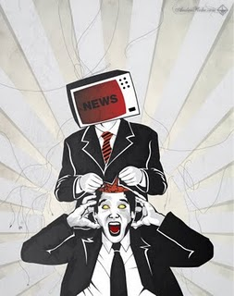
Problem 1 – Honesty
The lines become blurry
Facts and opinions
Human bias
http://www.globalresearch.ca/seeing-through-perception-management/5351569
Notes:
-Humans have a tendency to say something that they may not believe or mean to please others or to make themselves look good. This is an underlying problem when observing the perception of people.
-People will take the information for face value and let it influence opinions or thoughts when the user posting or sharing does not even agree.
-Fake news is becoming just as likely as real news and the general public has a hard time distinguishing so the problem lies with this influence is inaccurate information but having an effect
-There is a natural bias to making statements and decisions to only do so if there is some sort of personal gain which leads to people percieving what others want them to. This means that what appears to have or have not had an influence and the opinions people are making, may not be what is naturally occuring in their minds.

Slide 4
Problem 2 - Influencing
Notes:
-The average American or citizen for that matter will believe or support a celebrity, major political figure or other authority before it will believe peers or equals because there is a certain level of looking up and trust in that scenario. That therefore lies a shortfall in the perception of people because it can be greatly influenced by affluent people.
-Affluent people are also easily influenced by money and other means which leads to the idea that those in a position of power can be bribed to say or do something to get people on their side therefore altering what the honest perception would be and instead is manipulated to what those in charge would like.

Slide 5
Problem 3 - Affecting Factors
Affecting Perceiver
Schema
Motivational state
Mood
Affecting Target
Ambiguity
Social status
Impression management
Notes:
Components of perception include the perceiver, target of perception, and the situation.
Factors that influence the perceiver:
Schema: organization and interpretation of information based on past experiences and knowledge
Motivational state: needs, values, and desires of a perceiver at the time of perception
Mood: emotions of the perceiver at the time of perception
Factors that influence the target:
Ambiguity: a lack of clarity. If ambiguity increases, the perceiver may find it harder to form an accurate perception
Social status: a person's real or perceived position in society or in an organization
Impression management: an attempt to control the perceptions or impressions of others. Targets are likely to use impression management tactics when interacting with perceivers who have power over them. Several impression management tactics include behavioral matching between the target of perception and the perceiver, self-promotion (presenting one's self in a positive light), conforming to situational norms, appreciating others, or being consistent.

Slide 6
Limitations of current solutions
Algorithms predict more about popular political sentiment, not winner
Social Media users do not reflect actual voters

Slide 7
INEFFECTIVE ALGORITHMIC MODELS
Twitter and other social media platforms are proven to not serve well as accurate prediction subjects.
Have been shown numerous times to reflect strong political sentiments and trends, but fail to accurately predict winner.
No prediction algorithm using twitter to draw data has withstood the test of time, thus they are not proven reliable.
Notes:
- Some critics suggest to simply, "Make a better algorithm!" By studying past failed predictive election algorithms and pick the best parts from each. Unfortunately, that is not how algorithms or statistical analysis works.
- An algorithm was developed for the 2010 election and said to be successful because it predicted the correct result. However, the test used the same algorithm in 2012 and failed to predict the winner. Similar algorithms were implemented to forecast the German 2009 election and 2011 Dutch elections.
- It was determined that Twitter sentiment has the possibility to correlate with political polling, but this does not mean it gives any predictive insight into the election outcomes.
- A strong example of this can be seen in our most previous election. Popular American sentiment seemed to be in favor of Hillary, especially on social media. However, this strong popular movement did not necessarily determine her victory.
- This is a general overview in the deficiencies of the algorithmic models. Bryan will delve further into the specific pitfalls of the methods used in the tests.

Slide 8
Twitter users and voting base disparity
Twitter users generally younger millennials. Not a uniform representation of the voting base.
Strong political sentiments on social media does not point to large voting base
Notes:
-The first step to a strong statistical analysis is to have a representative sample group of the desired experiment. If the chosen experiment is to predict the election, the sample group from Twitter is not holistically representative of the voting population.
- Web crawlers and algorithms use the Twitter API to pull from millions of randomized Twitter accounts. The study even states that, "We retrieved all tweets possible." They believe with a large enough sample size that an accurate predictive sample size will be obtained. However, what they do not take into account is that Twitter accounts are generally liberal leaning, reflecting the opinions of the young more than the others. This can be further seen in the graphic above as 36%of adults aged 18 to 29 are on twitter. This vastly dominates over the other age brackets, like those aged 65+, where only 10% are on twitter. Twitter is also somewhat more popular among the highly educated: 29% of internet users with college degrees use Twitter, compared with 20% of those with high school degrees or less.
- The second image above shows that percentages of twitter users by age do not correlate to voting turnout. Due to this alone,predictive models used to show election results cannot be trusted.
- In fact, our paper states, "None of the methods used here made vigorous attempts to account for the demographic or partisan differences between the Twitter universe and the voting public."
-Furthermore, passionate and politically fueled tweets from a user does not mean that user will or can vote. Many opinions shared on Twitter are made by users too young to vote, or who simply do not vote, regardless of their passionate statements.
-Again,this is a general overview of the pitfalls of the demographics. Bryan will provide a more specific analysis of the analysis.

Slide 9
Specific technical limitations
Inadequate Models
Limited scope
Demographic data
Image credit: http://www.nsf.org/images/nsf/hs_data_integrity_300x300.jpg
Image credit: https://tallbloke.files.wordpress.com/2017/02/fail.jpg
Image credit: http://files.wendell.gethifi.com/departments/planning/pictures/demographics1.jpg
Notes:
Here, we would like to talk about the limitations that we intend to address in our research project.
We intend to focus on the three areas that Alex has already talked about in his slides as having been identified as lacking in previous efforts to evaluate opinions using social media and computer modeling.
inadequate models
limited scope
lack of demographic data
We will discuss each of these areas in the upcoming slides.

Slide 10
Inadequate Models
accuracy versus incumbency
forward applicability
language evaluation
Image credit: https://c1.staticflickr.com/6/5189/5695328396_427128d9be.jpg
Image credit: http://www.srpsystems.com/wp-content/uploads/2017/01/predictive-analytics.png
Image credit: https://media.licdn.com/mpr/mpr/AAEAAQAAAAAAAAjBAAAAJDg1YjI2OTQyLTQzZDctNDE3MC1iNTY4LWY1N2RjYTYzYzY0OQ.png
Notes:
Alex already covered the concepts here pretty well, so briefly:
Some of the deficiencies that have previously been identified in the models used for evaluating public sentiment are:
Accuracy versus incumbency
Forward applicability
Language evaluation
Explanation:
Accuracy vs incumbency: Incumbency refers to the fact that around 80% of office holders get re-elected to their office, if they run. When we say accuracy vs incumbency, we are referring to the fact that existing models fair worse than (possibly equal to ) just betting that the incumbent would win the election. At this point, we could say that all existing models are useless for predicting election outcome based on user sentiment.
Forward applicability: The model discussed in the reading for this class was “trained” on the data from the 2010 Congressional election. Using those models, but plugging in the data collected at the time of the 2012 Congressional election yielded results less accurate than what had been modeled for the 2010 election. Thus, even though the model could fairly accurately predict the results of the 2010 election (in retrospect) this did not correlate to accuracy in the 2012 election.
Language evaluation: Earlier models did not evaluate the language used in a social media post at all, but instead just relied on the fact that a candidate was mentioned. The model in the class reading did at least try to evaluate the language of the post to determine its meaning and underlying sentiment. Even the latest model had shortcomings in that it seemingly failed to account for the dynamic changes in language from one election cycle to the next. This could account for the loss of accuracy in the 2012 cycle

Slide 11
limited scope
twitter only
limited sample size
Scalability
Image credit: https://lh3.ggpht.com/lSLM0xhCA1RZOwaQcjhlwmsvaIQYaP3c5qbDKCgLALhydrgExnaSKZdGa8S3YtRuVA=w300
Image credit: http://static.guim.co.uk/sys-images/Guardian/Pix/pictures/2013/4/9/1365517545310/Cartoon-illustrating-the--012.jpg
Image credit: https://connectship.com/scalable/scalable3.jpg
Notes:
When we say “limited scope” we are referring to the fact that the paper for the class reading only evaluated Twitter feeds to glean information, and the fact that they used the Twitter Search API, which limited the results of their individual queries (1,500 results per query).
What about all of those people who aren’t on Twitter? What about the sentiment of those who more quietly hold to their convictions, as opposed to broadcasting them to the world? The models that were trained only the Twitter search results would be sorely lacking in the ability to evaluate overall sentiment.
Even if this were found to be accurate for a local election, this approach would not easily scale to a presidential election, for example.

Slide 12
demographic data
twitter users
political leanings
other data
Image credit: http://d3i6fh83elv35t.cloudfront.net/newshour/wp-content/uploads/2015/03/RTR3FL8C-1024x637.jpg
Image credit: http://blindgossip.com/wp-content/uploads/2017/01/democrat-republican-2.jpg
Image credit: https://s-media-cache-ak0.pinimg.com/564x/f3/39/28/f33928e6579a3edf453a4cfce4daf9eb.jpg
Notes:
Due to the fact that none of the techniques discussed in the class reading made any effort to determine if there was any demographic difference between the users of Twitter and the general population of the country, we can say that demographics were not factored into the predictive models. Do the users of a particular social media site have predominant political leanings that could skew the results? What about views on particular political issues? Are there more people who are for (or against) a particular issue in the Twitter-verse as opposed to the majority of the population?
Failing to look into these demographic areas could have been a contributing factor to the inaccuracy of the tested predictive models.

Slide 13
Proposed solutions
Webscrapers implementing:
Facebook Graph API
Google+ API
YouTube Data API
Notes:
One of the concerns we raised is that just analysing twitter is not enough to get whole picture picture of what’s going on in politics, not everybody is on twitter, but some people prefer Facebook, Google + is getting more popular. Therefore, it makes sense to write a webscraper taking advantage of Google+ API, Facebook Graph API, and other less popular social media networks such youtube, live journal, different blogs, forums, and so on.

Slide 14
PROPOSED solutions
Use Machine Learning algorithms
to learn from the previous elections
to learn sophisticated sentiment analysis
"I'm supporting Clinton to see her wearing striped pyjamas”​
(real tweet)
​
Notes:
Another thing which would be nice to do is to implement machine learning algorithms. There are a couple of reasons for that: to learn from incorrect sentiment analysis from previous years such that the algorithm wouldn’t make the same mistakes again and implement sophisticated analysis to correctly understand meaning of tweets like this: “
I'm supporting Clinton to see her wearing striped pyjamas”
No matter how smart the machine is it finds it difficult to realise the person who wrote it does not really support Ms. Clinton.

Slide 15
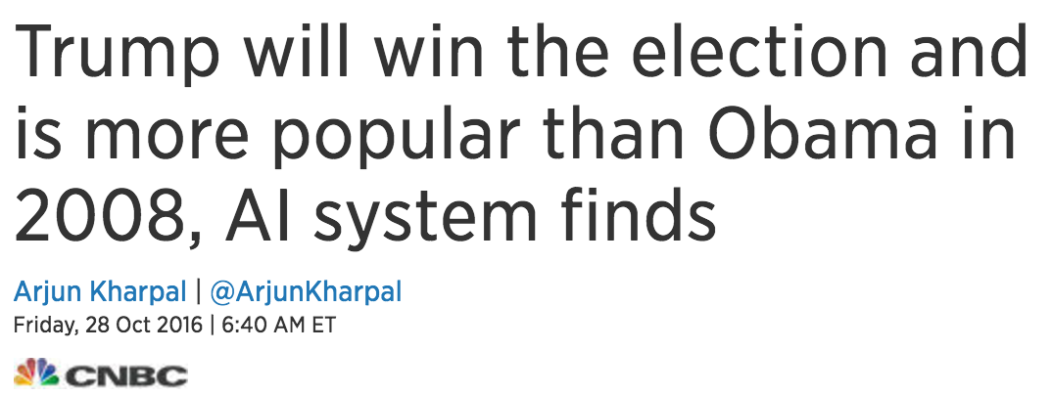
correct 2016 US Presidential Elections predictions
Notes:
Interesting, but when we started digging deeper into this topic, we found there were some correct predictions. Not everybody was saying Ms. Clinton will win. Well, first and foremost, Mr. Trump victory was predicted back In 2000, even before he knew he would be running a campaign. It’s just a joke, we put t to entertain you guys. Speaking seriously, BrandsEye, a tool that looks at people's tweets, correctly predicted both the vote to leave the EU in June's referendum and a Trump victory in the US election, but how did it do this?
For both elections, Brandseye measured which side had more tweets in its favour on Twitter - predicting that the most popular of the two on the social media platform would win.
The company took a sample of 200,000 tweets. These tweets were then checked by a crowd-sourced army logging in from their homes. Their task was simple; when presented with a tweet, decide if it was pro-Trump or pro-Clinton. This approach is not scalable and has little to do with Computer Science, but it worked.
Finally, An Artificial Intelligence system called MogIA called it for Trump as well. According to US TV channel CNBC, MogIA was developed by innovator Sanjiv Rai and has correctly predicted all US elections since 2004.
Mogia measures engagement data from sites like Google, Facebook and Twitter. For example how many people read a Trump tweet or watched a Trump Facebook Live? It takes in 20 million data points from public platforms including Google, Facebook, Twitter and YouTube in the U.S. and then analyzes the information to create predictions. Exactly as we were proposing, and this algorithm has never been wrong yet.

Slide 16
Conclusion
References:
Huberty, Mark Edward. "Multi-cycle forecasting of congressional elections with social media." Proceedings of the 2nd workshop on Politics, Elections and Data. ACM, 2013.
Notes:
In conclusion, …

