Slide 1
Office of Cybersecurity and Communications (CS&C) Overview
1

Slide 2
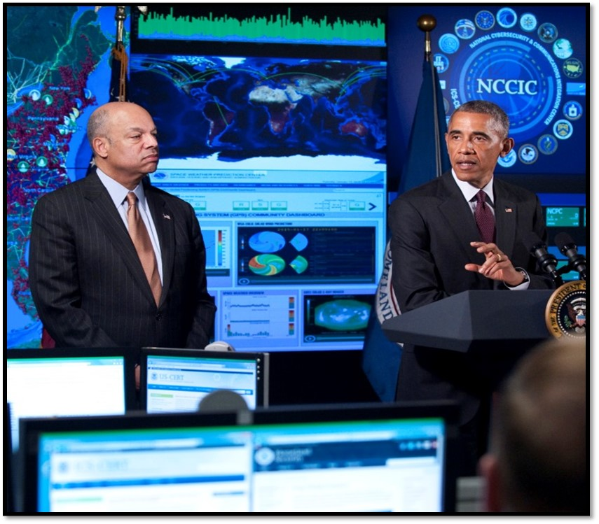
“Protecting our digital infrastructure is a national security priority and a national economic priority.”
President Barack Obama
January 2015

Slide 3
Our Mission and Vision
Vision
A secure and resilient national information technology and communications infrastructure.
Mission
Responsible for enhancing the security, resiliency, and reliability of the Nation’s cyber and communications infrastructure. CS&C actively engages the public and private sectors as well as international partners to prepare for, prevent, and respond to catastrophic incidents that could degrade or overwhelm these strategic assets.

Slide 4
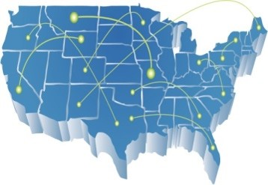
Our Responsibilities
Protect Federal civilian networks from malicious cyber actors
Support the private sector and state, local, tribal, and territorial governments in the management of their cyber risk
Provide technical assistance in the event of a cyber incident, as requested

Slide 5
Our Cybersecurity Customers

Slide 6
Our Cybersecurity Customers
Our Mission is to help four types of customers manage their cybersecurity risks:
Federal government (civilian Executive Branch)
State, Local, Tribal, and Territorial (SLTT) governments
Critical Infrastructure (mostly private sector)
General Public

Slide 7
Our Focus Areas

Slide 8
Cybersecurity & Communications Focus Areas
Provide a common baseline of security to protect federal civilian agencies where it is efficient and cost-effective to do so
Promulgate and increase the adoption of cybersecurity best practices, particularly the National Institute of Standards and Technology (NIST) Cybersecurity Framework
Serve as a national hub for cybersecurity information sharing, in real-time wherever possible
Provide incident response assistance to victims and coordinate the national response to significant cyber incidents.
Build a stronger cybersecurity ecosystem by driving the market toward effective solutions and helping build an effective cybersecurity workforce
Ensure the interoperability and continuity of national security/emergency preparedness communications

Slide 9
Focus Area 1: COMMON BASELINE of Security for .gov

Slide 10
Federal Cybersecurity
DHS provides a common baseline to protect agencies against threats and vulnerabilities through two programs:
EINSTEIN
Continuous Diagnostics and Mitigation
Provides DHS with the situational awareness to use threat information detected in one agency to protect the rest of the government.

Slide 11
Federal Cybersecurity
EINSTEIN – Intrusion Detection and Prevention
Deploys a baseline of enterprise security where efficient & effective. Defends the perimeter of federal civilian Executive Branch
EINSTEIN 1: Monitors network traffic transiting to/from agency
EINSTEIN 2: Detects and alerts potentially malicious activity
EINSTEIN 3 Accelerated: Blocks potentially malicious activity using classified information
https://www.dhs.gov/publication/einstein-3-accelerated

Slide 12
Federal Cybersecurity
Continuous Diagnostics and Mitigation (CDM)
A suite of tools and services to provide common baseline of cybersecurity across federal civilian government to help identify risks on their networks
Provides services to implement sensors and dashboards;
Delivers near-real time results;
Prioritizes the worst problems within minutes, versus quarterly or annually;
Enables defenders to identify and mitigate flaws at network speed; and
Lowers operational risk and exploitation of government IT systems and networks.
Fulfills Federal Information Security Management Act (FISMA) mandates
https://www.dhs.gov/cdm
Phase1
Detects vulnerabilities on agency computers and software
“What is on your network”
Phase 2
Detects unauthorized users and their activity
“Who is on your network”
Phase 3
Detects unusual activity inside agency networks
“What is happening on your network”
Phase 4
Encrypting data and segmenting networks to protect critical data
“Protecting data on the network”

Slide 13
Focus Area 2: BEST practices

Slide 14
Best Practices
NIST Cybersecurity Framework
Help organizations use the NIST Cybersecurity Framework, per Executive Order 13636, “Improving Critical Infrastructure Cybersecurity”
Created through collaboration between industry and government
Consists of standards, guidelines, and practices to promote the protection of cyber infrastructure
Prioritized, flexible, repeatable, and cost-effective approach of the Framework helps owners and operators of critical infrastructure to manage cybersecurity-related risk
www.nist.gov/cyberframework/

Slide 15
Best Practices
Critical Infrastructure Cyber Community Voluntary Program (C³VP)
Encourages use of the Framework for Improving Critical Infrastructure Cybersecurity to strengthen critical infrastructure cybersecurity.
Coordination point within the Federal Government for critical infrastructure owners and operators interested in improving their cyber risk management processes.
http://www.dhs.gov/ccubedvp

Slide 16
Risk Assessments
DHS assesses an organizations cybersecurity risk
Risk and Vulnerability Assessments
In-depth assessments to include penetration testing services, and web application and database testing
High Value Assets at federal agencies
Cyber Hygiene
Routinely scans Internet-accessible computers on federal civilian networks
Provide on-site risk assessments - Cyber Resilience Review (CRR)
Help organizations identify their cybersecurity vulnerabilities and implement targeted fixes (existing resilience & gap analysis)
Facilitated by a DHS expert or downloadable on-line (self-assessment)
Either technical or qualitative (programs & practices)
Across Ten Domains – (e.g. risk management, service continuity, etc.)
https://www.us-cert.gov/ccubedvp

Slide 17
Focus
Best Practices (For the Federal Civilian Executive Branch)
Measuring & motivating improved federal cybersecurity
Secretary’s Binding Operational Directive: Authority in statute to require that agencies implement specific cybersecurity actions
“Red teams”: Penetration testing inside agency networks to identify vulnerabilities that could be exploited by adversaries
Agency Self-Reporting: Collect and analyze agency reports on their own cybersecurity to track progress toward Cross-Agency Priority (CAP) Goals
CDM Dashboard: Provides recurring updates on government-wide cybersecurity

Slide 18
Focus Area 3: Information Sharing

Slide 19
Information Sharing
Automated bi-directional sharing of cyber threat indicators
Focusing increasing amount of shared indicators from connected federal agencies, private companies, and Information Sharing and Analysis Centers (ISACs)
Real-time collaboration on the NCCIC watch floor
9 agencies and 4 ISACs on watch floor; 114 companies have as-needed access
Cybersecurity alerts, bulletins, and warnings
Distribution to over 100,000 recipients
Foster Information Sharing and Analysis Organizations
To broaden the base of information sharing partners, per Executive Order 13691, “Promoting Private Sector Cybersecurity Information Sharing”.
Standing information sharing groups
For both government and private sector partners

Slide 20
Information Sharing
Cybersecurity information sharing programs:
Automated Indicator Sharing (share computer-readable data widely & quickly
Cyber Information Sharing and Collaboration Program (share sensitive information with trusted partners)
Alerts and Bulletins distributed to public and trusted partners (share validated information widely)
Information Sharing and Analysis Organizations support sharing within and across critical infrastructure sectors.
DHS has developed trusted relationships with these organizations, many of which now have representatives assigned to the NCCIC.

Slide 21
Information Sharing
Automated Indicator Sharing
Allows DHS to leverage machine-to-machine communication to rapidly share cyber threat indicators with partners in:
Federal Government;
State, local, tribal, and territorial governments;
Information sharing and analysis organizations (ISAOs)
Private sector critical infrastructure stakeholders.

Slide 22
Information Sharing
ISAOs and ISACs
DHS is supporting the development of best practices for Information Sharing and Analysis Organizations (ISAOs)
Information Sharing and Analysis Centers (ISACs) are sector-based organizations that are one type of ISAO.

Slide 23
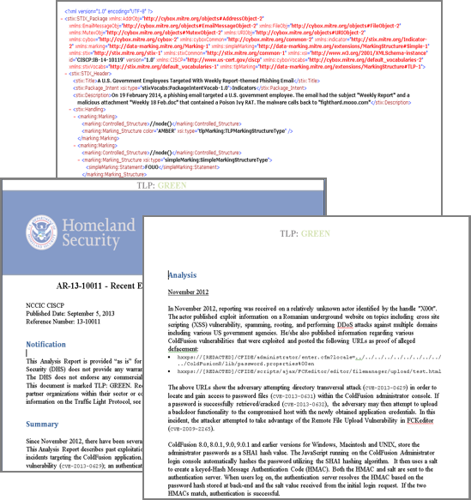
Information Sharing
Cyber Information Sharing and Collaboration Program (CISCP)
Automated Indicator Sharing
Indicator Bulletins
Analysis Reports
Priority Alerts
Recommended Practices

Slide 24
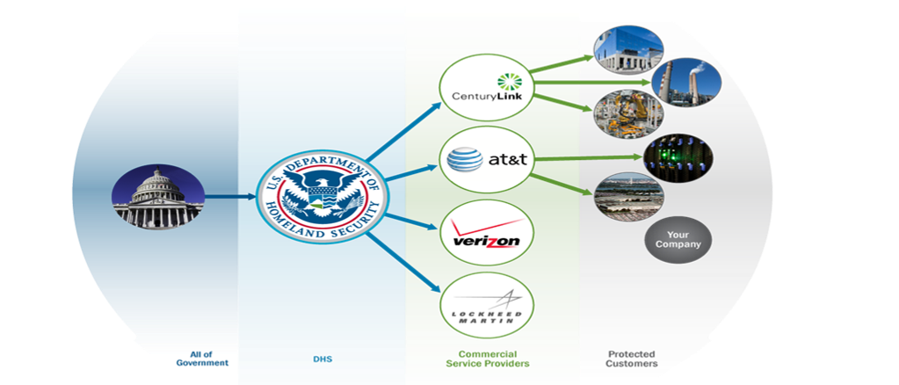
Information Sharing
Enhanced Cybersecurity Services (ECS)
Intrusion prevention capability that helps U.S.-based companies protect their computer systems against unauthorized access, exploitation, and data exfiltration.

Slide 25
Focus Area 4: Incident Response

Slide 26
Incident Response
When cyber incidents occur, DHS:
Provides assistance to potentially impacted entities,
Analyzes the potential impact across critical infrastructure,
Mitigates vulnerabilities and reduces impact of cyber incidents, and
Leads and coordinates the national asset response to significant cyber incidents via the NCCIC

Slide 27
Incident Response
National Cybersecurity & Communications Integration Center (NCCIC)
24/7 information sharing, analysis, and incident response:
Operational teams:
United States Computer Emergency Readiness Team (US-CERT)
Responds to incidents affecting regular IT systems (like servers and desktops) at government agencies and private companies
Industrial Control Systems Cyber Emergency Readiness Team (ICS-CERT)
Responds to incidents affecting control systems. (Control systems operate physical infrastructure such as power plants.)
National Cybersecurity Assessment and Technical Services (NCATS)

Slide 28
Incident Response
National Coordinating Center for Communications (NCC)
Lead for Emergency Support Function (ESF) #2
Coordinates restoration of communications infrastructure and ensures communications support to national response efforts.
“No cyber without fiber”
Focuses on both cyber attacks and physical incidents affecting the Nation’s communications infrastructure
National Cybersecurity Exercise Program (NCEP)
Develops, coordinates, and facilitates cybersecurity exercises to help government and private sector built response capabilities.

Slide 29
FOCUS AREA 5: Building the cyber Ecosystem

Slide 30
Cyber Ecosystem
Progress toward a more secure cyber ecosystem will require investments in both technology and people
America needs well trained professionals working in cybersecurity roles in both private industry and the government

Slide 31
Cyber Ecosystem
Private Sector Outreach
Cybersecurity Advisors
Offer on-site risk assessments
Provide guidance and best practices
Serve as a conduit for additional DHS and USG resources
Protective Security Advisors (based in NPPD’s Infrastructure Protection office)
Provide physical security assessments and guidance
Serve as a “force multiplier” to connect companies with DHS cybersecurity resources
Sector Coordinating Councils
Policy bodies comprised of private sector representatives
DHS is the Sector Specific Agency for the IT and Communications sectors (among others)
Information Sharing and Analysis Centers/Organizations (ISACs/ISAOs)
Private sector bodies organized by sector (ISACs) or other criteria (ISAOs)
Serve as a principal conduit for sharing cybersecurity threat, vulnerability, and incident information among members and with the government
Allow the government to reach many companies through a single information sharing agreement and technical connection

Slide 32
Cyber Ecosystem
Cyber Education and Workforce Development
Develop and promote training and education:
CyberCorps: Scholarship for Service (SFS)
DHS partnership with National Science Foundation offers scholarships to outstanding undergraduate, graduate, and doctoral students in exchange for government service to a federal agency. www.sfs.opm.gov
Centers of Academic Excellence (CAE) in Information Assurance/ Cyber Defense
Sponsored by DHS and the National Security Agency to promote higher education and research, and produce a growing pipeline of professionals. www.nsa.gov/ia/academic_outreach/nat_cae/index.shtml
National Initiative for Cybersecurity Careers and Studies (NICCS)
Serves as a national resource for cybersecurity education, training, and career opportunities. https://niccs.us-cert.gov/

Slide 33
Cyber Ecosystem
Awareness Programs: Stop.Think.Connect.
National public awareness campaign aimed at increasing the understanding of cyber threats and empowering the American public to be safer and more secure online.
http://www.dhs.gov/stopthinkconnect

Slide 34
Cross-Cutting: Accelerate Adoption of Innovative Technologies
Cyber Ecosystem
Automated information sharing with law enforcement, IC, other agencies, and the private sector
Analytics to find previously unknown attacks using EINSTEIN, CDM, and private-sector data
Enrich shared information, such as through reputation scoring, to provide better value for our customers

Slide 35
Focus Area 6: national security/emergency preparedness communications

Slide 36
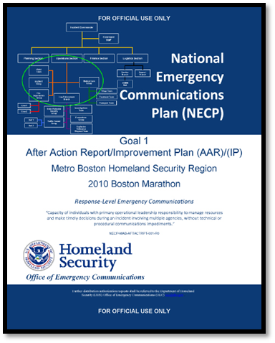
Emergency Communications
The Office of Emergency Communications (OEC) provides operable and interoperable communications for the national security/ emergency preparedness (NS/EP) community during all-hazard events.

Slide 37
Emergency Communications
National Emergency Communications Plan
Provides information and guidance to those who plan for, coordinate, invest in, and use operable and interoperable communications for response and recovery operations.
http://www.dhs.gov/national-emergency-communications-plan

Slide 38
Emergency Communications
Government Emergency Telecommunications Service (GETS)
Supports national leadership; federal, state, local, tribal, and territorial governments; and other authorized NS/EP users
Wireless Priority Service (WPS)
Intended to be used in an emergency or crisis situation when the wireless network is congested and the probability of completing a normal call is reduced
Telecommunications Service Priority (TSP)
Authorizes NS/EP organizations to receive priority treatment for vital voice and data circuits or other telecommunications services

Slide 39
CS&C Contact Information
For more information:
www.dhs.gov/cyber
www.dhs.gov/topic/emergency-communications

