Slide 1
Role of Web Application Vulnerabilities in Information Warfare
Aditya Tripathi
Mohan Krishna Karanam
Siva Prasad Reddy Nooli
Srinivas Balivada
Srinivas Burra
Yugendhar Reddy Sarabudla

Slide 2
Problem Overview
Current Problems :
1) Cross-Site scripting (XSS)
2) Cross-Site Request Forgery (XSRF)
3) SQL injection
4) Broken Authentication and Session Management
5) Insufficient TLS binding
6) Insecure Cryptographic storage
Notes:
Cross-Site Scripting (94%): This attack lets the attacker completely alter the contents of the site.
Cross-Site Request Forgery (92%):
SQL Injection : Injections let attackers modify a back-end statement of command through unsanitized user input.
Broken Authentication and Session Management: Attackers bypass the authentication methods that are used by an application.
Insecure Direct Object References: his type of insecure direct object reference allows attackers to obtain data from the server by manipulating file names.

Slide 3
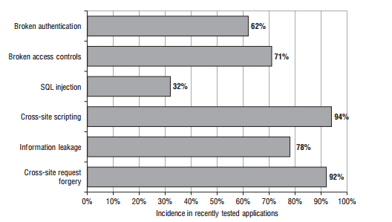
Problem Overview
zXZX
Web Application Security Consortium (WASC) reports:
12,186 real-world websites list a total of 97,554 vulnerabilities
49% of these websites contain high-risk vulnerabilities
Notes:
Using several different black box security vulnerability detecting tools, the WASC was able to find 58.51% of the high-risk vulnerabilities and only 12.05% of the medium-risk vulnerabilities.

Slide 4
Problem Overview - Current Solutions
Black-Box Security Testing Methodology
XSS Analyzer
Notes:
Main complication of BBST: They have limited insights into the workings of server-side defenses.

Slide 5
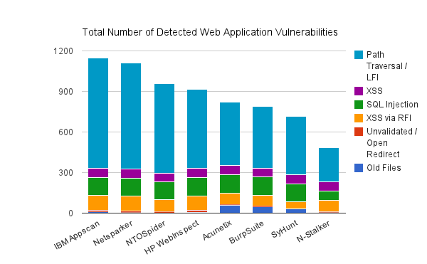
Problem Overview - Current Solutions
Notes:
http://securityaffairs.co/wordpress/16557/hacking/statistics-on-web-application-vulnerabilities-statistics-2013.html

Slide 6
Limitations of Current Solution
Static Verification
Manual Intervention to Dynamic Tools
May provide False positives
Dependence on security experts
Notes:
In addition to the limitations mentioned above the scanners are not smart enough to test for specific vulnerabilities in the application logic. Web application vulnerability scanners are not able to test for:
Authentication vulnerabilities such as username enumeration, resilience to password guessing, any account recovery functions, credentials predictability or any other logic flaws in the authentication
Session management flaws like meaningful or predictable tokens, session fixation, mapping tokens to session, session hijacking etc.
Vulnerabilities in access controls where a user can access others’ user data or admin functionality without having admin privileges assigned
Application logic flaws such as ordering negative number of items, skipping a stage in multi-stage processes (i.e. going straight to shipping page skipping the payment page) etc.
Shared hosting vulnerabilities – test segregation in shared infrastructure or between ASP-hosted applications
Leakage of sensitive information such as password hashes in the hidden fields or user logs

Slide 7
Limitations of Current Solution
Static Verification :
▶Tools deployed as plugins on the browser
▶Predefined payload on input points targeting unsanitized HTML Elements
Notes:
Most of the research on web application security has turned toward static security veriﬁcation . The static security verification involves testing of static input. They will not detect the attacks that happen on the back end or server side.
Not equipped with learning capabilities
Rely on manual intervention to detect common cases of broken input sanitization or validation

Slide 8
Limitations of Current Solution
Manual Intervention :
Hand Picked Payload while performing server side scan
No Knowledge on Server side detection

Slide 9
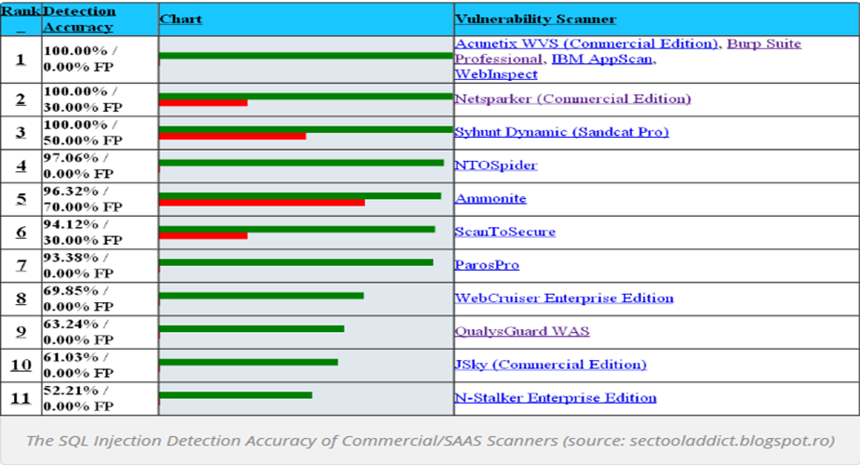
Limitations of Current Solution
False Positives :

Slide 10
Limitations of Current Solution
Dependence on Security Experts :
Synthesizing of effective payload -
Based on common cases of broken(or partial) input sanitization or validation

Slide 11
Specific Technical Limitations
Limited Scope - Main source code is out of static tool reachability.
No Detection of Logical Flaws - Cannot detect logical flaws in the code.
Processing cost- Processing cost is huge for huge data.
Lack of Learning Capabilities- No Self-learning.
No detection of Server MisConfiguration-Critical security configurations can be missed.
Notes:
https://theses.lib.vt.edu/theses/available/etd-08102010-184408/unrestricted/Shelly_DA_T_2010.pdf
http://www.eosensa.com/en/limitations-of-automated-web-application-vulnerability-scanners/
1. limitation of this approach is that vulnerabilities could be accidentally included in the web application. Scanner results could include vulnerabilities that were not intentionally put into the web server, and could cause the false-positive and false-negative results to be inaccurate. Because of this limitation, a detailed analysis of scanner results needed to be completed.
2.The last limitation, and probably the most significant limitation, of the approach was that the knowledge of the inner workings of the commercial web application vulnerability scanners was not known. If the scanners were developed in house, or if access to the source code to see
how their algorithms worked was available, then the analysis would have been much easier because exactly what each scanner was doing would be known. Since this was not possible,the analysis had to rely on using the packet traces, cookie files, database entries, and scanner test results instead
3.approach did not take into consideration vulnerabilities that occur in popular dynamic based web technologies. Technologies such as AJAX, Flash, and image maps are not present in this implementation of the web server and therefore cannot be analyzed. JavaScript was the only dynamic technology implemented, because there are only a select
few web application scanners that check for vulnerabilities in these technologies. However,since these dynamic technologies are becoming more and more popular, all web application scanners should search for their security flaws. Future studies that analyze the limitations of
web application scanner techniques will need to consider the vulnerabilities caused by these technologies.
4.research focused on web applications written in PHP and did not consider other web development languages such as Python, Perl, Ruby, .NET, and Java since they are not as popular. Therefore, the results found may only be specific to the configuration used (LAMP). For more generalized results and analysis, additional web based technologies will need to be onsidered. Regardless, the results obtained are still significant since the LAMP configuration is the most popular web server configuration, as explained earlier

Slide 12
Specific Technical Limitations
Limited Scope :
No access to server-side code
Black-box model of scanning
Only client side learning knowledge
Notes:
Hybrid testing techniques, which provide leverage on the problem of stored vulnerabilities, have shown promising results , but the fundamental assumption that the server-side code is outside the tool’s reach, which often holds in practice with industry web applications, is not met.

Slide 13
Specific Technical Limitations
No Detection of Logical Flaws :
Missing logical code
Invalid logic in the code
Misinterpretation of use case

Slide 14
Specific Technical Limitations
Lack of Learning Capabilities :
Cannot use the previous experiences on server code
Leverages problem on stored vulnerabilities
Notes:
The main problem of implementing learning algorithms is the expenditure of setting such databases which requires high computation and results in costly processing of such huge data.
The main limitation of is that the XSS Analyzer learns from failed attacks on tokens that server-side defenses reject.This allows pruning of large regions within the search space, leading to lose large amount of data which affect the results.

Slide 15
Specific Technical Limitations
No Detection of Server Misconfiguration :
Only on the browser
Uses load testing with payload on HTML elements
No knowledge on Server side configuration

Slide 16
Proposed Solution
Dynamic scanning
Server side scan
Detection of logical flaws
Self learning capabilities
Detection of server misconfiguration
More of white box testing
Learn from previous learning experience

Slide 17
How will we implement ?
The idea of XSS analyser in the case of testing reusability
Advanced machine learning techniques for self learning
Uses version control for bug fixes
Taint analysis for detecting false positives
1. Taint analysis
2. Data Mining
3. Code Correction
4. Feedback
5. Testing

Slide 18
How feasible is it?
Suitable for specific scripting lang.
Tools with these ideas , taint analysis has shown some significant results.
Easy to migrate to new programming languages.
Notes:
Tool:
Server Side
Machine Learning
Self Learning
Detect Vulnerabilities before deployment
http://www.gsd.inesc-id.pt/~mpc/pubs/WAP-journal-jul15.pdf
Comprehensive security database. An important foundation of the learning algorithm is a database of half a billion XSS payloads, which we believe is the largest and most comprehensive source of XSS tests.
A database of XSS payloads can be used as a comprehensive source of XSS tests
We would like to develop a tool to detect the Sql Injection and CSRF attacks using the learning algorithm
In which we propose to use payloads of data, and make attempt to detect the attack comparing all the payloads and instances taken place in the past.
We also propose to implement a tool to measure coverage of cases and using its feedback as an input to detect the next attacks.
http://www.gsd.inesc-id.pt/~mpc/pubs/WAP-journal-jul15.pdf

Slide 19
Conclusion
It is important to detect vulnerabilities before the application is deployed into production.
Adopting a learning approach to identify vulnerabilities can increase efficiency of the scanners.

Slide 20
References
[1] Omer Tripp, Omer Weisman, Lotem Guy. (2013). Finding your way in the testing jungle: A learning approach to web security testing. In Proceedings of the 2013 International Symposium on Software Testing and Analysis (ISSTA 2013).
[2] OWASP Top Ten Project, https://www.owasp.org/index.php/Top_10_2010-A1
[3] R. S. Sutton and A. G. Barto. Introduction to Reinforcement Learning. MIT Press, Cambridge, MA, USA, 1st edition, 1998.
[4] Ibéria Medeiros, Nuno Neves (2013).Detecting and Removing Web Application Vulnerabilities with Static Analysis and Data Mining.

Slide 21
THANK YOU

