Slide 1
Performance Pitfalls in Large-Scale Java Applications Translated from COBOL Toshio Suganuma Toshiaki Yasue Tamiya Onodera Toshio Nakatani
Presented By:
Nawras Alkassab
Natasha Delahunt
Marcos Moraes
Vaishnavi Sunku

Slide 2
Introduction
Legacy transformation:
Adaptation to modern Web-based service-oriented architecture (SOA)
difficult to find skilled COBOL programmers
Conversion from COBOL to java
Need to translate large-scale legacy mainframe applications
corrections and fine tuning are applied by hand

Slide 3
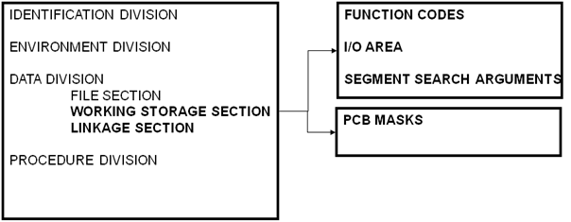
COBOL
Structure of COBOL Program
Drawbacks of this structure
No dynamic allocation of data
Single thread of execution

Slide 4
Overview of Problem
Structural issues are categorized as
Impedance mismatch
Inappropriate program conversions
Technical Problems are categorized into four
eager object allocations
exceptions in normal control
flows, reflections in common paths
inappropriate use of the Java class library

Slide 5
Major Contributions
Identify performance bottlenecks and pitfalls that easily slip into large scale Java applications translated from COBOL
Detailed experimental evaluations showing significant performance overheads caused by those problems

Slide 6
Limitations of Current Solutions
Cobol
History
Cobol 60 - 1959
Limitations
Memory allocation
High cost to maintaining the mainframes
Lack of developers

Slide 7
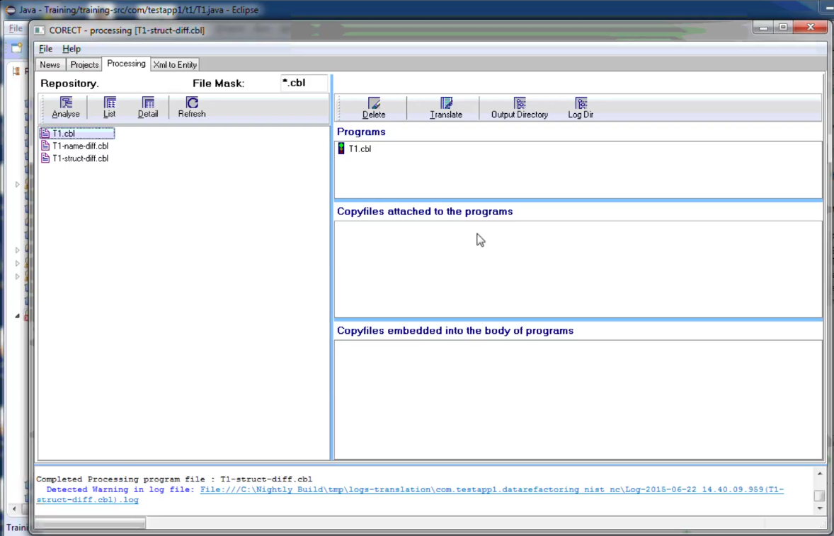
Limitations of Current Solutions
Software Mining Translator. How it works?

Slide 8
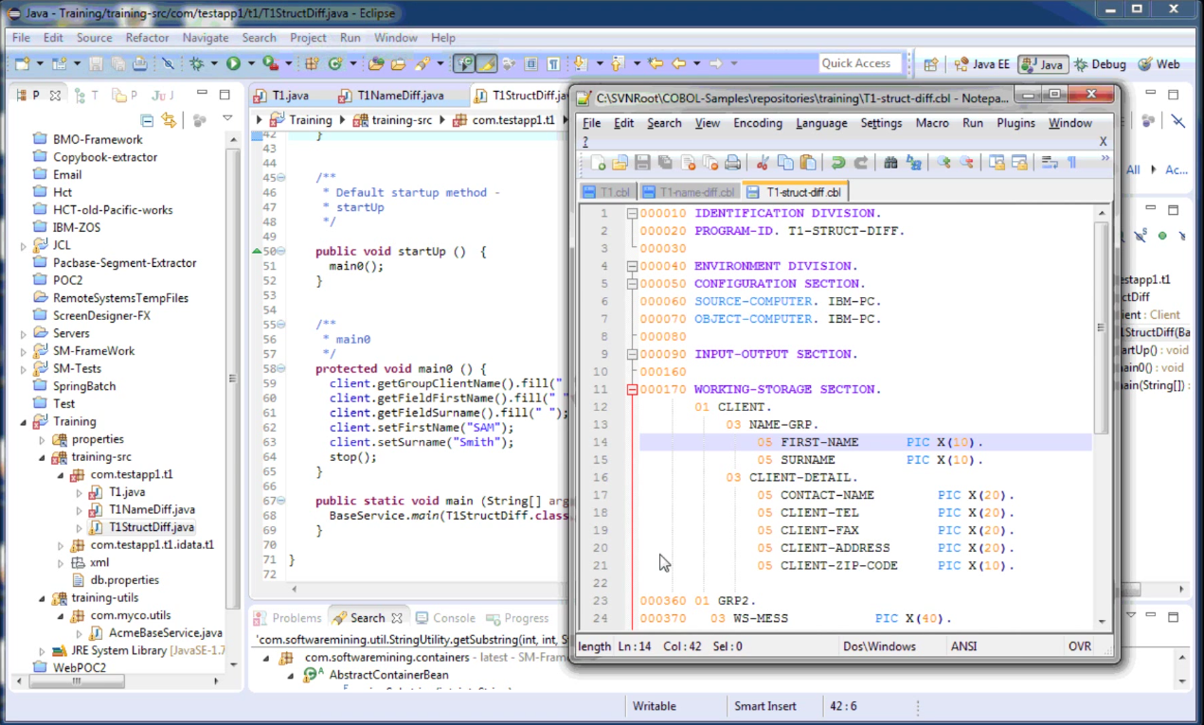
Limitations of Current Solutions
Software Mining Translator. How it works?

Slide 9
Limitations of Current Solutions
Translation problems
Convert Variables
Typed x Untyped
Fix converted and complete the code
Documentation
Long-term Maintanence

Slide 10
Technical Limitations
Closer look at COBOL

Slide 11
Technical Limitations

Slide 12
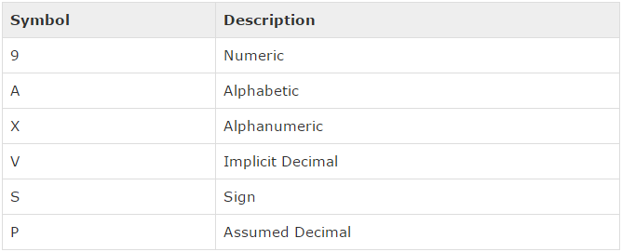
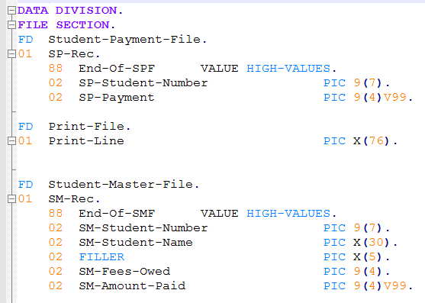
Technical Limitations

Slide 13
Technical Limitations
Eager Object Allocations
String initialization and reinitialization

Slide 14
Technical Limitations

Slide 15
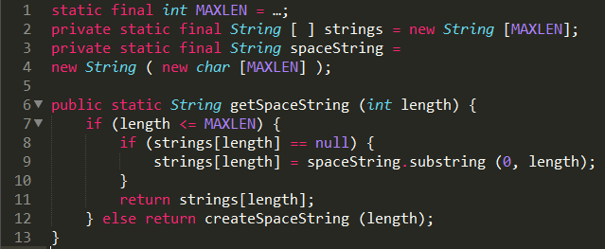
Technical Limitations
Authors’ solution:

Slide 16
Technical Limitations
Eager Object Allocations
String initialization and reinitialization
BigDecimal and its initialization

Slide 17
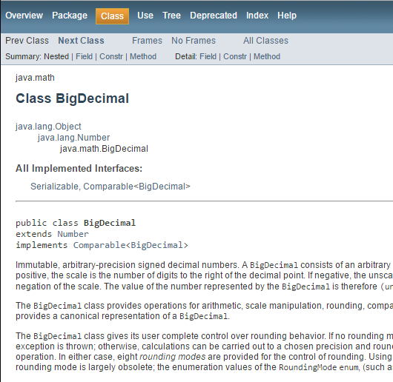
Technical Limitations

Slide 18
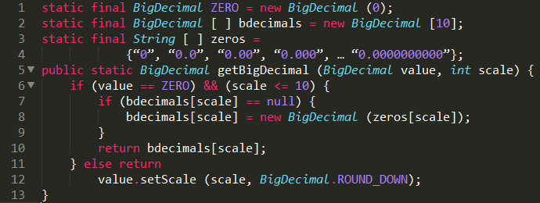
Technical Limitations
Authors’ solution:

Slide 19
Technical Limitations
Eager Object Allocations
String initialization and reinitialization
BigDecimal and its initialization
Class constructor and arrays

Slide 20
Technical Limitations
Inappropriate Calls to Class Libraries

Slide 21
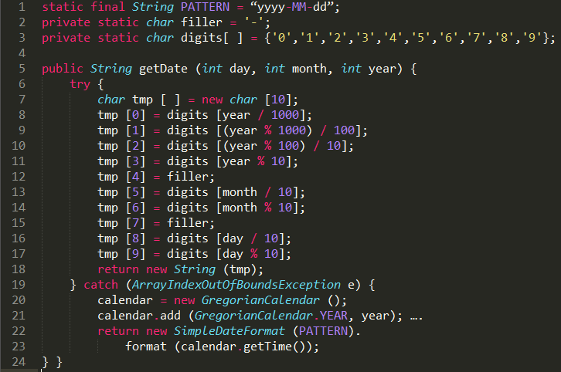
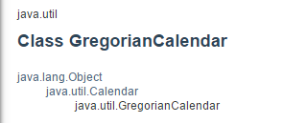
Technical Limitations
Authors’ solution:

Slide 22
Experimental Results
Authors looked into the performance problems of a large Java middleware system that was translated from an original COBOL version
Fixing eager object allocations is particularly effective for large tansactions

Slide 23
Conclusion
As mentioned in the paper:
using translators may generate a code with many bugs which opens the door for security problems.
Good (secure) COBOL code may lead to bad JAVA code, if translated using translators
Security vulnerabilities and database breaches may occur.

Slide 24
Conclusion
To overcome this, the translation process can either be adjudicated by a long-term monitoring by developers
Or, the developers need to hardcode the translation by themselves ( very expensive)

Slide 25
Proposed Solution
Program analysis can estimate potential executions of a code (both dynamic and static)
Therefore, such tools can help detecting bugs and security vulnerabilities.
Implementing dynamic analysis tools on the JAVA code after translation to dynamically identify bugs during the run-time.
On the other hand, running dynamic analysis tool on COBOL code may give some insights and facilitate the translation procedure. For example, analyzing a COBOL code before translation.
It’s worth mentioning that Dynamic analysis and translation is much more complicated than static analysis.

