Slide 1
Tweeting Propaganda, Radicalization and Recruitment:Islamic State Supporters Multi-Sided Twitter Networks
Akemi Takeoka Chatfield, Christopher G. Reddick, Uuf Brajawidagda
Presented By: Abel Jose, Adarsh Pillay, Deepak Begrajka, Rudra Gupta

Slide 2
CONTENT
Background
Introduction
Framework
Research Methodology
Experiments Performed
Results
Project Proposal
Conclusion

Slide 3
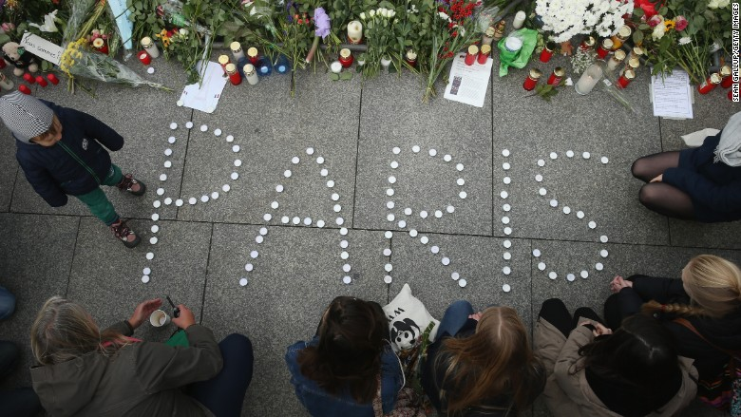
BACKGROUND- Attack 1
Paris Attack, November 2015

Slide 4
Attack 2
San Bernardino Attack, December 2015

Slide 5
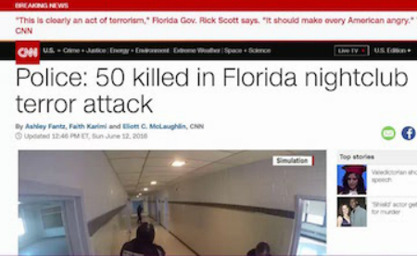
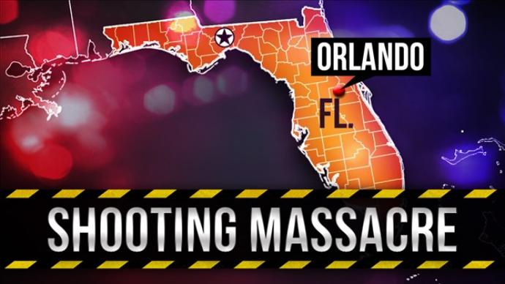
Attack 3
Orlando Attack, June 2016

Slide 6
COMMON ELEMENTS
TERRORISM
HOMEGROWN TERRORISM
RELATIONSHIP WITH ISIS
COMMUNICATION WITH ISIS
SOCIAL MEDIA

Slide 7
INTRODUCTION
- Ex-President Barack Obama earlier referred to Islamic State (IS) – Islamic terrorist networks of predominantly Sunni Muslim extremists, foreign fighters, and sympathizers – as a “Junior Varsity” version of Al Qaeda”.
- Since then the rapid rise and resilience of the IS militants in Syria and Iraq against the US led coalition of 60-plus nations, however, seems to pose a serious threat.
- IS is World’s richest terrorist group and their main funding comes from illegal revenue generated from oil fields, also bank assets in their city.

Slide 8
Two Reasons for Concerns
- First:
Both al-Qaeda and IS hold the political goal of establishing a new Islamic state (or “caliphate”) where Sharia law is the highest authority and jihad is sanctioned.
- Second:
Al-Qaeda exploits mass media and the Internet for terrorism propaganda.
IS use social media to lure younger Muslims and the Westerners alike to fight with its IS multi-ethnic force in Syria and Iraq.

Slide 9
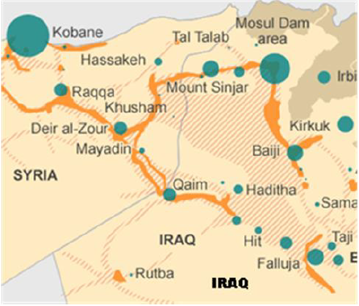
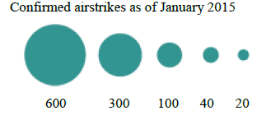
AIR STRIKES
2014 UNSC report shows 15,000 foreign fighters recruited by ISIS from 80 countries to fight in Syria and Iraq.
- CIA predict 20,000-31500 fighters recruited.
IS control of Syria and Iraq

Slide 10
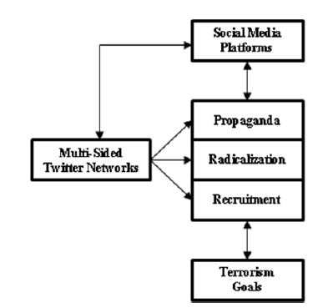
FRAMEWORK
Framework for multi-sided Twitter networks in the global Islamic terrorist communication environment

Slide 11
FRAMEWORK (Contd.)
Propaganda is defined as information, especially of a
biased or misleading nature, used to promote a political cause or
point of view.
Radicalization is defined as increasing extremity of
beliefs, feelings, and behaviors in support of intergroup conflict
and violence.
Terrorist Recruitment is defined as enticing other,
similarly situated young men, to join them in terrorizing and
fighting the jihad war

Slide 12
RESEARCH METHODOLOGY
KEYWORDS
How do IS members/supporters use Twitter for terrorism communication: propaganda, radicalization, and recruitment?
“propaganda AND (terrorism or terrorist)”
“radicalization AND Islam”
“radicalization AND ‘Islamic extremism’”
"terrorist recruitment"

Slide 13
EXPERIMENTS PERFORMED
@shamiwitness
Types of Analysis Performed
Trend Analysis
Content Analysis
Social Network Analysis
Analyzed @shamiwitness tweets from Oct 6 to Oct 27, 2014 which were a total of 3,039 tweets.

Slide 14
RESULTS
60% were RT’s & 40% were his own
Daily Work Rate - 16 Hours 9 minutes
57 Tweets of his own and 138 retweets on an average per day
TREND ANALYSIS

Slide 15
RESULTS (contd.)
Multi-sided Twitter networks of users mentioned in @shamiwitness tweets

Slide 16
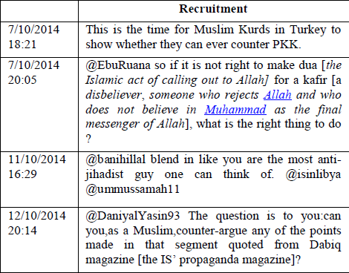
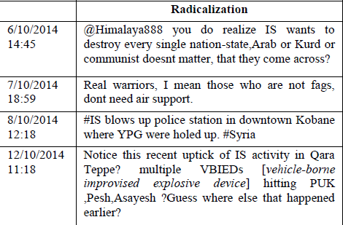
SAMPLE TWEETS

Slide 17
Project Proposal
What problems are we trying to address?
Inconclusive or inefficient methods of catching and preventing homegrown terrorists
Extremists from other countries work to recruit individuals in the US through social media
Primarily Twitter
Even if an account is deactivated users can create a new profile and continue their practices
Notes:
The problem we are trying to address:
Currently the methods used to identify or stop cyber terrorists is sparse
Investigation and prevention methods tend to be focused on rooting out extremists who have already been radicalized and are in the country. We want to focus on working to eliminate external terrorists who work to spread hateful propaganda and recruit in different countries through social mdeia (specifically Twitter). Many of these individuals are persistent

Slide 18
Project Proposal (contd.)
Solution : Create an efficient content moderation system aimed specifically at radicalization and recruitment on twitter
How: Graph pattern matching
Investigative simulation
Analyze a series of terrorist profiles and create graphs where the node is the terrorist user profile and edges are connections to their tweets, retweets, profile descriptions
Match these graphs to an “ideal graph” of an online terrorist
Notes:
Our proposed solution is to create a specialized content moderation system aimed at cyber terrorists who use twitter as their recruitment and radicalization grounds.
We hope to do this by using an investigative simulation approach to graph pattern matching. Which is basically a process for searching for and prioritizing persons of interest who may exhibit part or all of a pattern of suspicious behaviors or connections.

Slide 19
Project Proposal (contd.)
Novelty
Create a predictive analyzer
Train a model using all created cyber terrorist graphs
Monitor new user profiles and tweets
Report known or highly suspected cyber terrorists to twitter content mods
Receive feedback and use it to strengthen our model
Notes:
We will then use the graphs that we have in order to train a predictive analysis model. This model will take in a user profile along with relevant connections and give a prediction of how similar this is to a previous profile or just a general profile of a cyber terrorist. Once an individual is selected they are added to a database and if we find enough evidence to assume that the individual has connections to terrorist groups we will report to Twitter content moderators. Hopefully they will block the account .

Slide 20
CONCLUSION
The research paper calls for urgent attention to have a look on the potential power of multi-sided Twitter networks in more effectively and more efficiently promoting the radical Islamic propaganda, radicalization, and recruitment messages to the global audiences.
It is limited here by focusing on @shamiwitness and his Twitter networks.

Slide 21
QUESTIONS ?

