Slide 1
Detection of Misinformation on Online Social Networking
Group Members:
Sunghun Park
Venkat Kotha
Li Wang
Wenzhi Cai

Slide 2
Outline
Problem Overview
Current Solutions
Limitations of Current Solutions
Conclusion
Our Solution

Slide 3
Problem Overview

Slide 4
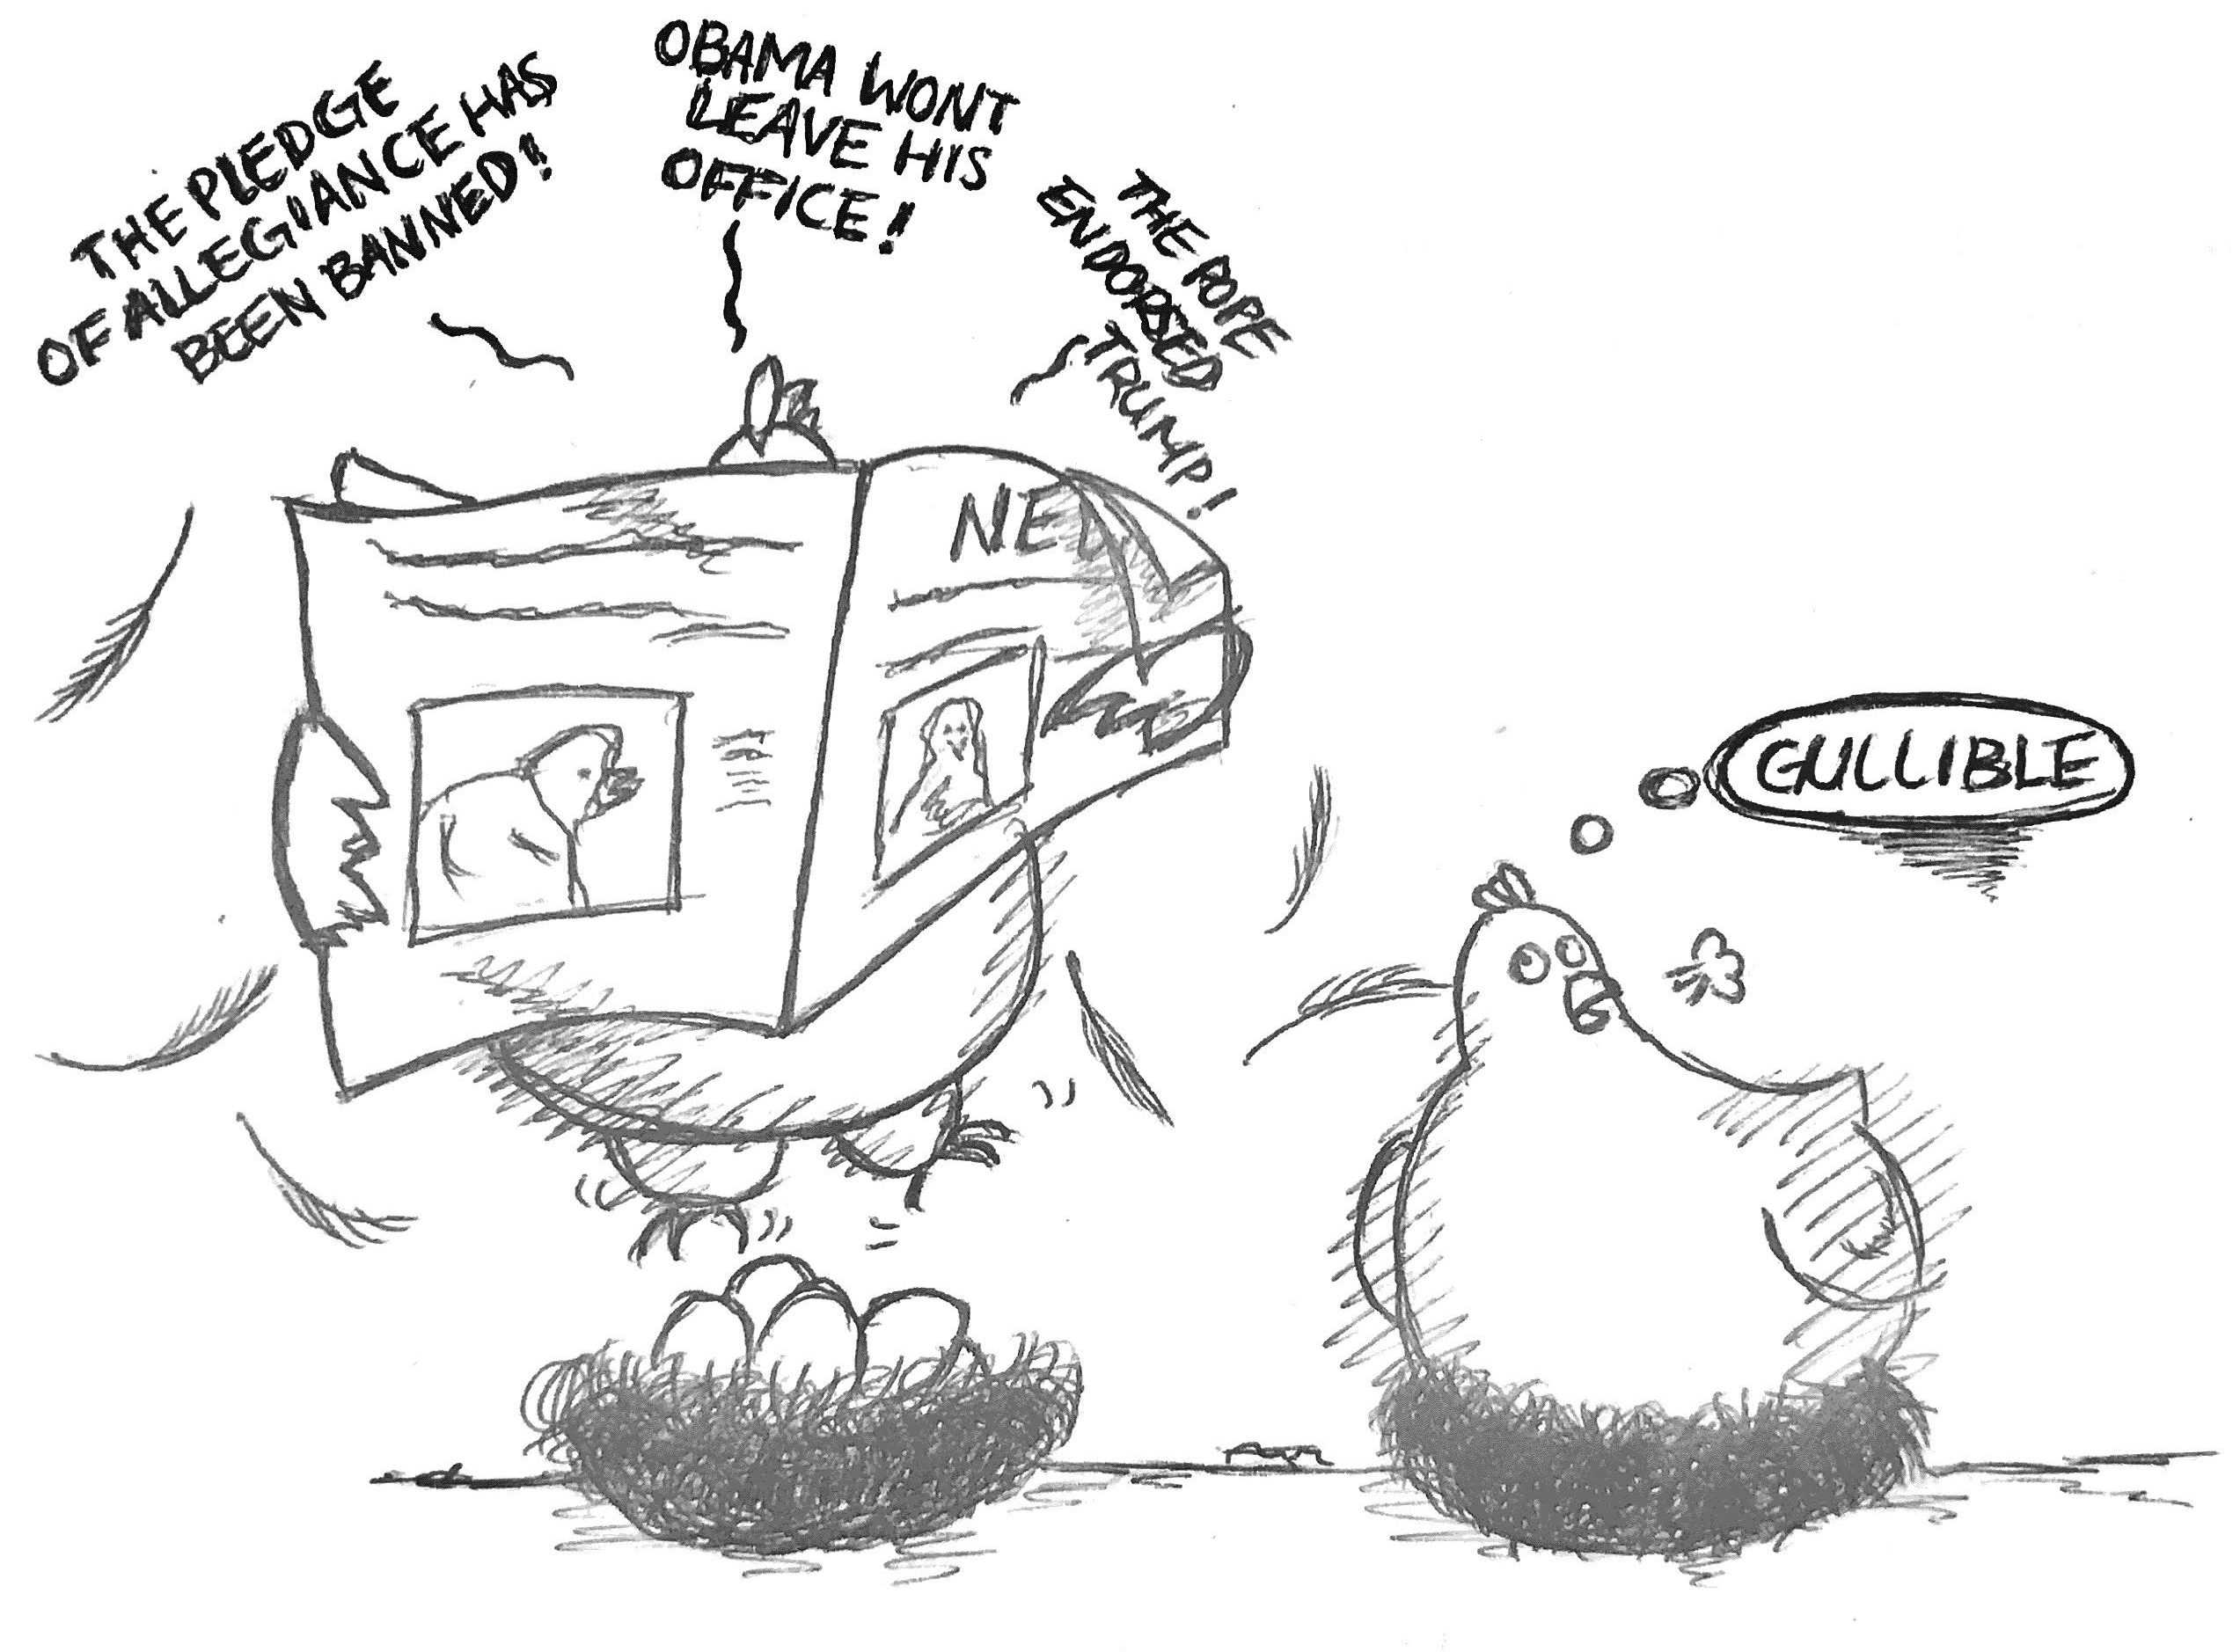
What is MISINFORMAION?
Misinformation: False or incorrect information
Purpose: Affect the perception of people
Notes:
Misinformation is false or incorrect information, it can be spread intentionally or unintentionally (without realizing it is untrue)

Slide 5
Problem Overview:
The large use of Online Social Networking has provided fertile soil for the emergence and fast spread of rumors.
It is difficult to determine all of the messages or posts on social media are truthful.
Fake news harms to real life.

Slide 6
Sweden signed the deal to become a member of NATO??
Defend Misinformation!
PepsiCo CEO indra Nooyi told Trump fans to “take their business elsewhere”

Slide 7
How to detect misinformation?
“As Obama bows to Muslim leaders Americans are less safe not only at home but also overseas. Note: The terror alert in Europe... ”
b. “RT @johnnyA99 Ann Coulter Tells Larry King Why People Think Obama Is A Muslim http://bit.ly/9rs6pa

Slide 8
Current Solutions
100,000

Slide 9
Current Solutions:
Linguistic approaches
Data Representation
Deep Syntax
Semantic Analysis
Rhetorical Structure and Discourse Analysis
Classifers

Slide 10
Linguistic Cues to Deception in Online Dating Profiles
Measures:
Emotional linguistic cues:
H1: Fewer self-references ;
More negations and negative emotion words
Effects of media affordances on cues:
H3: Emotionally-related linguistic cues to deception should account for more variance in deception scores than cognitively-related linguistic cues in online dating profiles.
Cognitive linguistic cues:
H2: Fewer exclusive words; Increased motion words;
A lower overall word count
Deception index:
Absolute deviations from the truth were calculated by subtracting observed measurements from profile statements.
Standardize and average the deviations.
2) Accuracy of textual self-descriptions:
Participants rated the accuracy of the self-
description on a scale from 1 to 5.
3) Linguistic measure:
Self-description → Text File → Run through LIWC → Indicate the word frequency for each category

Slide 11
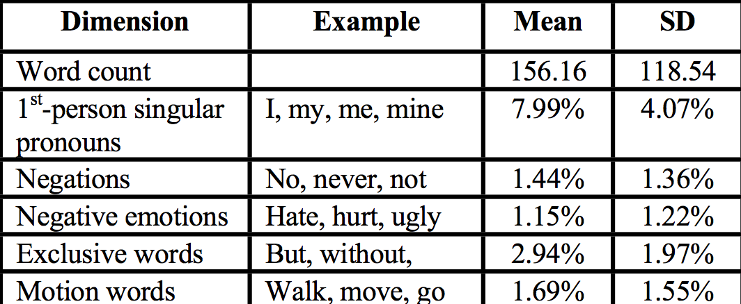
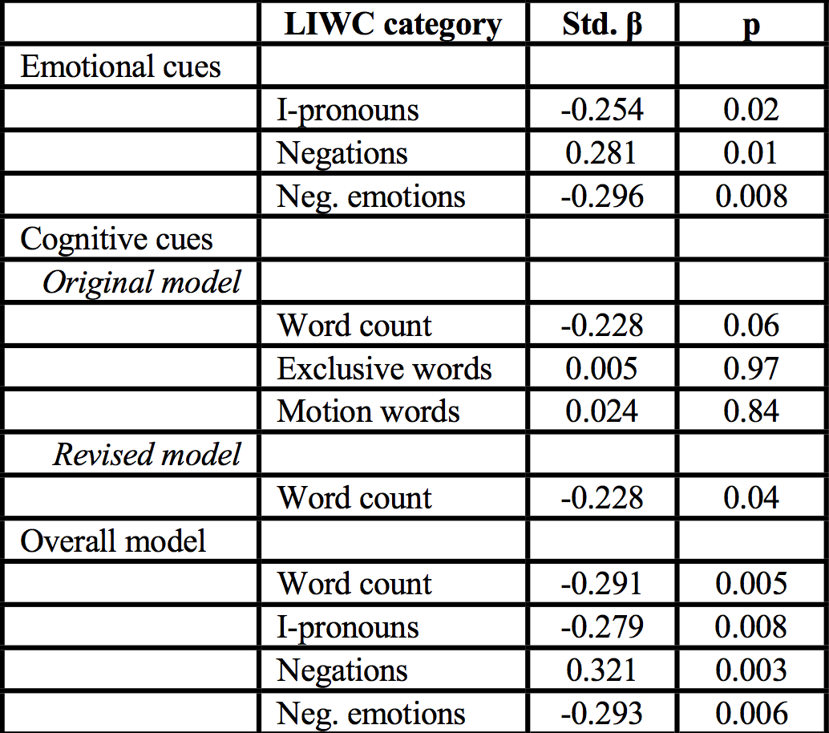
Analysis: Regression model
1) Word Frequency in LIWC:
2) Regression model for linguistic indicators
All of the hypothesized emotional cues were significant predictors of the deception index, but the only reliable cognitive cue was word count.

Slide 12
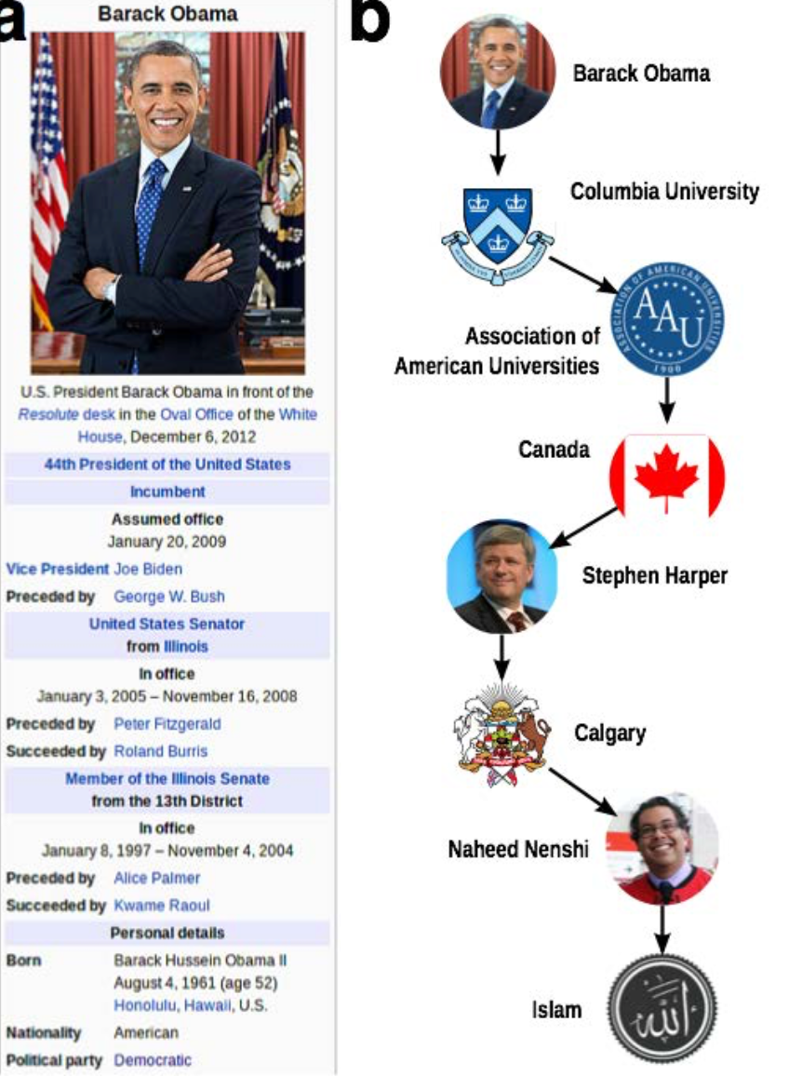
2) Network Approaches:
Linked Data
Fact-checking methods
Leverages an existing body of collective human knowledge
Query existing knowledge network, or publicly available structured data

Slide 13
Limitations of Current Solutions

Slide 14
Time Sensitivity
Quality vs Quickness
Operate in a retrospective manner
Results in the delay between the publication and detection of a rumor
Latency aware rumor detection

Slide 15
Clustering data by keywords using an ensemble method that combine user, propagation and content-based features could be effective.
Computation of those features is efficient, but needs repeated responses by other users.
Results in increased latency between publication and detection.

Slide 16
Accuracy
Current studies focus on improving accuracy, but the accuracy of current techniques is still below 70%.
Ambiguity in the language
Evolving usage of Language:
e.g. Emoticons, Symbols
Difficulty in classification

Slide 17
Other Drawbacks
Most models are specific to some networks
Identification of only small percentage of fake data
Need more features

Slide 18
Technical Limitations
Mainly concentrate on two specific technical problems
1. How can we detect the signal of misinformation early?
2. How can we improve the accuracy?

Slide 19
Conclusion

Slide 20
Linguistic and network-based approaches have shown relatively high accuracy results in classification tasks within limited domains.
Previous studies provide a basic topology of methods available
New tool - Refine, Evolve and Design
Hybrid System - Techniques arising from disparate approaches may be utilized together.

Slide 21
Our Solution

Slide 22
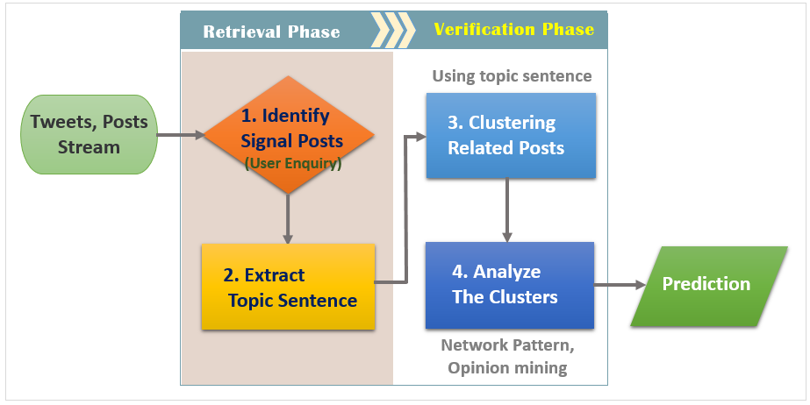
Our Proposed Solutions

Slide 23
Identifying Signal Posts
The utilization of users’ enquiries and corrections as the signal.
Training a support vector machine (SVM) with the language features and sentiment features.
Language features: the signals can be detected by Natural Language Process (NLP) with a Part-of-Speech (POS) tagging technique for different types of language components.
Sentiment features: modern sentiment classifiers are able to determine positive, negative and neutral sentiments for the writings in social media.

Slide 24
Extracting Topic Sentence
It is inefficient to extract valuable information from a single tweet using NLP because of grammatical complexity and newly coined words.
Most of the rumors spreading out on social networks will have the same or similar contents.
Clustering the signal posts with high similarity

Slide 25
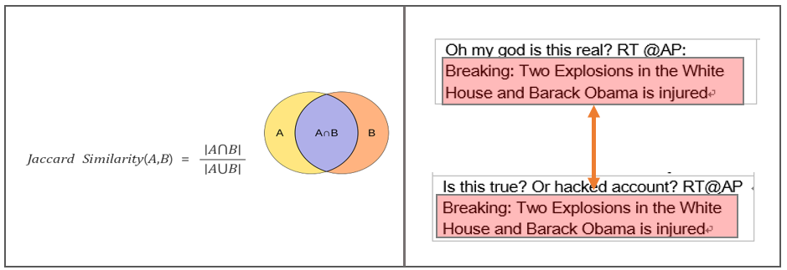
Jaccard Similarity Method
Text Summarization (TS) algorithms like LexRank, which identifies the most important sentence in a set of documents could be used to summarize the main topic from our signal cluster with high accuracy.

Slide 26
Analysis of Cluster
Category | Description
Network features | ∙ Number of fake and bots accounts
Opinion features | ∙ Degrees of positive/negative/sad/anxious/surprised emotion
Timing features | ∙ Numbers of tweets created in given time interval ∙ Ratio of retweets or sharing ∙ The distributions of the interval between two consecutive events

Slide 27
Thank you!

