Slide 1
CSCE 590 April 21, 2020
Business Plan
Final Project Report

Slide 2
Lecture materials
Chapters 2, 7

Slide 3
Recap: Cost and Value
Perceived value
Influences sale
Price
Cost
$

Slide 4
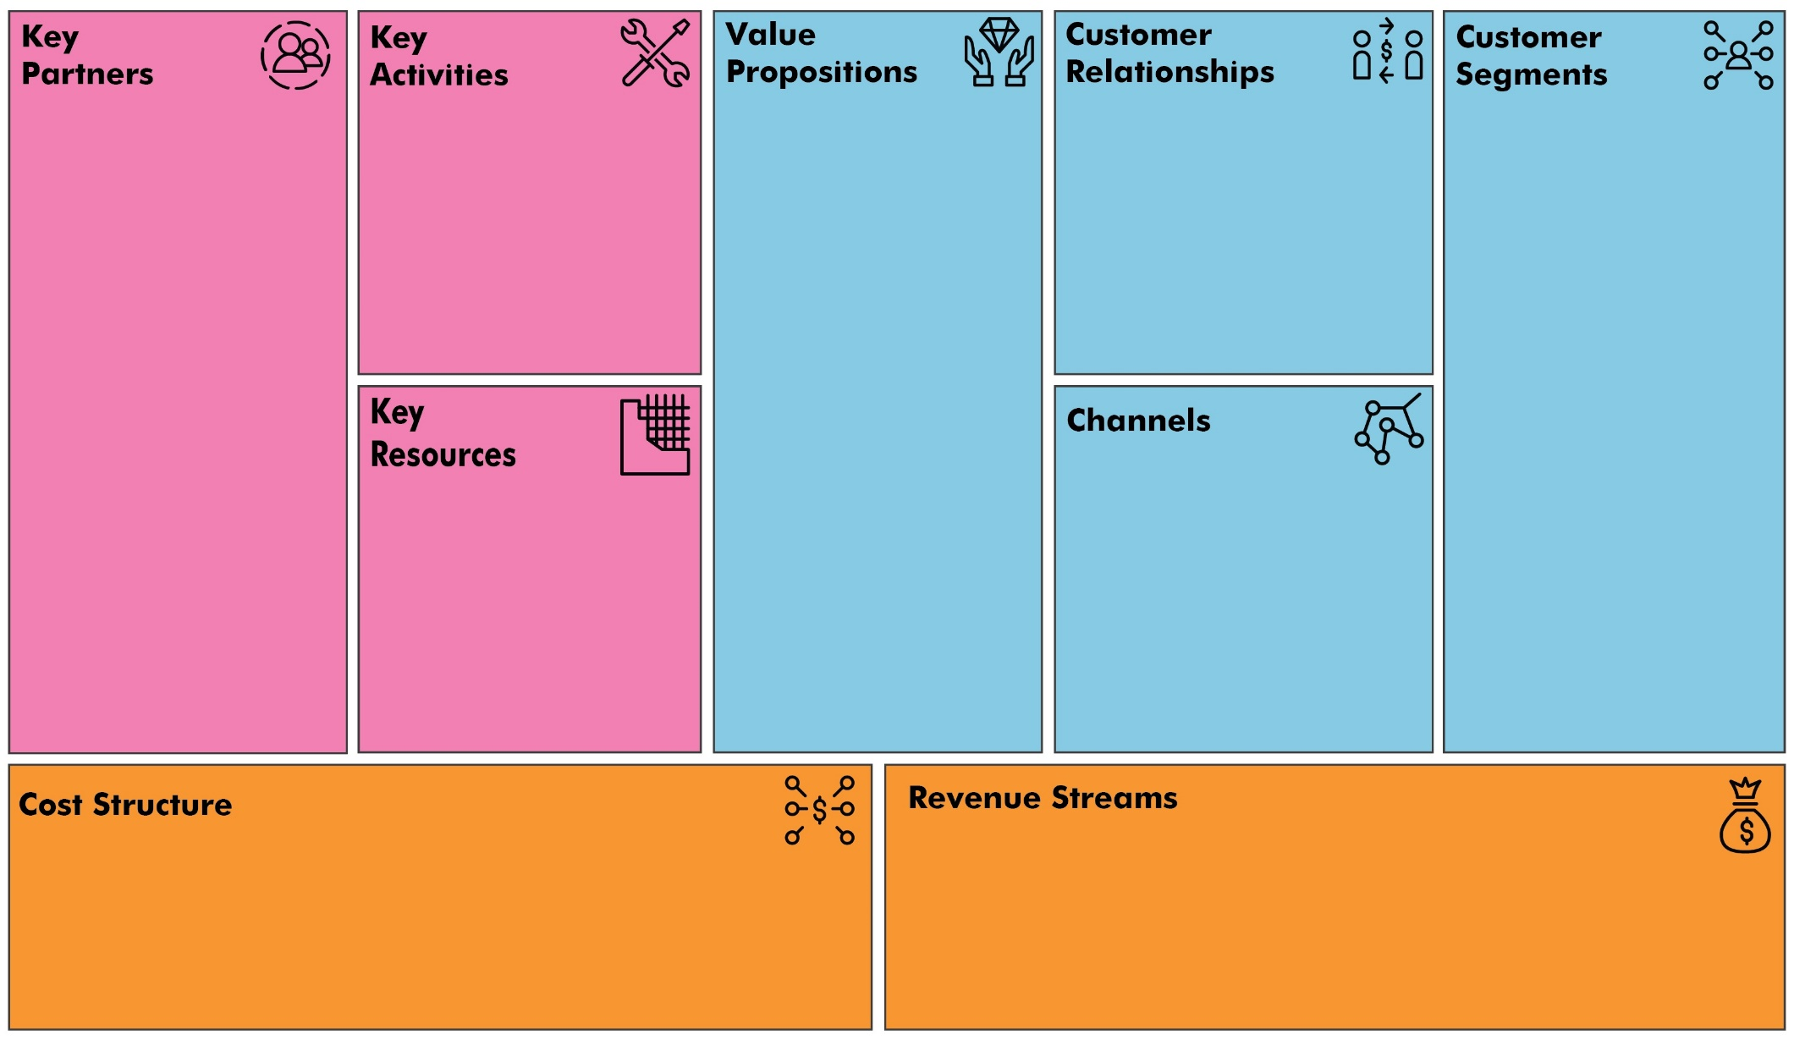
Business Model Canvas
Source: https://www.thestrategygroup.com.au/business-model-canvas/

Slide 5
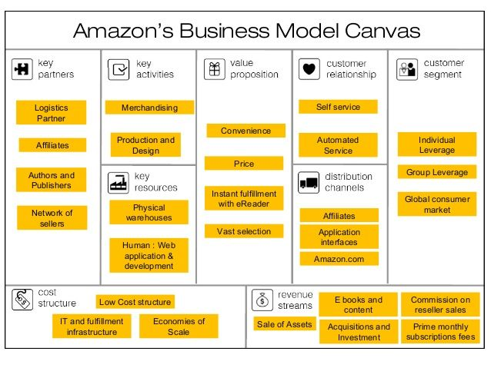
Business Model Canvas Example
Source: https://www.thestrategygroup.com.au/business-model-canvas/

Slide 6
Elements of Business Plan
Section 1
Section 2
Section 3

Slide 7
Final Report Content
Business Plan – 90 points
Section 1
Title page
Table of content
Executive summary
Section 2
Description of business including Business Model Canvas
Description of industry
Technology plan
Marketing plan
Financial plan
Product outsourcing plan
Organization plan
Operational plan
Summary

Slide 8
Group Member Evaluations
Each student should submit the following table: (1 worst, … , 10 best score)
EvaluationcCriteria | self | Name of group member 1 | Name of group member 2 | Name of group member 3 | Name of group member 4 | Name of group member …
Attended group meetings regularly and promptly. Responded to communications in a reasonable timeframe.
Contributed meaningfully to group discussions. Let others contribute meaningfully.
Completed group assignments on time.
Prepared work in a quality manner.
Did fair share of work
Total

Slide 9
Final Report Score
Max. 100
90 points from final report
10 points: AVG(self and group members evaluation)

Slide 10
Next Class
Project discussion individual groups
Contact farkas@cse.sc.edu for time and mode of group discussion

