Slide 1
MDScript+: Analysis of iPad for Physician Use and Secure Application Development
Latasha A. Gibbs
Johnathan Benton
Amanda Stephenson
April 11, 2012
University of South Carolina
College of Engineering and Computing
Computer Science and Engineering Department

Slide 2
AGENDA
Introduction
Problem Description
Related Work
Risk Management Framework
Proposed Solutions
Conclusion

Slide 3
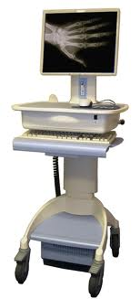
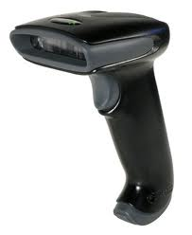
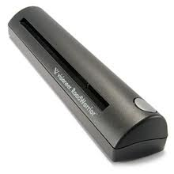
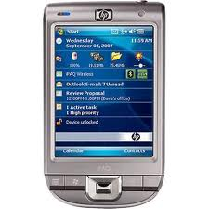
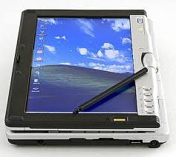
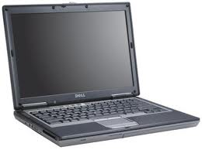
Mobile Devices in Healthcare Today

Slide 4
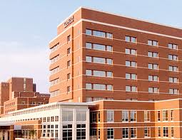
PROBLEM DESCRIPTION

Slide 5
HIPAA
Enacted by United States Congress and signed by Bill Clinton in 1996
Title I-protects health insurance coverage for workers and their families when they change or lose their jobs
Title II-Requires the establishment of national standards for electronic health care transactions, health insurance plans, employers, and national identifiers for providers
Notes:
Health Insurance Portability and Accountability Act includes policies and procedures designed to clearly protect the privacy of personal health information (on paper or electronic). Includes administrative, physical, and technical safeguards. “Under HIPAA, there is no such thing as implied authorization.”

Slide 6
What does this mean?
Changing the way health care operates
Increase in the amount of paper work
High implementation Costs
Patient privacy concerns
Stiff penalties for non-compliance and breaches

Slide 7
HITECH Act-Subtitle D
Enacted as a part of the American Recovery and Reinvestment Act of 2009
Extended to include business associates of covered entities
Extended to include information that is used to carry out treatment, payment, and health care operations when using an EHR
Notes:
New changes include new breach notification requirements on covered entities.

Slide 8
CONCERNS
Why do we care?
Writing daily instead of weekly
No signature
Supply and reimbursement issues
Prescriber violations
Side effects
Medication-related injuries

Slide 9
Categories of E-Prescribing Systems
Standalone Software Systems
Integrated EMR
Workstations that running e-Prescribe software applications in a health care facility
Applications running on mobile devices that have handwriting capabilities
E-Prescribe software application is integrated into a health information system
can be directly linked to a computerized medical record

Slide 10
RISKS
Business Risks
Technical Risks
Loss or Stolen iPad
Physical Damage
Loss of Patient Trust
HIPAA Violations
Low acceptance
Unauthorized Logon
Spoofed Prescription or Spoofed Physician Note
Prescription Modification
Web Server susceptible to DoS attack

Slide 11
HAPPY DAY SCENARIO

Slide 12
MISUSE

Slide 13
AGENDA
Introduction
Problem Description
Related Work
Risk Management Framework
Proposed Solutions
Conclusion

Slide 14
RELATED WORK
Voice-Based Mobile Prescription Application
Natural Interaction
Benefits from Cellular Network Coverage
Extensive development skills
3-Tier Client Server Architecture (Client, Server, and Backend MySQL database
Web server acts as the data warehouse

Slide 15
EXISTING APPLICATIONS
eDoctor – FREE
Allscripts Remote + – FREE
Rx-Writer – FREE
ScriptPad – $0.99
5 Ratings
9 Ratings
80 Ratings
21 Ratings

Slide 16
AGENDA
Introduction
Problem Description
Related Work
Risk Management Framework
Proposed Solutions
Conclusion

Slide 17
Risk Management Framework
MDScript +
Business Context
Business and Technical Risks
Synthesize and Prioritize Risks
Risk Mitigation Strategies
Carry Out and Validate Mitigation Strategies

Slide 18
MDScript + Business Context
Business Goals:
Provide a stand alone prescription management solution that assists physicians streamline the process of writing prescriptions and maintaining patient medication history.
Provide a secure method for healthcare professionals to send prescriptions directly to a participating pharmacy.
The MDScript+ iPad application should be developed with a clean and self explanatory user interface which will require minimal training.
MDScript+ should help improve healthcare practices’ bottom line by providing a low cost, feature rich, and resource efficient software product.
Assist physicians to deliver a service which offers best-in-class patient safety.
Ensure that MDScript+ web server maintains as high a percentage of availability as feasibly possible.
Provide an iPad applicatinon that can ensure the integrity of patient records , and records maintain 100% accuracy. (Our software doesn’t create the errors)

Slide 19
REQUIREMENTS
What do you need?
Mac OS X
Apple iOS SDK 5
Xcode 4
Objective C
Apple Instruments
*Optional Static Analysis Tools –
Flawfinder and Clang

Slide 20
APPLE SECURITY
Apple Bug Reporter can be used by all Apple Developers
Encrypted Keychain used for password management
Hashing algorithm
Code Signing for verification

Slide 21
AGENDA
Introduction
Problem Description
Related Work
Risk Management Framework
Proposed Solutions
Conclusion

Slide 22
Access Control
Access Control
Assigns and enforces privileges to authorized users
Simple way to incorporate access control:
-unique usernames
-passwords

Slide 23
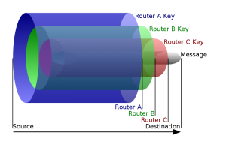
Darknet
Darknet- hidden under cover network. The term refers to any private, distributed network, where connections are made only between trusted peers- sometimes called "friends" (F2F)-using non-standard protocols and ports or using onion routing.
Onion Routing –Each onion router removes a layer of encryption to uncover routing
instructions and sends the message
to the next router and the process
is repeated
Example: The anonymous remailer software
Mixminion

Slide 24
SSL
Secure Socket Layer
A.K.A.-Transport Layer Security
Protocol used to encrypt data as it goes through a connection
-validates users through certificates
-ensures that the data hasn’t been tampered through message authentication codes

Slide 25
AGENDA
Introduction
Problem Description
Related Work
Risk Management Framework
Proposed Solutions
Conclusion

Slide 26
CONCLUSION
Leveraging a risk management framework improve overall software security
Standalone solution appears to be more feasible for environments that have implemented an HIS
Mobile devices like the iPad and iPhone are invevitable!

Slide 27
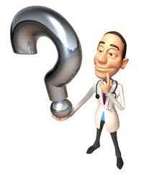
Questions, Concerns, Comments…

Slide 28
THANK YOU!

