Slide 1
Web Application Security Concerns

Slide 2
Web Evolution
Past: Human usage
HTTP
Static Web pages (HTML)
Current: Human and some automated usage
Interactive Web pages
Service Oriented Architecture (WSDL, SOAP, SAML)
Semantic Web (RDF, OWL, RuleML, Web databases)
Future:
Mobile Technology
Semantic Web Services

Slide 3
Web Applications
Goal: enable autonomous and distributed entities to collaborate efficiently, reliably, cost-effectively, and comply with regulations
Characteristics: open and heterogeneous environment, loose coupling, code reuse, standard-based interfaces, platform independent & language neutral
Support for:
Data & Information Sharing
Mobile application
Automated processing – Web with a meaning
Express business logic

Slide 4
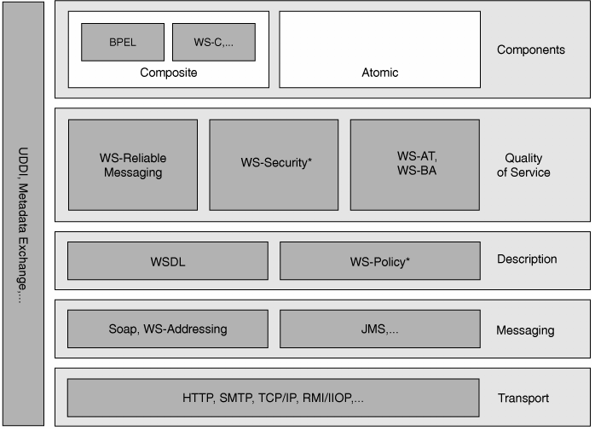
Standards
Web Services Platform Architecture, ISBN-10: 0131488740, pg 34
Courtesy of P. Buhler

Slide 5
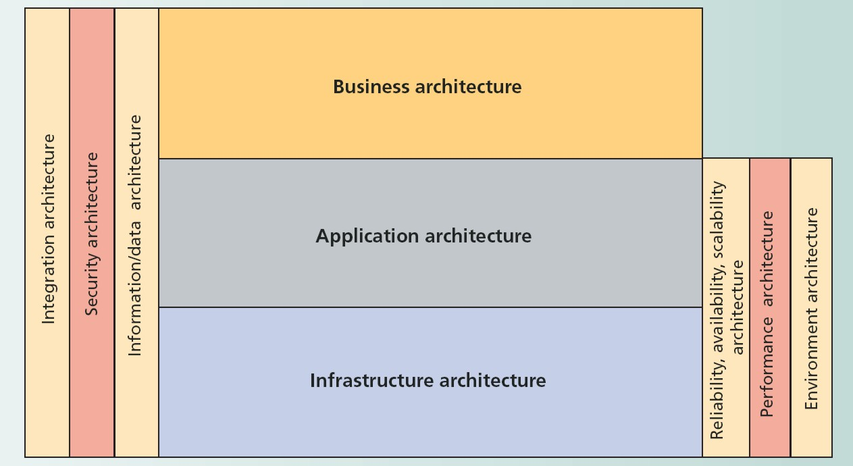
Layered Model
March/April 2007, IT Pro Magazine, “The Role of Solution Architects in Systems Integration”
Courtesy of P. Buhler

Slide 6
SOA Security Components
Data-level security
Software-level security
Business level security
Network-level security

Slide 7
Web Data and Metadata Security

Slide 8
Secure XML Views - Example
<medicalFiles> UC
<countyRec> S
<patient> S
<name>John Smith </name> UC
<phone>111-2222</phone> S
</patient>
<physician>Jim Dale </physician> UC
</countyRec>
<milBaseRec> TS
<patient> S
<name>Harry Green</name> UC
<phone>333-4444</phone> S
</patient>
<physician>Joe White
</physician> UC
<milTag>MT78</milTag> TS
</milBaseRec>
</medicalFiles>
medicalFiles
countyRec
milBaseRec
physician
Jim Dale
physician
Joe White
milTag
MT78
patient
patient
name
John Smith
phone
111-2222
name
Harry Green
phone
333-4444
View over UC data

Slide 9
Secure XML Views - Example cont.
medicalFiles
<medicalFiles>
<countyRec>
<patient>
<name>John Smith</name>
</patient>
<physician>Jim Dale</physician>
</countyRec>
<milBaseRec>
<patient>
<name>Harry Green</name>
</patient>
<physician>Joe White</physician>
</milBaseRec>
</medicalFiles>
countyRec
milBaseRec
physician
Jim Dale
physician
Joe White
patient
patient
name
John Smith
name
Harry Green
View over UC data

Slide 10
Secure XML Views - Example cont.
medicalFiles
<medicalFiles>
<tag01>
<tag02>
<name>John Smith</name>
</tag02>
<physician>Jim Dale</physician>
</tag01>
<tag03>
<tag02>
<name>Harry Green</name>
</tag02>
<physician>Joe White</physician>
</tag03>
</medicalFiles>
countyRec
milBaseRec
physician
Jim Dale
physician
Joe White
patient
patient
name
John Smith
name
Harry Green
View over UC data

Slide 11
Secure XML Views - Example cont.
medicalFiles
<medicalFiles> UC
<countyRec> S
<patient> S
<name>John Smith</name> UC
</patient>
<physician>Jim Dale</physician> UC
</countyRec>
<milBaseRec> TS
<patient> S
<name>Harry Green</name> UC
</patient>
<physician>Joe White</physician> UC
</milBaseRec>
</medicalFiles>
countyRec
milBaseRec
physician
Jim Dale
physician
Joe White
patient
patient
name
John Smith
name
Harry Green
View over UC data

Slide 12
Secure XML Views - Example cont.
medicalFiles
<medicalFiles>
<name>John Smith</name>
<physician>Jim Dale</physician>
<name>Harry Green</name>
<physician>Joe White</physician>
</medicalFiles>
physician
Jim Dale
name
John Smith
physician
Joe White
name
Harry Green
View over UC data

Slide 13
Secure XML Views - Solution
Multi-Plane DTD Graph (MPG)
Minimal Semantic Conflict Graph (association preservation)
Cover story
Transformation rules

Slide 14
Multi-Plane DTD Graph
MPG = DTD graph
over multiple
security planes
<milBaseRec>
<milTag>
TopSecret
D,medicalFiles
UC
<countyRec>
S
TS
<patient>
D, countyRec
D, milBaseRec
Secret
<phone>
UC
S
TS
D, physician
D, patient
D, milTag
<physician>
<name>
UC
S
<medicalFiles>
D, name
D, phone
Unclassified

Slide 15
Transformation - Example
<milBaseRec>
MPG
<milTag>
TS
MSCG
<countyRec>
name
phone
<patient>
S
<phone>
physician
<medicalFiles>
Security
Space
Secret
<physician>
<name>
UC

Slide 16
Transformation - Example
<milBaseRec>
<milTag>
TS
<countyRec>
name
<patient>
<phone>
S
physician
<medicalFiles>
<emrgRec>
MSCG
<physician>
<name>
UC
SP
MPG

Slide 17
Transformation - Example
<milBaseRec>
<milTag>
TS
<countyRec>
<patient>
<phone>
S
∅
<medicalFiles>
<emrgRec>
MSCG
<physician>
<name>
UC
SP
MPG

Slide 18
Transformation - Example
<milBaseRec>
<milTag>
TS
medicalFiles
<countyRec>
<patient>
emergencyRec
<phone>
S
physician
name
<medicalFiles>
<emrgRec>
Data Structure
<physician>
<name>
UC
SP
MPG

Slide 19
Delete - Example
Report
P
Title
P
Data
P
Date
P
?
Temperature
P
Images
S
Water Resources
S
Concrete Location
S
Civil Area
S
Defense Sector
TS

Slide 20
Delete Operations
Delete entire sub-tree under a deleted node
Most widely used approach
Problem: blind write
Delete only the viewable nodes
Problem: fragmentation of XML tree
Reject the delete
Problem: covert channel

Slide 21
Different Solution – Deleted Label
Basic Idea
A unique domain “Del” for deleted nodes
Change security classification of deleted node (μ_{o}, {d_{o} ∪ Del})
Perform after delete operation
Change security clearance of users, where λ_{s} = (μ_{s}, {d_{s}}) > (μ_{o}, {d_{o}}) to ( (μ_{s}, {d_{s}}) , (μ_{o}, {d_{o} ∪ Del}) )
Can be preprocessed
Use BLP axioms

Slide 22
Example - Top Secret View
Report
P
Subject clearances:
(TS, {}) → { (TS, {}) , (S, {Del}),
(P, {Del}) }
(S, {}) → { (S, {}), (P, {Del}) }
(P, {}) → { (P, {}) }
Title
P
Data
P
Date
P
Temperature
P
Images
(S,{Del})
Concrete Location
(S,{Del})
Defense Sector
TS

Slide 23
Node Association - Example
MedicalDb
*
Patient
Patient
SSN
Patient
Name
Name
Phone
Phone
Birthdate
Birthdate
Race
*
Race
Diagnosis
Date
Diagnosis
Date
Physician
Prescription
Comments
Comments
Allergies
*
Allergen
DTD of Patient Health Record

Slide 24
Layered Access Control
Object ⁻
Association level
classification
+
-
+
Node level
classification
+
+
+

Slide 25
Simple Security Object
o
∀ t_{i} : λ(t_{i}) = λ(o)
t₁
t₂
t₃
t₄

Slide 26
Association Security Object
o
∀ t_{i} : λ(t_{i}) < λ(o)
t₁
t₂
t₃
t₄

Slide 27
The Inference Problem
General Purpose Database:
Non-confidential data + Metadata →
Undesired Inferences
Semantic Web:
Non-confidential data + Metadata (data and application semantics) + Computational Power + Connectivity → Undesired Inferences

Slide 28
Association Graph
Association similarity measure
Distance of each node from the association root
Difference of the distance of the nodes from the association root
Complexity of the sub-trees originating at nodes
Example:
XML document:
Association Graph:
Public
Air show
Public, AC
fort
address
fort
address

Slide 29
Correlated Inference
Concept Generalization: weighted concepts, concept abstraction level,
range of allowed abstractions
Object[].
waterSource :: Object
basin :: waterSource
place :: Object
district :: place
address :: place
base :: Object
fort :: base
Public
fort
address
Public
basin
district
?
Confidential
base
Water source

Slide 30
Correlated Inference (cont.)
Object[].
waterSource :: Object
basin :: waterSource
place :: Object
district :: place
address :: place
base :: Object
fort :: base
Base
Place
base
place
Public
fort
address
Water source
Public
basin
district
Water Source
Confidential
base
Water source
Notes:
f

Slide 31
Inference Removal
Relational databases: limit access to data
Web inferences
Cannot redesign public data outside of protection domain
Cannot modify/refuse answer to already published web page
Protection Options:
Release misleading information
Remove information
Control access to metadata

Slide 32
Software Security

Slide 33
SOA Applications
Aggregated services → each component is vulnerable
What is the level of security provided by the aggregate?
Trust management
Security Patterns
Exception Shielding
Message Screening
Trusted subsystem
Service Perimeter Guard

Slide 34
Secure Software Development
Develop software that is free of flaws
Software engineering – functional requirements
Security, reliability, QoS – non-functional requirements
Protect against malicious code
Reading:
G. McGraw, Software Security , http://www.cigital.com/papers/download/bsi1-swsec.pdf
US National Security Agency: System Security Engineering CMM (SSE CMM), http://www.sse-cmm.org/index.html
Computer Science and Engineering
34

Slide 35
Software Security during SDLC
External Review
3. Penetration Testing
6. Security Requirements
1. Code Review
(Tools)
4. Risk-Based
Security Tests
2. Risk Analysis
7. Security
Operations
5. Abuse cases
2. Risk Analysis
Requirement and
Use cases
Architecture
and Design
Test Plans
Code
Tests and
Test Results
Feedback from
the Field
From: G. McGraw, Software Security

Slide 36
Open Web Application Security Project (OWASP)
Non-for-profit, worldwide organizations
Goal: improve the security of application software
All materials: available under a free and open software license
Common Weakness Enumeration (CWE): list of software weaknesses
Full dictionary view
Development view
Research view

Slide 37
Exception Shielding
Goal: prevent the disclosure of information about the service’s internal implementation via exception data
Problem:
Exception data released by a service may contain internal implementation details
Malicious users may exploit this data to compromise the service and its environment
Solution: replace unsafe data with data that is safe by design

Slide 38
Improper Error Handling
OWASP “A7 Improper Error handling,” 2007, http://cwe.mitre.org/data/definitions/728.html
Variants:
Yielding too much information
Ignoring errors
Misinterpreting errors
Using useless error values
Handling the wrong exception
Handling all exceptions together

Slide 39
Redemptions – SDLC
Handle exceptions in application code
Do not group exceptions
Check return values when appropriate
Time to target problem:
Design
Code review
Testing

Slide 40
Redemption – SOA pattern
Unsafe data is “sanitized”
Routines added to the service logic to perform the sanitization
Need: pre-defined exception details that are “safe by design”
During:
Design time
Run time

Slide 41
Sanitization Process
Server
Customer submits a request message
Server: attempts to process
The request and throws an
Exception
Exception Shielding Routines:
Evaluates exception data and
Replaces it if unsafe
Customer
Server returns safe exception message

Slide 42
Exception Shielding
A form of utility logic
Supported by: Service Agent, Utility Abstraction, and Service perimeter Guard
Impact:
Extra processing cost
Targets dangerous vulnerability
Incorrect application (e.g., only some of the exceptions are addressed) may lead to a false sense of security

Slide 43
Message Screening
Goal: protect a service from malformed or malicious input
Problem:
Malicious user may violate service security or take over the control of the service and its environment
Solution: assume all input data is harmful and screen before using it

Slide 44
Input Validation
OWASP: CWE-20: improper Input Validation, http://cwe.mitre.org/data/definitions/20.html
Problem: no or improper validation of input that can affect control flow or data flow of a program
Variants:
Buffer overrun
Integer overflow
Command injection
SQL injection
Reading: G. Hoglund and G. McDraw, Exploiting Software: How to Break Code, Chapter 7 Buffer Overflow, http://searchsecurity.techtarget.com/searchSecurity/downloads/Exploiting Software-Ch07.pdf

Slide 45
Impact
Availability: malicious input may
Crash the program
Exhaust resources (e.g., memory, CPU)
Confidentiality: attacker may be able to access confidential resources
Integrity: attacker may
Modify data
Alter control flow
Execute arbitrary commands

Slide 46
Redemption – SDLC
Always validate data
Stop using unsafe commands, e.g., strcpy, strncat, etc.
Understand casting and operators
Use “white list”
Static analysis tool
Manual analysis – design level

Slide 47
Redemption – SOA Pattern
Assume all input data is harmful until proven otherwise
Use specialized threat screening routines
Routines invoked when input data is received by any service capability
Standard screening tasks:
Compare the size of the input against the allowable size
Parse the entire input for malicious content

Slide 48
Other Considerations about Screening Routines
Screening requires the decryption of encrypted traffic
Must be able to handle all types of attachments to evaluate malicious content
Must be very efficient – not a bottleneck
Related to Utility Abstraction and Service Agent → isolate message screening routine into a separate utility service
Vulnerabilities of XML messages (data types, data content, limited XML parser support)

Slide 49
Trusted Subsystem
Goal: prevent customers from circumventing a service and directly accessing the resources of the service
Problem:
Customer may perform incorrect modifications
May lead to undesirable forms of implementation coupling
Solution: service is designed to use own credentials for authentication with backend resources

Slide 50
Impact
Compromised service may allow access to unauthorized users
Protocol for accessing remote resources
Authenticate and authorize the message
Send a request to the remote resource, accompanied with the services’ own credentials
Issue the appropriate issue to the customer

Slide 51
Implementation Variants
Service accounts within the trusted subsystem
Local accounts are used on each host
Use digital certificate (e.g., X509 PKI) for authentication in the trusted subsystem
Use IPSec to provide secure communications.

Slide 52
Perimeter Guard
Goal: protect internal resources from users that remotely access internal computers
Problem:
External attacker may gain access to services running within a private network, and thus to the resources within the private network
Solution: establish an intermediate service at the perimeter of the private network as a secure contact point

Slide 53
2010 CWE/SANS Top 25 Most Dangerous Programming Errors
URL: http://cwe.mitre.org/top25/
List of 25 most dangerous programming errors leading to software vulnerable to malicious attacks
Result of collaboration between the SANS Institute, MITRE, and many top software security experts in the US and Europe
Aims to help
Programmers to prevent well known software vulnerabilities
Software customers to ask for more secure software
Researchers to focus on important problems
Software managers and CIOs to measure their improvement in software security

Slide 54
Network-Level Security
Messaging middleware
Communication security
End point security
Protocol assurance
Authentication and identification
Cross-domain communication security

Slide 55
Code-Level Security
Secure software development – software development life cycle
Best practices
Avoid software security pitfalls
Vulnerability detection tools
Security is NOT a feature

Slide 56
Service-Level Security
Ongoing research:
Business process execution across heterogeneous domains
Identity management
Trust management
Upcoming research areas:
Web Services Composition
Web Service Transactions
Service-Level Dependencies

Slide 57
Web Services Composition
Create complex applications on the fly from individual services
BPEL4WS, WSBPEL
How to express security and reliability needs?
How to verify that these needs are satisfied?
How to resolve conflict between business needs and security requirements?

Slide 58
Web Services Transactions
Traditional database transaction managements vs. SOA application needs
How can we evaluate correct execution? ACID properties? Serializability?
WS transaction framework:
Atomic (short-term) transactions
Business activity (long-term) transactions
What are the security implications of WS transactions?

Slide 59
Service-Level Dependencies
Old threats reappearing in new context: deadlocks, denial-of-service, network flooding, etc.
How to detect and prevent the occurrence of these threats?
In composition, independently developed services are dependent on each other
No information about internal processing of the workflow components

Slide 60
New Approaches to Improve Security and Reliability
Develop criteria to evaluate correctness of composite application execution
E.g., WS transactions: compensation-based transactions
Increase reliability using redundant services
Offer security as service
Develop defense models using distributed and collaborative components
E.g., detect malicious behavior based on collaborative nodes, verify execution correctness by comparing outcome of different services, deploy intelligent software decoy, etc.

Slide 61
Conclusion and Future Work
All aspects of SOA security must be addressed
Standards are not enough to provide security!
New security concepts applicable to SOA environment must be developed
Security must be incorporated during the system development process
Requires collaboration among SOA developers, business experts, and security professionals

Slide 62
Questions?

